Slide 1
Statistical Genomics
Lecture 2: Programming in R
Zhiwu Zhang
Washington State University

Slide 2
Current and future needs
"By 2018, the US alone could face a shortage of 1.5 million managers and analysts with the know-how to investigate big data to make effective decisions"
-McKinsey Global Institute, 2014 report

Slide 3
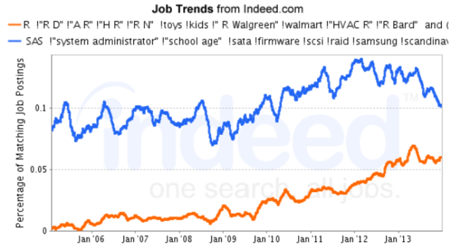
R You Ready for R?
http://www.analyticsvidhya.com/blog/2014/03/sas-vs-vs-python-tool-learn/

Slide 4
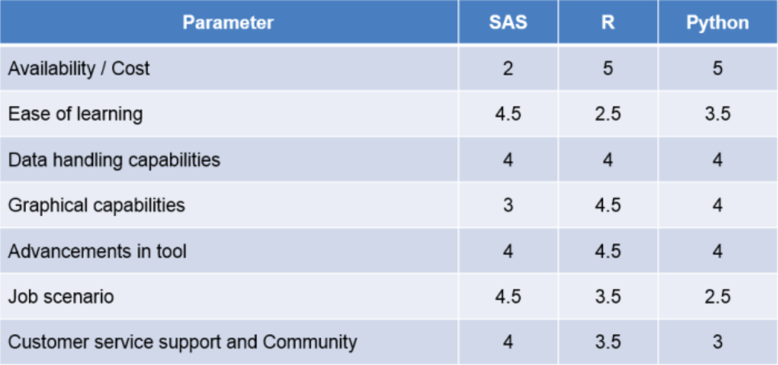
R You Ready for R?
http://www.analyticsvidhya.com/blog/2014/03/sas-vs-vs-python-tool-learn/

Slide 5
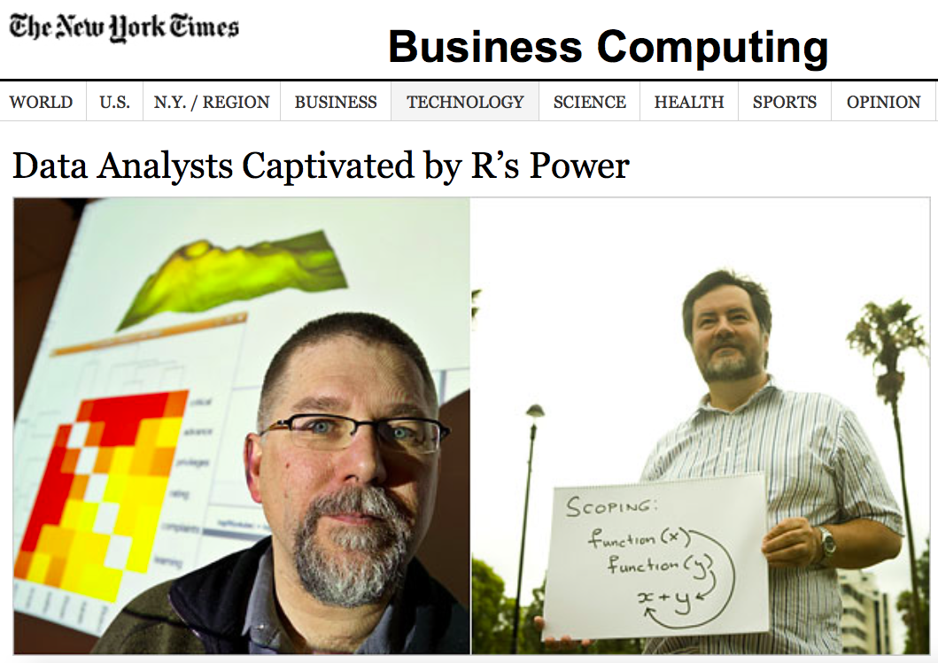
Robert Gentleman and Ross Ihaka
Start with S in 1996
Open source
Open packages

Slide 6
IF
if(distribution=="norm")
{addeffect=rnorm(NQTN,0,1)
}else
{addeffect=alpha^(1:NQTN)}

Slide 7
Function
phenoSimu=function(X,h2,alpha,NQTN,distibution,seed){
Define function here
}

Slide 8
List
return(list(addeffect = addeffect,
y=y,
add = effect,
residual = residual,
QTN.position=QTN.position,
SNPQ=SNPQ))

Slide 9
Loop
myNQTL=c(3,10,20,50,100,200)
for(i in 1:length(myNQTL))
{
myv=validation(n=n,m=m,y=myps$y,X=X,residual=myps$residual,effect=myps$add,QTN.position=myps$QTN.position,addeffect=myps$addeffect,NQTL=myNQTL[i])
print(c(i,myNQTL[i],myv$fit,myv$accuracy))
}

Slide 10
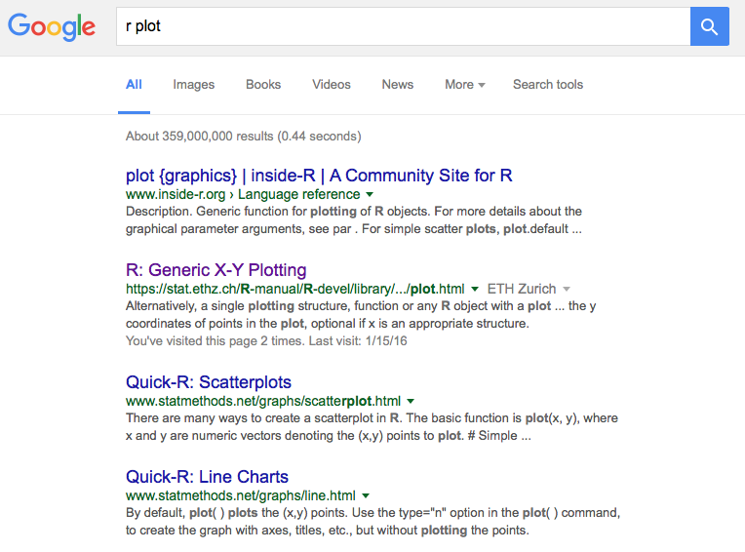

Slide 11
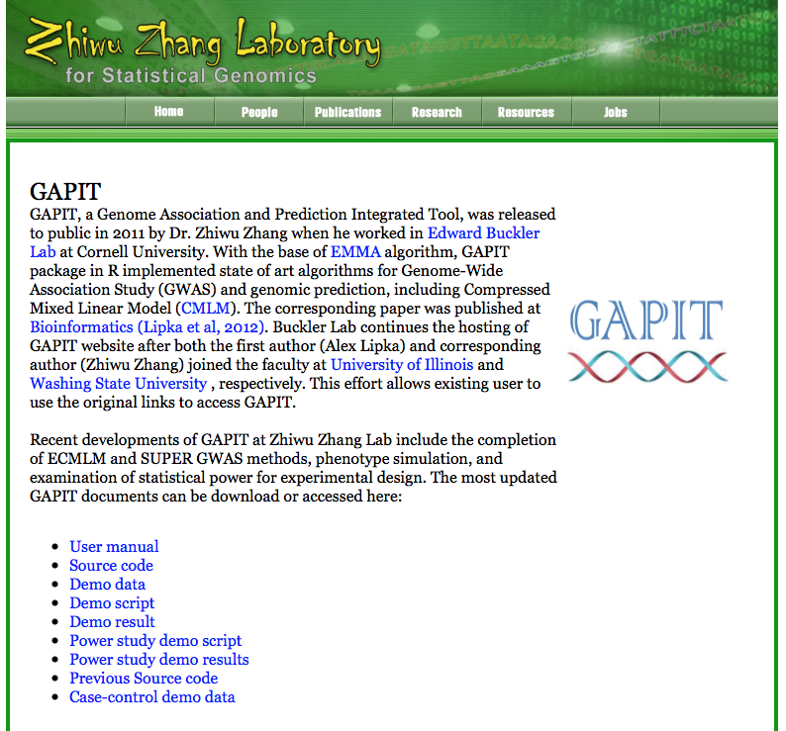

Slide 12
Demonstration

Slide 13
Highlight
File input and output
R objects
numeric vs. character
vector, matrix, and data.frame, list
myF$p
IF and Loop
Apply
Graph
Function

