Slide 1


Statistical Genomics
Lecture 20: MLMM
Zhiwu Zhang
Washington State University

Slide 2
Administration
Homework 4 graded
Homework 5, due April 13, Wednesday, 3:10PM
Final exam: May 3, 120 minutes (3:10-5:10PM), 50
Department seminar (March 28) , Brigid Meints, “Breeding Barley and Beans for Western Washington”

Slide 3
My believes
After final exam
but, something remain life long
Xi~N(0,1), Y=Sum(Xi) over n, Y~X2(n)
y = Xb + Zu + e
Vay (y) = 2K SigmaA + I SiggmaE
rep(rainbow(7),100)
sample(100,5, replace=F)
QTNs on CHR1-5, signals pop out on CHR6-10
100% "prediction accuracy" on a trait with h2=0

Slide 4
Core values behind statistics, programming, genetics, GWAS and GS in CROPS545
Doing >> looking
Reasoning
Learn = (re)invent
Creative
Self confidence

Slide 5
Doing >> looking

Slide 6
Reasoning
Teaching model
Hypothesis: There is no space to improve
Objective: Reject the null hypothesis
Method: Increase statistical power

Slide 7
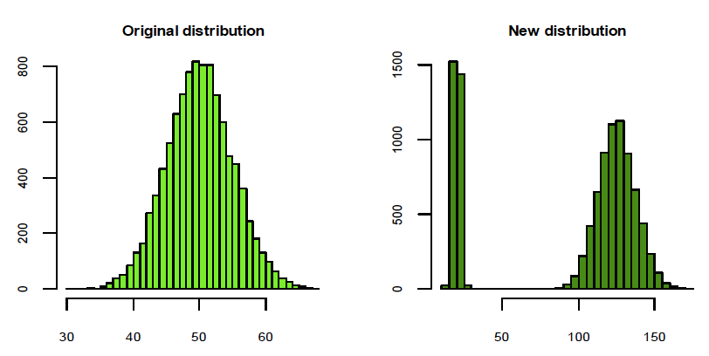

Learn = (re)Invent

Slide 8
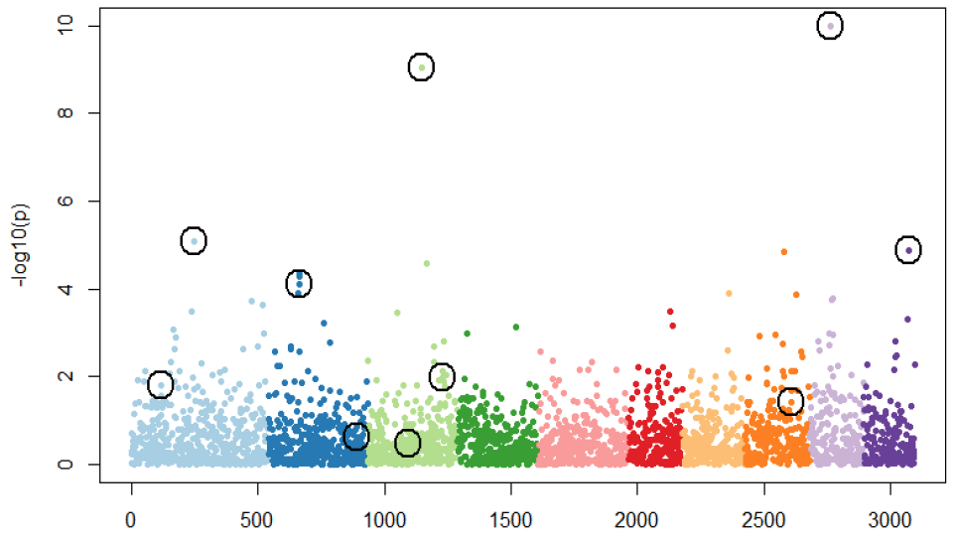
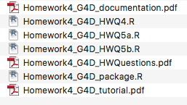
Creative
Dare to break the rules with judgment

Slide 9
Self confidence
Questioning why decreasing missing rate does not improve accuracy of stochastic imputation by Chongqing
Questioning what is "u" in MLM by Joe
Finding of setting seed in impute (KNN) package by Louisa
One more example of my own

Slide 10
Evaluation
Comment: Much more work than other WSU courses
Adjustment
Assignments: 9 to 6
Requirements: No experience with statistics and programming
Easy to pass, or a grade C⁻ after 1st assignment unless unusual behavior or recommended to withdraw

Slide 11
Outline
Stepwise regression
Criteria
MLMM
Power vs FDR and Type I error
Replicate and mean

Slide 12
Testing SNPs, one at a time
Phenotype
Population
structure
Unequal
relatedness
Y = SNP + Q (or PCs) + Kinship + e
(fixed effect)
(fixed effect)
(random effect)
General Linear Model (GLM)
Mixed Linear Model (MLM)
(Yu et al. 2005, Nature Genetics)

Slide 13
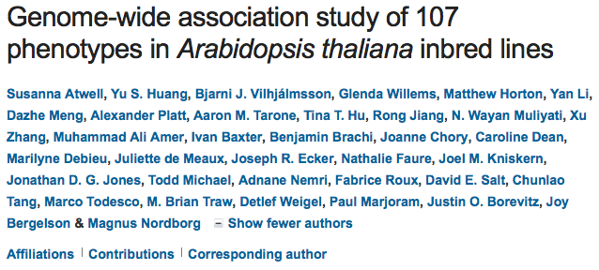
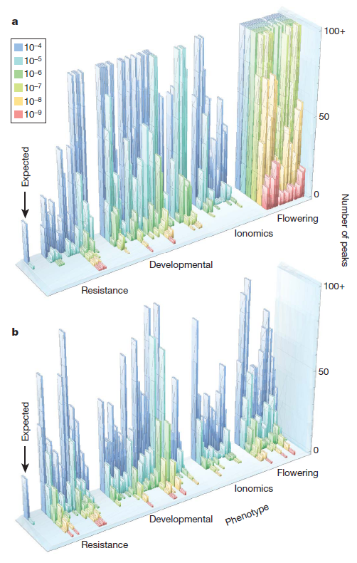

GWAS does not work for traits associated with structure
Test WO correction
Nature 2010
Correction with MLM
Magnus Norborg

Slide 14

Two years later

Slide 15
Stepwise regression
Choose m predictive variables from M (M>>m) variables
The challenges :
Choosing m from M is an NP problem
Option: approximation
Non unique criteria

Slide 16
Stepwise regression procedures
sequence of F-tests or t-tests
Adjusted R-square
Akaike information criterion (AIC)
Bayesian information criterion (BIC)
Mallows's Cp
PRESS
false discovery rate (FDR)
Why so many?

Slide 17
Forward stepwise regression t or F test
Test M variables one at a time
Fit the most significant variable as covariate
Test rest variables one at a time
Is the most
influential variable
significant
Yes
No
End

Slide 18
Backward stepwise regression t or F test
Test m variables simultaneously
Is the least
influential variable
significant
Yes
End
No
Remove it and test the rest (m)

Slide 19
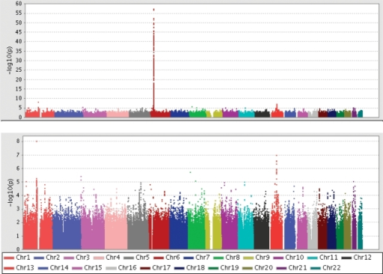
Hind from MHC (Major histocompatibility complex)

Slide 20
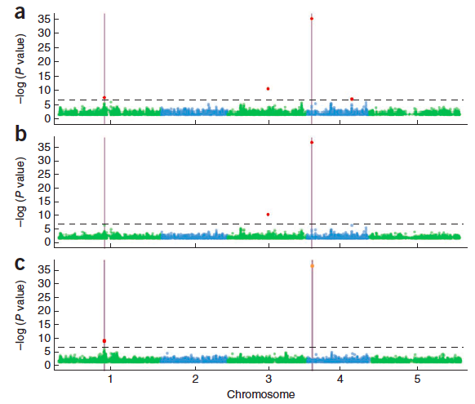
Nature Genetics, 2012, 44, 825-830
Two QTNs
GLM
MLM
MLMM

Slide 21
MLMM
y = SNP + Q + K + e
Most significant SNP as pseudo QTN
y = SNP + QTN1 + Q + K + e
Most significant SNP as pseudo QTN
y = SNP + QTN1 + QTN2 + Q + K + e
So on and so forth until…

Slide 22
Forward regression
y = SNP +QTN1+QTN2+…+ Q + K + e
Var(u)
Var(y)
Stop when the ratio close to zero

Slide 23
Backward elimination
y = QTN₁+QTN₂+…+QTN_{t}+ Q + K + e
Remove the least significant pseudo QTN
y = QTN₁+QTN₂+…+QTN_{t-1}+ Q + K + e
Until all pseudo QTNs are significant

Slide 24
Final p values
Pseudo QTNs:
y = QTN₁+QTN₂+…+ Q + K + e
Other markers:
y = SNP +QTN₁+QTN₂+…+ Q + K + e

Slide 25
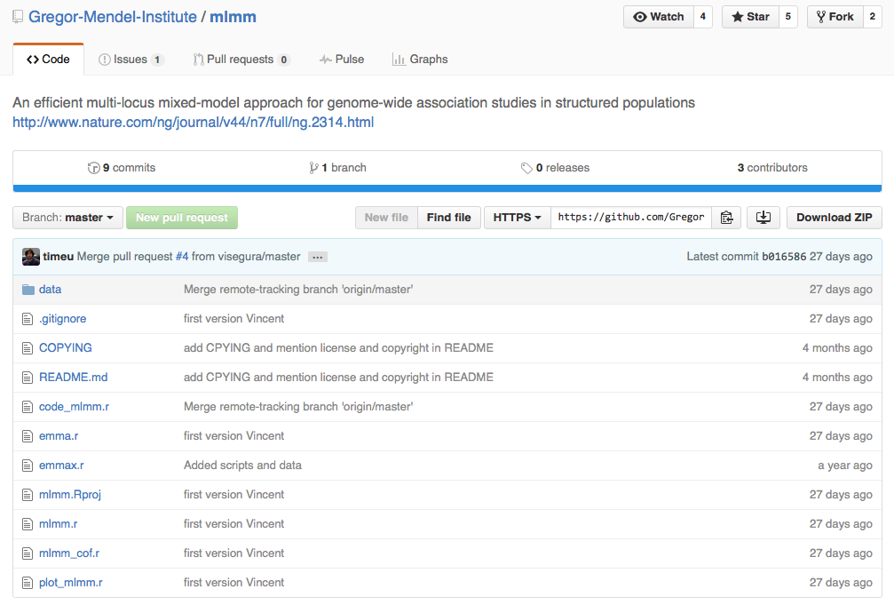
MLMM R on GitHub

Slide 26
#Siultate 10 QTN on the first chromosomes
X=myGD[,-1]
index1to5=myGM[,2]<6
X1to5 = X[,index1to5]
taxa=myGD[,1]
set.seed(99164)
GD.candidate=cbind(taxa,X1to5)
mySim=GAPIT.Phenotype.Simulation(GD=GD.candidate,GM=myGM[index1to5,],h2=.5,NQTN=10,QTNDist="norm")
myy=as.numeric(mySim$Y[,-1])
myMLMM<-mlmm_cof(myy,myX,myPC[,1:2],myK,nbchunks=2,maxsteps=20)
myP=myMLMM$pval_step[[1]]$out[,2]
myGI.MP=cbind(myGM[,-1],myP)
setwd("~/Desktop/temp")
GAPIT.Manhattan(GI.MP=myGI.MP,seqQTN=mySim$QTN.position)
GAPIT.QQ(myP)
rm(list=ls())
setwd('/Users/Zhiwu/Dropbox/Current/ZZLab/WSUCourse/CROPS545/mlmm-master')
source('mlmm_cof.r')
library("MASS") # required for ginv
library(multtest)
library(gplots)
library(compiler) #required for cmpfun
library("scatterplot3d")
source("http://www.zzlab.net/GAPIT/emma.txt")
source("http://www.zzlab.net/GAPIT/gapit_functions.txt")
source("/Users/Zhiwu/Dropbox//GAPIT/functions/gapit_functions.txt")
setwd("/Users/Zhiwu/Dropbox/Current/ZZLab/WSUCourse/CROPS512/Demo")
myGD <- read.table("mdp_numeric.txt", head = TRUE)
myGM <- read.table("mdp_SNP_information.txt" , head = TRUE)
#for PC and K
setwd("~/Desktop/temp")
myGAPIT0=GAPIT(GD=myGD,GM=myGM,PCA.total=3,)
myPC=as.matrix(myGAPIT0$PCA[,-1])
myK=as.matrix(myGAPIT0$kinship[,-1])
myX=as.matrix(myGD[,-1])

Slide 27
GAPIT.FDR.TypeI Function
myGWAS=cbind(myGM,myP,NA)
myStat=GAPIT.FDR.TypeI(WS=c(1e0,1e3,1e4,1e5),GM=myGM,seqQTN=mySim$QTN.position,GWAS=myGWAS)

Slide 28
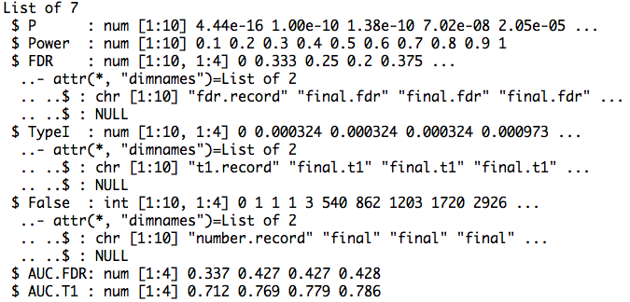
Return

Slide 29
Area Under Curve (AUC)
par(mfrow=c(1,2),mar = c(5,2,5,2))
plot(myStat$FDR[,1],myStat$Power,type="b")
plot(myStat$TypeI[,1],myStat$Power,type="b")

Slide 30
Replicates
nrep=10
set.seed(99164)
statRep=replicate(nrep, {
mySim=GAPIT.Phenotype.Simulation(GD=GD.candidate,GM=myGM[index1to5,],h2=.5,NQTN=10,QTNDist="norm")
myy=as.numeric(mySim$Y[,-1])
myMLMM<-mlmm_cof(myy,myX,myPC[,1:2],myK,nbchunks=2,maxsteps=20)
myP=myMLMM$pval_step[[1]]$out[,2]
myGWAS=cbind(myGM,myP,NA)
myStat=GAPIT.FDR.TypeI(WS=c(1e0,1e3,1e4,1e5),GM=myGM,seqQTN=mySim$QTN.position,GWAS=myGWAS)
})

Slide 31
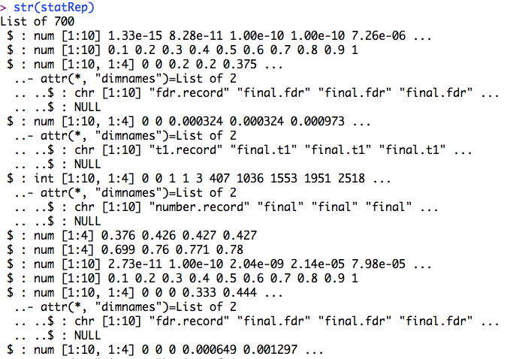
str(statRep)

Slide 32
Means over replicates
power=statRep[[2]]
#FDR
s.fdr=seq(3,length(statRep),7)
fdr=statRep[s.fdr]
fdr.mean=Reduce ("+", fdr) / length(fdr)
#AUC: power vs. FDR
s.auc.fdr=seq(6,length(statRep),7)
auc.fdr=statRep[s.auc.fdr]
auc.fdr.mean=Reduce ("+", auc.fdr) / length(auc.fdr)

Slide 33
Plots of power vs. FDR
theColor=rainbow(4)
plot(fdr.mean[,1],power , type="b", col=theColor [1],xlim=c(0,1))
for(i in 2:ncol(fdr.mean)){
lines(fdr.mean[,i], power , type="b", col= theColor [i])
}

Slide 34
Highlight
Stepwise regression
Criteria
MLMM
Power vs FDR and Type I error
Replicate and mean

