Slide 1
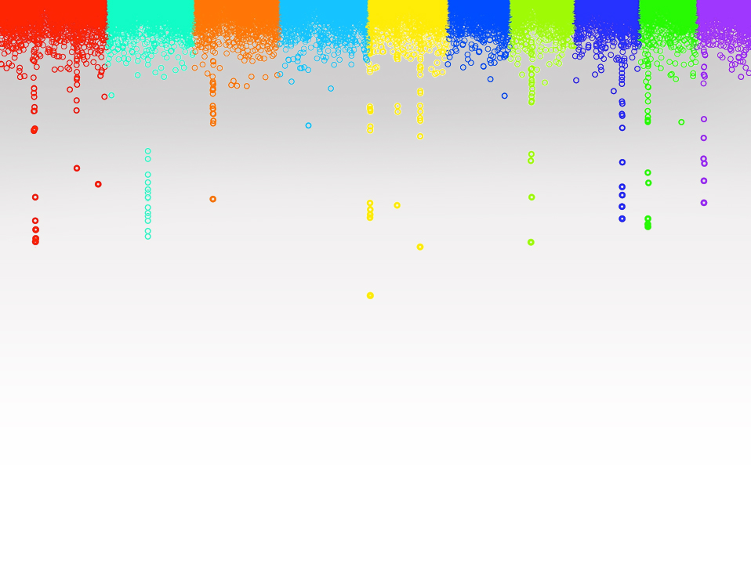

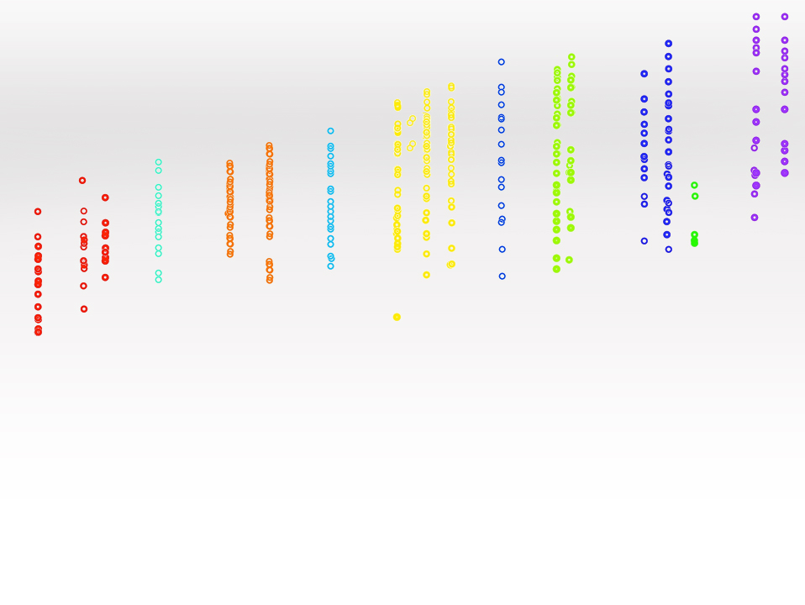

Statistical Genomics
Lecture 30: BLUP Alphabet
Zhiwu Zhang
Washington State University
Notes:
This is a test

Slide 2
Administration
Final exam: 204 Johnson Hall, May 3, 120 minutes (3:10-5:10PM), 50 questions
Review: Monday (May 2) 1:30-2:30 PM
Evaluation due May 6 (14 out of 19 (75%) received, THANKS).

Slide 3
Outline
Homework5
Comparison among gBLUP, and Bayesian alphbet
Development of BLUP alphabet
  gBLUP
  cBLUP
  sBLUP

Slide 4
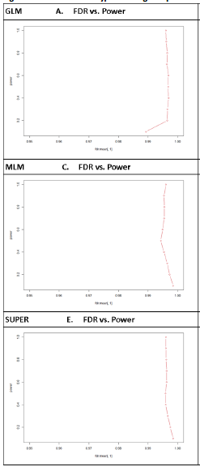
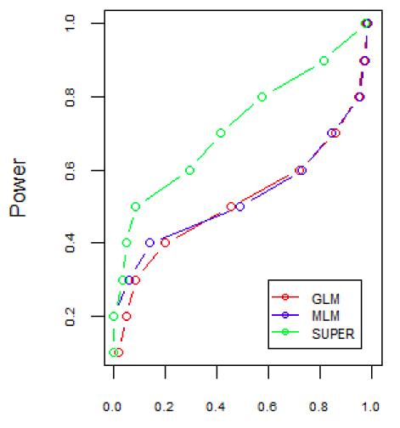
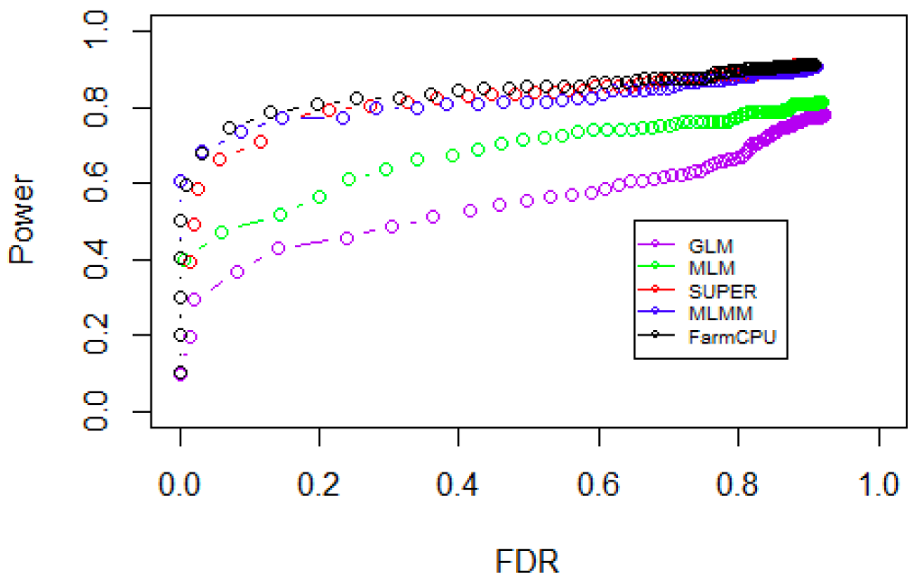
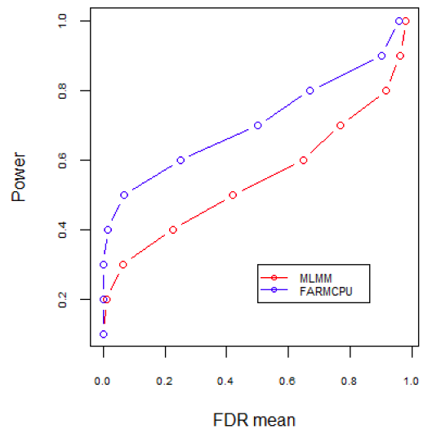
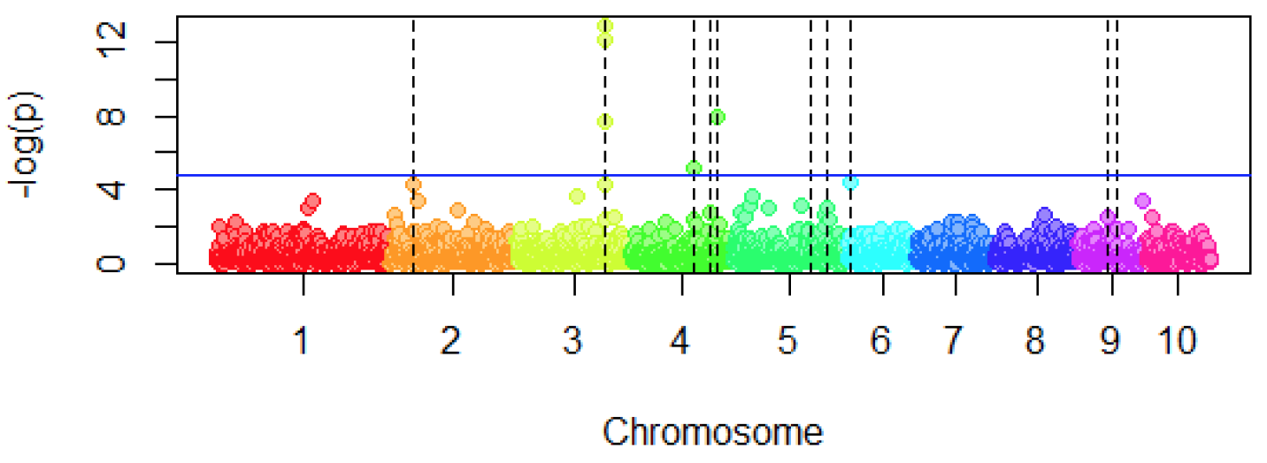
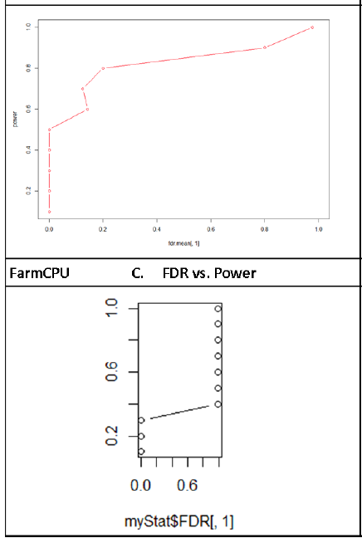
Critical thinking, Creative & Perfection

Slide 5
Comparison among methods
Simulated data
Real data
Some claimed differences
Some claimed no difference
Depend on genetic architecture

Slide 6
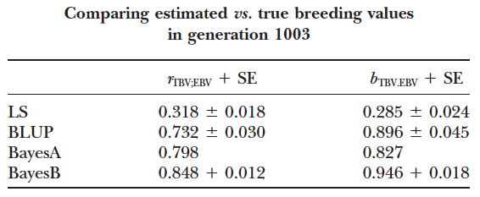
Simulated data
(10 CHR, 100cM, 1 QTN per half cM)
Meuwissen et al., Genetics 2001

Slide 7
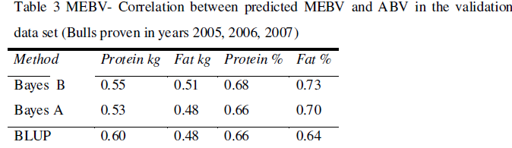
Real data

Slide 8
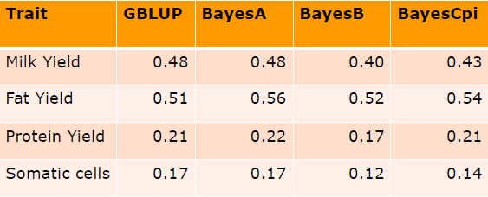
(Habier et al 2011)
– Accuracy in German Holstein Friesian data set

Slide 9
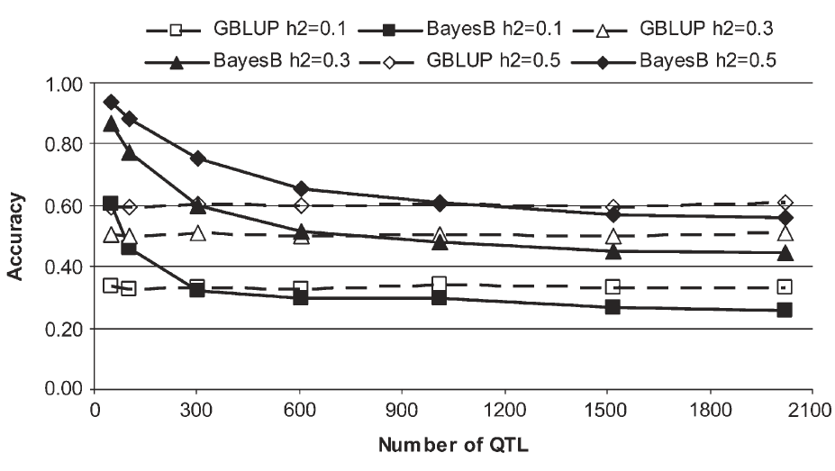
gBLUP: more QTN, Bayes: less
Daetwyler et al., 2010 Genetics, 185 (3) 1021-1031

Slide 10
Cycles of prediction method
Marker selection
1980s
Bayesian
2000s
Marker
?
2020s
Selection bases
BLUP
1950-70s
MAS
1990s
gBLUP
2010s
Kinship
None
Handful
Thousands
Millions
Number of markers

Slide 11
Developments at Zhang Lab
Move away from individual kinship to group kinship
  -compression BLUP (cBLUP)
Move away from using all markers to using QTNs to define kinship
  -SUPER BLUP (sBLUP)

Slide 12
Compressed MLM is more general
GLM
(1 group)
SA, GC and QTDT
Compressed MLM
Compressed MLM (s groups)
Sire model
n ≥ s ≥ 1
Full MLM
(n groups)
Henderson’s MLM
Unified MLM
Pedigree
based kinship
Marker
based kinship

Slide 13
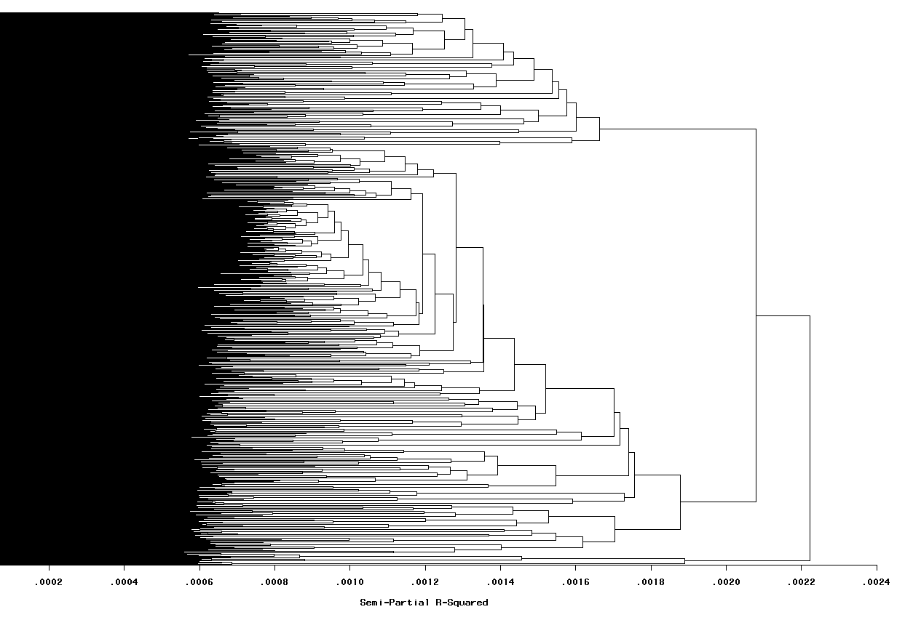
Cluster analysis
Groups=N
Groups=s
Groups=1

Slide 14
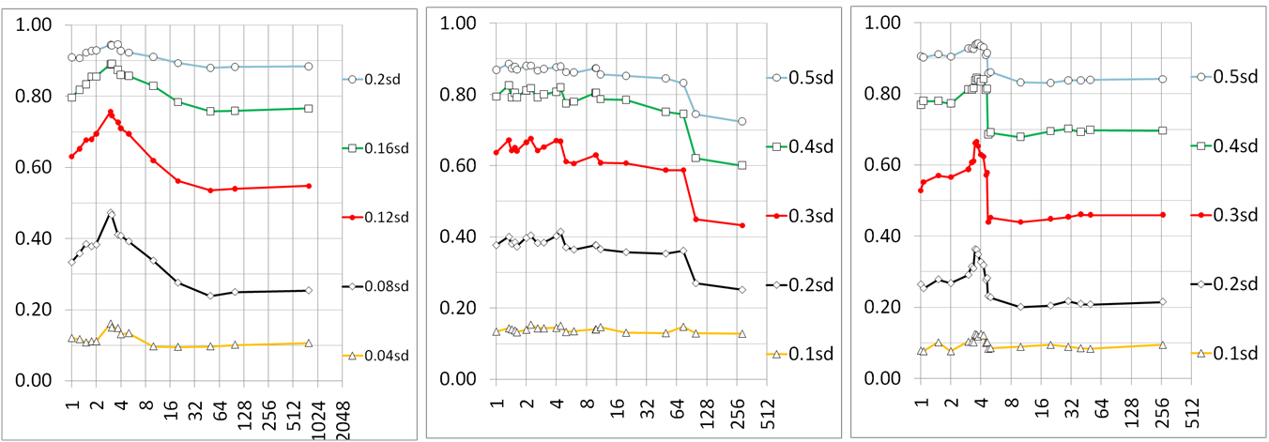
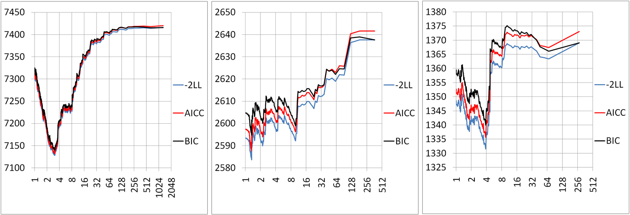
Compression improve fit & power

Slide 15
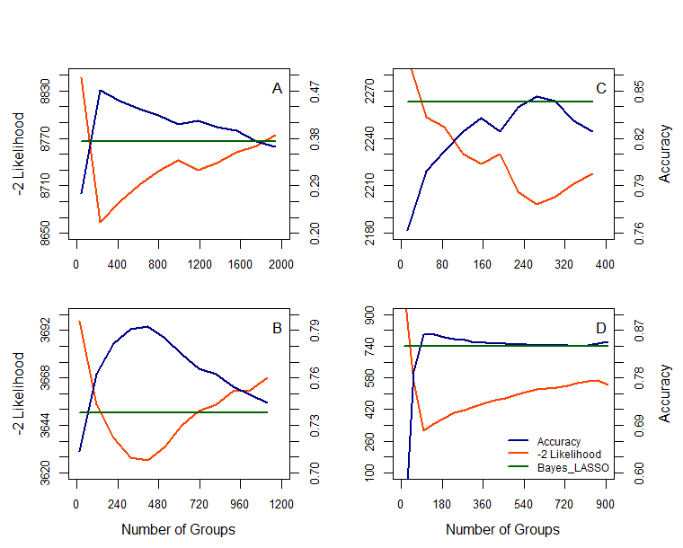
Same trend for prediction accuracy

Slide 16
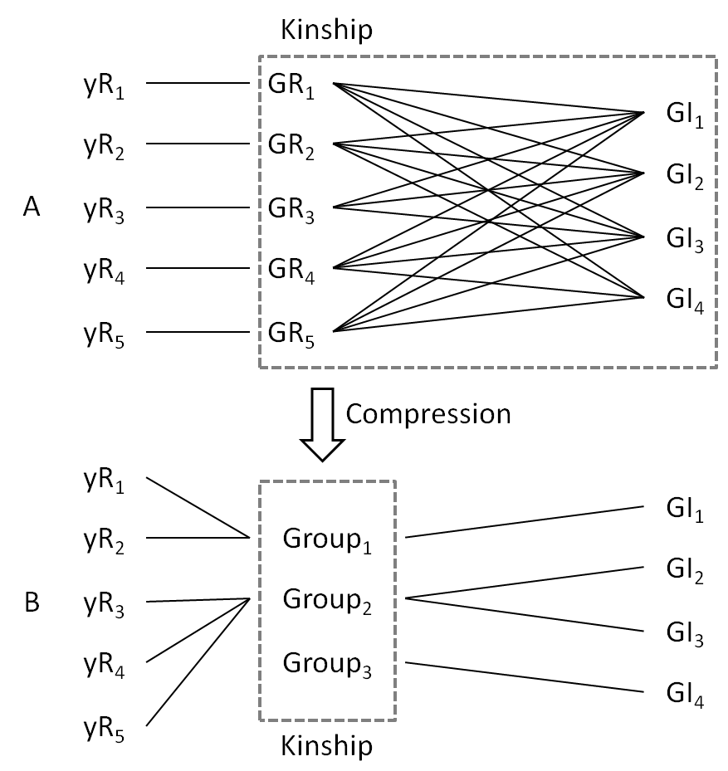
The base of gBLUP

Slide 17
Notes:
Figure 3.Impact of number of groups on model fit and genomic prediction accuracy.
The number of groups (horizontal axis) was defined as number of compressed groups. The number of groups of max is equivalent to the general BLUP method where each individual was treated as a single group. Model fit, expressed as twice the negative log likelihood (-2LL), was determined using only the reference observations. Four fifths of the entire population was sampled as reference and the rest used for inference with each observation masked. The correlation between the observations and genomic predictions of the inference group was defined as the accuracy of genomic prediction. The sampling was repeated 40 times in Mice (A), Human (B), Rice (C), and Pine (D). Their Average and standard error are displayed. The dashed green line indicates the mean accuracy of Bayes LASSO.

Slide 18
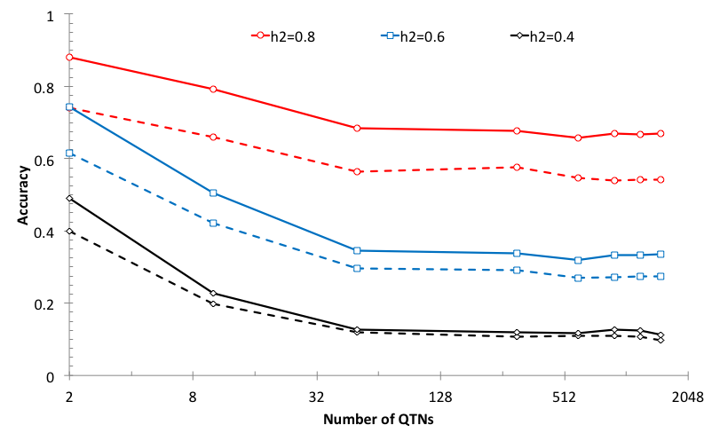
Study in simulation data
Solid: cBLUP, Dash: gBLUP

Slide 19
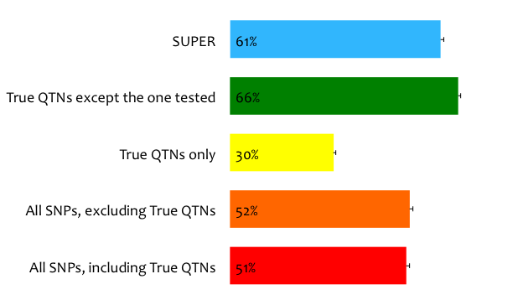
Statistical power of kinship
Notes:
A simulation study shoed that the statistical power is 42% if all SNPs were used to derive the kinship. The power reduced to 21% if the kinship was derived from the QTNs only. The power jump over to 50% when the kinship was derived from all QTNs except the one of test.

Slide 20
Kinship evolution
All traits
QTNs
Pedigree
Markers
QTNs
QTNs
Single trait
QTNs
Remove QTN one at a time
Average
Realized
Notes:
Settlement of kinship at trait base. Pedigree is the first information used to estimate kinship which are general expectation for a pair of individuals, e.g. full sib A and B have kinship of 50%. The introduction of genetic diagnostic markers increases the certainty for a specific Mendilian trait, e.g. full sibs are identical and have kinship of 1 for color. The certainty also are also increased for complex traits with multiple markers covering entire genome and became the general realized kinship, e.g. full sibs A and B have kinship of 60% instead of 50%. With dense markers, a trait specific realized kinship exist (theoretically) by using all the QTNs underlying the trait. A kinship with all QTNs (full) is ideal for genome prediction. However, its complimentary (using all QTNs except the one of test) should be used for association study to remove the confronting between the kinship and the tested SNPs.

Slide 21
Statistical power of kinship from
Notes:
A simulation study shoed that the statistical power is 42% if all SNPs were used to derive the kinship. The power reduced to 21% if the kinship was derived from the QTNs only. The power jump over to 50% when the kinship was derived from all QTNs except the one of test.

Slide 22

Statistical power of kinship from
SUPER
(Settlement of kinship Under Progressively Exclusive Relationship)
Qishan Wang
PLoS One, 2014
Notes:
A simulation study shoed that the statistical power is 42% if all SNPs were used to derive the kinship. The power reduced to 21% if the kinship was derived from the QTNs only. The power jump over to 50% when the kinship was derived from all QTNs except the one of test.

Slide 23
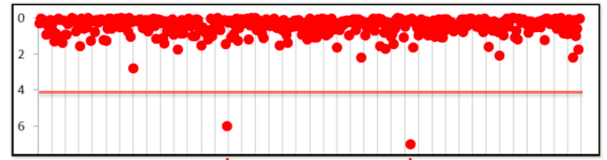
SUPER BLUP
1. Choose t associated SNPs as QTNs each represent an interval of size s.
2. Build kinship from the t QTNs
3. Optimization on t and s
4. Use the optimized QTNs to build kinship for prediction
No remove of QTNs!!!

Slide 24
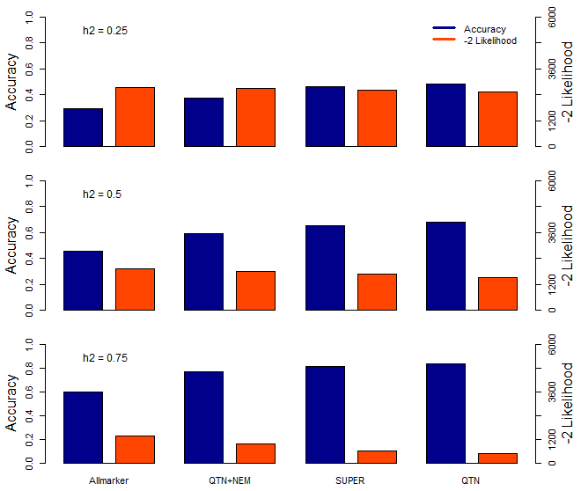
Notes:
Figure 2. The relationship between different kinships built with different number of causative mutations.
The plot show the distribution of the accuracy and -2 fold likelihood were calculated from different kinships which were used to predict which were build with all marker, QTN plus 1000 No Effect Markers (NEM), SUPER select pseudo QTNs and real QTNs.
The experiments were repeated 40 times and simulated with 10 QTNs and different heritability(0.25, 0.5 and 0.75)

Slide 25
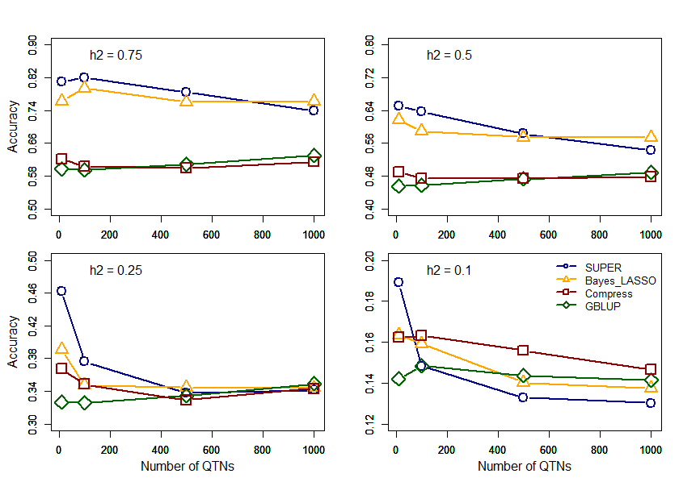
Notes:
Figure 5. The relationship between different methods and number of causative mutations.
The phenotypes were simulated with different number of causative mutations (QTNs). The heritability of the phenotype was 0.25, 0.5 and 0.75. Prediction methods (SUPER (blue), Bayes LASSO (orange), Compress (red) and gBLUP (green))were tested with 5 folds cross validation. These phenotypes were simulated by mouse data.

Slide 26

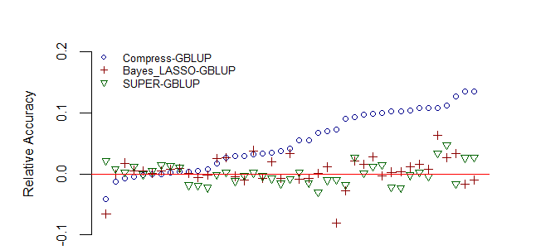
Comparisons on real traits in mice
Jiabo Wang
Notes:
Figure 4.Comparison of the evaluated methods in prediction of Maize (A)and Mouse (B)phenotypes.
Each dot represents the difference between the prediction performance of evaluated methods (SUPER ,Compression and Bayes LASSO) and gBLUP across one of the phenotypes, measured according to Pearson Correlation. All the BLUP experiments were replicated 40 times and Bayesion LASSO method were replicated 20 times, number of interrations were set 80000 and 60000 were set burning part. All were 5 folds cross validation to ensure the SD less than 0.01.

Slide 27
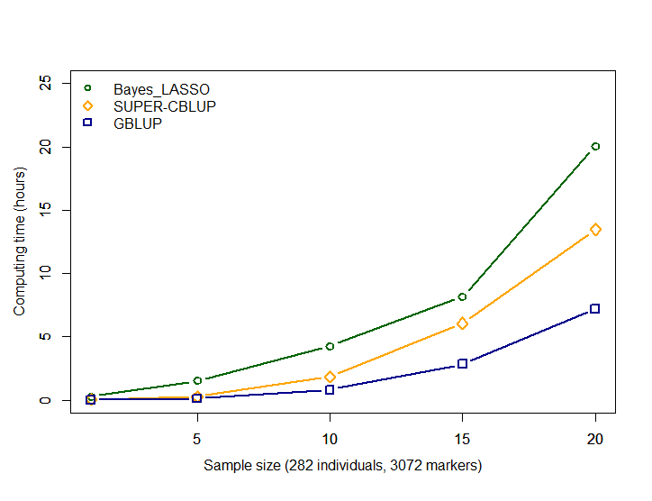
Computing time
Notes:
Figure 6.The cost time of computing genomic prediction in three method.
Bayesion method (green) cost most time than other methods, and gBLUP (blue) is the least. The cost time of scBLUP (orange) computing genomic prediction depend on the number of individuals of population (compression) and the number of markers (SUPER). The computing time is calculated by CPU computing time.

Slide 28
Highlight
Comparison among gBLUP, and Bayesian alphbet
Development of BLUP alphabet
  gBLUP
  cBLUP
  sBLUP

Slide 29
Final remark

Slide 30
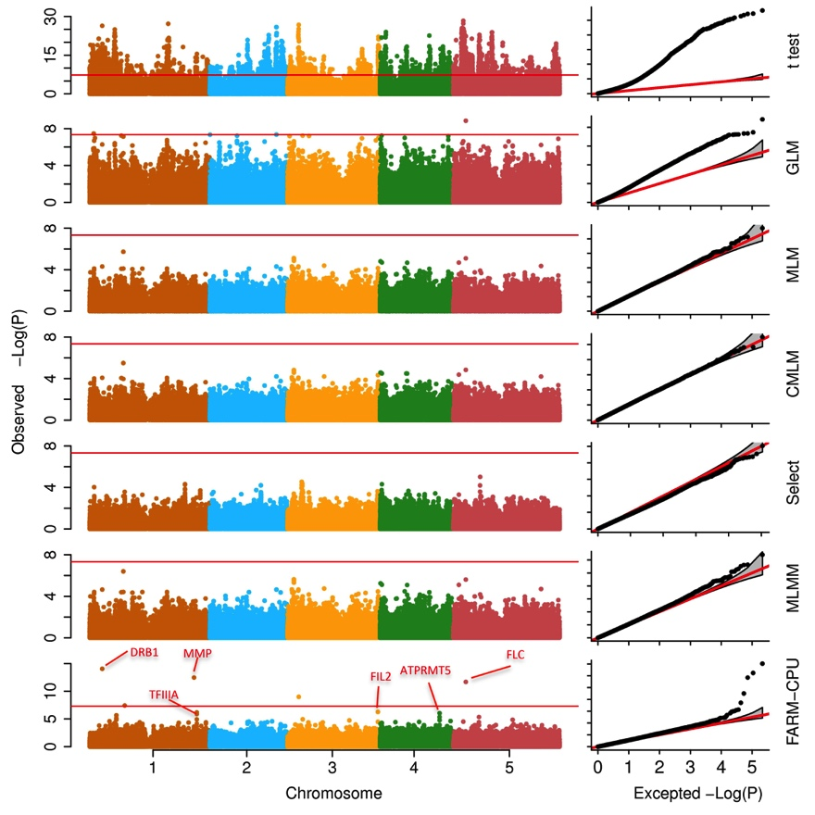
Is Bonferroni criteria conservative?
Single test threshold : a=0.01
Multiple (m=10,000) test threshold : a/m=0.01/10,000=E-6
No
Yes

Slide 31
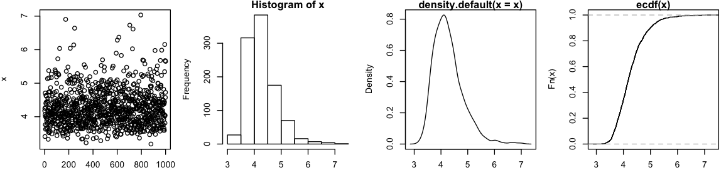
How to establish a reliable threshold?
Perform GWAS on real phenotypes and genotypes
Randomly shuffle phenotypes
Perform GWAS, record the most significant P value
Repeat step 2 and 3 multiple (1000) times to obtain the null distribution of the most significant P values
Examine the percentile on the null distribution for the observed P values from real data
6.03
P=1%

Slide 32
When markers are correlated
m=10000
n=1000
p=matrix(runif(m*n),n,m)
r=0.0001
for (j in 2:m) p[,j] = p[,j-1]*r + runif(n)*(1-r)
x=apply(p, 1, min)
length(x)
x=-log10(x)
par(mfrow=c(1,4),mar = c(3,4,1,1))
d=density(x)
plot(x)
hist(x)
plot(d)
plot(ecdf(x))
quantile(x,.99)

Slide 33
r=0.5
2.39
P=1%
r=0.01
3.70
P=1%
r=0.0001
4.86
P=1%

Slide 34
How many PC to fit as covariates?
Examine the statistical power with different number of PCs and choose the best

Slide 35
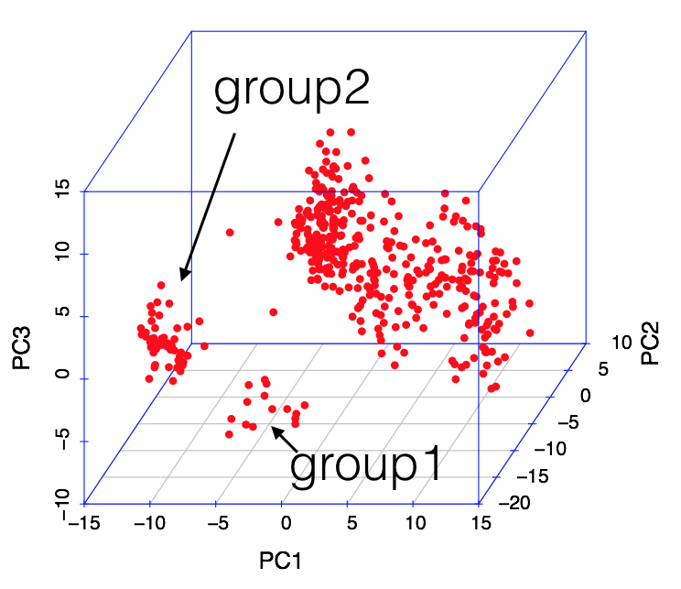
Analyze subpopulations separately or jointly?
Try both and choose the one with better power

Slide 36
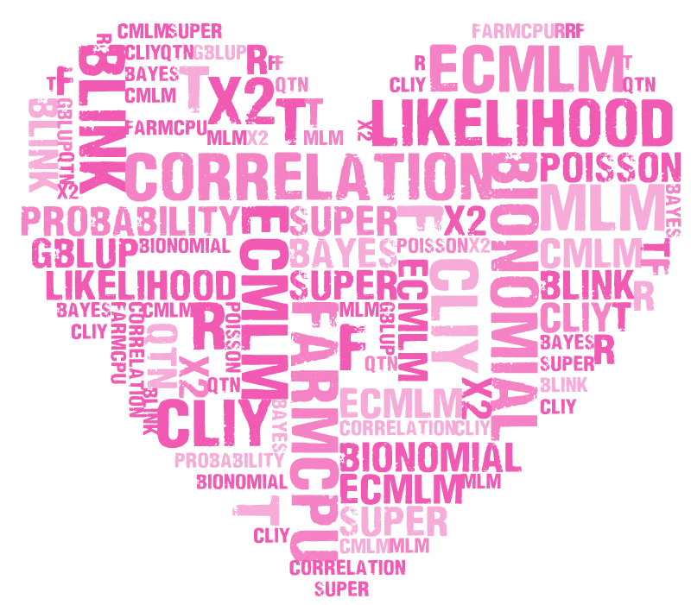
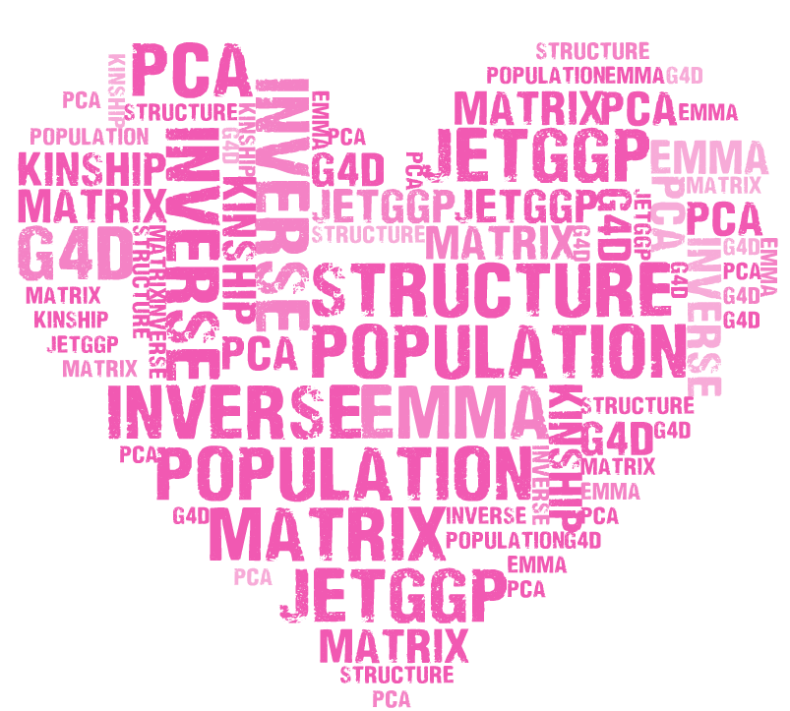
Keywords
MLM cMLM ecMLM SUPER FarmCPU BLINK CLIY correlation QTN gBLUP Bayes likelihood probability R t f x2 Bionomial Poisson distribution statistics phenotype genotype sequencing MAF GAPIT rrBLUP BLR MLMM LASSO Gibbs G4D PCA Structure Population Kinship EMMA Matrix inverse JETggp Transpose if loop function type1 error FDR threshold coverage BAGS depth simulation linkage disequilibrium power P3D MAS Cpi A B C Prior Posterior Exponential Kernel Ridge

Slide 38
Remains in CROPS 545
Critical thinking
Innovative
Pefection

Slide 39
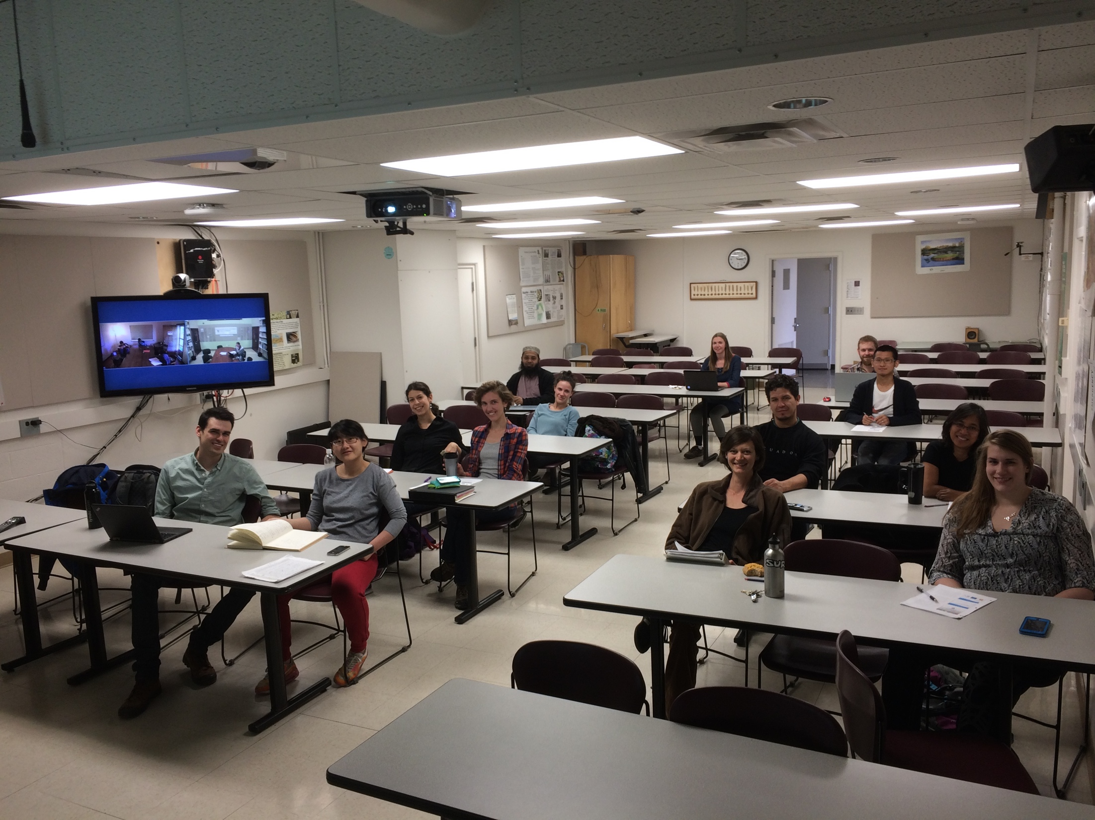

Slide 40
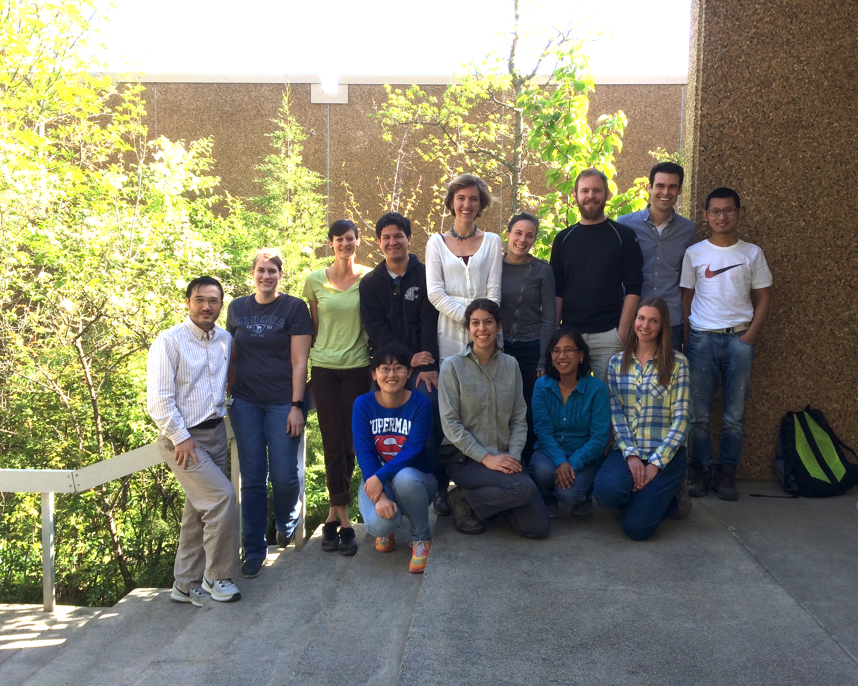
Thank you

