Slide 1
Statistical Genomics Introduction to R
Yuanhong Song
1/12/2018

Slide 2
How may I help you? — A little more about your TA
R
Statistics
Genomics
images © Renice Wernette 1996

Slide 3
Yuanhong Song (Song)
Email: yuanhong.song@wsu.edu
Tel: 509-335-4551 (office)
Please include “crop545” in email subject line.

Slide 4
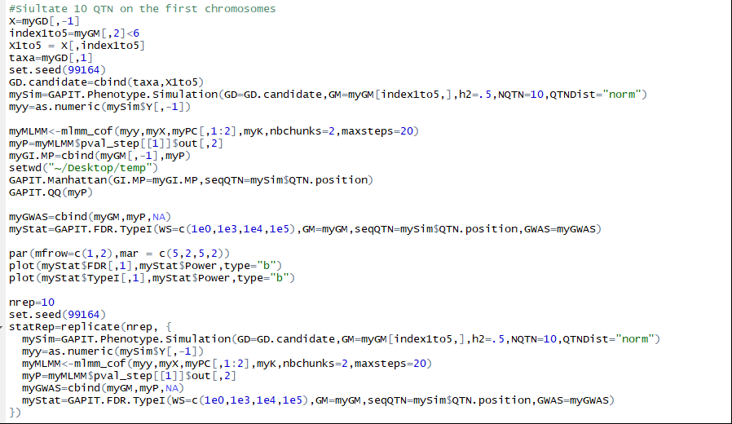

Slide 5
Topics
Primer
Motivation
Installation
R as a calculator
Basics
R objects (variables and constants)
Files (reading and writing data files)
Data manipulation
Specific topics
List
IF function
Loop (for loop)
Function
Packages

Slide 6
Why R?
open source
(relatively) easy to use
very flexible
very extensive
up-to-date
graph capabilities

Slide 7
Some catch
Steep learning curve
Not efficient for big data
Relatively restricted in the statistical world

Slide 8
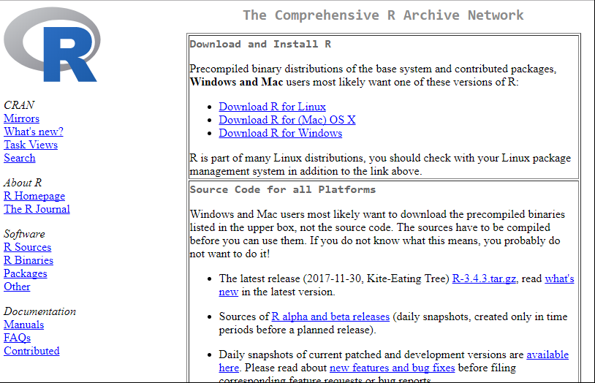
To Install

Slide 9
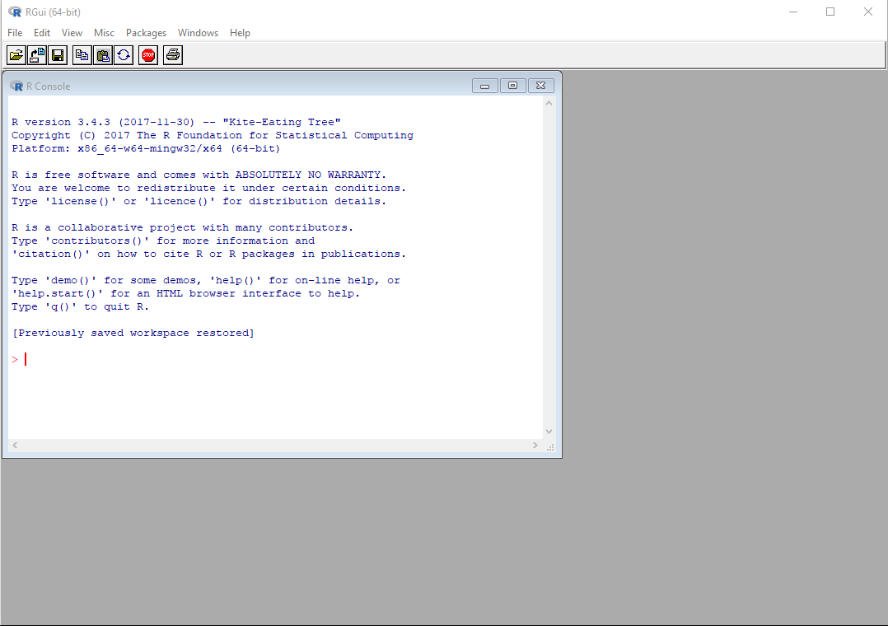
To Install

Slide 10
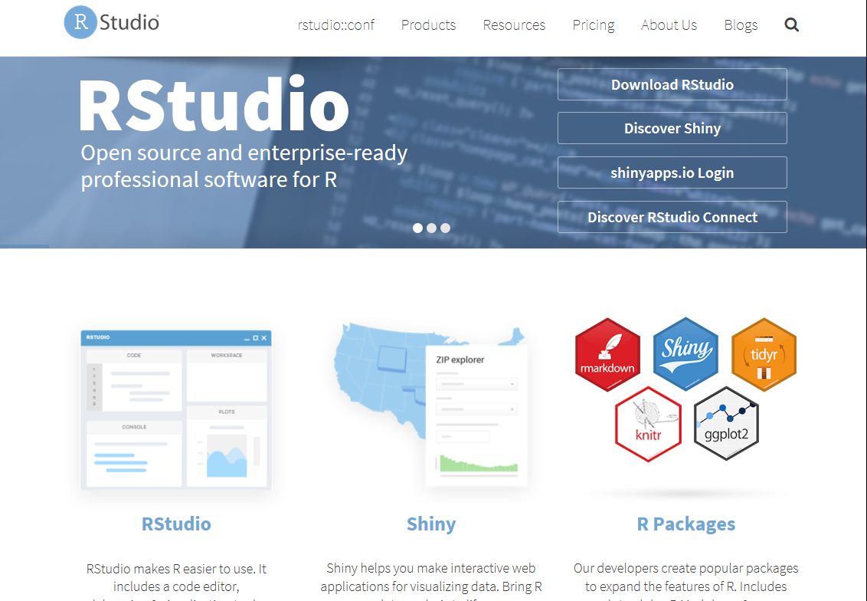
To Install

Slide 11
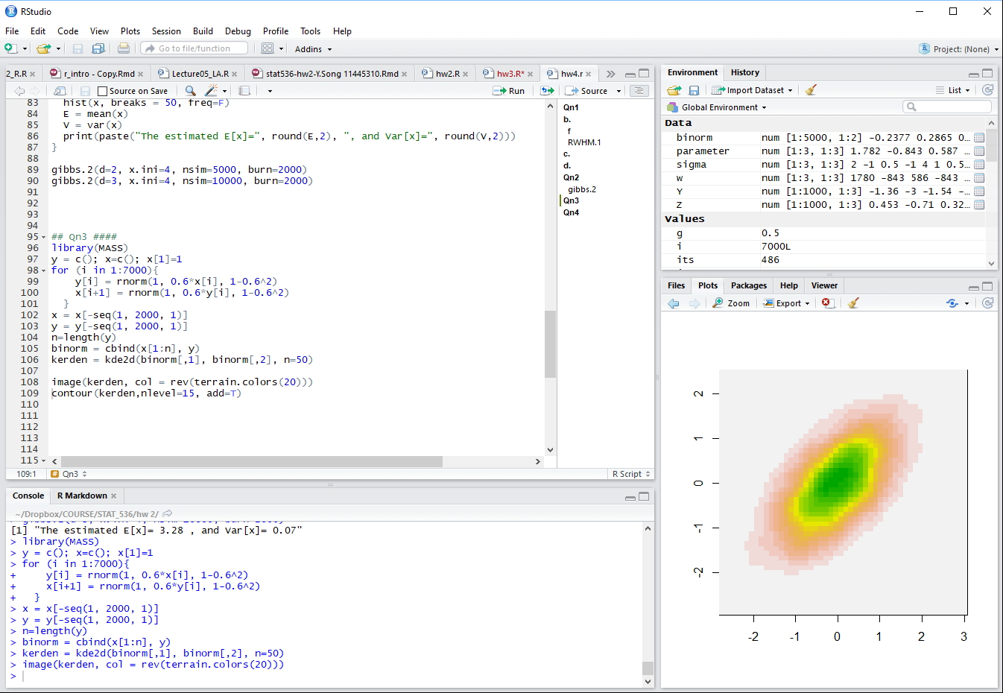
To Install
Text editor/
Script
Console

Slide 12
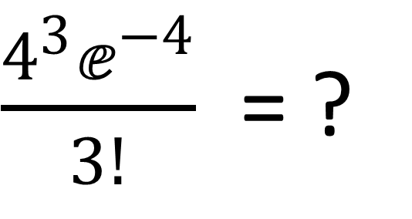
Use R as a calculator
$\frac{4^{3}ⅇ^{−4}}{3!}$ = ?

Slide 13
R Basics

Slide 14
Variables and Constants
Value
Vector
Matrix
Dataframe
List
Numerical
Text string
Logic value

Slide 15
Folder and Path
“ C:/ Uswers/yuanh/Documents/Dropbox/COURSE/CROP_545/2018/R intro ”

Slide 16
Data manipulation
Examine the data
Subsample
Combine and merge datasets
Basic operations

Slide 17
Functions

Slide 18
$\frac{4^{3}ⅇ^{−4}}{3!}$
$$\frac{λ^{k}e^{−λ}}{k!}$$
Lambda = 3, k = 2
Lambda = 5, k = 2
Lambda = 5, k=10

