Slide 1
Bayesian Genomic Selection
Matthew McGowan
Spring 2020

Slide 2
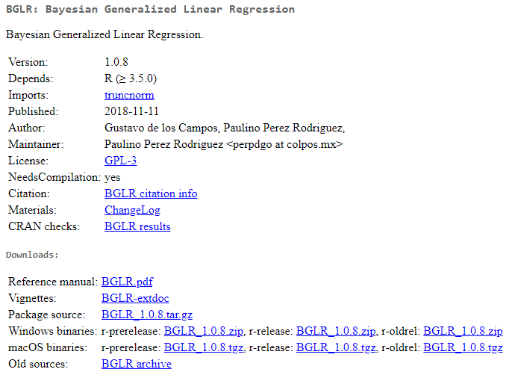
BGLR is the go-to package for Bayesian genomic selection
BGLR CRAN URL

Slide 3
Prepare your data
The core operation consists of 4 steps
Define your model
Solve with Gibbs sampling and MCMC
Predict your unknown phenotypes

Slide 4
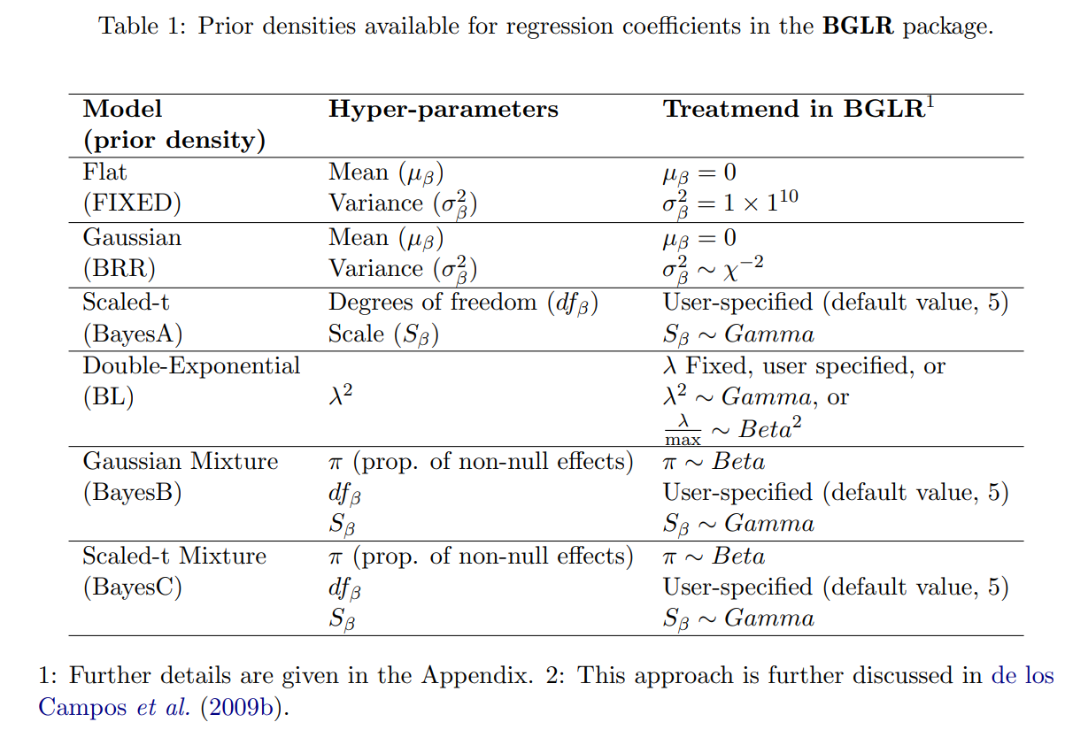
There are multiple prior-densities implemented

Slide 5
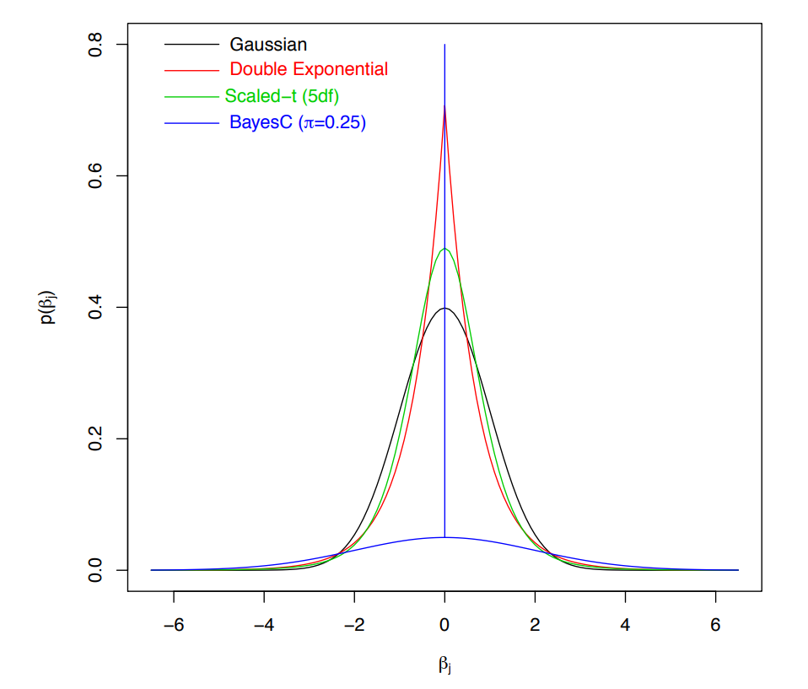
What do these densities look like?

Slide 6
Code Example

Slide 7
Code Exercise
Try different data configurations
Simulated phenotype with known effects
Sample/Marker size variations
BurnIn and number of iterations
Try different outcome types
Continuous (censored)
Categorical (binary and ordinal)

