Slide 1
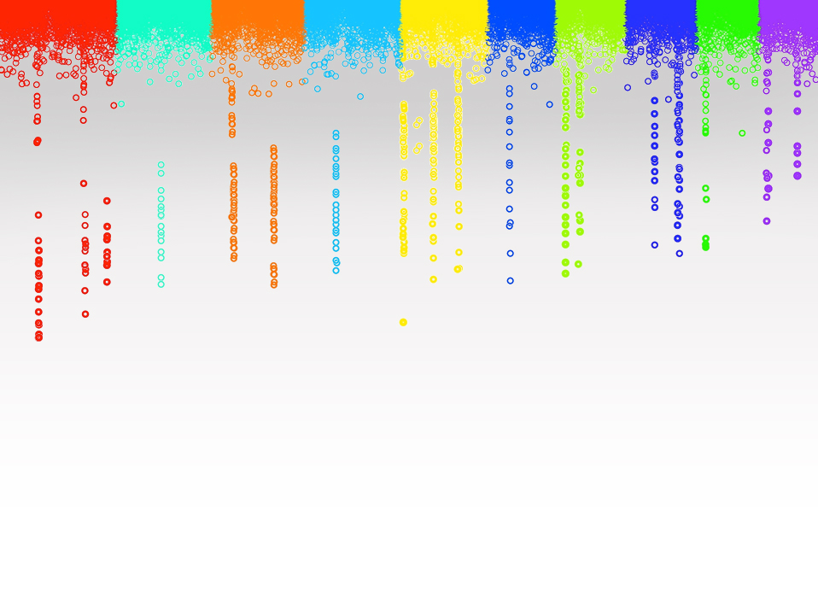
Statistical Genomics
Lab 1: Practicing R
Matthew McGowan
Washington State University

Slide 2
Track 1: Beginner
Track 2: Advanced
Download and install R
Download and install Rstudio
Install and load the ‘swirl’ package
Work through ‘swirl’ section 1: R programming
Work through the ggplot2 tutorial: http://r-statistics.co/Complete-Ggplot2-Tutorial-Part1-With-R-Code.html
Work through this tutorial to learn about Rmarkdown: https://rmarkdown.rstudio.com/lesson-1.html
Go to kaggle.com and find a dataset you are interested in
Create your own Rmarkdown file for analyzing your data
Import your data and start exploring the different variables (general stats)
Try creating some ggplots that visualize these statistics:
Box Plots
Histograms
Violin plots?

