Slide 1
Lab 10 Cross-validation
Crop Sci. 545
Spring 2020

Slide 2
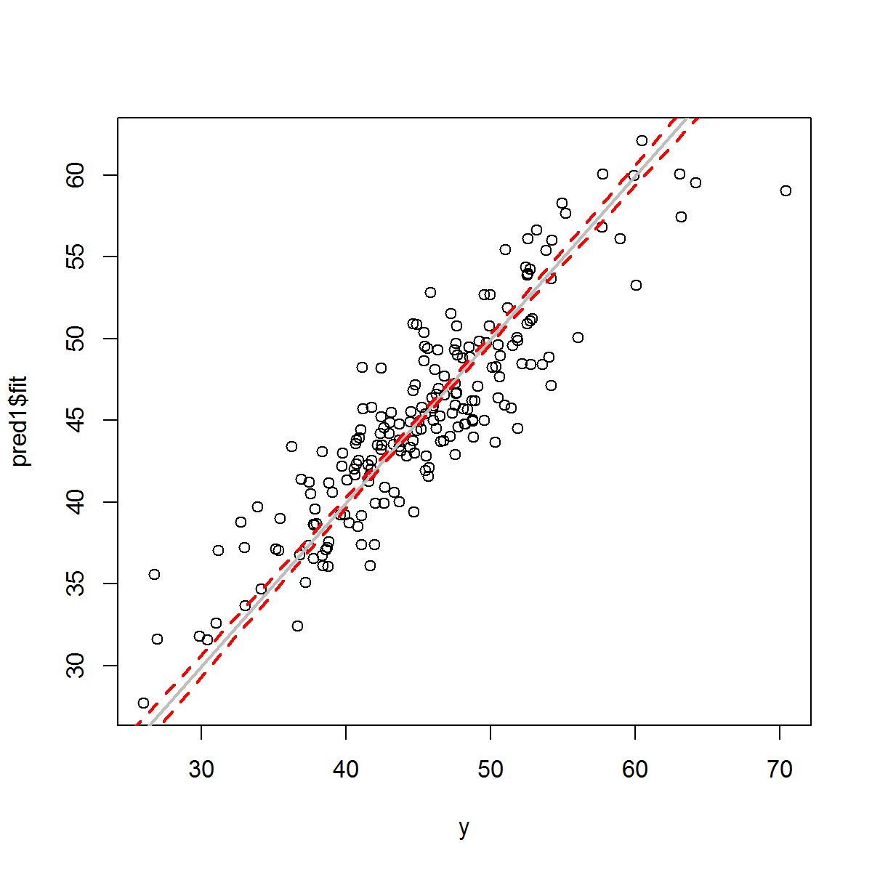
General validation framework
Genotype
Matrix
Simulated phenotype
Training predictors
Training
outcomes
Test predictors
The final accuracy is based on a correlation between predicted and observed.
(usually R²)
Test model predictions
vs.
Predictive model
Test outcomes

Slide 3
Fundamentals of Clinical Data Science 2018
Notes:
Dankers FJWM, Traverso A, Wee L, et al. Prediction Modeling Methodology. 2018 Dec 22. In: Kubben P, Dumontier M, Dekker A, editors. Fundamentals of Clinical Data Science [Internet]. Cham (CH): Springer; 2019. Fig. 8.8, [Schematic overview of k-fold cross-validation...]. Available from: https://www.ncbi.nlm.nih.gov/books/NBK543534/figure/ch8.Fig8/ doi: 10.1007/978-3-319-99713-1_8

Slide 4
What to use for a model?
Let’s try out something simple…
Genotype
Matrix
Simulated phenotype
PCA components
3 random components
Top 3 components
Simulated phenotype
= PCAcomp1 + PCAcomp2 + PCAcomp3 + e
https://en.wikipedia.org/wiki/Principal_component_regression

Slide 5
Activities:
How would you perform jackknife validation instead of k-fold?
Try and implement your own method:
GWAS-based
Other forms of dimensional reduction (tSNE, UMAP, etc.)
Decision trees
Shrinkage estimation (ridge-regression, LASSO, elasticnet)

