Slide 1
Lab 5 Creating and Maintaining R packages with Rstudio + GitHub
Crop Sci. 545
Spring 2020

Slide 2
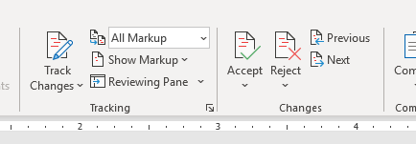
Version control is a common problem with digital files.
Some software has built-in version control
However, it is usually specific to a particular type of file…

Slide 3
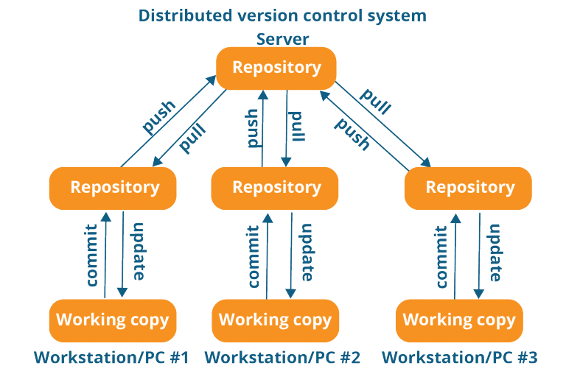
Git is a generic tool for version control that can work with many types of data (especially scripts!)
GitHub is an online host for Git projects that allows for distributed version control
The combo of Git and Github are incredibly powerful for team coding projects.

Slide 4
These are crucial resources for working with R Packages:
Prerequisites for developing packages
Developing packages with Rstudio

Slide 5
Demonstration 1:
Linking your GitHub account with Rstudio
Setting up an R package on GitHub
Function to install a package from GitHub
Create a new R package in Rstudio
Set up the package with GitHub
Using Git to commit, push, and pull your project

Slide 6
Activity:
Try to set up your own Rstudio package that includes some functions you used in previous homework assignments
Try committing, pushing, and pulling from GitHub

Slide 7
Demonstration 2:
Writing Documentation with 'roxygen2’
Manual for documenting R code
Specifically look at the ‘Documenting Functions’ section

Slide 8
Activity:
Add some documentation for one of your functions using ‘roxygen2’ format
Roxygenize your script and push the documentation to your GitHub repository
Install your package and view your documentation

