Slide 1
Lab 6 Planning and Executing an R project
Crop Sci. 545
Spring 2020

Slide 2
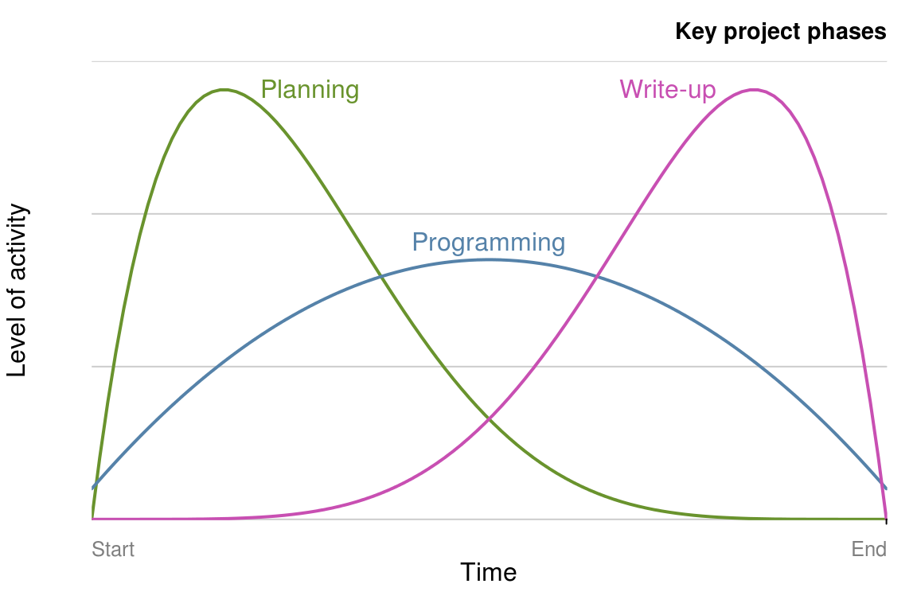
Three core parts of creating an R package are:
Planning
Programming
Write-up
Spend time to learn these soft programming skills. Research is becoming increasingly quantitative, collaborative, and big-data driven!
Think of this as small-scale model of a large project you are managing.
PMBoK, A. 2000. “Guide to the Project Management Body of Knowledge.” Project Management Institute, Pennsylvania USA.

Slide 3
Top 5 tips for efficient workflow
Do not start coding right away!
Make a plan. Use a strategy that matches the scope of your project.
Select package dependencies early and thoroughly research available options.
Document your work at every stage (Version control!!)
Make your entire workflow as reproducible as possible.

Slide 4
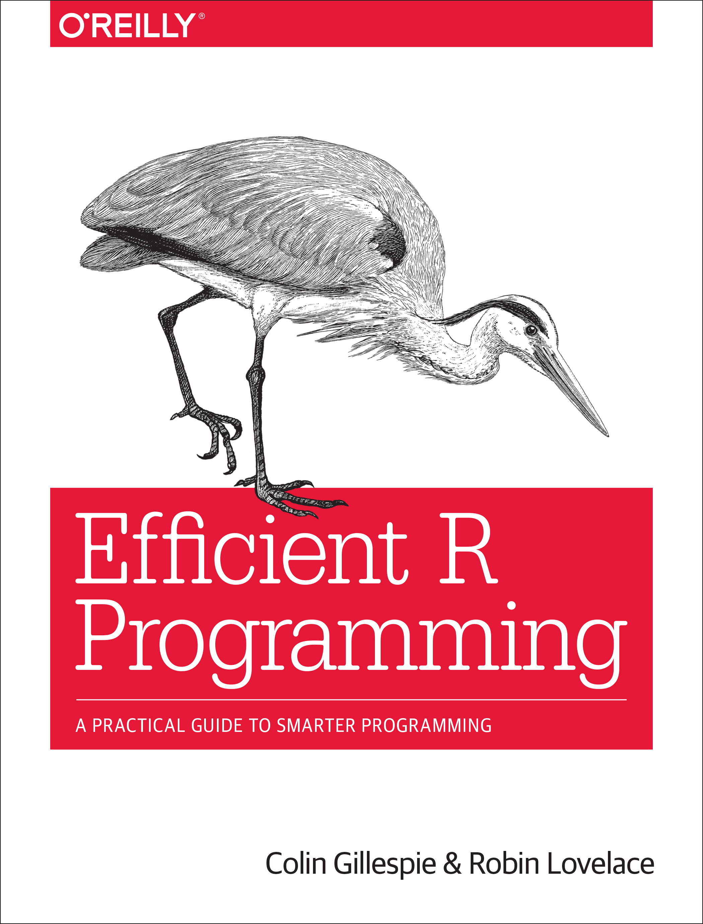
Efficient R programming (Online Version)

Slide 5
Activity:
Meet with your team
Determine the strategy you want to use
Plan out the work ‘chunks’ required
Set up a GitHub repo for your HW4 package
Use the main markdown to document your plan and work chunks (or use ZenHub or Trello if you feel ambitious)

