Slide 1
Lab 8 GWAS with GAPIT
Crop Sci. 545
Spring 2020

Slide 2
GAPIT is a GWAS package that implements many of the methods explained in class
Methods
GLM
MLM
CMLM
Enriched CMLM
SUPER
Input Format
HapMap
Numeric
Output
Pre-GWAS diagnostic plots
Manhattan Plot
Q-Q plot
Association table

Slide 3
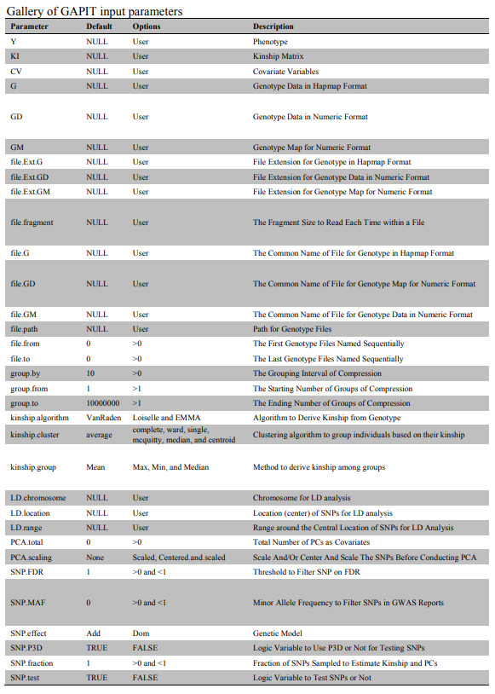
All methods use a single function: GAPIT()
This function has a lot of parameters!
Page 11 of the GAPIT documentation is crucial for using this function.
There is an undocumented “model” parameter that is very important for using non-default methods!
Online GAPIT Manual

Slide 4
Method: GLM
myGAPIT_GLM <- GAPIT(
Y=myY[,c(1,2)],
GD=myGD,
GM=myGM,
model="GLM",
PCA.total=5,
file.output=T
)

Slide 5
Method: MLM
myGAPIT_MLM <- GAPIT(
Y=myY[,c(1,2)],
GD=myGD,
GM=myGM,
model="MLM",
PCA.total=5,
file.output=T
)
myGAPIT_MLM <- GAPIT(
Y=myY[,c(1,2)],
GD=myGD,
GM=myGM,
model=“CMLM",
group.from = n,
group.to = n,
file.output=T
)

Slide 6
Method: MLMM
myGAPIT_MLMM <- GAPIT(
Y=myY[,c(1,2)],
GD=myGD,
GM=myGM,
model="MLMM",
PCA.total=5,
file.output=T
)

Slide 7
Method: CMLM
myGAPIT_CMLM <- GAPIT(
Y=myY[,c(1,2)],
GD=myGD,
GM=myGM,
model="CMLM",
PCA.total=5,
file.output=T
)

Slide 8
Method: SUPER
myGAPIT_SUPER <- GAPIT(
Y=myY[,c(1,2)],
GD=myGD,
GM=myGM,
model="SUPER",
PCA.total=5,
file.output=T
)

Slide 9
Method: FarmCPU
myGAPIT_CMLM <- GAPIT(
Y=myY[,c(1,2)],
GD=myGD,
GM=myGM,
model=“FarmCPU",
PCA.total=5,
file.output=T
)

Slide 10
Activities:
Use the G2P function to simulate a phenotype for the GAPIT demo data
Try to implement GWAS for your simulated trait using the available methods in GAPIT
Compare the Power vs. FDR for all the tested methods

