Slide 1


Statistical Genomics
Lecture 22: Marker Assisted Selection
Zhiwu Zhang
Washington State University

Slide 2
Outline
Success of MAS
Reasons of low impact
Complex traits
Environment effect
Prediction by GAPIT
Modeling MAS

Slide 3
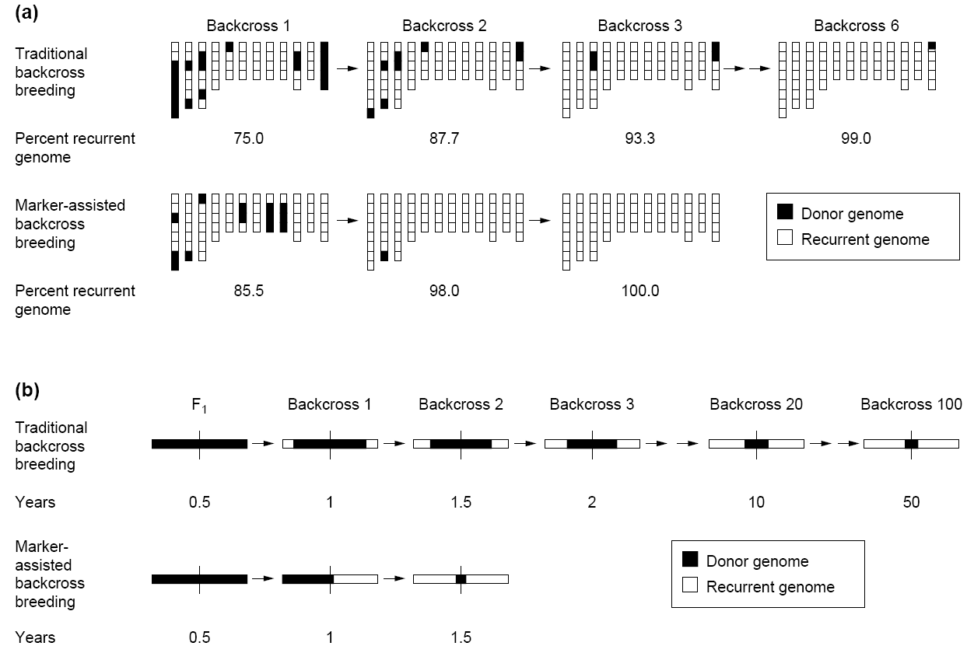

Recurrent genome recovery
30 progeny per backcross
Backcross 100
Traditional method achieve only 99% in 6 generations
100% can be achieved in only three generations by MAS
Tanksley et al. Biotechnology 1989

Slide 4
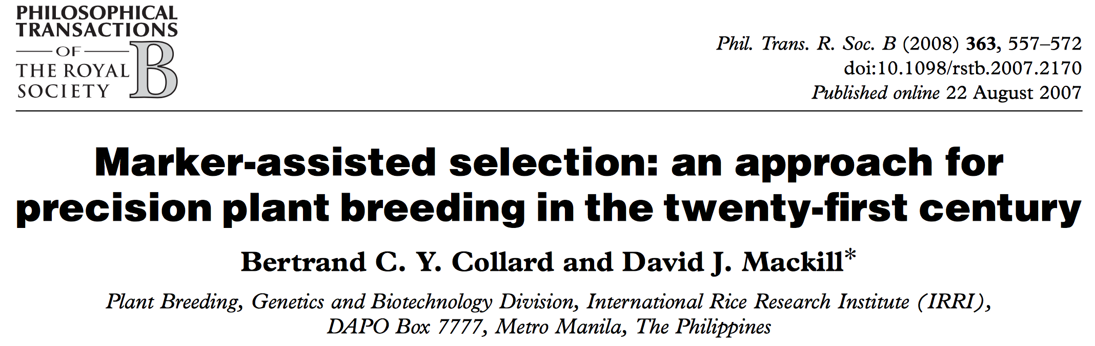
A high impact review article
(1500 citations by March 31, 2020)

Slide 5
Explanations on low impact of MAS
Bertrand C. Y. Collard and David J. Mackill, Phil. Trans. R. Soc. B (2008) 363, 557–572
(a) Still at the early stages of DNA marker technology development
(b) Marker-assisted selection results may not be published
(c) Reliability and accuracy of quantitative trait loci mapping studies
(d) Insufficient linkage between marker and gene/ quantitative trait locus
(e) Limited markers and limited polymorphism of markers in breeding material
(f ) Effects of genetic background
(g) Quantitative trait loci x environment effects
(h) High cost of marker-assisted selection
(i) ‘Application gap’ between research laboratories and plant breeding institutes
(j) ‘Knowledge gap’ among molecular biologists, plant breeders and other disciplines

Slide 6
Missing heritability
Over 100 known loci only explained 20% of variation of human height that has70~80% heritability
Teri A. Manolio et al. , Finding the missing heritability of complex diseases, Nature, 2009 October 8; 461(7265): 747–753

Slide 7
Predicting a complex trait
10 genes
50% heritability
Environmental effects
QTL by GWAS
Predicting phenotype and breeding value

Slide 8
Simulation of environment effects
Examples: Nursery of maize 282 association panel
Tropical lines: planting one week earlier
Stiff Stalk lines: removing tillers

Slide 9
mdp_env.txt
Taxa | SS | NSS | Tropical | Early | Tiller
33-16 | 0.014 | 0.972 | 0.014 | 0 | 0
38-11 | 0.003 | 0.993 | 0.004 | 0 | 0
4226 | 0.071 | 0.917 | 0.012 | 0 | 0
4722 | 0.035 | 0.854 | 0.111 | 0 | 0
A188 | 0.013 | 0.982 | 0.005 | 0 | 0
A214N | 0.762 | 0.017 | 0.221 | 0 | 1
A239 | 0.035 | 0.963 | 0.002 | 0 | 0
A272 | 0.019 | 0.122 | 0.859 | 1 | 0
A441-5 | 0.005 | 0.531 | 0.464 | 0 | 0
A554 | 0.019 | 0.979 | 0.002 | 0 | 0
A556 | 0.004 | 0.994 | 0.002 | 0 | 0
A6 | 0.003 | 0.03 | 0.967 | 1 | 0
A619 | 0.009 | 0.99 | 0.001 | 0 | 0
A632 | 0.993 | 0.004 | 0.003 | 0 | 1

Slide 10
GAPIT.Phenotype.Simulation
function(GD,
GM=NULL,
h2=.75,
NQTN=10,
QTNDist="normal",
effectunit=1,
category=1,
r=0.25,
CV,
cveff=NULL){
…, environment component,...
})

Slide 11
Environment component
vy=effectvar+residualvar
ev=cveff*vy/(1-cveff)
ec=sqrt(ev)/sqrt(diag(var(CV[,-1])))
enveff=as.matrix(myCV[,-1])%*%ec

Slide 12
Import GAPIT/data and simulation
setwd("~/Desktop/temp")
library(compiler) #required for cmpfun
source("http://www.zzlab.net/GAPIT/gapit_functions.txt")
#Import demo data
myGD=read.table(file="http://zzlab.net/GAPIT/data/mdp_numeric.txt",head=T)
myGM=read.table(file="http://zzlab.net/GAPIT/data/mdp_SNP_information.txt",head=T)
myCV=read.table(file="http://zzlab.net/GAPIT/data/mdp_env.txt",head=T)
#Simultate 10 QTN on the first half chromosomes
X=myGD[,-1]
index1to5=myGM[,2]<6
X1to5 = X[,index1to5]
taxa=myGD[,1]
set.seed(99164)
GD.candidate=cbind(taxa,X1to5)
mySim=GAPIT.Phenotype.Simulation(GD=GD.candidate,GM=myGM[index1to5,],h2=.5,NQTN=10, effectunit =.95,QTNDist="normal",CV=myCV,cveff=c(.51,.51))

Slide 13
GWAS with GAPIT
myGAPIT_GLM <- GAPIT(
Y=mySim$Y,
GD=myGD,#Genotype
GM=myGM,#Map information
PCA.total=3,
CV=myCV,
QTN.position=mySim$QTN.position,
model="GLM",# MLM CMLM GLM SUPER MLMM FarmCPU Blink
)

Slide 14
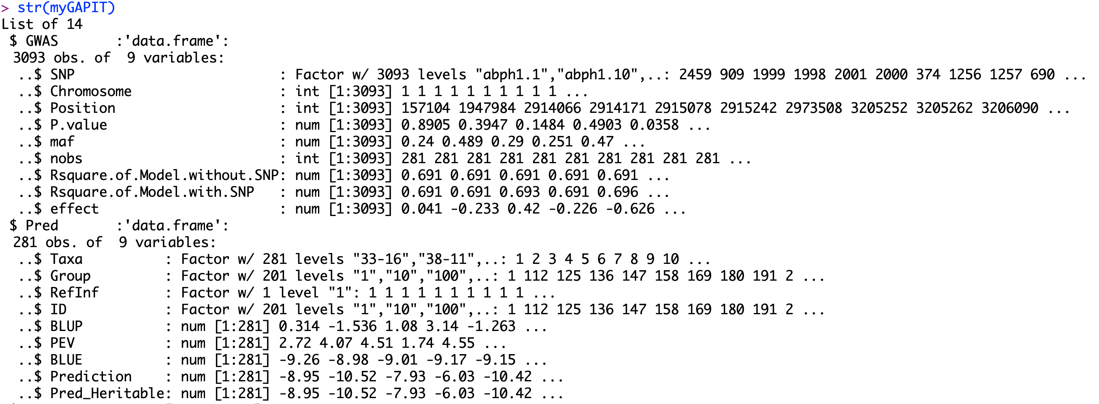
GAPIT output

Slide 15
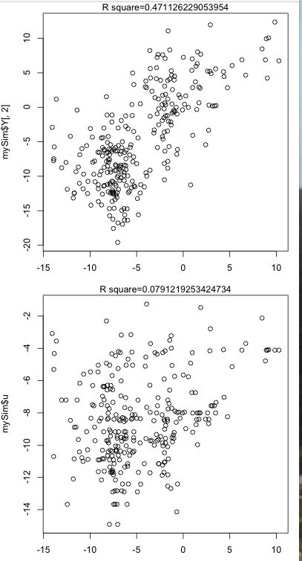
Prediction with PC
myGAPIT <- GAPIT(
Y=mySim$Y,
GD=myGD,
GM=myGM,
PCA.total=3,
#CV=myCV,
QTN.position=mySim$QTN.position,
model="GLM")
ry2=cor(myGAPIT$Pred[,8],mySim$Y[,2])^2
ru2=cor(myGAPIT$Pred[,8],mySim$u)^2
par(mfrow=c(2,1), mar = c(3,4,1,1))
plot(myGAPIT$Pred[,8],mySim$Y[,2])
mtext(paste("R square=",ry2,sep=""), side = 3)
plot(myGAPIT$Pred[,8],mySim$u)
mtext(paste("R square=",ru2,sep=""), side = 3)
Phenotype
Breeding value

Slide 16
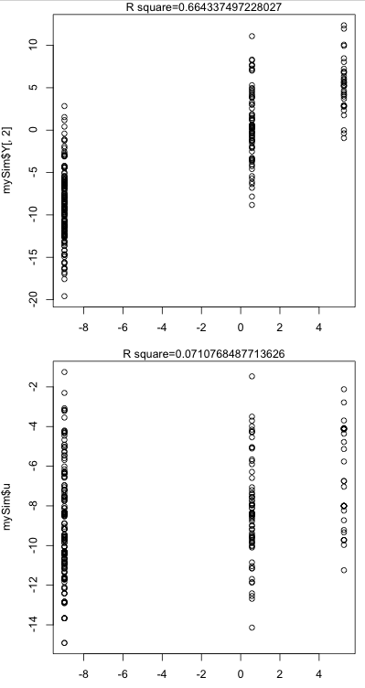
Prediction with ENV
myGAPIT <- GAPIT(
Y=mySim$Y,
GD=myGD,
GM=myGM,
PCA.total=0,
CV=myCV,
QTN.position=mySim$QTN.position,
model="GLM")
ry2=cor(myGAPIT$Pred[,8],mySim$Y[,2])^2
ru2=cor(myGAPIT$Pred[,8],mySim$u)^2
par(mfrow=c(2,1), mar = c(3,4,1,1))
plot(myGAPIT$Pred[,8],mySim$Y[,2])
mtext(paste("R square=",ry2,sep=""), side = 3)
plot(myGAPIT$Pred[,8],mySim$u)
mtext(paste("R square=",ru2,sep=""), side = 3)
Phenotype
Breeding value

Slide 17
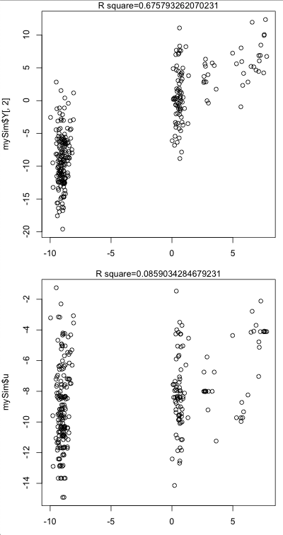
Prediction with PC and ENV
myGAPIT <- GAPIT(
Y=mySim$Y,
GD=myGD,
GM=myGM,
PCA.total=3,
CV=myCV,
QTN.position=mySim$QTN.position,
model="GLM")
ry2=cor(myGAPIT$Pred[,8],mySim$Y[,2])^2
ru2=cor(myGAPIT$Pred[,8],mySim$u)^2
par(mfrow=c(2,1), mar = c(3,4,1,1))
plot(myGAPIT$Pred[,8],mySim$Y[,2])
mtext(paste("R square=",ry2,sep=""), side = 3)
plot(myGAPIT$Pred[,8],mySim$u)
mtext(paste("R square=",ru2,sep=""), side = 3)
Phenotype
Breeding value

Slide 18
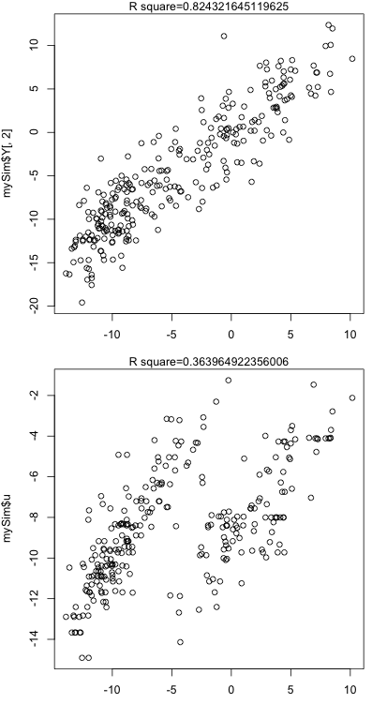
Prediction with top ten SNPs
ntop=10
index=order(myGAPIT$GWAS[,4])
top=index[1:ntop]
myCV=cbind(myGAPIT$PCA,myGD[,c(top+1)])
myGAPIT2 <- GAPIT(
Y=mySim$Y,
GD=myGD,
GM=myGM,
#PCA.total=3,
CV=myCV,
QTN.position=mySim$QTN.position,
model="GLM")
Phenotype
ry2=cor(myGAPIT2$Pred[,8],mySim$Y[,2])^2
ru2=cor(myGAPIT2$Pred[,8],mySim$u)^2
par(mfrow=c(2,1), mar = c(3,4,1,1))
plot(myGAPIT2$Pred[,8],mySim$Y[,2])
mtext(paste("R square=",ry2,sep=""), side = 3)
plot(myGAPIT2$Pred[,8],mySim$u)
mtext(paste("R square=",ru2,sep=""), side = 3)
Breeding value

Slide 19
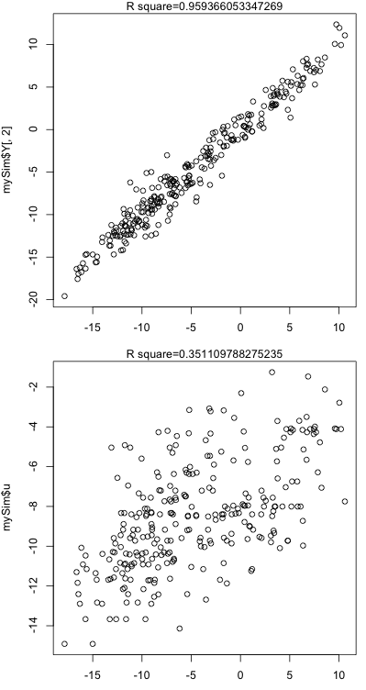
Prediction with top ten SNPs
ntop=200
index=order(myGAPIT$GWAS[,4])
top=index[1:ntop]
myCV=cbind(myGAPIT$PCA,myGD[,c(top+1)])
myGAPIT2 <- GAPIT(
Y=mySim$Y,
GD=myGD,
GM=myGM,
#PCA.total=3,
CV=myCV,
QTN.position=mySim$QTN.position,
model="GLM")
Phenotype
ry2=cor(myGAPIT2$Pred[,8],mySim$Y[,2])^2
ru2=cor(myGAPIT2$Pred[,8],mySim$u)^2
par(mfrow=c(2,1), mar = c(3,4,1,1))
plot(myGAPIT2$Pred[,8],mySim$Y[,2])
mtext(paste("R square=",ry2,sep=""), side = 3)
plot(myGAPIT2$Pred[,8],mySim$u)
mtext(paste("R square=",ru2,sep=""), side = 3)
Breeding value

Slide 20
Prediction accuracy
Model | Phenotype | Breeding value
y=PC + e | 0.47 | 0.08
y=C1 + … + C10 + e | 0.66 | 0.07
y=C1 + … + C10 + PC + e | 0.68 | 0.09
y=C1 + … + C10 + PC+ ENV+ e | 0.82 | 0.36
y=C1 + … + C200 + PC + ENV + e | 0.96 | 0.35

Slide 21
Outline
Success of MAS
Reasons of low impact
Complex traits
Environment effect
Prediction by GAPIT
Modeling MAS

