Slide 1


Statistical Genomics
Lecture 30: Machine Learning
Zhiwu Zhang
Washington State University

Slide 2
Outline
Machine learning
Deep learning
Data mining

Slide 3
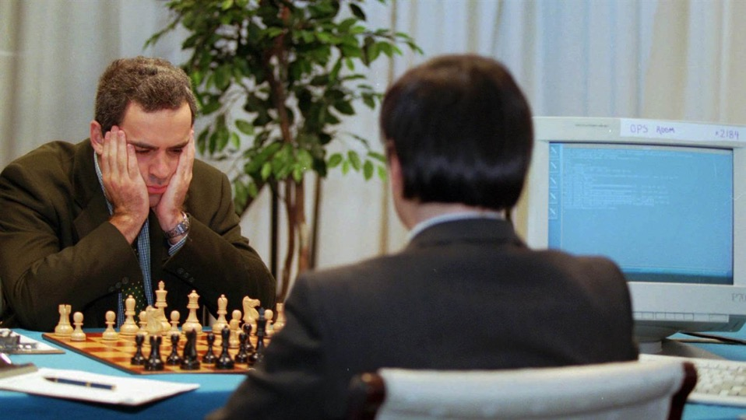
Hard coded multiple players' moves won the champion
1996: Garry Kasparov vs IBM deep blue

Slide 4

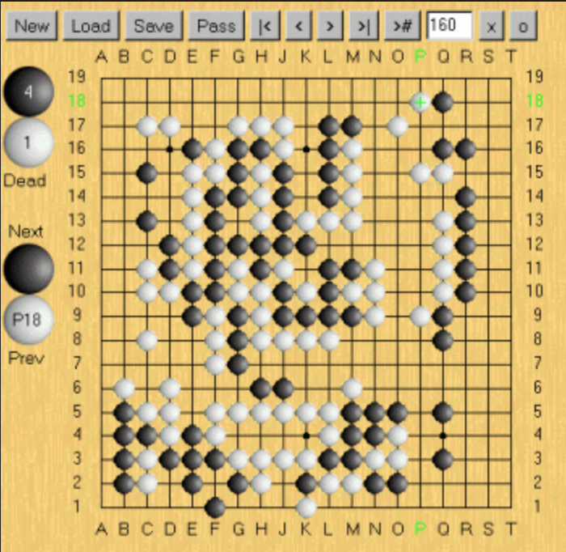
Human online game behavior
2016: AlphaGo by Google DeepMind
vs.
Lee Sedol (No2)

Slide 5

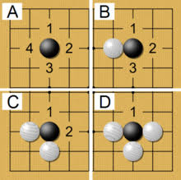
Self learning
2017: AlphaGo by Google DeepMind
vs.
Ke Jie 柯洁 (No1)

Slide 6
Machine learning
Machine learning is a type of artificial intelligence (AI) that provides computers with the ability to learn without being explicitly programmed.

Slide 7
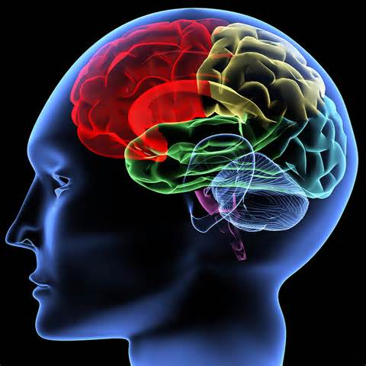

Brain vs. computer
Characteristics
Memory |  | ✔️
Calculation |  | ✔️
Information access |  | ✔️
Life span |  | ✔️
Creative | ✔️

Slide 8
https://media.autoexpress.co.uk/image/private/s--AgytYsMD--/t_content-image-desktop@1/v1563183852/autoexpress/2016/10/dsc_2334.jpg

Slide 9
Natural and Artificial Brains

Slide 10
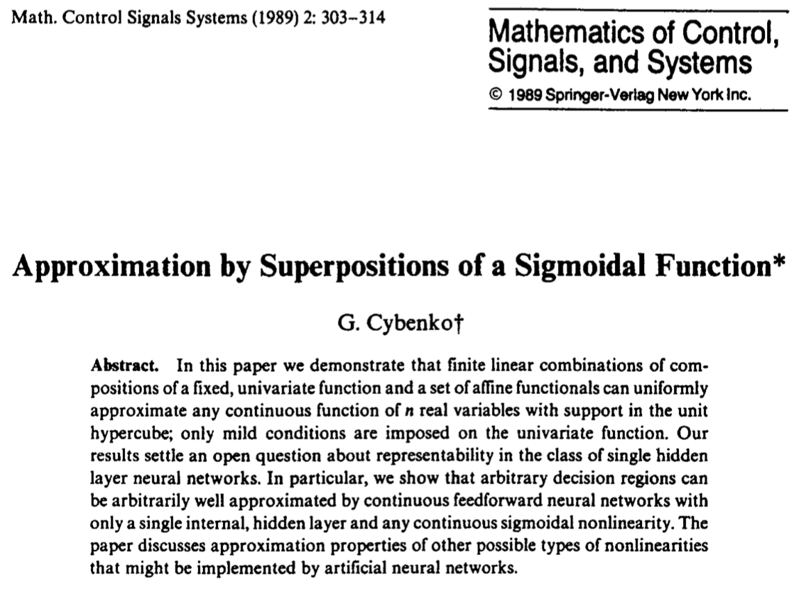
Theoretical Proof
Simple neural networks can represent a wide variety of interesting functions

Slide 11


Computer demonstration
By Michael Nielsen / Dec 2019

Slide 12
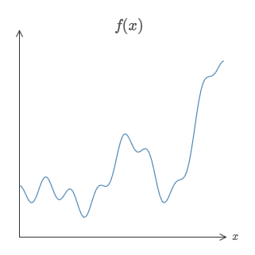

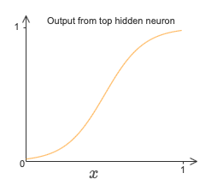
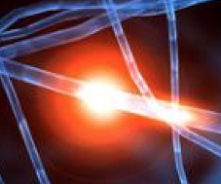
Weight and Bias
Weight5
Weight1
Weight4
Weight2
Weight3
Weight6

Slide 13
Brain vs. computer
Characteristics
Memory |  | ✔️
Calculation |  | ✔️
Information access |  | ✔️
Life span |  | ✔️
Creative | ✔️
Connections | ✔️ (100B N, 4QD C)

Slide 14
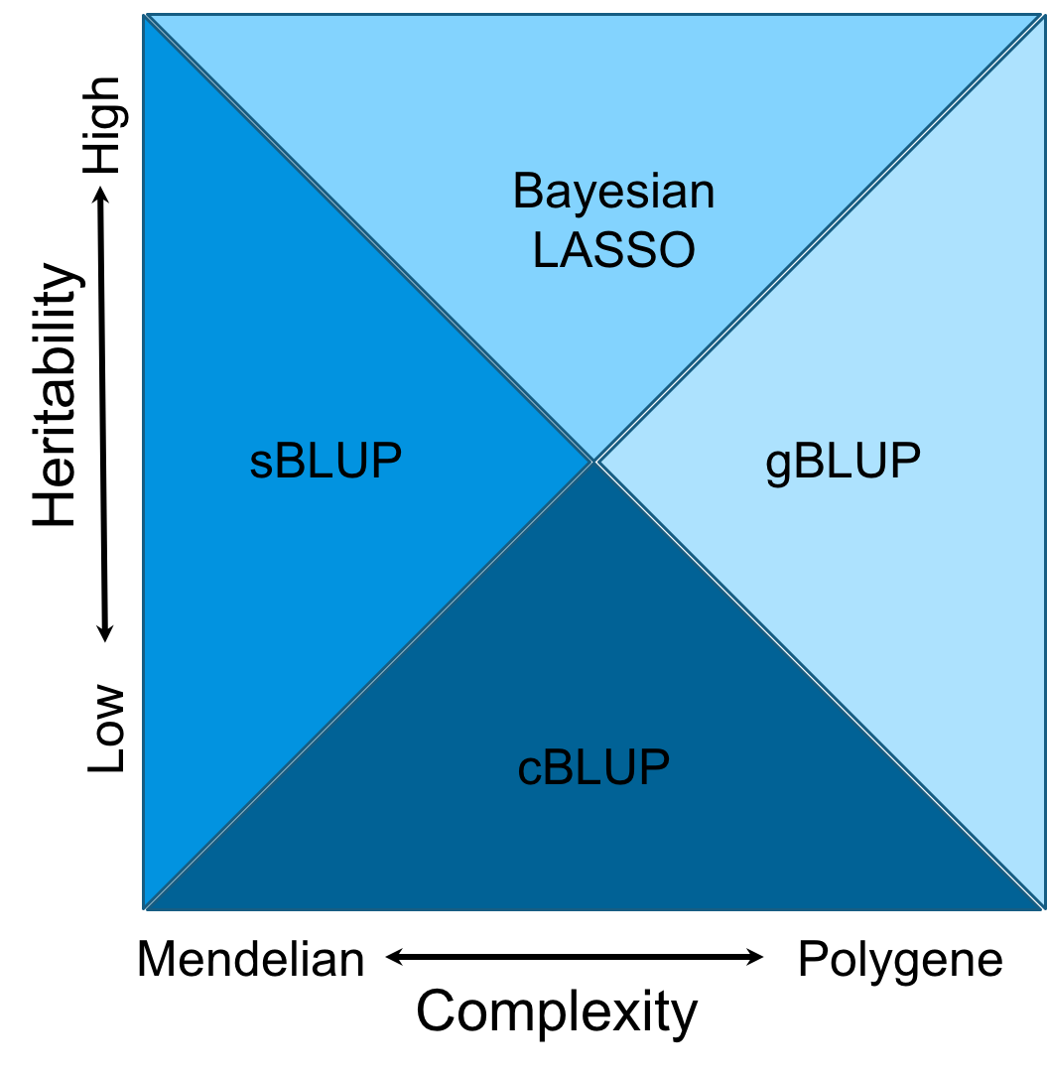
Domains
Notes:
Figure 6.The cost time of computing genomic prediction in three method.
Bayesion method (green) cost most time than other methods, and gBLUP (blue) is the least. The cost time of scBLUP (orange) computing genomic prediction depend on the number of individuals of population (compression) and the number of markers (SUPER). The computing time is calculated by CPU computing time.

Slide 15
Data mining
Knowledge
Data
Prediction

Slide 16
Knowledge and expansion
mMap
…
Data | rrBLUP | gBLUP | cBLUP
Start.Weight | 0.41 | 0.41 | 0.50
FN.Age | 0.57 | 0.58 | 0.74
FN.PctWtLoss | 0.25 | 0.25 | 0.28
FN.postWeight | 0.40 | 0.40 | 0.49
FN.preWeight | 0.39 | 0.39 | 0.49
Weight.Growth Intercept | 0.37 | 0.37 | 0.48
Weight.Growth Slope | 0.31 | 0.32 | 0.34
HTLC | 0.43 | 0.43 | 0.39
BA | 0.49 | 0.49 | 0.47
BD | 0.25 | 0.25 | 0.24
BLC | 0.47 | 0.47 | 0.44
CWAC | 0.45 | 0.44 | 0.43
CWAL | 0.36 | 0.35 | 0.34
DBH | 0.43 | 0.42 | 0.39
HT | 0.36 | 0.35 | 0.34
rootnum | 0.23 | 0.23 | 0.21
rootnumbin | 0.26 | 0.26 | 0.26
gall | 0.23 | 0.22 | 0.22
rustbin | 0.27 | 0.27 | 0.28
c5c6 | 0.26 | 0.25 | 0.23
density | 0.20 | 0.21 | 0.18
lateWood.4 | 0.23 | 0.24 | 0.24
lignin | 0.16 | 0.17 | 0.16
stiffnessTree | 0.37 | 0.38 | 0.37
New data
0.25
0.23

Slide 17
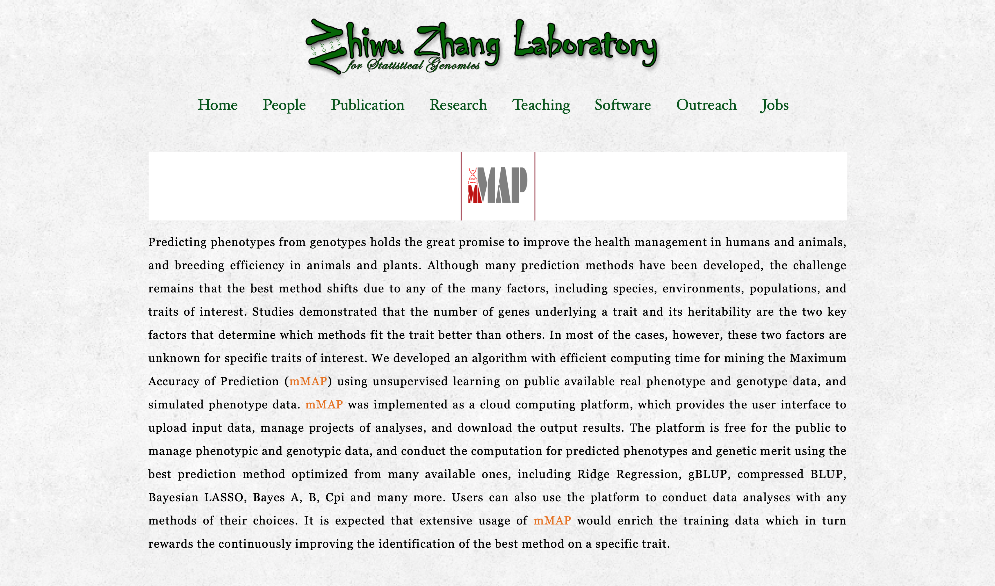

Slide 18



mMap: An Online Computing Platform to Transform Genotypes to Phenotypes by Mining the Maximum Accuracy of Prediction
You Tang
mMAP website: http://zzlab.net/mMAP

Slide 19
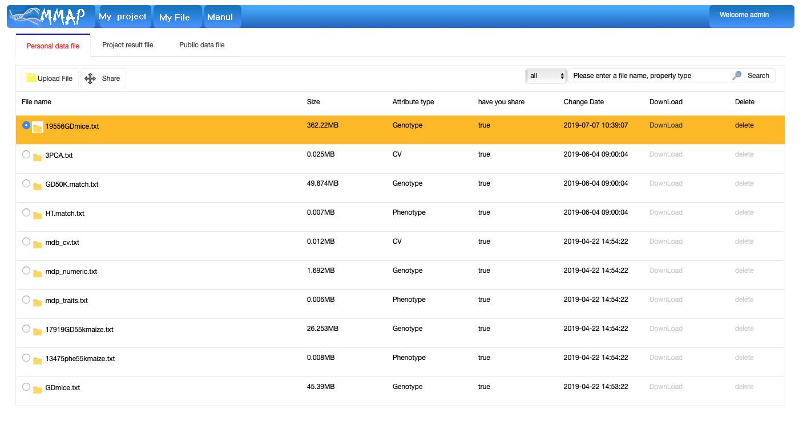
Upload Files

Slide 20
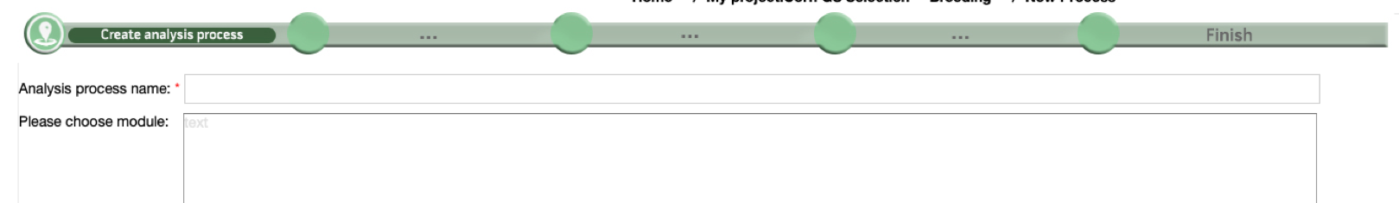
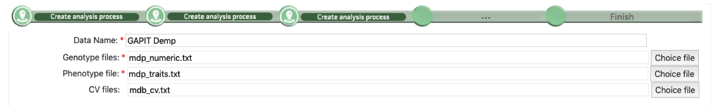
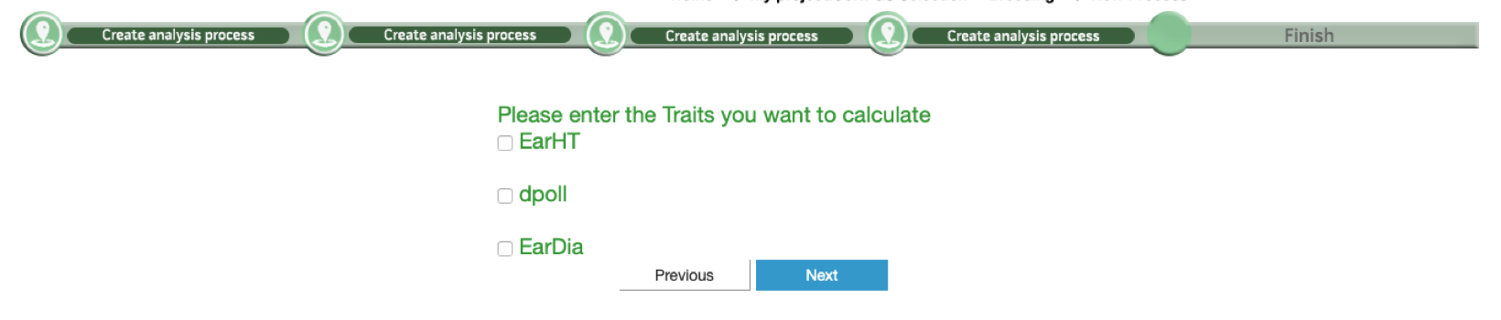

Create New Project

Slide 21
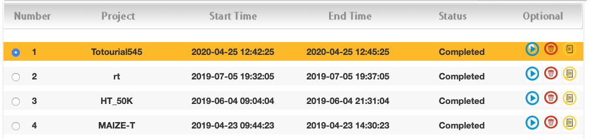
Check status and download results

Slide 22
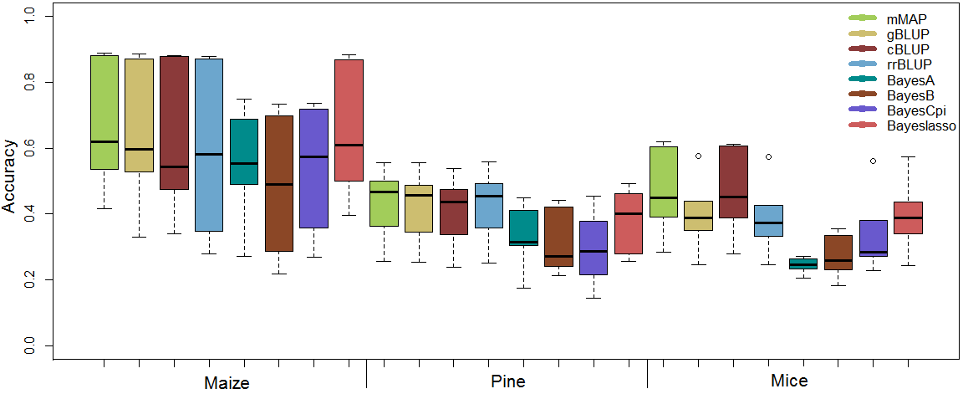
Real traits

Slide 23
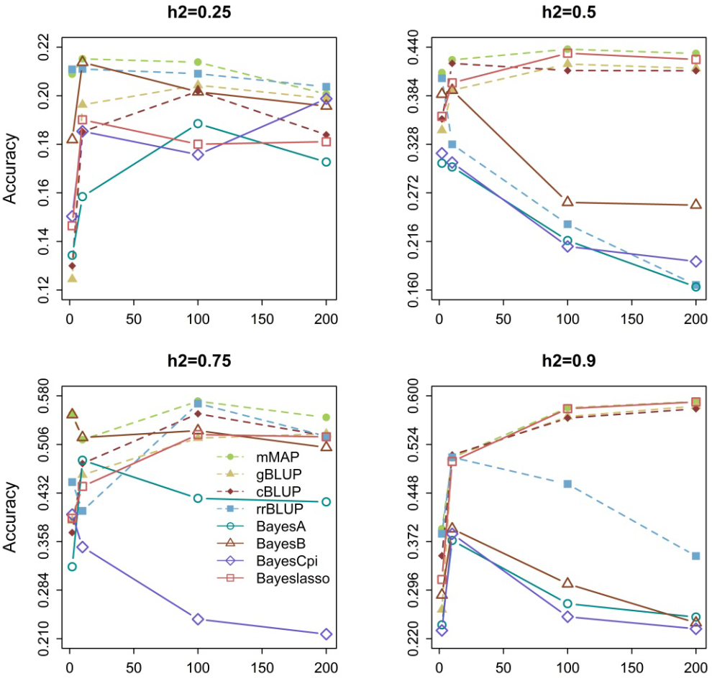
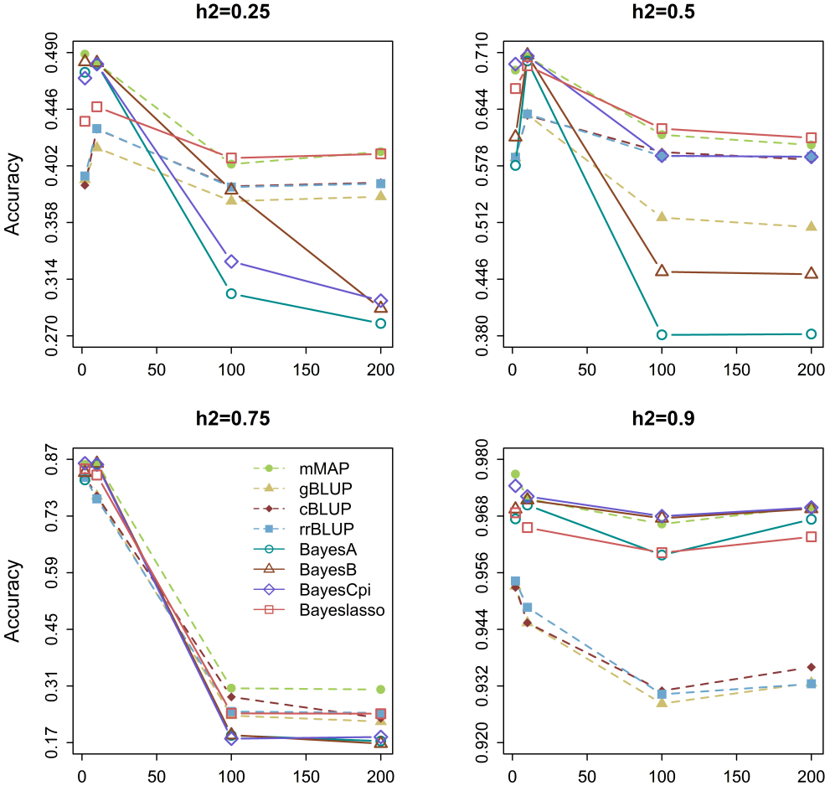
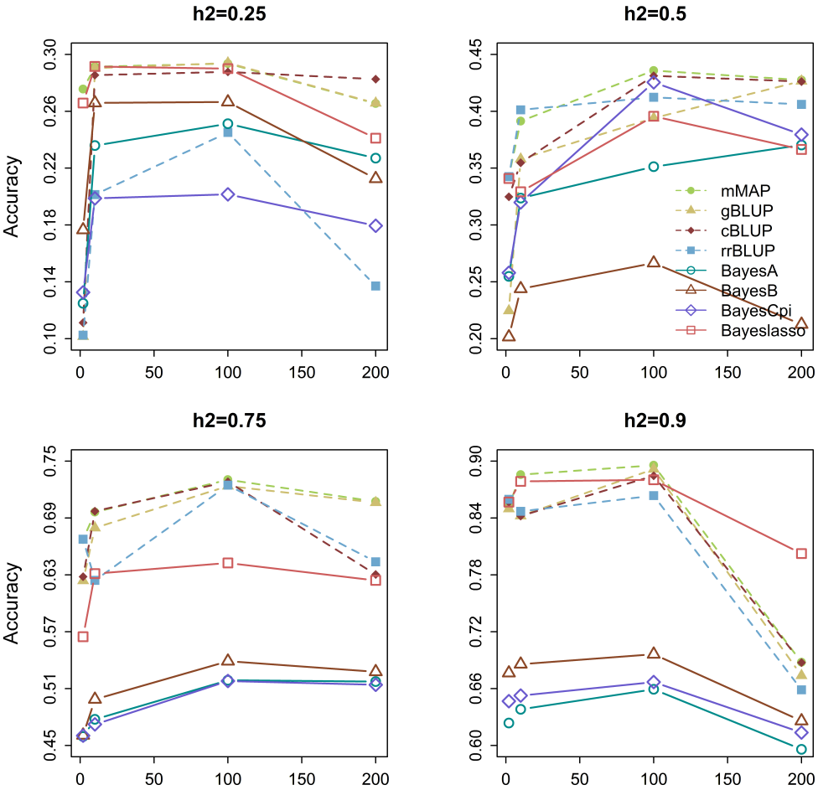
mMAP stays on the top
Maize
Mice
Pine
Number of genes

Slide 24
Import data and simulate phenotype
source("http://zzlab.net/GAPIT/GAPIT.library.R")
source("http://www.zzlab.net/GAPIT/gapit_functions.txt")
myGD=read.table(file="http://zzlab.net/GAPIT/data/mdp_numeric.txt",head=T)
myGM=read.table(file="http://zzlab.net/GAPIT/data/mdp_SNP_information.txt",head=T)
myCV=read.table(file="http://zzlab.net/GAPIT/data/mdp_env.txt",head=T)
#Simultate 10 QTN on the first half chromosomes
X=myGD[,-1]
index1to5=myGM[,2]<6
X1to5 = X[,index1to5]
taxa=myGD[,1]
GD.candidate=cbind(taxa,X1to5)
nqtn=10
setwd("~/Desktop/temp")
set.seed(99164)
mySim=GAPIT.Phenotype.Simulation(GD=GD.candidate,GM=myGM[index1to5,],h2=.75,NQTN=nqtn, effectunit =.95,QTNDist="normal",CV=myCV,cveff=c(.01,.01))

Slide 25
Dividing into training and testing
#Cross validation
set.seed(99164)
n=nrow(mySim$Y)
testing=sample(n,round(n/5),replace=F)
training=-testing

Slide 26

mMap: An Online Computing Platform for Mining the Maximum Accuracy of Prediction of Phenotypes from Genotypes
http://zzlab.net/mMAP
#Data
names(mySim$Y)=c("Taxa", "SimTrait")
write.table(mySim$Y, file="mdp_Y.txt", sep="\t",quote=F,row.names=F)
write.table(mySim$Y[training,], file="mdp_YRef.txt", sep="\t",quote=F,row.names=F)
write.table(mySim$Y[-training,], file="mdp_YInf.txt", sep="\t",quote=F,row.names=F)
write.table(cbind(mySim$Y,mySim$u),file="mdp_BV.txt", sep="\t",quote=F,row.names=F)
mymMapFull=read.csv("admin513.csv")
mymMapRef=read.csv("admin514.csv")
accuracy <- cor(mySim$u[testing], mymMapRef[testing,2] )^2
modelfit <- cor(mySim$u[training], mymMapRef[training,2] )^2
par(mfrow=c(2,1), mar = c(3,4,1,1))
plot(mymMapRef[training,2] ,mySim$u[training])
mtext(paste("Training R square=", modelfit,sep=""), side = 3)
plot(mymMapRef[testing,2] ,mySim$u[testing])
mtext(paste("Testing R square=", accuracy,sep=""), side = 3)

Slide 27
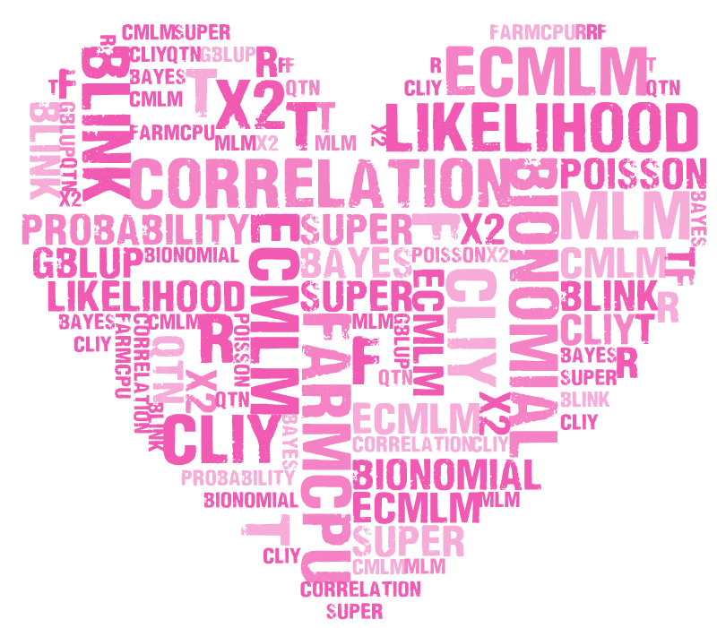
Keywords
MLM cMLM ecMLM SUPER FarmCPU BLINK GWASbyGLM correlation QTN gBLUP Bayes likelihood probability R t f x2 GWhEAT Bionomial Poisson distribution statistics phenotype genotype sequencing MAF GAPIT rrBLUP BLR MLMM LASSO Gibbs DJ PCA Structure Population Kinship GWASP EMMA Matrix inverse GWASzfTranspose if loop function type1 error FDR threshold coverage BAGS depth simulation linkage disequilibrium power P3D MAS Cpi A B C Prior Posterior Exponential Kernel Ridge
545

Slide 29
Remains in Statistical Genomics (545)
Critical thinking
Innovative
Perfection

Slide 30
