Slide 1
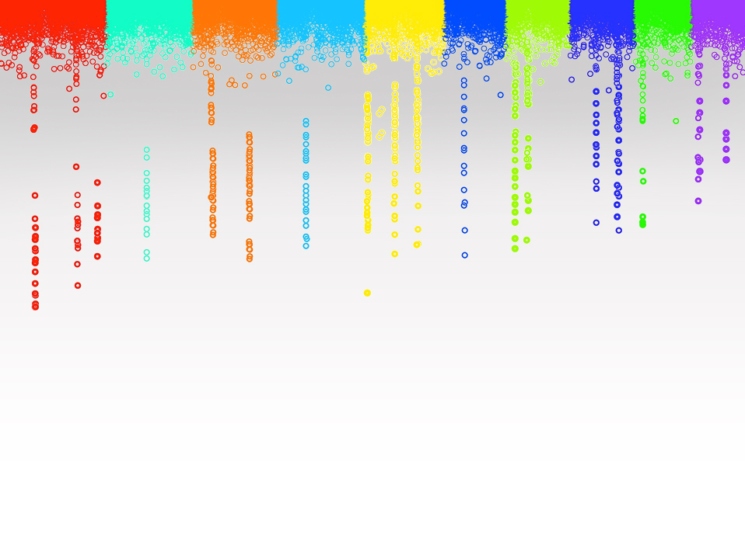
Statistical Genomics
Programming in R
Zhou Tang
Washington State University

Slide 2
Robert Gentleman and Ross Ihaka
Start with S in 1996
Open source
Open packages

Slide 3
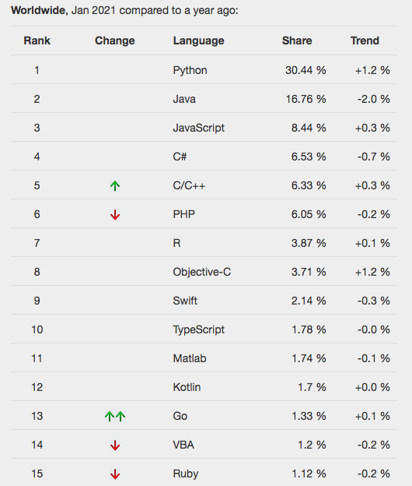
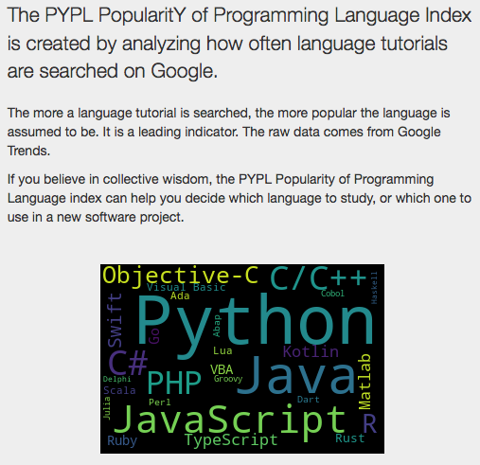
R You Ready for R?
http://pypl.github.io/PYPL.html

Slide 4
R You Ready for R?
Parameter | SAS | R | Python
Availability / Cost | 3 | 5 | 5
Ease of learning | 4.5 | 2.5 | 3.5
Data handling capabilities | 4 | 4 | 4
Graphical capabilities | 3 | 4.5 | 4.5
Advancements in tool | 4 | 4.5 | 4.5
Job scenario | 4 | 4.5 | 4.5
Deep Learning Support | 2 | 3 | 4.5
Customer service support and Community | 4 | 3.5 | 3.5
https://www.analyticsvidhya.com/blog/2017/09/sas-vs-vs-python-tool-learn/

Slide 5
Variables and Assignment Operators
<- or =
variable1 <- 1
variable2 = 2
variable3 <- variable1 + variable2
string1 <- ‘variables can also be words’
string2 <- “quote type doesn’t matter unless they are nested”
vector1 <- c(1,2,3,4,5,6,7,8,9,10)

Slide 6
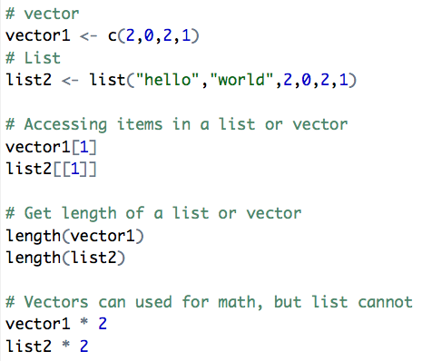
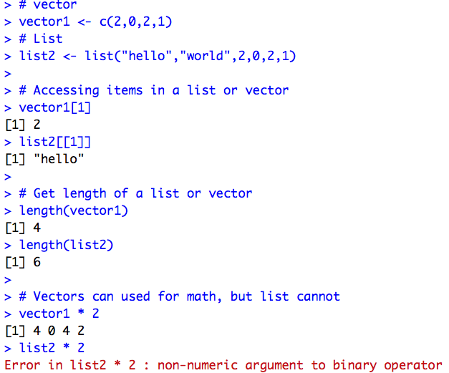
Lists and Vectors
R source file
R Console

Slide 7
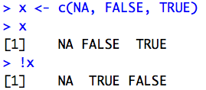
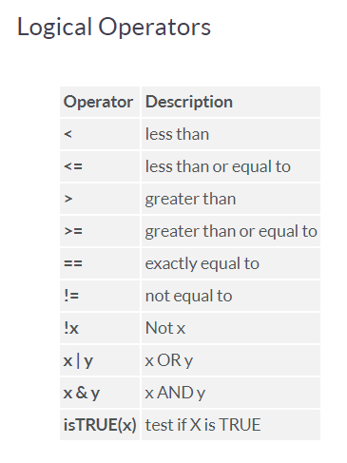
Logical Operators
y x | True | False | NA
True | True | True | True
False | True | False | NA
NA | True | NA | NA
## OR (|) table
y x | True | False | NA
True | True | False | NA
False | False | False | False
NA | NA | False | NA
## AND (&) table

Slide 8
Functions ‘do’ things
function_name <- function (arg_1, arg_2, ...) {
Do something here
}

Slide 9
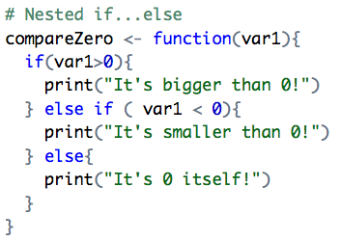
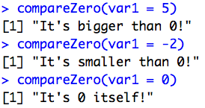
IF
if (expression){
Do Something
}
if (expression){
Do Something
} else {
Do a different thing
}

Slide 10
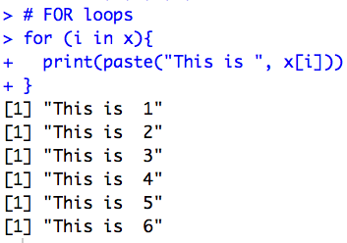
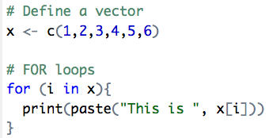
FOR Loops
for (item in vector){
Do something with this item
}

Slide 11
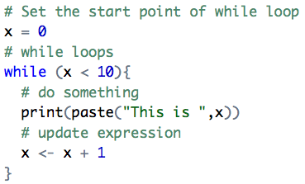
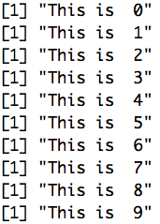
WHILE Loops
while (expression is true)
{
do something
update expression
}

Slide 12
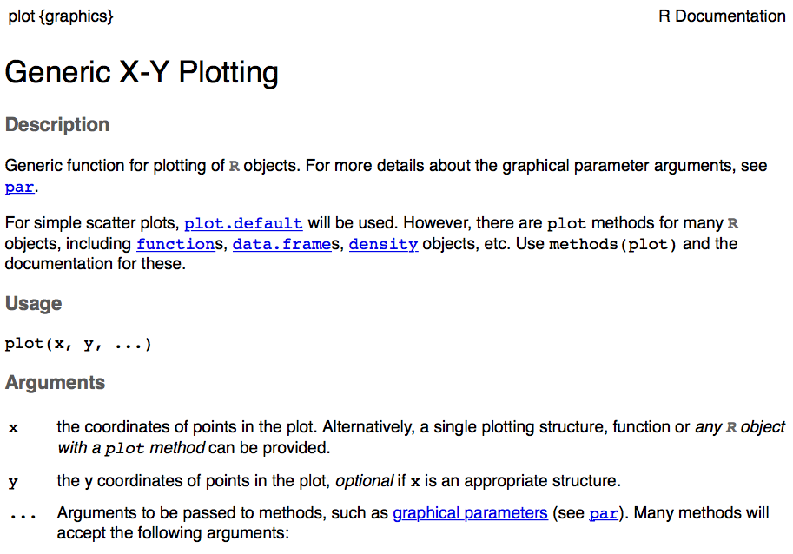
?help is incredibly useful
Use the ? feature to get a help page for any function

Slide 13
Packages
Collection of functions
16957 available packages on CRAN (Comprehensive R Achieve Network)
install.packages("package_name")
library("package_name")

Slide 14
http://zzlab.net/

Slide 15
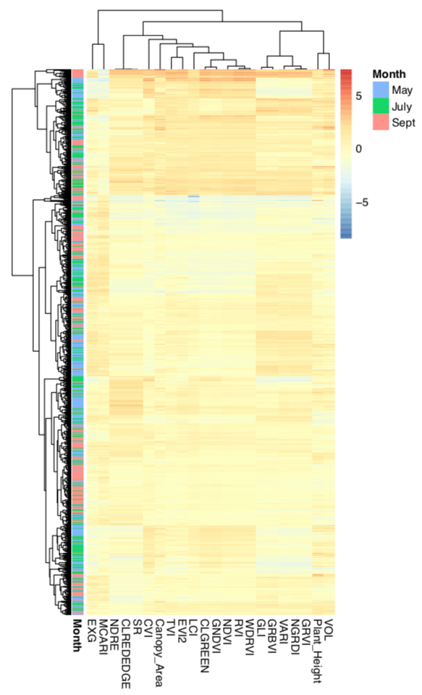
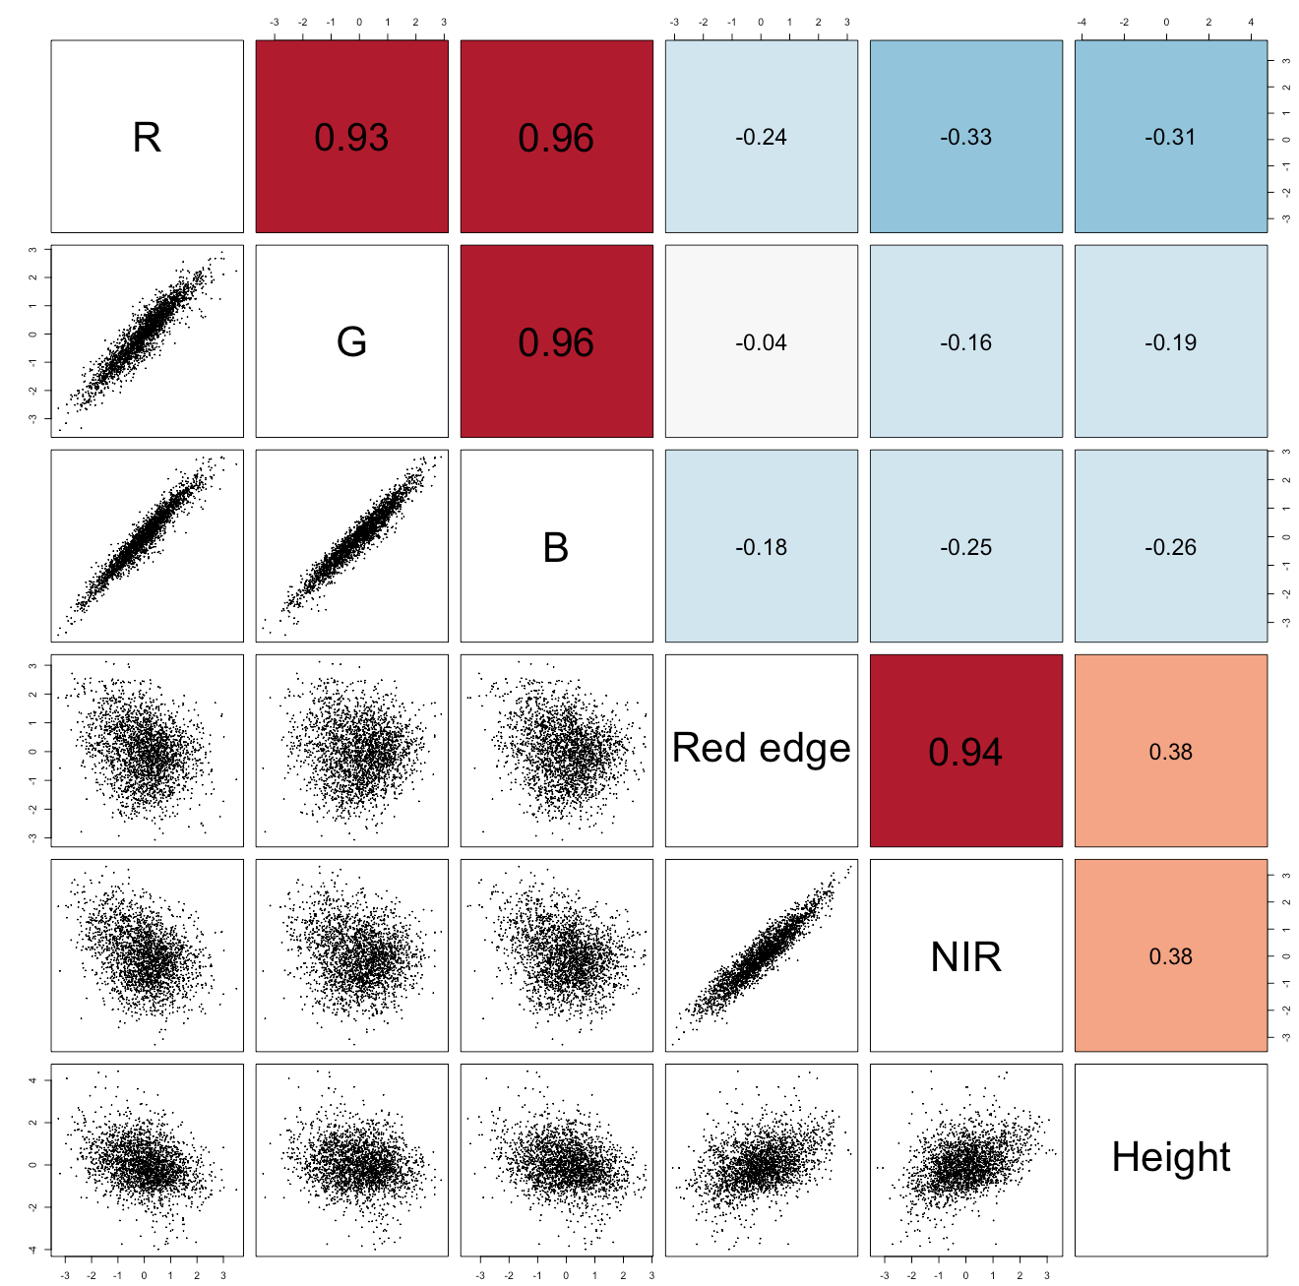
R has many plotting libraries
pairs()
pheatmap::pheatmap()
Zhou et al,. 2021

Slide 16
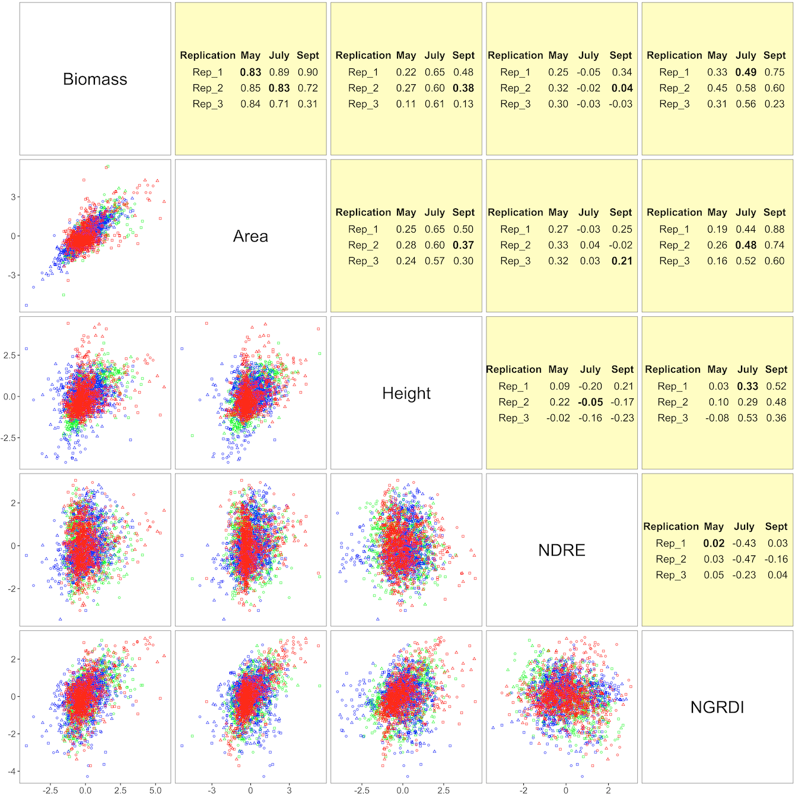
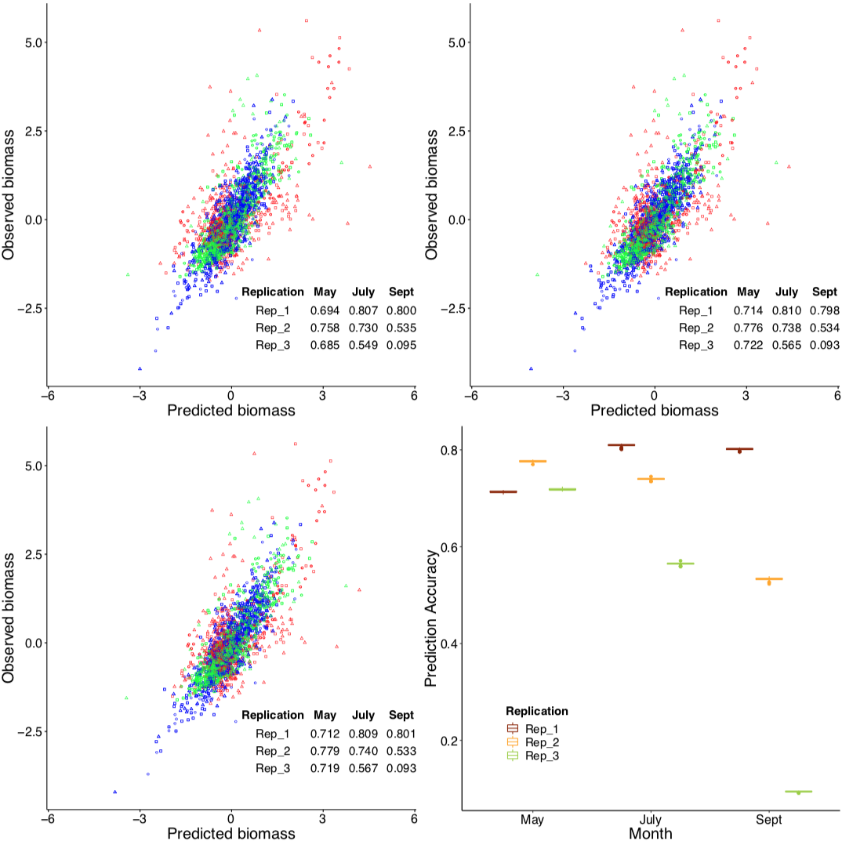
ggplot2
Zhou et al,. 2021

Slide 17
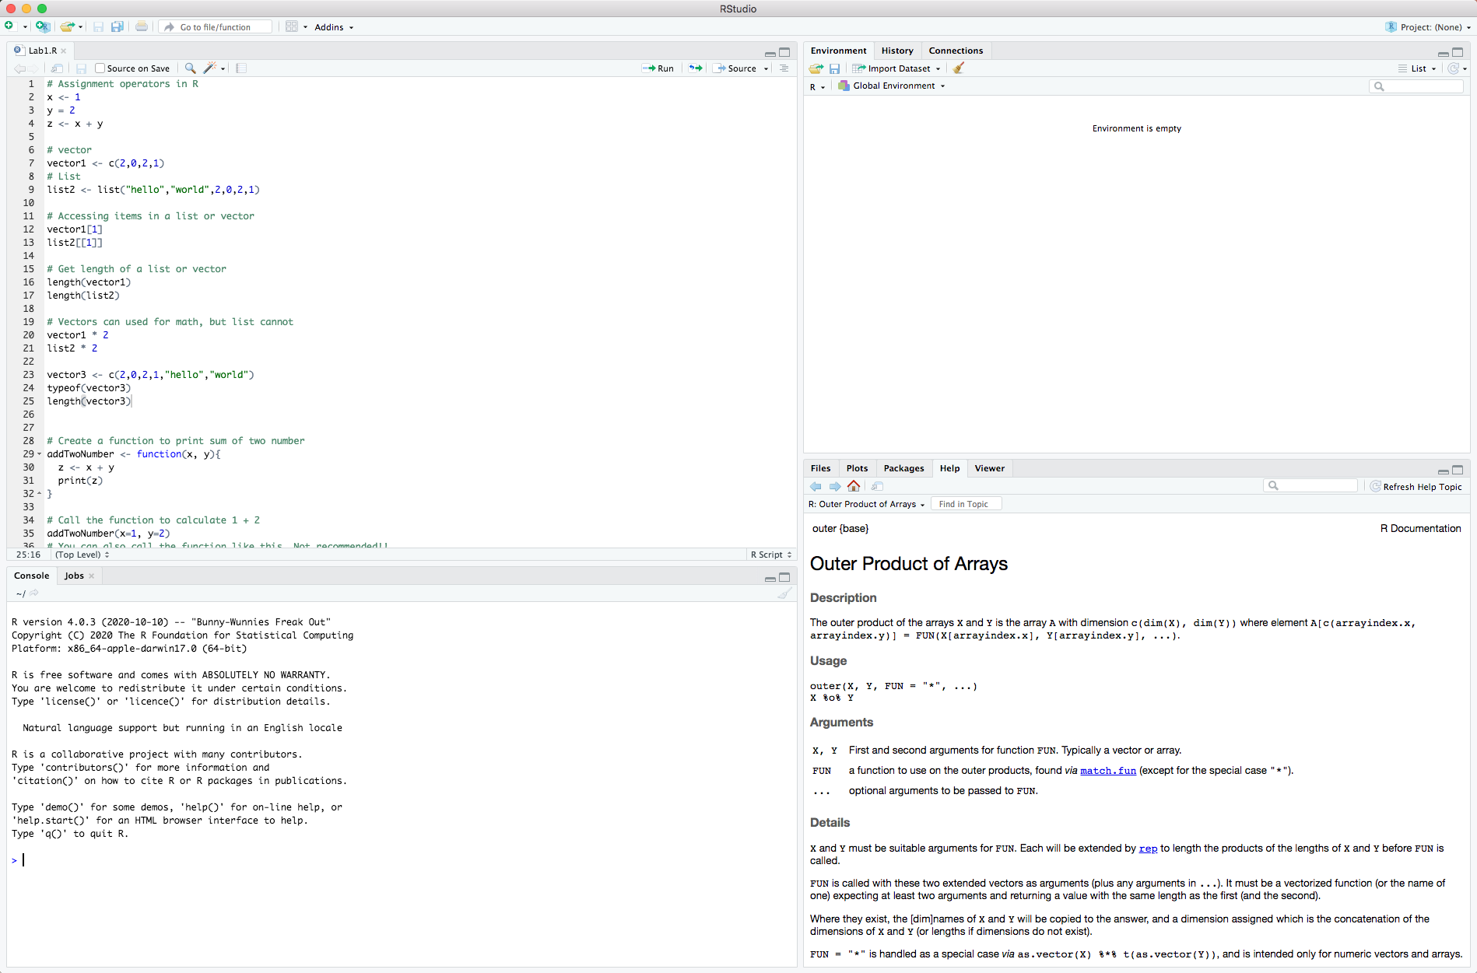
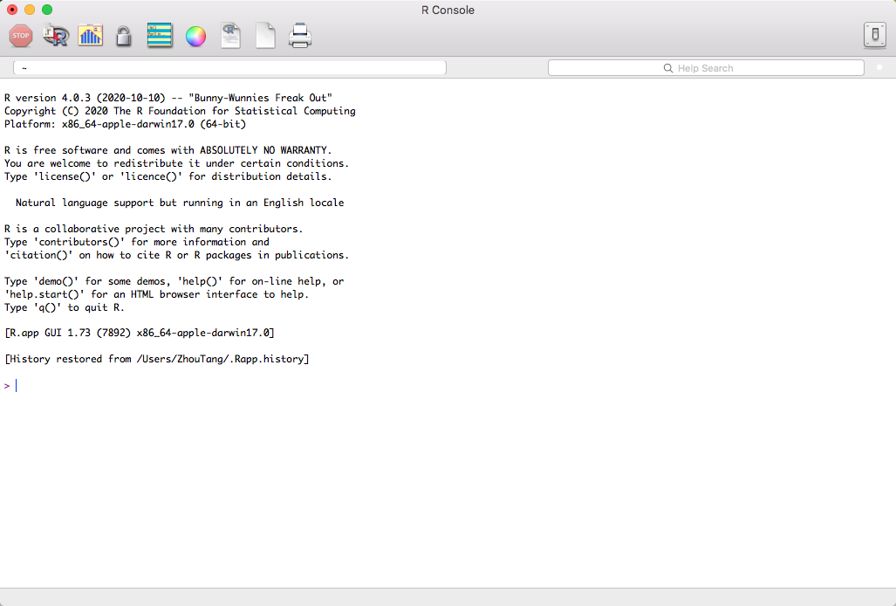
Let’s write R code
Download and install R
https://cran.r-project.org/
Download and install Rstudio
https://rstudio.com/products/rstudio/download/#download

Slide 18
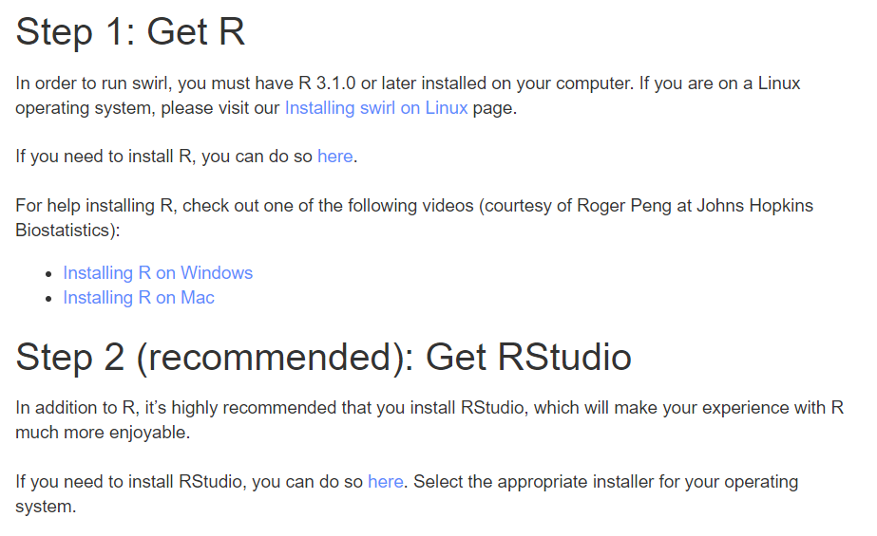
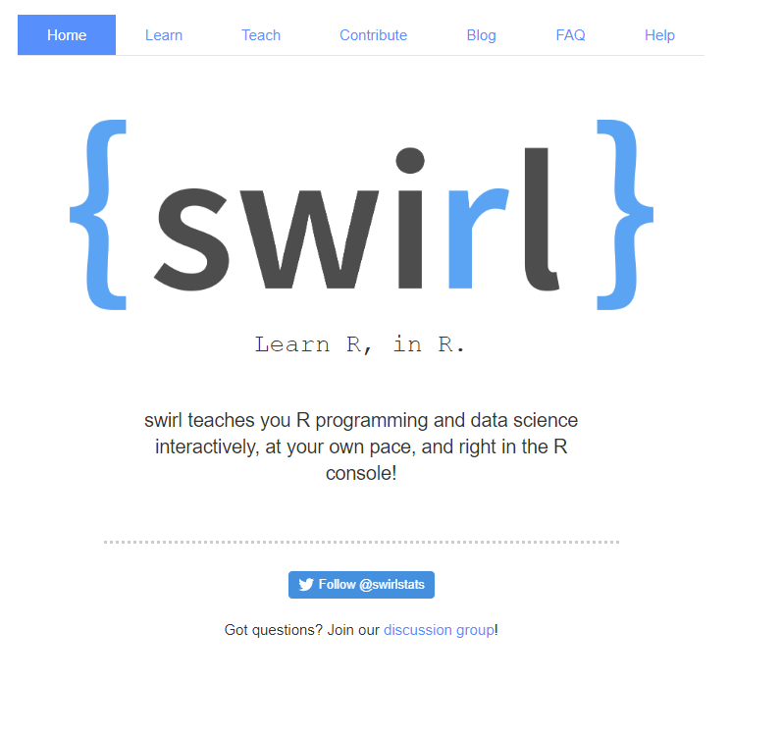
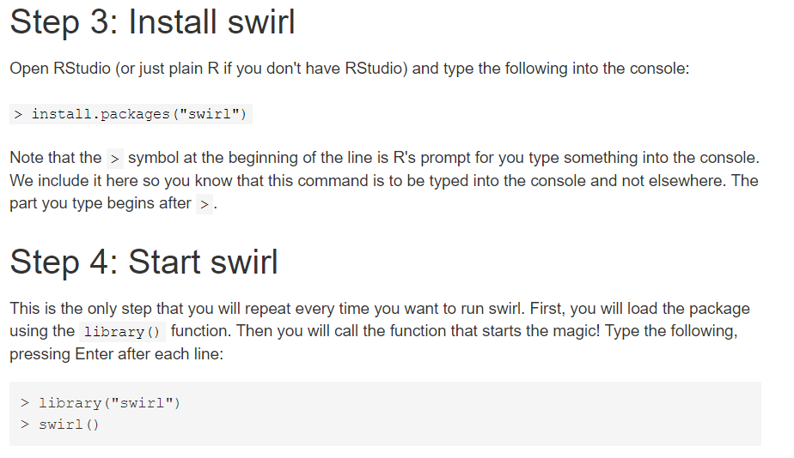
Let’s write R code
Basic R in the swirl (https://swirlstats.com/)

Slide 19
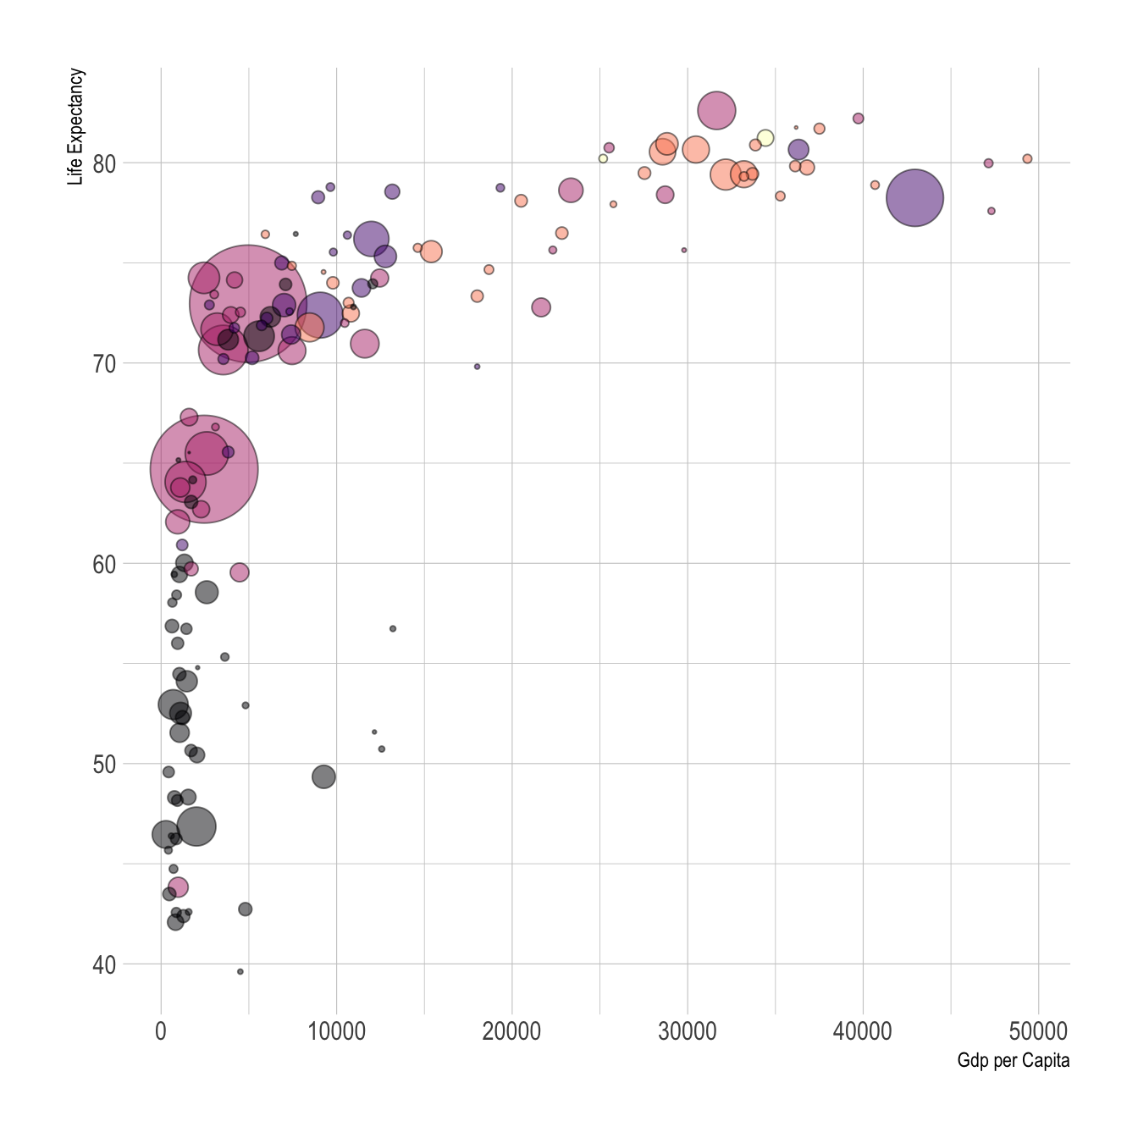
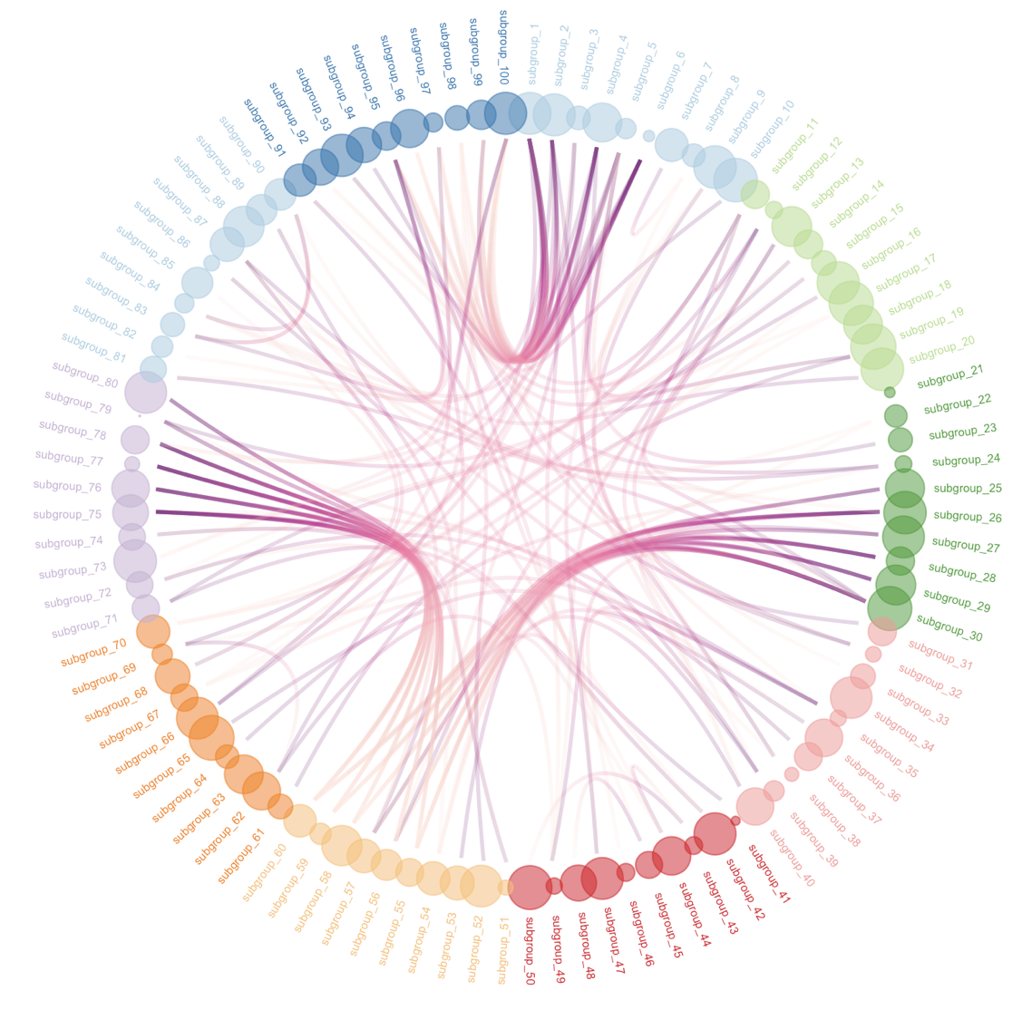
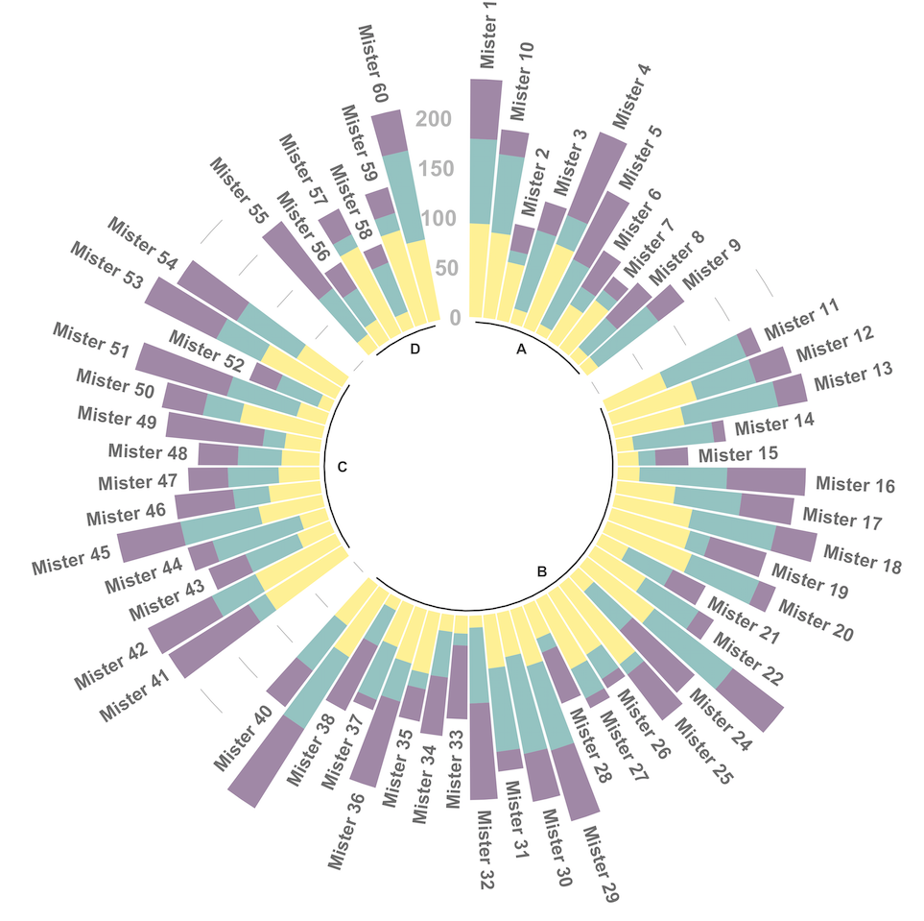
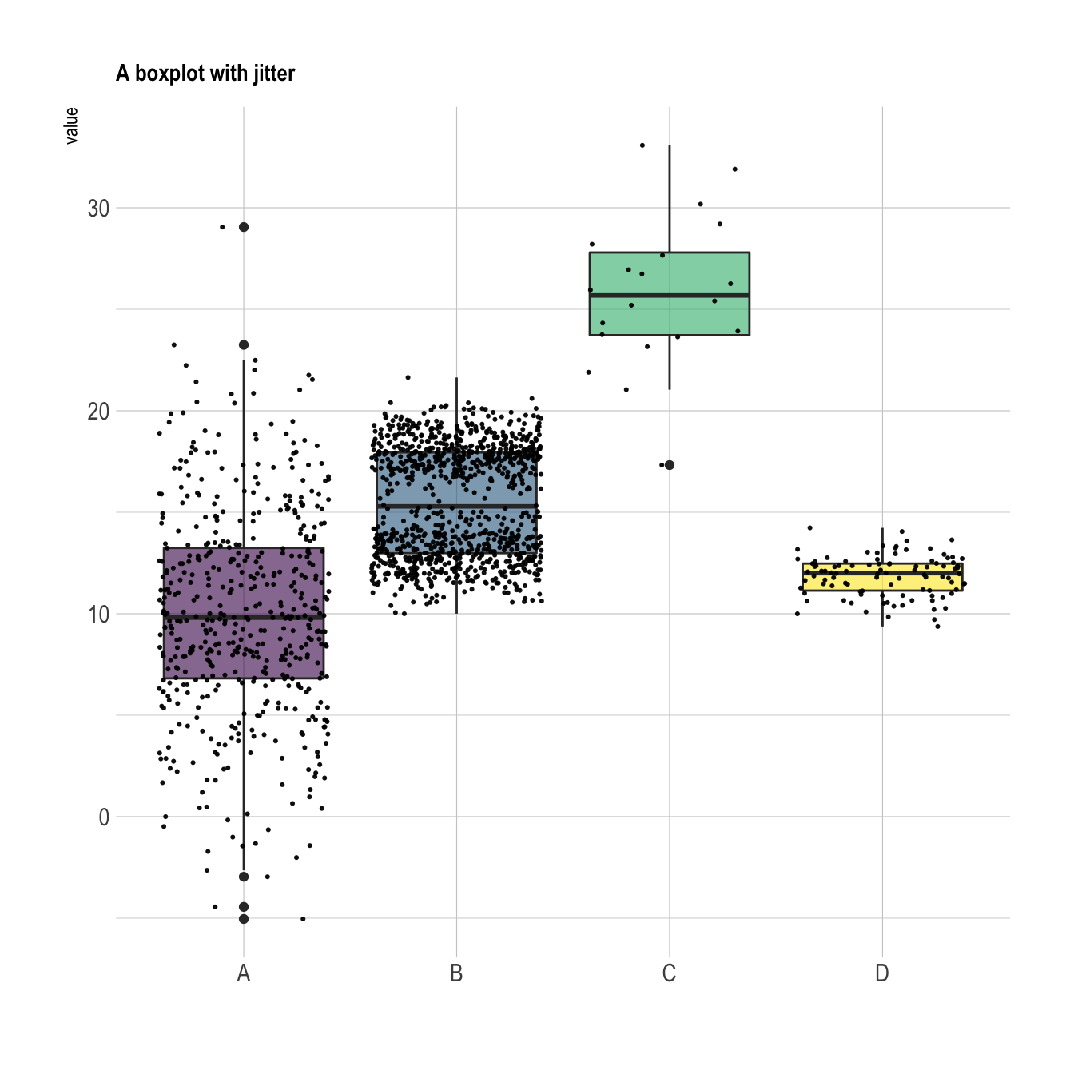
Let’s write R code
ggplot2 : http://r-statistics.co/Complete-Ggplot2-Tutorial-Part1-With-R-Code.html
https://www.r-graph-gallery.com/index.html

Slide 20
Highlight
Background of R
Install R and Rstudio
Basic R knowledge
Install ‘swirl’ and the ‘ggplot2’ package

