Slide 1
Lab 11: Marker Assisted Selection and Cross validation
Crop545
Spring 2021

Slide 2
Phenotype simulation

Slide 3
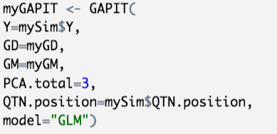
Prediction with GAPIT

Slide 4
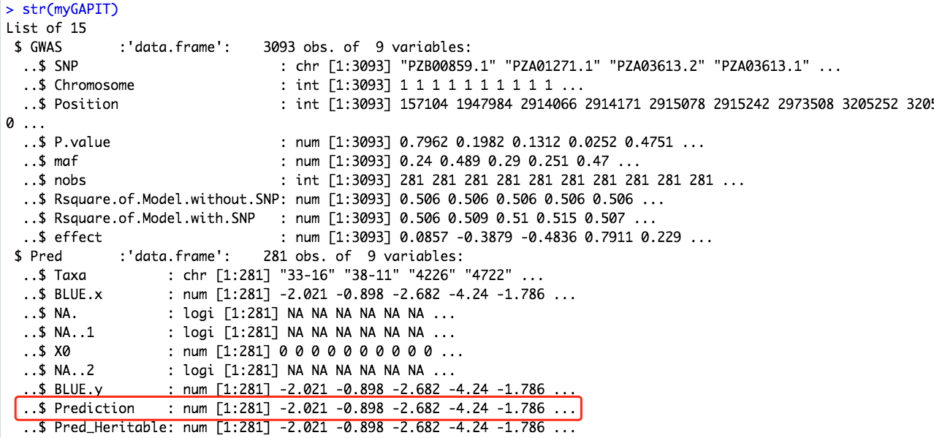
Prediction with GAPIT

Slide 5
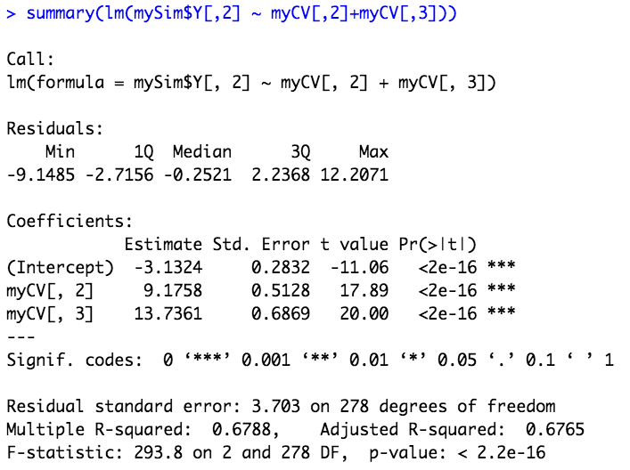
Prediction with the lm function

Slide 6
Prediction mission
Prediction with PCs
Prediction with environment factors
Prediction with SNPs
Prediction with PCs, environment factors and SNPs

Slide 7
Create folds for your data

