Slide 1
Lab 13: rrBLUP
Crop545
Spring 2021

Slide 2
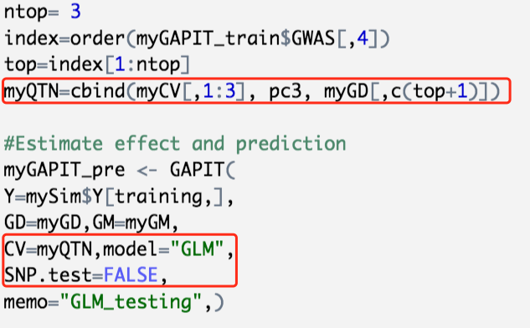
MAS by GAPIT

Slide 3
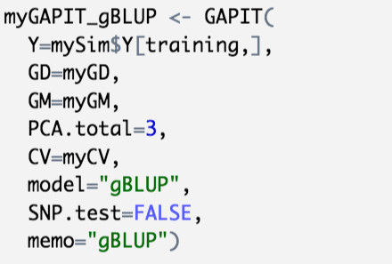
gBLUP by GAPIT

Slide 4
rrBLUP
https://cran.r-project.org/web/packages/rrBLUP/rrBLUP.pdf

Slide 5
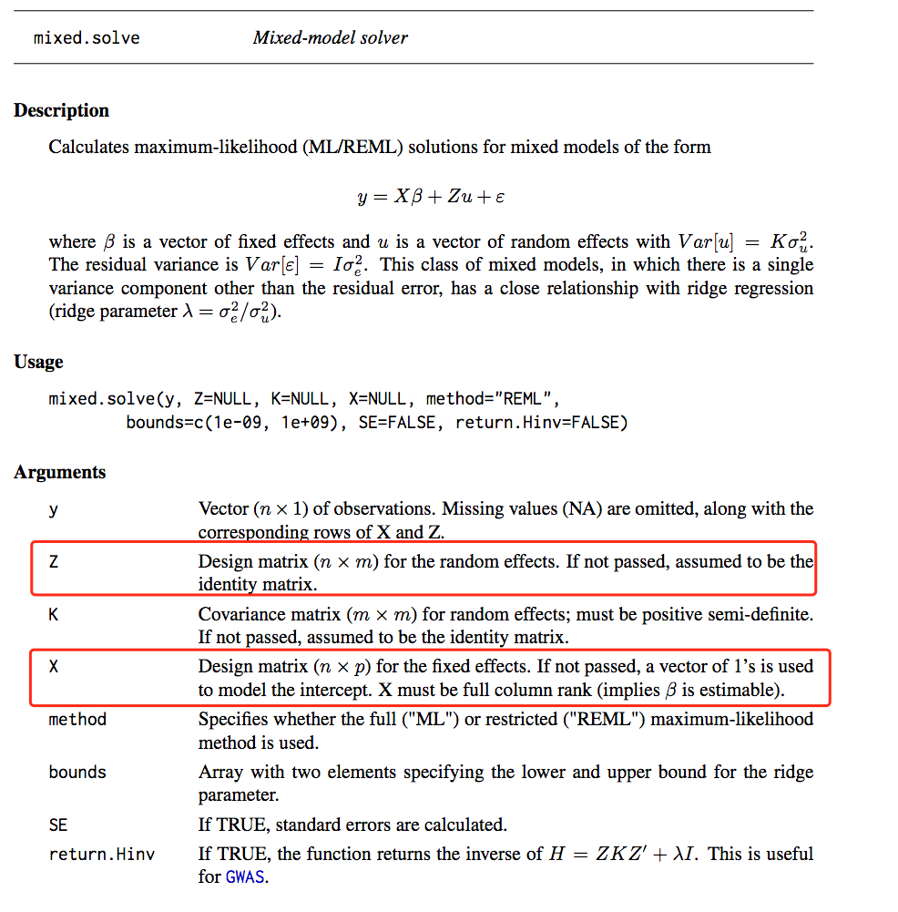
rrBLUP

Slide 6
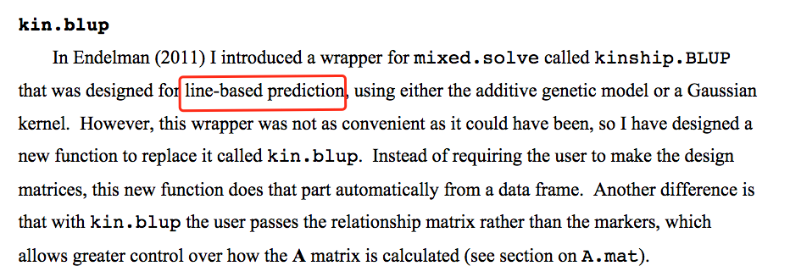
rrBLUP
https://potatobreeding.cals.wisc.edu/wp-content/uploads/sites/161/2014/01/GS_tutorial.pdf

