Slide 1
Lab 4: Impute
Crop545
Spring 2021

Slide 2
Agenda
1. Stochastic imputation with allele frequency
2. KNN
3. BEAGLE

Slide 3
1. Stochastic imputation with allele frequency
1.1 Data prepare
1.2 Stochastic imputation
1.3 Imputation Accuracy

Slide 4
1. Stochastic imputation with allele frequency
1.1 Data prepare
Set the missing values

Slide 5
1. Stochastic imputation with allele frequency
1.2 Stochastic imputation
In case of inbred with alleles A or B, the frequency of A is f(A). If x has uniform distribution U(0,1), then missing allele N can be imputed as

Slide 6
1. Stochastic imputation with allele frequency
1.3 Imputation Accuracy
#Impute
XI= StochasticImpute(X)
#Correlation
accuracy.r=cor(X.raw[index.m], XI[index.m])
#Proportion of match
index.match=X.raw==XI # get the index of SNPs that are correct
index.mm=index.match&index.m # get the index of imputed SNPs that are correct
accuracy.m=length(X[index.mm])/length(X[index.m]) #Proportion of match
accuracy.r
accuracy.m

Slide 7
2. KNN
2.1 Imputation packages installation
if (!requireNamespace("BiocManager", quietly = TRUE)) install.packages("BiocManager")
BiocManager::install("impute")
library(impute)

Slide 8
2. KNN
2.2 example

Slide 9
3. BEAGLE
3.1 Imputation packages installation
Java installation
https://www.oracle.com/java/technologies/javase-downloads.html
Download the BEAGLE
https://zzlab.net/StaGen/2021/Lab/Lab4/

Slide 10
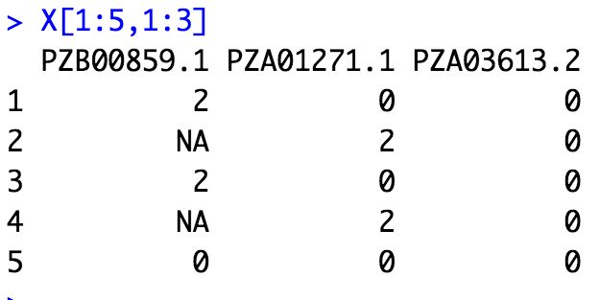
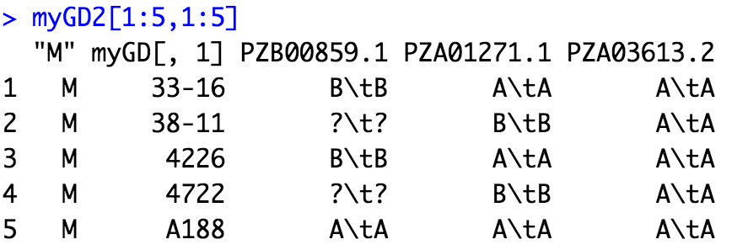
3. BEAGLE
3.2 example
Convert input format
Run BEAGLE
Convert output format

Slide 11
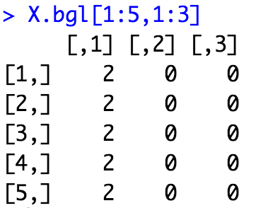
3. BEAGLE
3.2 example
Convert input format
Run BEAGLE
Convert output format
system("java -Xmx12g -jar /Users/ZhouTang/Documents/WSU_courses/2021_spring/545/2021/Lab/Lab4/lab4_imputation/beagle.jar unphased=test.bgl missing=? out=test1" )

