Slide 1
Lab 6: Power, type I error and False Discovery Rate
Crop545
Spring 2021

Slide 2
Power and False Discovery Rate
 | Prediction True | Prediction False
True | TP(true positive) | FN(false negative)
False | FP(false positive) | TN(true negative)
Power = TP/(TP+FN)
FDR = FP/(TP+FP)

Slide 3
 | Prediction True | Prediction False
True | TP (true positive) | FN (false negative)
False | FP (false positive) | TN (true negative)
TP/(TP+FN)
Power
vs
FDR: FP/(TP+FP)
Recall
vs
Precision: TP/(TP+FP)
Sensitivity
vs
Specificity: TN/(FP+TN)
True positive rate
vs
False positive rate: FP/(FP+TN)

Slide 4
Type I error and Type II error
 | H₀ is True | H₀ is False
Reject H₀ | Type I error | Correct conclusion
Fail to reject H₀ | Correct conclusion | Type II error

Slide 5
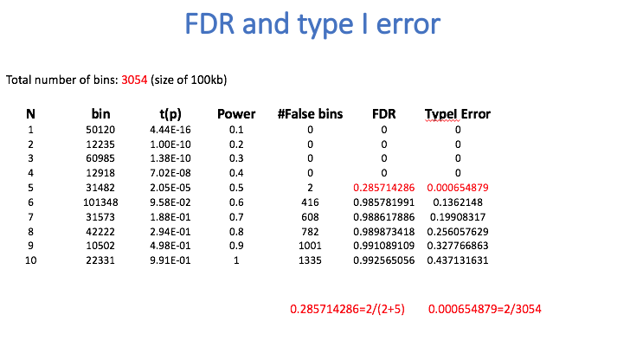
Case study

Slide 6
GAPIT Function for FDR and Type I error

