Slide 1
Lab 7: PCA and GLM
Crop545
Spring 2021

Slide 2
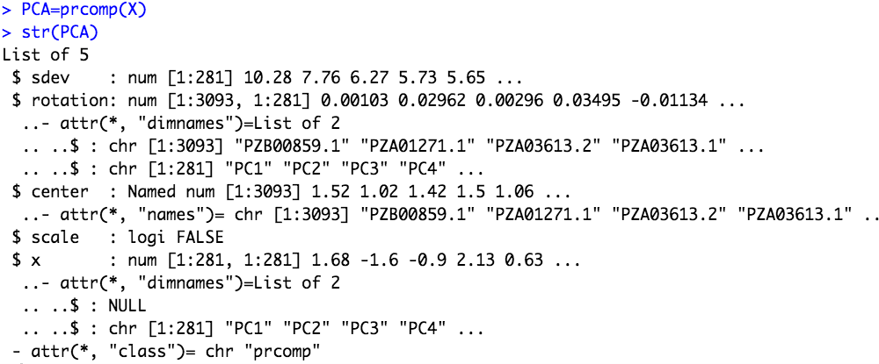
Q1: which list contains PCs which we can put in the GLM model?

Slide 3
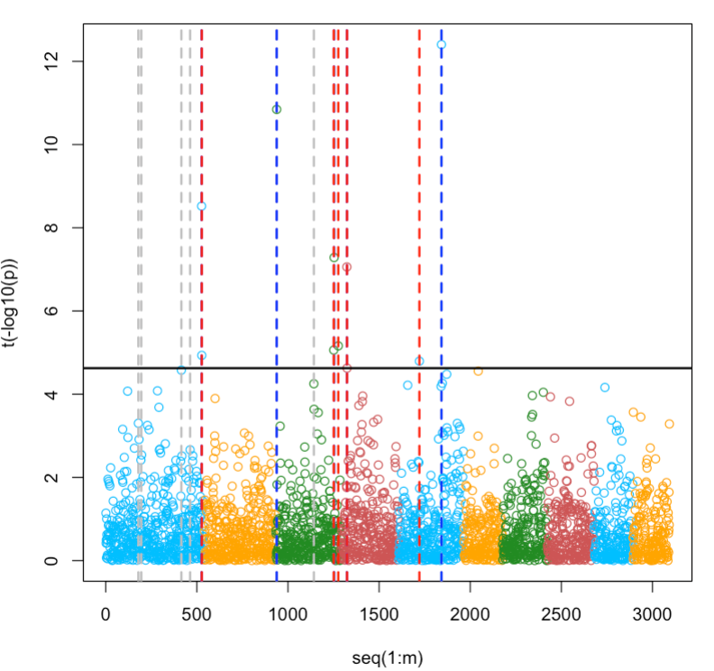
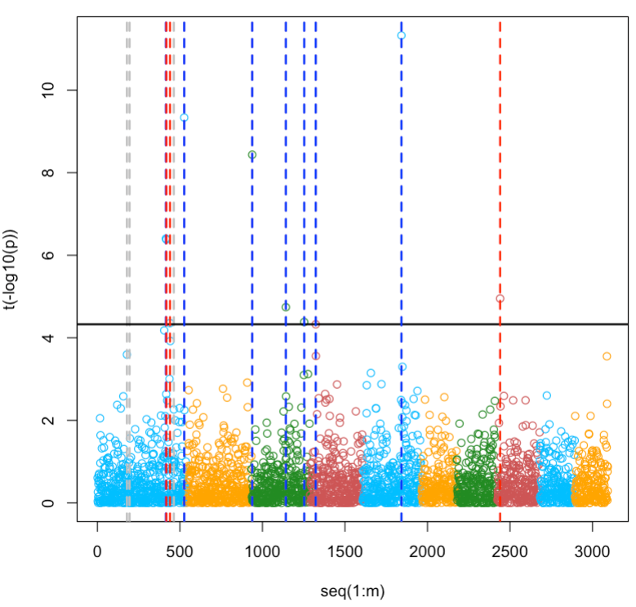
Manhattan plot
GWASbyCor
GLM with PC1:3

Slide 4
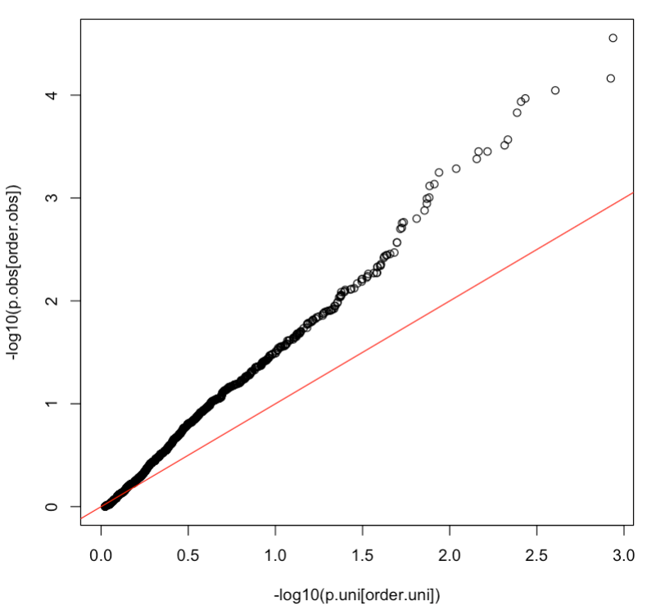
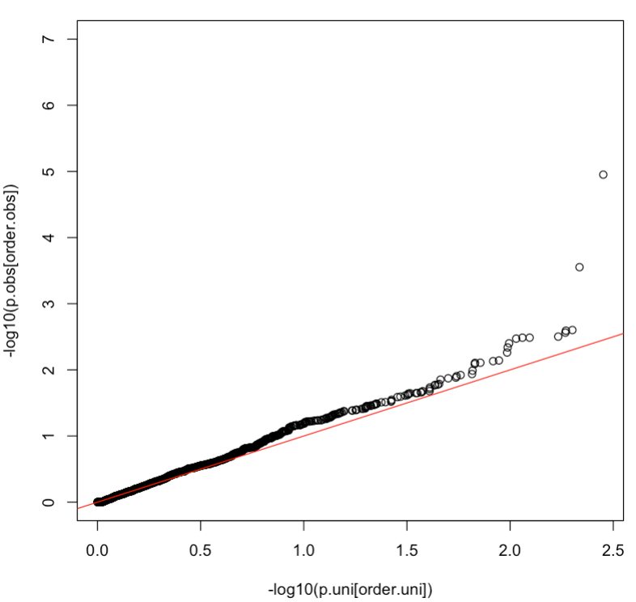
QQ plots
GWASbyCor
GLM with PC1:3
Q2: what else method can be used to compare these two models?

