Slide 1
Lab 8: Mixed Linear Model
&
Create your own R package
Crop545
Spring 2021

Slide 2
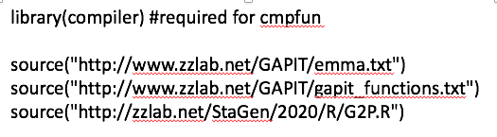
Q: Other way to source a file?

Slide 3
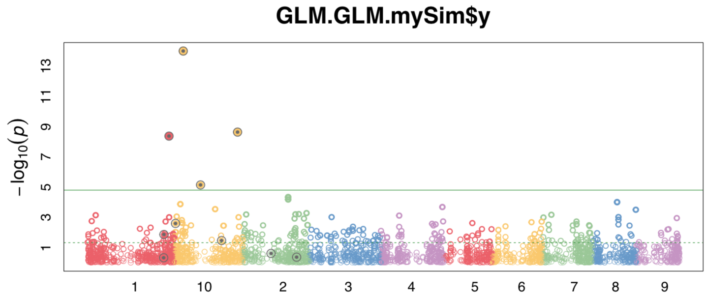
Q: what are these two horizontal lines? How to get them?

Slide 4
Demonstration 1:

Slide 5
Create your own package in RStudio
Demonstration 2:
install.packages("devtools")
devtools::has_devel()
install.packages("roxygen2")

Slide 6

Upload and Install package from github
Demonstration 3:
library(devtools)
install_github(”githubAccount/repositoryName")

Slide 7
Assignments
Create your own package
Create an account for github (https://github.com/)
Upload your R package into the github by using command line

