Slide 1
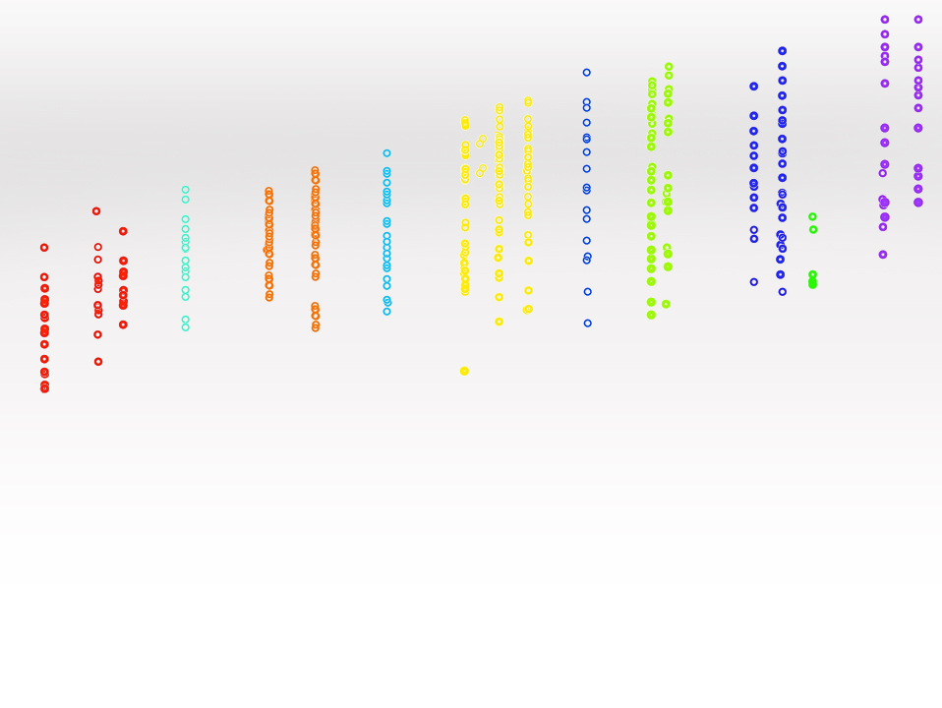
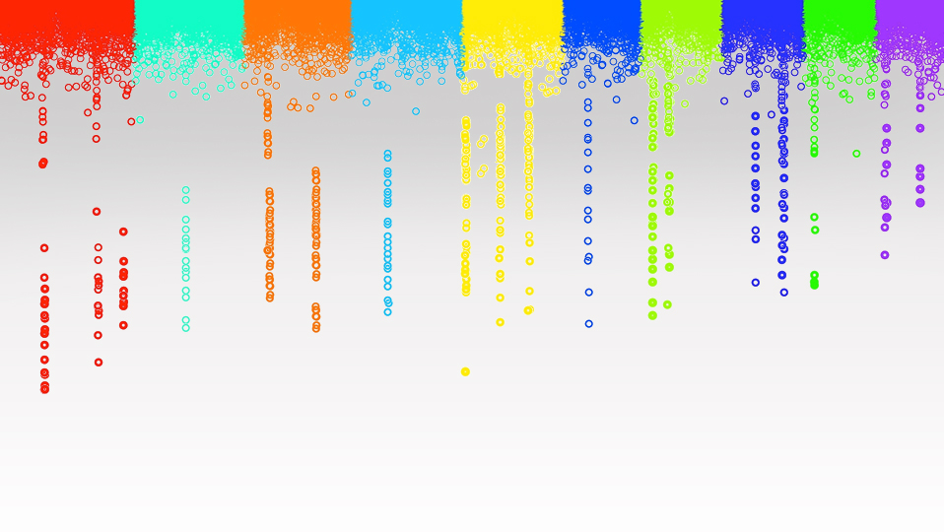
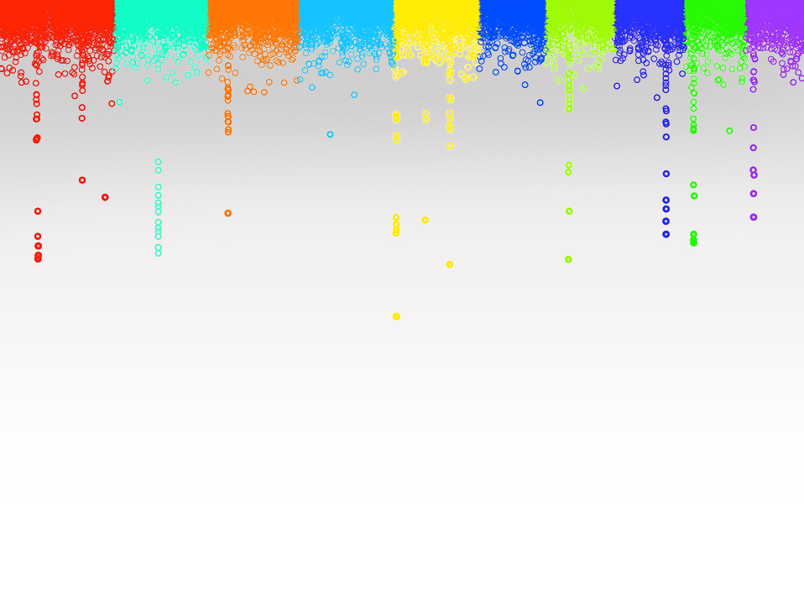
Statistical Genomics
GWAS and GS
Zhiwu Zhang
Washington State University

Slide 2
Outline
Self introduction
Syllabus
Course structure
Why this course

Slide 3
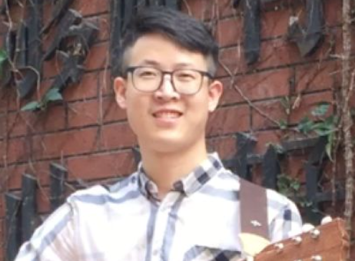
Teaching assistant
Zhou Tang
Email: zhou.tang@wsu.edu
Office: 130 Johnson hall
Phone: 509-335-4551
Graduate student in CSS
http://zzlab.net/zhoutang

Slide 4
Registered
First | Last | Email | Program | Plan | Subject
Aichatou | Djibo Waziri | a.djibowaziri@wsu.edu | Crop Science | Ph.D | CROP_SCI
Cristina D | Ocana Gallegos | c.ocanagallegos@wsu.edu | Crop Science | M.S. | CROP_SCI
Jonathan Thomas | Puglisi | jonathan.puglisi@wsu.edu | Plant Pathology | M.S. | CROP_SCI
June | Labbancz | june.labbancz@wsu.edu | Molecular Plant Sciences | Ph.D | CROP_SCI
Lindsey Mae | Kornowske | lindsey.kornowske@wsu.edu | Food Science | M.S. | HORT
Md Mahedi | Hasan | mdmahedi.hasan@wsu.edu | Statistical Science | Ph.D | CROP_SCI
Pabitra | Joshi | pabitra.joshi@wsu.edu | Univ Idaho Coop | Ph.D | UI
Richard | Manasseh | richard.manasseh@wsu.edu | Plant Pathology | Ph.D | PL_P
Shelby LaRue | Tisinai | shelby.tisinai@wsu.edu | Molecular Plant Sciences | Ph.D | CROP_SCI
Srijana | Shrestha | srijana.shrestha@wsu.edu | Horticulture | M.S. | HORT
Yao | Gao | yao.gao@wsu.edu | Animal Sciences | Ph.D | ANIM_SCI

Slide 5
Objectives
Knowledgeable (deep understanding)
Useful: (tools, analytical, research, jobs)
Reasoning and critical thinking
Fun: motivation through re-inventing or invention

Slide 6
Lectures and Labs
M&F (3:10-4:00): Lectures
W (3:10-5:40): Lab (R code in lectures and HW)

Slide 7
Grade options
Letter
S/U
Percentage | Letter
93%-100% | A
90%-93% | A-
87%-90% | B+
83%-87% | B
80%-83% | B-
77%-80% | C+
73%-77% | C
70%-73% | C-
66%-70% | D+
60%-66% | D
0%-60% | F
Satisfied
Unsatisfied

Slide 8
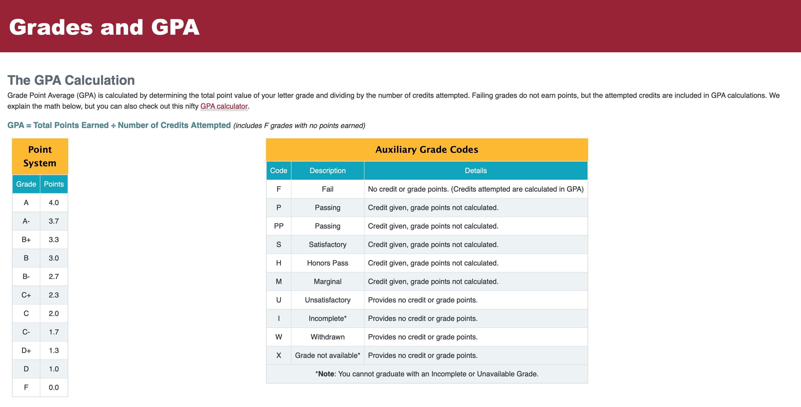
https://registrar.wsu.edu/grades-and-gpa

Slide 9
Grade components
Homework: 50%
Attendance: 5%
Participation: 5%
Pre-class quizzes: 10%
Midterm : 10%
Final exam: 20%

Slide 10
Homework
Assignments: Six in total
Due 3:10PM every other week, except break week and final
Submit RMD and Knit files, and data used by email to Instructor
Three Knit formats are acceptable: HTML, PDF, or Word
Late homework: half off per day.

Slide 11
Participation
Participation | Score
No question, no discussion | 0%
Question or discussion occasionally | 25%
Question actively | 50%
Discussion actively | 75%
Question AND discussion actively | 100%

Slide 12
Pre Class Quizzes
Watch pre-recorded lectures and prepare questions
Take quizzes
Email answers to TA before class begins
Quizzes questions will be online 24 hours before the class
Lecture time will focus on solving problems, interpretation, and discussion

Slide 13
Example of Pre Class Quizzes

Slide 14
Exams
Multiple choice: A, B, C and D (choose one only)
Question
Middle term: 25
Final: 50 (Accumulative)

Slide 15
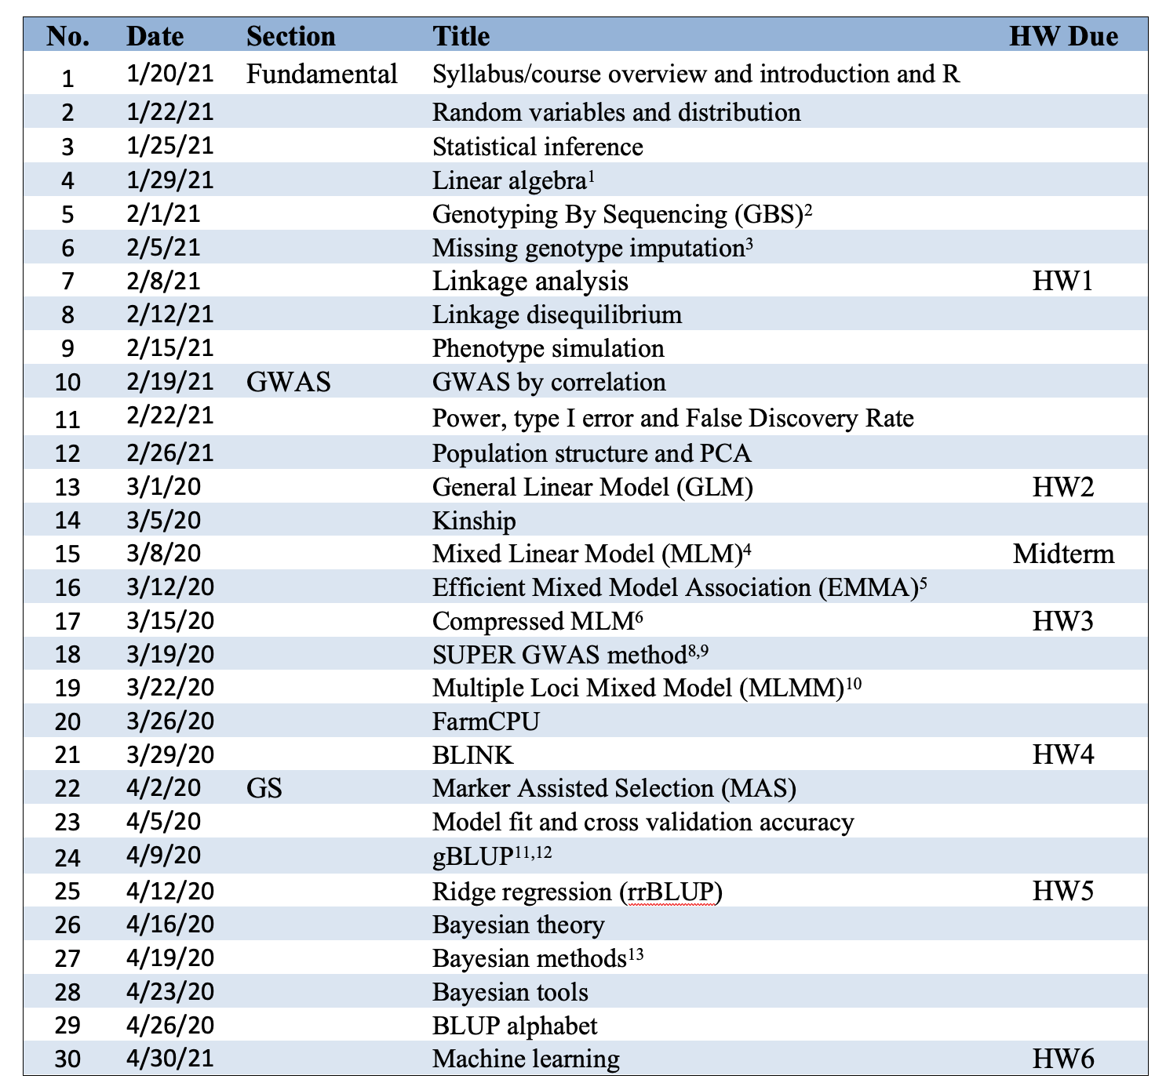
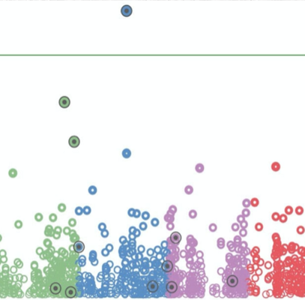
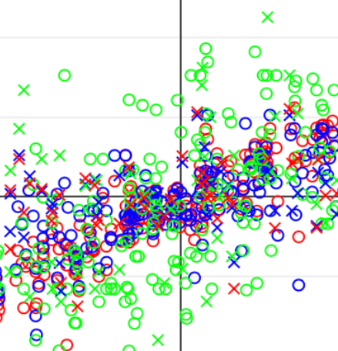
Lecture structure

Slide 16
Lecture time
Discussion on Quizzes
Questions and discussion
Recap the sections specified by students

Slide 17
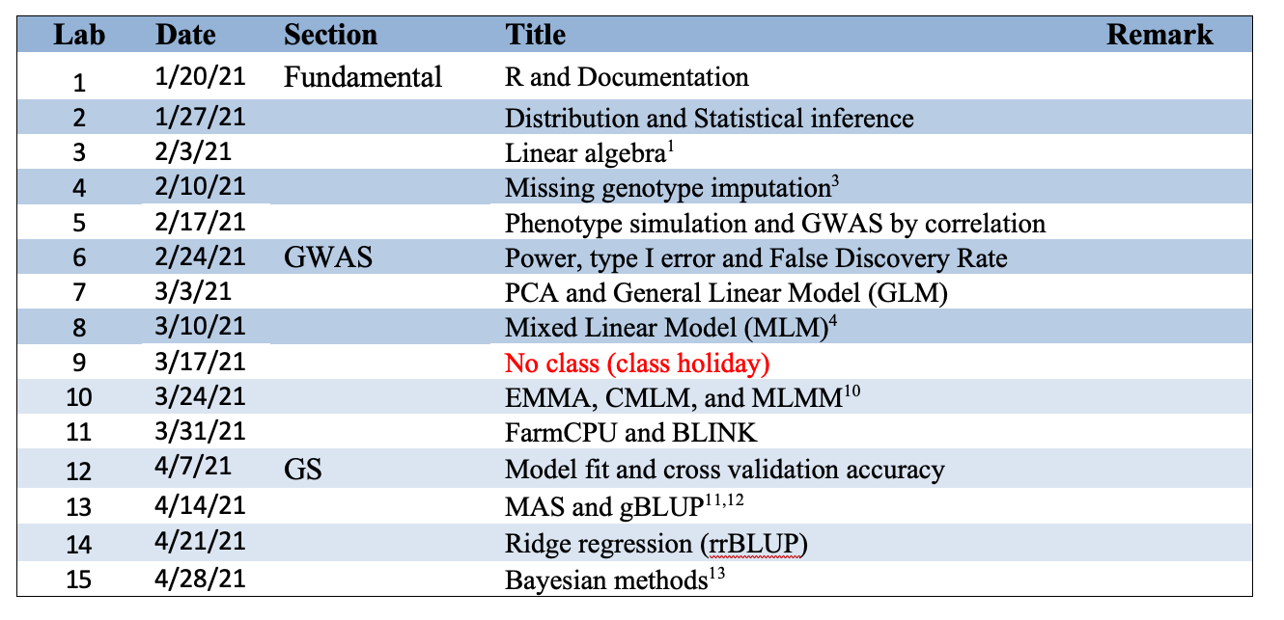
Lab structure
3:10-4:00 Assignment to interpret R code in lecture (TA)
4:10-5:00 Homework (Design, coding skills, and debug, TA)
5:10-5:40 General questions and discussion (Instructor)

Slide 18
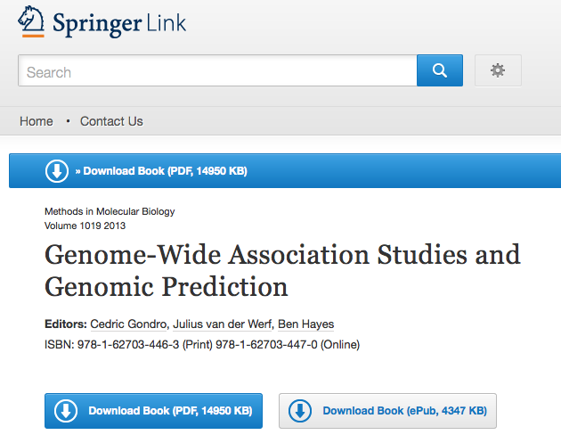
Text book
http://link.springer.com/book/10.1007%2F978-1-62703-447-0

Slide 19
Reference
1. Lynch, M. & Walsh, B. Genetics and analysis of quantitative traits. Genetics and analysis of quantitative traits. (1998).
2. Elshire, R. J. et al. A robust, simple genotyping-by-sequencing (GBS) approach for high diversity species. PLoS One 6, e19379 (2011).
3. Marchini, J. & Howie, B. Genotype imputation for genome-wide association studies. Nat Rev Genet 11, 499–511 (2010).
4. VanRaden, P. M. Efficient methods to compute genomic predictions. J Dairy Sci 91, 4414–4423 (2008).
5. Yu, J. et al. A unified mixed-model method for association mapping that accounts for multiple levels of relatedness. Nat. Genet. 38, 203–208 (2006).
6. Zhang, Z. et al. Mixed linear model approach adapted for genome-wide association studies. Nat Genet 42, 355–360 (2010).
7. Kang, H. M. et al. Efficient control of population structure in model organism association mapping. Genetics 178, 1709–1723 (2008).
8. Kang, H. M. et al. Variance component model to account for sample structure in genome-wide association studies. Nat Genet 42, 348–354 (2010).
9. Wang, Q., Tian, F., Pan, Y., Buckler, E. S. & Zhang, Z. A SUPER Powerful Method for Genome Wide Association Study. PLoS One 9, e107684 (2014).
10. Lippert, C. et al. FaST linear mixed models for genome-wide association studies. Nature Methods 8, 833–835 (2011).
11. Segura, V. et al. An efficient multi-locus mixed-model approach for genome-wide association studies in structured populations. Nature Genetics 44, 825–830 (2012).
12. Liu, X., Huang, M., Fan, B., Buckler, E. S. & Zhang, Z. Iterative Usage of Fixed and Random Effect Models for Powerful and Efficient Genome-Wide Association Studies. PLoS Genet. 12, e1005767 (2016).
13. Zhou, Y., Isabel Vales, M., Wang, A. & Zhang, Z. Systematic bias of correlation coefficient may explain negative accuracy of genomic prediction. Briefings Bioinforma. (2016).
14. Zhang, Z., Todhunter, R. J., Buckler, E. S. & Van Vleck, L. D. Technical note: Use of marker-based relationships with multiple-trait derivative-free restricted maximal likelihood. J. Anim. Sci. 85, 881–885 (2007).
15. Bernardo, R. Prediction of maize single-cross performance using RFLPs and information from related hybrids. Crop Sci. 34, 20–25 (1994).
16. Endelman, J. Ridge regression and other kernels for genomic selection in the R package rrBLUP. Plant Genome 4, 250–255 (2011).
17. Meuwissen, T. H., Hayes, B. J. & Goddard, M. E. Prediction of total genetic value using genome-wide dense marker maps. Genetics 157, 1819–1829 (2001).
18. Pérez, P., de los Campos, G., Crossa, J. & Gianola, D. Genomic-Enabled Prediction Based on Molecular Markers and Pedigree Using the Bayesian Linear Regression Package in R. Plant Genome J. 3, 106 (2010).

Slide 20
Feedback from previous class
Anonymous Feedback Form: https://forms.gle/ExUmS2vB94e3XXW1A
Homework
Increases weight
Reduces work load
Clarify rubrics
Revise questions for clarity
Define expectations
Exams
Reduces the weight on midterm
Make sure the questions are covered in the lectures or labs
Prerequisites
Add warning on multidiscipline (Genetics + Statistics + Computing)
R experience

Slide 21
Feedback from previous class
Lecture slides
Comments for R code
Add title for figures
Label axis on figures
Explicitly describe in text
Improve structure
Relate to industry
Define expectation
Textbook
The challenge is there is no textbook available
I wrote two reviews for GWAS and GS to partially solve the problem.
GAPIT
Comments R code and describe functions
GAPIT team developed new manuscript (GAPIT Version 3) to document GAPIT functions
Others
Create an abbreviation list
Method summary on GWAS and GS

Slide 22
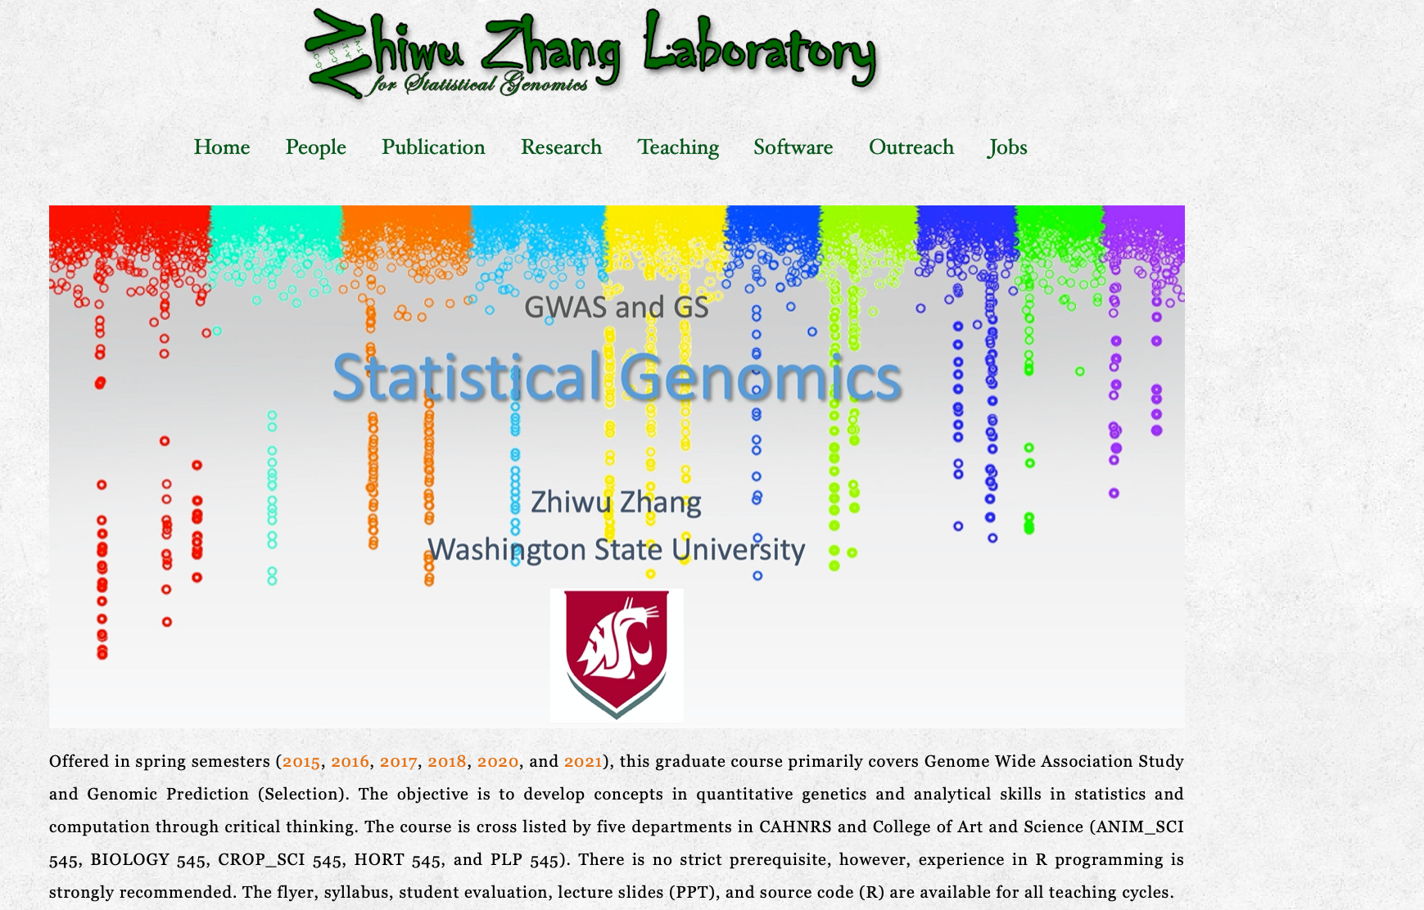
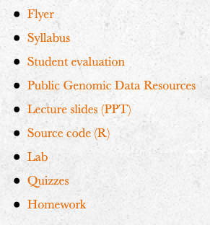
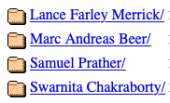
http://zzlab.net
Learn from others and do by yourself!

Slide 23
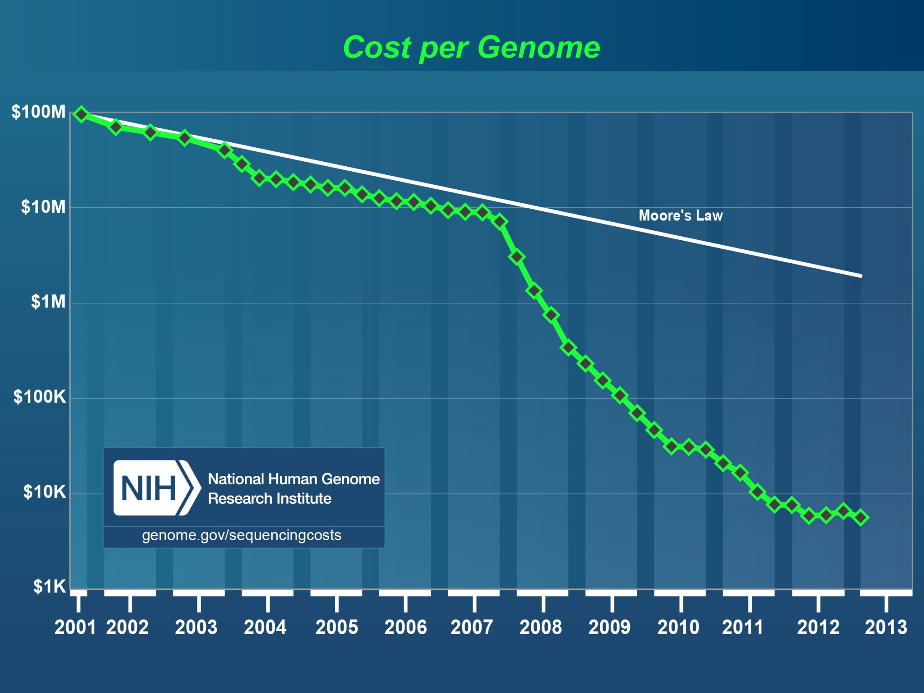
Human
genome
2nd
Generation Sequencing
http://luckyrobot.com/wp-content/uploads/2013/04/nih-cost-genome.jpg

Slide 24
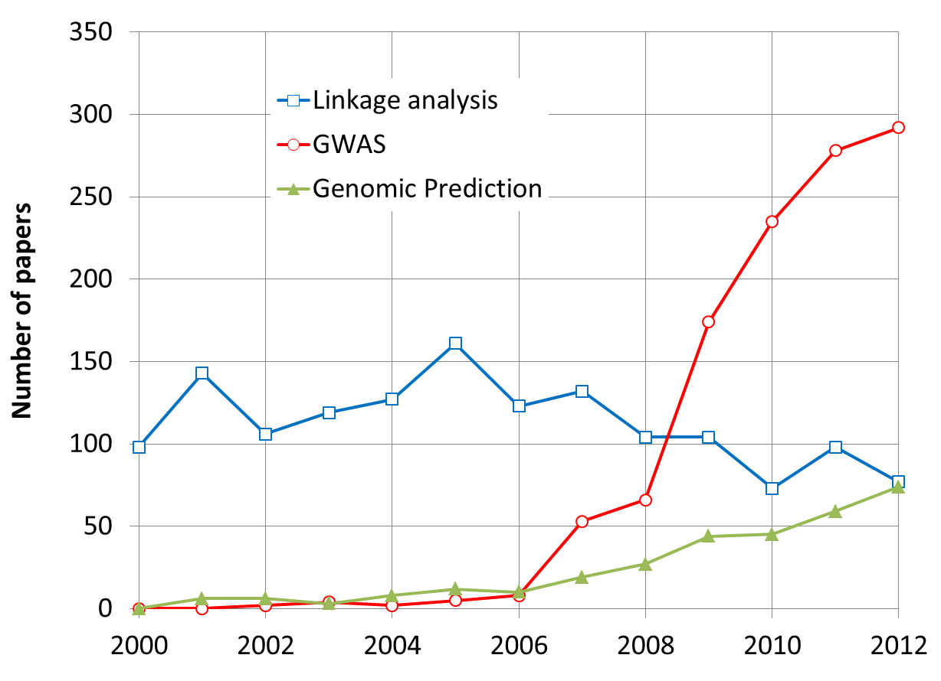
More Research on GWAS and GS
By May 31, 2013

Slide 25
Problems in GWAS
Computing difficulties: millions of markers, individuals, and traits
False positives, ex: “Amgen scientists tried to replicate 53 high-profile cancer research findings, but could only replicate 6”, Nature, 2012, 483: 531
False negatives

Slide 26
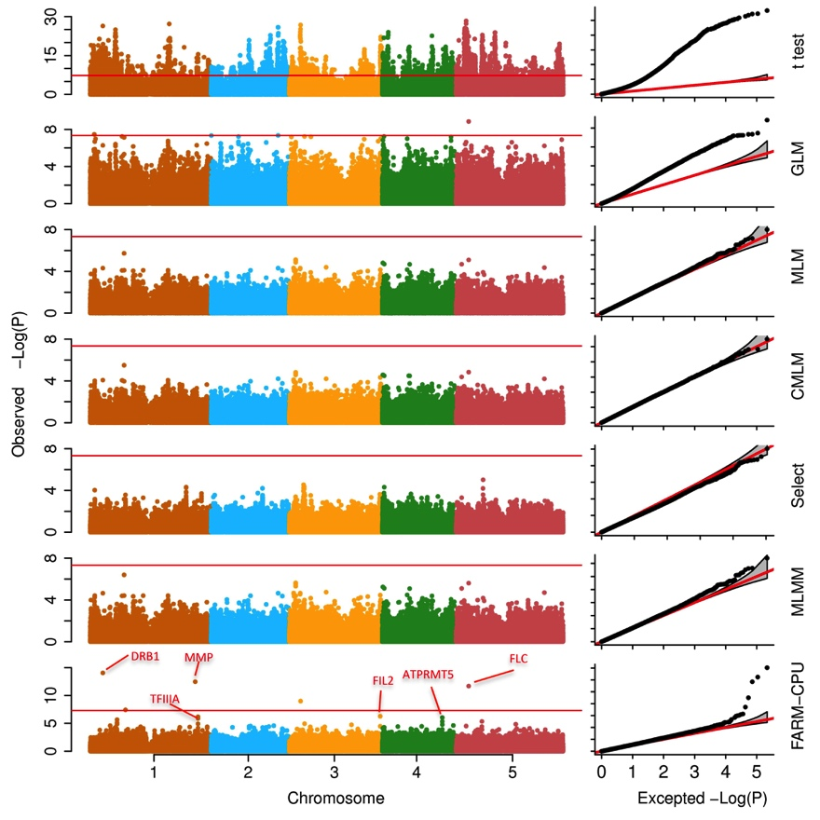
Associations on flowering time

Slide 27
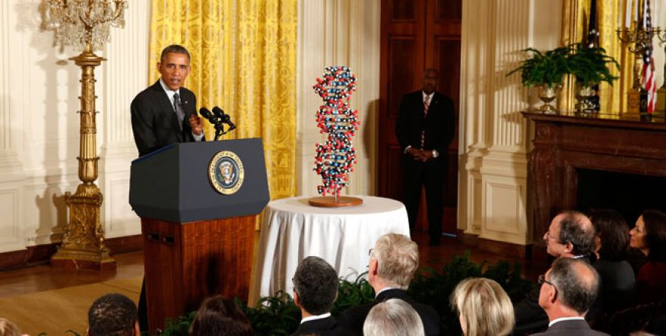
The Precision Medicine Imitative (2015)
250 Million dollars investment in 2016

Slide 28
Dosage variation among individuals

Slide 29
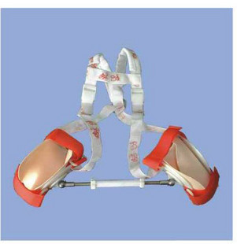
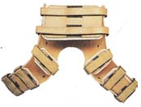
Preventive medical treatment

Slide 30
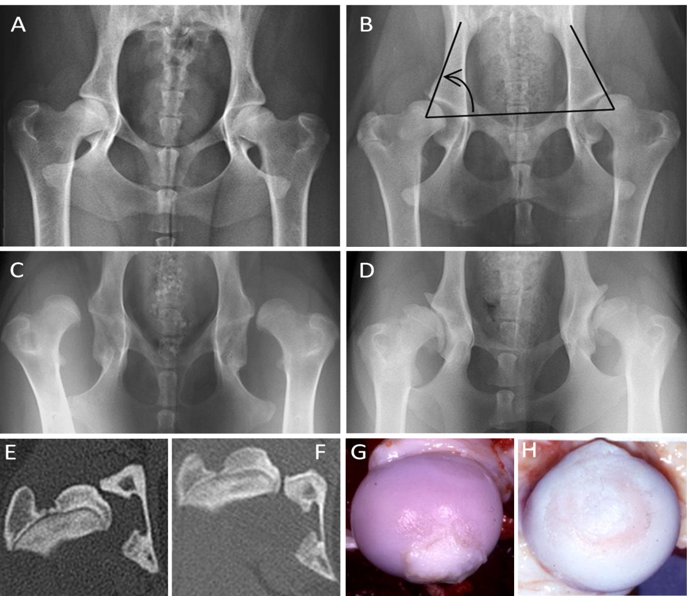
Canine Hip Dysplasia is predictive

Slide 31
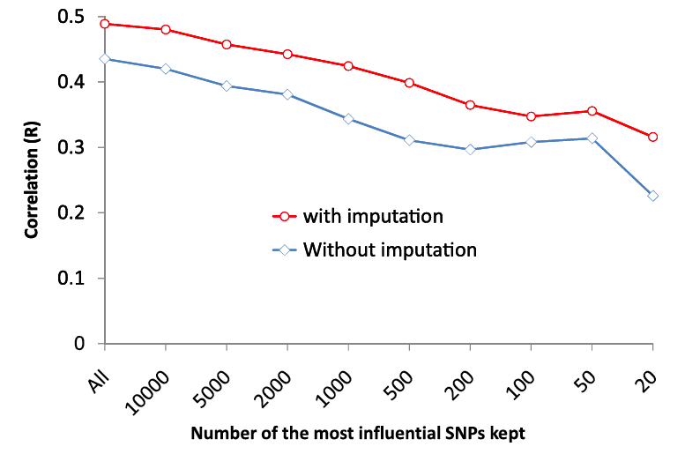
Canine hip dysplasia is predictable

Slide 32
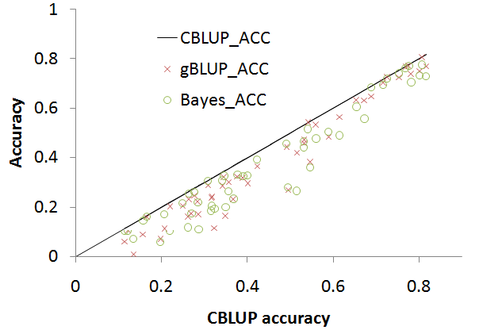
Genomic prediction

Slide 33
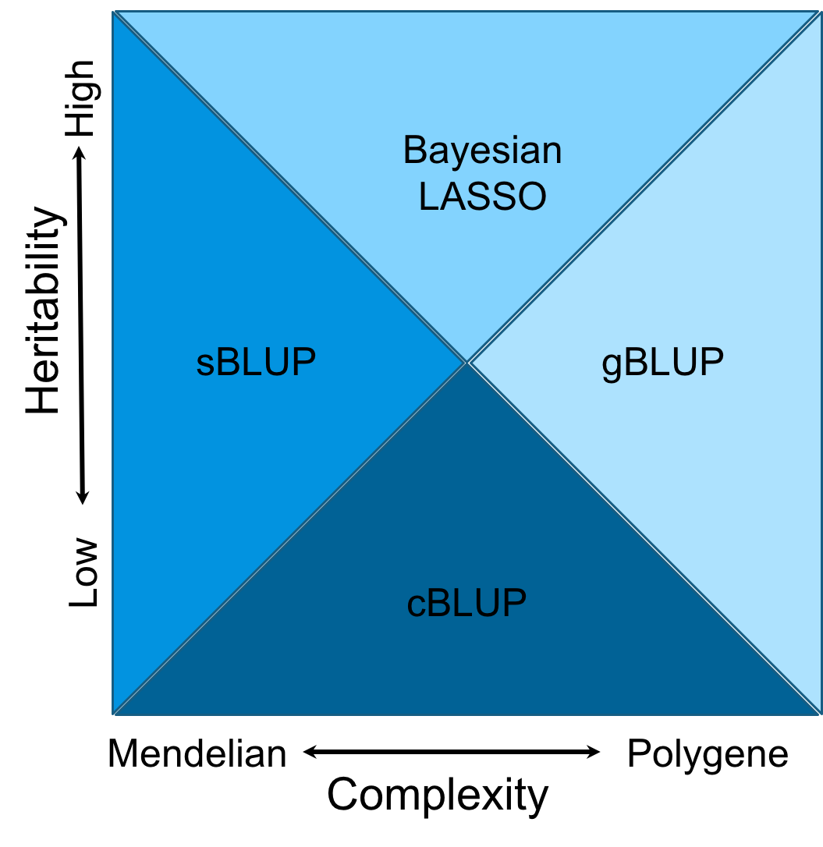
Domains
Notes:
Figure 6.The cost time of computing genomic prediction in three method.
Bayesion method (green) cost most time than other methods, and gBLUP (blue) is the least. The cost time of scBLUP (orange) computing genomic prediction depend on the number of individuals of population (compression) and the number of markers (SUPER). The computing time is calculated by CPU computing time.

Slide 34
Highlight
Syllabus
Course structure
Why this course

