Slide 1


Statistical Genomics
Lecture 9: Linkage Disequilibrium
Zhiwu Zhang
Washington State University

Slide 2
Outline
Hardy-Weinberg principle
LD measurements
  D
  D’
  R2
  Causes of LD
LD decay

Slide 3
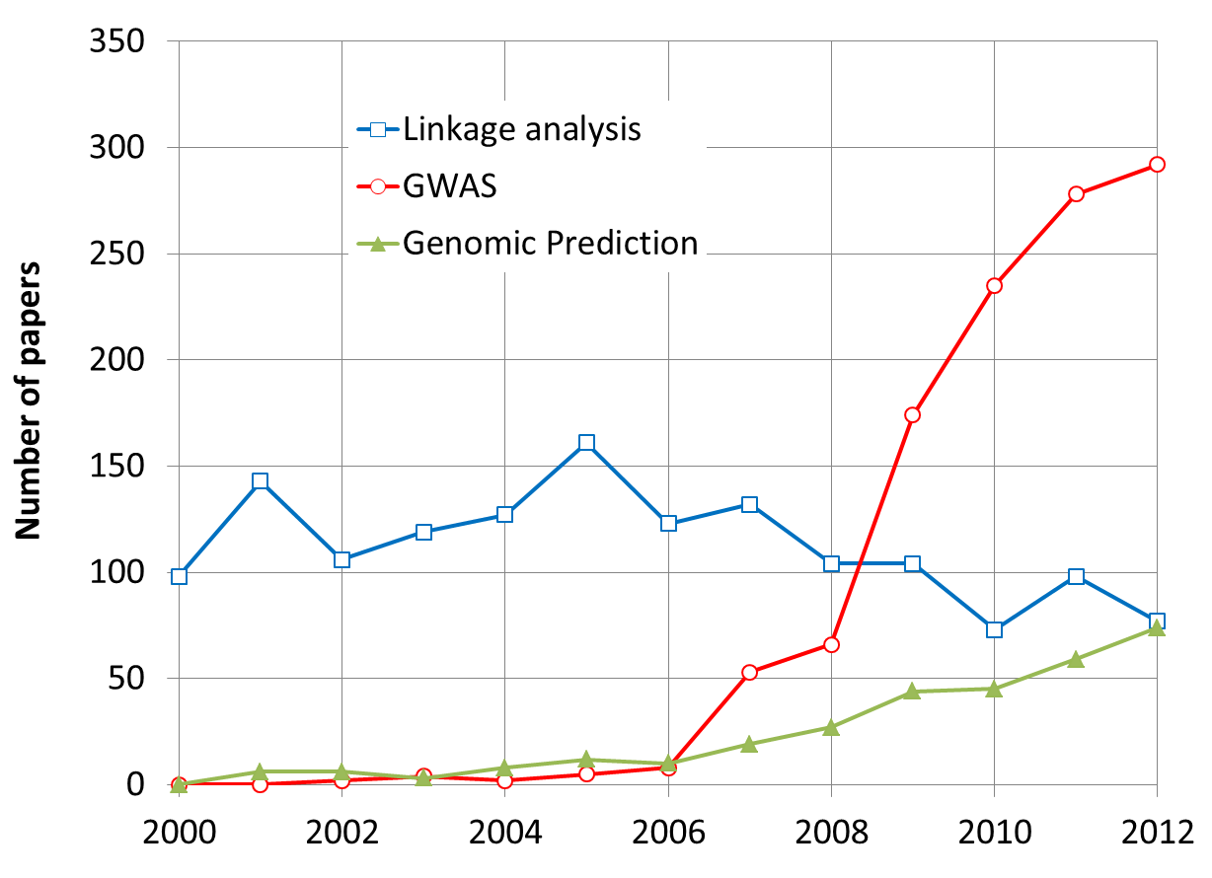
By May 31, 2013

Slide 4
Association analysis
Marker | AA | aa | SUM
Herbicide Resistant (BB) | 35 | 5 | 40
Non herbicide Resistant (bb) | 35 | 25 | 60
SUM | 70 | 30 | 100
Observed
Marker | AA | aa | SUM
Herbicide Resistant (BB) | 28 | 12 | 40
Non herbicide Resistant (bb) | 42 | 18 | 60
SUM | 70 | 30 | 100
Expected
49/28+49/12+49/42+49/18=9.72
1-pchisq(9.72,1)
0.0018

Slide 5
The Hardy–Weinberg (HD) principle
Allele and genotype frequencies in a population will remain constant from generation to generation in the absence of other evolutionary influences.
These influences include non-random mating, mutation, selection, genetic drift, gene flow and meiotic drive.
Allele frequency: f(A)=p, f(a)=q
Genotype frequency: f(AA)=p², f(aa)=q², f(Aa)=2pq
Both allele and genotype frequency remain unchanged: Hardy-Weinberg equilibrium

Slide 6
HD principle for two loci
First locus: A and a alleles; Second locus: B and b alleles
Allele frequency: P_{A}+P_{a} = 1, P_{B}+P_{b}=1
Haplotype frequency: P_{AB}=P_{A}P_{B}, P_{ab}=P_{a}P_{b}, so on so forth
Haplotype frequency reaches the equilibrium stage with one generation of random matting if the two loci are on different chromosomes
It takes multiple generation to reach the the equilibrium stage if the two loci are on the same chromosome
It takes more generation to move out the linkage disequilibrium stage with lower recombination rate between the two loci

Slide 7
Linkage equilibrium and Disequilibrium
Linkage equilibrium: haplotype frequencies in a population have the same value that they would have if the genes at each locus were combined at random.
Linkage disequilibrium: Non-random association of alleles at different loci in a given population

Slide 8
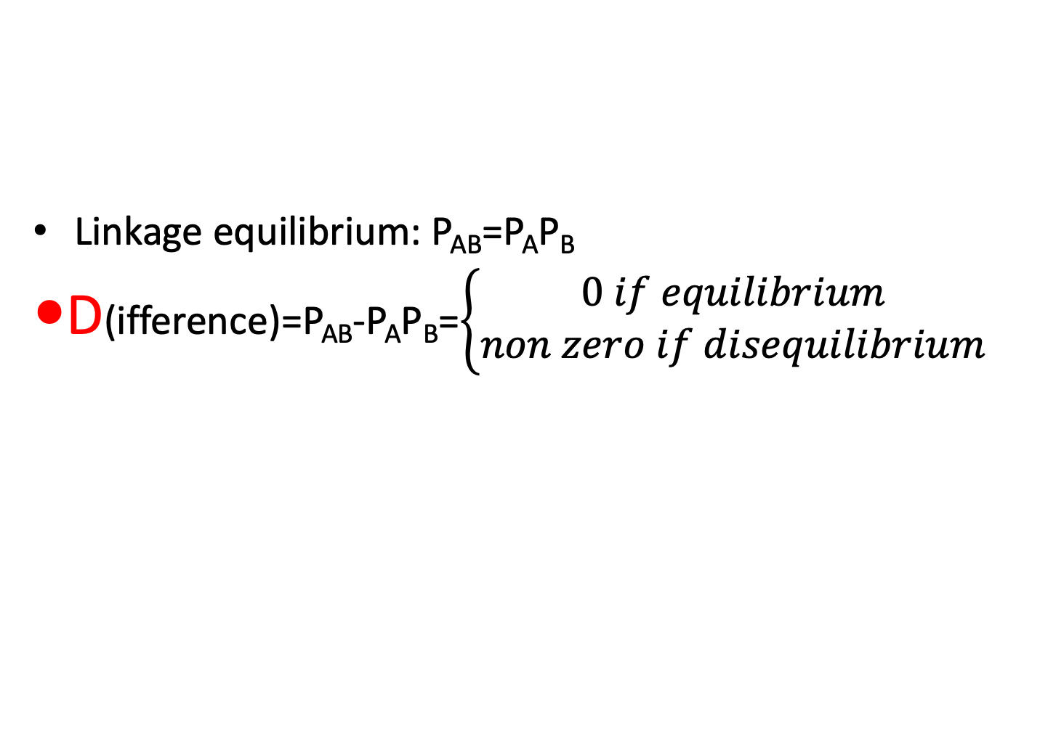
Linkage Disequilibrium Quantification
Linkage equilibrium: P_{AB}=P_{A}P_{B}
D(ifference)=P_{AB}-P_{A}P_{B}=$\left\{\begin{aligned}0 if equilibrium \\ non zero if disequilibrium\end{aligned}\right.$

Slide 9
Linkage Disequilibrium (LD)
Loci and allele | A | a | B | b
Frequency | .6 | .4 | .7 | .3
Gametic type | AB | Ab | aB | ab
Observed | 0.5 | 0.1 | 0.2 | 0.2
Frequency equilibrium | 0.42 | 0.18 | 0.28 | 0.12
Difference | 0.08 | -0.08 | -0.08 | 0.08
D = P_{AB}-P_{A}P_{B} =P_{ab}-P_{a}P_{b}
=-(P_{Ab}-P_{A}P_{b)} =-(P_{aB}-P_{a}P_{B} )

Slide 10
Lemma
D=P_{AB}P_{ab}-P_{Ab}P_{aB}
Proof
(1): P_{AB}P_{ab}=(P_{A}P_{B}+D) (P_{a}P_{b}+D)= P_{A}P_{B} P_{a}P_{b} + P_{A}P_{B} D + P_{a}P_{b} D + D²
(2): P_{Ab}P_{aB}=(P_{A}P_{b}-D) (P_{a}P_{B}-D)= P_{A}P_{b} P_{a}P_{B} - P_{A}P_{b} D - P_{a}P_{B} D + D²
Subtracting (2) from (1): P_{AB}P_{ab}-P_{Ab}P_{aB}=D(P_{A}P_{B} + P_{a}P_{b} + P_{A}P_{b} + P_{a}P_{B} )=D

Slide 11
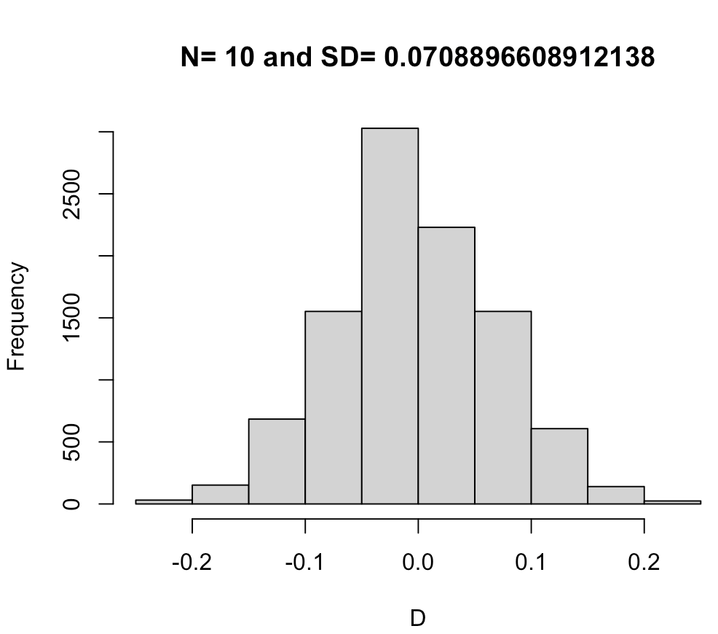
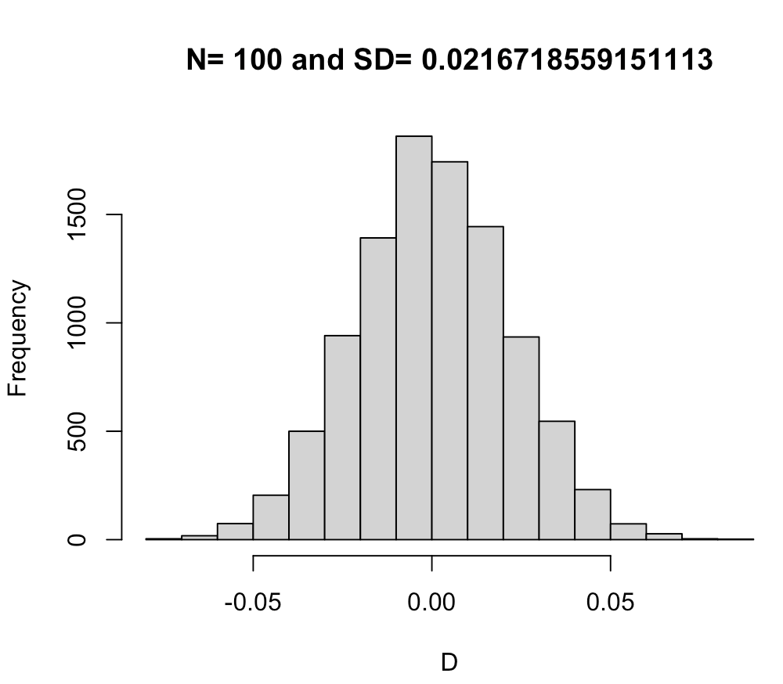
Distribution of D depends on sample size
n=10000
N=10
PA=.5
PB=.5
x11=rbinom(n,N,PA*PB)
x12=rbinom(n,N,PA*(1-PB))
x21=rbinom(n,N,(1-PA)*PB)
x22=rbinom(n,N,(1-PA)*(1-PB))
P=x11+x12+x21+x22
P1=(x11+x12)/P
P2=(x11+x21)/P
D=x11/P-P1*P2
hist(D,main = paste("N=", N, "and SD=",sd(D)))

Slide 12
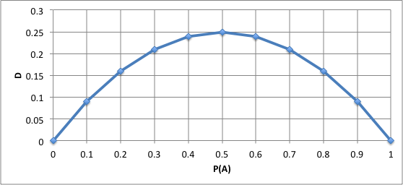
D depends on allele frequency
Vary even with complete LD
P_{Ab}=P_{aB}=0
P_{AB}=1-P_{ab}=P_{A}=P_{B}
D=P_{A}-P_{A}P_{A}

Slide 13
Property of D
Deviation between observed and expected
Extreme values: -0.25 and 0.25
Non LD (equilibrium): D=0
Dependency on allele frequency

Slide 14
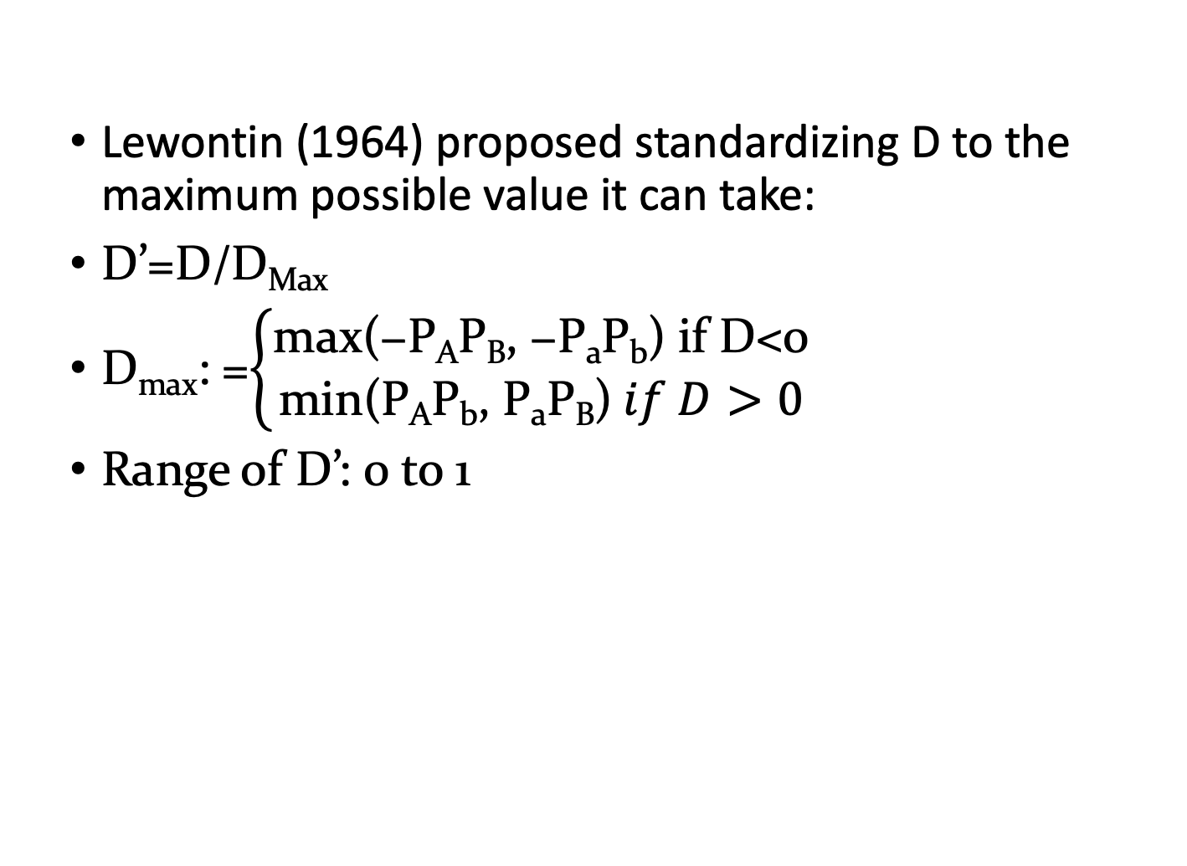
Modification of D: D’
Lewontin (1964) proposed standardizing D to the maximum possible value it can take:
D’=D/D_{Max}
D_{max}: =$\left\{\begin{aligned}\text{m}\text{ax}\text{(}\text{−}\text{P}\text{A}\text{P}\text{B}\text{, }\text{−}\text{P}\text{a}\text{P}\text{b}\text{)} \text{if} \text{D}\text{<0} \\ \text{min}\text{(}\text{PAPb}\text{, }\text{PaPB}\text{)} if D>0\end{aligned}\right.$
Range of D’: 0 to 1

Slide 15
Example
Loci and allele | A | a | B | b
Frequency | .6 | .4 | .7 | .3
Gametic type | AB | Ab | aB | ab
Observed | 0.5 | 0.1 | 0.2 | 0.2
Frequency equilibrium | 0.42 | 0.18 | 0.28 | 0.12
Difference | 0.08 | -0.08 | -0.08 | 0.08
D =P_{AB}-P_{A}P_{B} = 0.08
D_{max}=min (P_{A}P_{b}, P_{a}P_{B})
=min(.6x.3, .4x.7)
=0.18
D’=D/D_{max}=0.08/0.18=0.44

Slide 16
Example (switch A and a)
Loci and allele | a | A | B | b
Frequency | .6 | .4 | .7 | .3
Gametic type | aB | ab | AB | Ab
Observed | 0.5 | 0.1 | 0.2 | 0.2
Frequency equilibrium | 0.42 | 0.18 | 0.28 | 0.12
Difference | 0.08 | -0.08 | -0.08 | 0.08
D =P_{AB}-P_{A}P_{B} = -0.08
D_{max}=max (-P_{A}P_{B}, -P_{a}P_{b})
=max(-.4x.7, -.6x.3)
=-0.18
D’=D/D_{max}=-0.08/-0.18=0.44

Slide 17
R²
Hill and Robertson (1968) proposed the following measure of linkage disequilibrium:
r² (Δ²)=D²/(P_{A}P_{B}P_{a}P_{b})
Square makes positive
The product of allele frequency creates penalty for 50% allele frequency.
Range: 0 to 1

Slide 18
Summary of LD statistics
 | P values | D | D’ | R²
Definition | Statistical test (e.g. X²) | P_{AB}-P_{A}P_{B} | D/D_{Max} | D²/(P_{A}P_{B}P_{a}P_{b})
Value at equilibrium | 1 | 0 | 0 | 0
Value at complete LD | 0 | -0.25 or 0.25 | 1 | 1
Disadvantage |  | Dependency on allele frequency |  | Penalty on neutral loci

Slide 19
Causes of LD
Linkage
Mutation
Selection
Inbreeding
Genetic drift
Gene flow/admixture
True association
Spurious association

Slide 20
Mutation and selection
mutation
A____Q
Generation 1
A____q
A____q
A____q
A____q
A____q
A____q
Generation 2
A____q
A____Q
Selection
A____Q
A____q
A____q
A____q
Generation 3
A____Q
A____Q
Selection
A____Q
A____q
A____Q
A____q

Slide 21
Change in D over time
c: recombination rate
D_{t}=D₀(1-c)^{t}
t=log(D_{t}/D₀)/log(1-c)
if c=10%, it takes 6.5 generation for D to be cut in half
1Mb=1cM,
if two SNPs 100kb apart,
c=1% / 10 = 0.001
It takes 693 generations for D to be cut in half

Slide 22
Change in D over time
c=.01
c=.05
c=.1
c=.25

Slide 23
Human out of Africa
https://arstechnica.com/science/2015/12/the-human-migration-out-of-africa-left-its-mark-in-mutations/

Slide 24
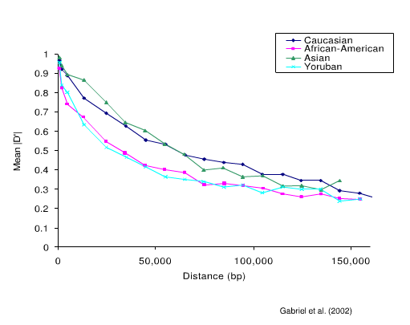
LD decay over distance

Slide 25
HW equilibrium, Linkage equilibrium and Linkage disequilibrium
HWE
LE
LD
Single locus
P_{AA}=P²
LD Decay
Multiple locus
P_{AB}=P_{A}P_{B}
P_{AB}=P_{A}P_{B}
P_{AB}!=P_{A}P_{B}
Association
Same chromosome
different chromosome

Slide 26
Highlight
Trait-marker association
Hardy-Weinberg principle
Linkage an recombination
LD measurements
  D
  D’
  R2
  Causes of LD
LD decay

