Slide 1


Statistical Genomics
Lecture 10: GWAS by Correlation
Zhiwu Zhang
Washington State University

Slide 2
Outline
Correlation and t distribution
GWAS by correlation
Power and false positives
Observed null distribution
True positives
False positives
Type I error
Cut off of P values

Slide 3
Observed and expected frequency
 | AA | TT | SUM
Herbicide Resistant | 35 | 5 | 40
Non herbicide Resistant | 35 | 25 | 60
SUM | 70 | 30 | 100
 | AA | TT | SUM
Herbicide Resistant | 28 | 12 | 40
Non herbicide Resistant | 42 | 18 | 60
SUM | 70 | 30 | 100
49/28+49/12+49/42+49/18=9.72, P=0.002

Slide 4
Observed and expected frequency
 | AA | TT | SUM
Herbicide Resistant | 35 | 5 | 40
Non herbicide Resistant | 35 | 25 | 60
SUM | 70 | 30 | 100
Herbcide | Marker | Count
1 | 2 | 35
1 | 0 | 5
0 | 2 | 35
0 | 0 | 25
r=31%

Slide 5
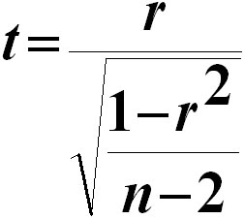
Pearson Correlation
Suitable for continued variables
r=Cov(x,y)/(SxSy)
Range from -1 to 1
t=3.2278
p=0.0017 (vs. 0.002 from Chi-square test)

Slide 6
Approximation of t distribution
cort=function(n=10000,df=100){
z=replicate(n,{
x=rnorm(df+2)
y=rnorm(df+2)
r=cor(x,y)
t=r/sqrt((1-r^2)/(df))
})
return(z)}
x=cort(10000,5)
t=rt(100000,5)
plot(density(x),col="blue")
lines(density(t),col="red")

Slide 7
Influence of DF
par(mfrow=c(3,1))
df=1
x=cort(10000,df)
t=rt(100000,df)
plot(density(x),col="blue")
lines(density(t),col="red")
df=3
x=cort(10000,df)
t=rt(100000,df)
plot(density(x),col="blue")
lines(density(t),col="red")
df=5
x=cort(10000,df)
t=rt(100000,df)
plot(density(x),col="blue")
lines(density(t),col="red")

Slide 8
Can we use correlation to map genes?
Try it
Sample ten SNPs as QTNs (mutations of genes)
Assign gene effects and make total genetic effects
Add residuals to make phenotypes with 75% heritability
Test all the SNPs and see how many can be found among the top ten associations.

Slide 9
G2P=function(X,h2,alpha,NQTN,distribution){
n=nrow(X)
m=ncol(X)
#Sampling QTN
QTN.position=sample(m,NQTN,replace=F)
SNPQ=as.matrix(X[,QTN.position])
QTN.position
#QTN effects
if(distribution=="norm")
{addeffect=rnorm(NQTN,0,1)
}else
{addeffect=alpha^(1:NQTN)}
#Simulate phenotype
effect=SNPQ%*%addeffect
effectvar=var(effect)
residualvar=(effectvar-h2*effectvar)/h2
residual=rnorm(n,0,sqrt(residualvar))
y=effect+residual
return(list(addeffect = addeffect, y=y, add = effect, residual = residual, QTN.position=QTN.position, SNPQ=SNPQ))
}

Slide 10
Read data and source code in R
myGD=read.table(file="http://zzlab.net/GAPIT/data/mdp_numeric.txt",head=T)
myGM=read.table(file="http://zzlab.net/GAPIT/data/mdp_SNP_information.txt",head=T)
source("http://zzlab.net/StaGen/2020/R/G2P.R")

Slide 11
Let us have more fun!
Have the ten genes on chromosome 1-5 only, nothing on 6 to 10.
Any associations on chromosome 6-10 should be false positives
X=myGD[,-1]
index1to5=myGM[,2]<6
X1to5 = X[,index1to5]

Slide 12
Phenotype simulation
set.seed(99164)
mySim=G2P(X= X1to5,h2=.75,alpha=1,NQTN=10,distribution="normal")
str(mySim)
List of 6
$ addeffect : num [1:10] -0.622 -1.212 -2.064 0.99 -0.418 ...
$ y : num [1:281, 1] -1.37 -6.02 -1.11 -1.02 -5.52 ...
$ add : num [1:281, 1] -2.419 -4.763 -2.519 -0.546 -2.782 ...
$ residual : num [1:281] 1.045 -1.258 1.414 -0.477 -2.733 ...
$ QTN.position: int [1:10] 687 1060 320 1927 992 698 587 92 204 1306
$ SNPQ : int [1:281, 1:10] 0 0 2 0 0 0 0 0 0 0 ...
..- attr(*, "dimnames")=List of 2
.. ..$ : NULL
.. ..$ : chr [1:10] "PZA00730.2" "PZA00363.6" "PHM15871.11" "PZB02189.1" ...

Slide 13
QTN positions
plot(myGM[,c(2,3)])
lines(myGM[mySim$QTN.position,c(2,3)],type="p",col="red")
points(myGM[mySim$QTN.position,c(2,3)],type="p",col="blue",cex = 5)

Slide 14
Association test by correlation
r=cor(mySim$y,X)
n=nrow(X)
t=r/sqrt((1-r^2)/(n-2))
p=2*(1-pt(abs(t),n-2))

Slide 15
Manhattan plots
color.vector <- rep(c("deepskyblue","orange","forestgreen","indianred3"),10)
m=ncol(X)
plot(t(-log10(p))~seq(1:m),col=color.vector[myGM[,2]])
abline(v=mySim$QTN.position, lty = 2, lwd=1.5, col = "black")

Slide 16
Two additional findings
sort(p)[1:5]
zeros=p==0
p[zeros]=1e-10
plot(t(-log10(p))~seq(1:m),col=color.vector[myGM[,2]])
abline(v=mySim$QTN.position, lty = 2, lwd=1.5, col = "black")

Slide 17
GWAS by correlation
GWASbyCor=function(X,y){
n=nrow(X)
r=cor(y,X)
n=nrow(X)
t=r/sqrt((1-r^2)/(n-2))
p=2*(1-pt(abs(t),n-2))
zeros=p==0
p[zeros]=1e-10
return(p)}
source("http://zzlab.net/StaGen/2020/R/GWASbyCor.R")

Slide 18
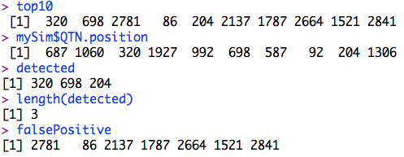
The top ten associations
index=order(p)
top10=index[1:10]
detected=intersect(top10,mySim$QTN.position)
falsePositive=setdiff(top10, mySim$QTN.position)
top10
mySim$QTN.position
detected
length(detected)
falsePositive

Slide 19
The top ten associations
plot(t(-log10(p))~seq(1:m),col=color.vector[myGM[,2]])
abline(v=mySim$QTN.position, lty = 2, lwd=2, col = "black")
abline(v= falsePositive, lty = 2, lwd=2, col = "red")

Slide 20
Null distribution of P values
hist(p[!index1to5])

Slide 21
QQ plot
p.obs=p[!index1to5]
m2=length(p.obs)
p.uni=runif(m2,0,1)
order.obs=order(p.obs)
order.uni=order(p.uni)
plot(-log10(p.uni[order.uni]),-log10(p.obs[order.obs]))
abline(a = 0, b = 1, col = "red")

Slide 22
Cutoff (Graph approach)
plot(ecdf(-log10(p.obs)))
5%
10E-3

Slide 23
Cutoff (Exact))
type1=c(0.01, 0.05, 0.1, 0.2)
cutoff=quantile(p.obs,type1,na.rm=T)
cutoff
plot(type1, cutoff,type="b")
P value of 0.000034 is equivalent to type 1 error of 1%

Slide 24
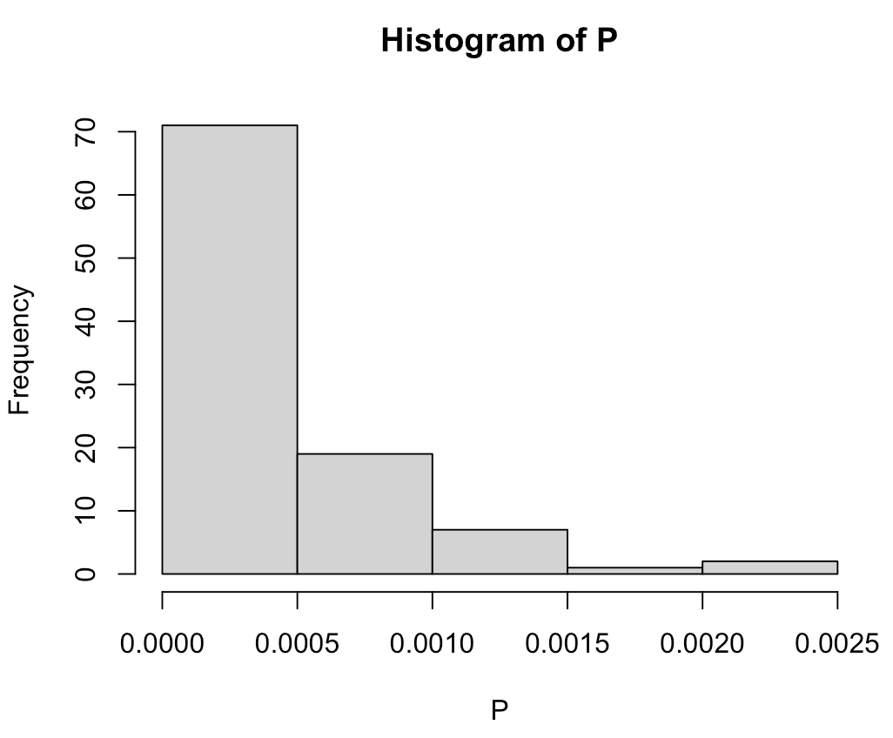
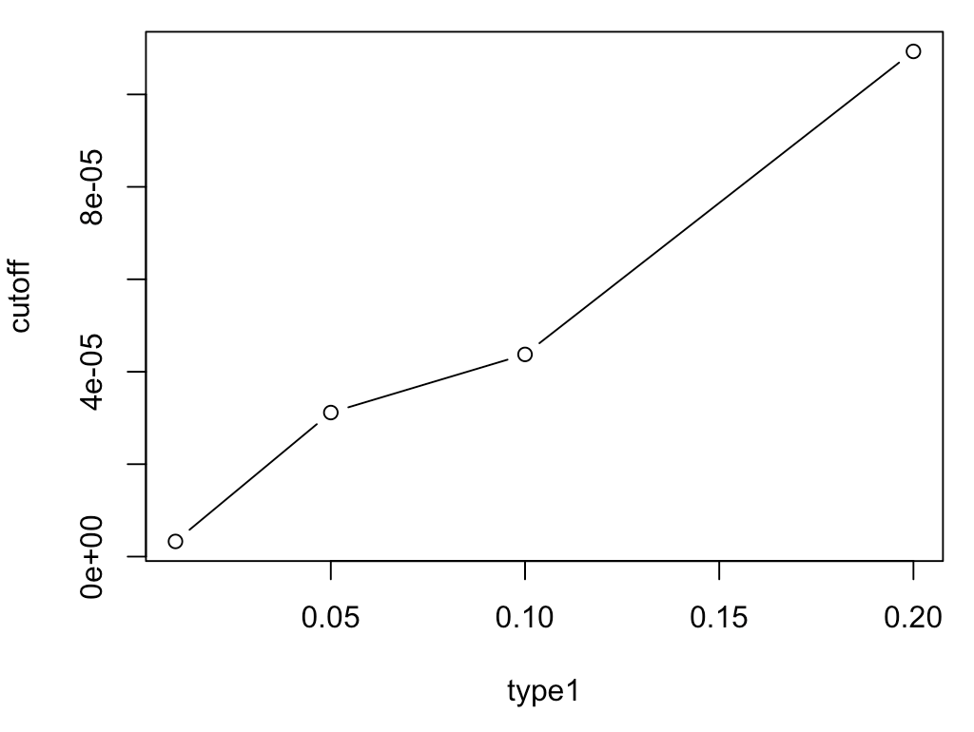
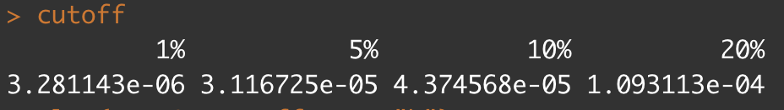
Distribution of P values under null hypothesis
Simulate phenotypes with zero heritability
Conduct GWAS and record the minimum P value
Repeat and get the distribution of the the minimum P value
set.seed(99164)
n=100
P=matrix(NA,n,1)
for (i in 1:100){
mySim=G2P(X= X1to5,h2=.0001,alpha=1,NQTN=10,distribution="norm")
p.min=min(GWASbyCor(X, mySim$y),na.rm=T)
P[i]=p.min
}
hist(P)
cutoff=quantile(P,type1,na.rm=T)
plot(type1, cutoff,type="b")

Slide 25
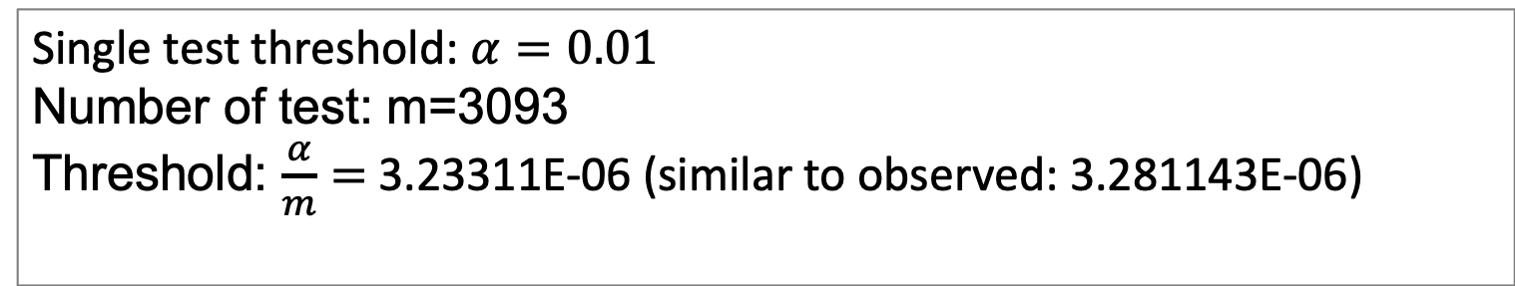
Approximation: Bonferroni multiple test correction
Single test threshold: $α=0.01$
Number of test: m=3093
Threshold: $\frac{α}{m}=$3.23311E-06 (similar to observed: 3.281143E-06)
Bonferroni threshold could be too conservative if multiple tests are not independent, e.g. dense markers or long LD extent.

Slide 26
Highlight
Correlation and t distribution
GWAS by correlation
Power and false positives
Observed null distribution
True positives
False positives
Type I error
Cut off of P values

