Slide 1


Statistical Genomics
Lecture 15: Mixed Linear Model
Zhiwu Zhang
Washington State University

Slide 2
Outline
From GLM to MLM
Concept and working models
Incorporating kinship for GWAS
BLUE and BLUP
MLM in GAPIT
GLM in GAPIT

Slide 3
GWAS by GLM (3PCs)
4 without mistake
GWAS by Correlation
2 without mistake

Slide 4
Hidden, observed, induction, and modeling
Genes
SNPs
PCs
y=SNP+e
y=SNP+PC+e
y=SNP+PC+K+e
y=SNP+PC+BLUP+e
BLUP=SNP+e
BLUP=SNP+PC+e
Residual=SNP+e
Residual=SNP+PC+e
Y=SNP1 + SNP2+ … + e
K
BV
BLUP
y
Residual
Hidden
Observed
Induction
Modeling

Slide 5
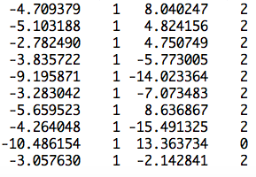
More covariates
observation
mean
PC2
SNP
Ind1 | Ind2 | … | Ind9 | Ind10
u1 | u2 | … | u9 | u10
1 | 0 | … | 0 | 0
0 | 1 | … | 0 | 0
0 | 0 | … | 1 | 0
0 | 0 | … | 0 | 1
u=
]
[
]
[
b=
b0
b1
b2
y
1
x1
x2
=X
Z
[
]
y = Xb + Zu +e

Slide 6
Recall for linear model
y=b₀ + x₁b₁ + x₂b₂ + … + x_{p}b_{p} + e
y: observation, dependent variable
x: Explainary/independent variables
e: Residuals/errors
Δ =e₁² + e₂² + … + e_{n}²
=e'e
=(y-Xb)'(y-Xb)

Slide 7
Optimization to minimize residual
Δ =e'e
=e²=(y-Xb)²
∂Δ/∂b
=2X'(y-Xb)
=2X'y-2X'Xb=0
X'Xb=X'y
b=[X'X]⁻¹[X'Y]

Slide 8
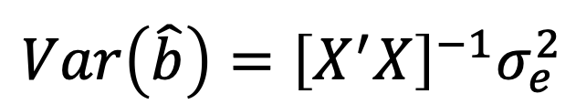
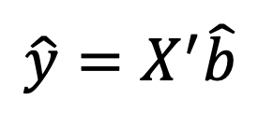
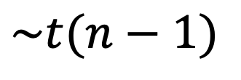
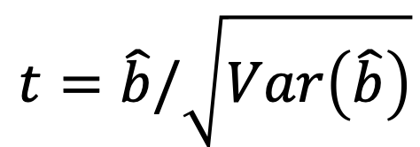
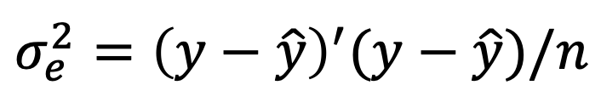
Statistical test
$$\hat{y}=X^{′}\hat{b}$$
$$σ_{e}^{2}={\left(y−\hat{y}\right)}^{′}(y−\hat{y})/n$$
$$Var\left(\hat{b}\right)={\left[X^{′}X\right]}^{−1}σ_{e}^{2}$$
$$t=\hat{b}/\sqrt{Var\left(\hat{b}\right)}$$
$$\sim t(n−1)$$

Slide 9
GLM (Conceptual)
Phenotype on individuals
Population
structure
y = SNP + Q (or PCs) +
e
(fixed effect)
(fixed effect)
General Linear Model (GLM)

Slide 10
Minimize residual does not work for adding individuals' effects
More parameters than observations
Residuals are always zero due to over model fitting
Needs new rules
X

Slide 11
New rules
Free individuals effects
Only regulate the features for the population where they from: means (0) and variances
Optimize variances according to kinship and observation to maximize the likelihood

Slide 12
MLM for GWAS
Phenotype
Population
structure
Unequal
relatedness
Y = SNP + Q (or PCs) + Kinship + e
(fixed effect)
(fixed effect)
(random effect)
General Linear Model (GLM)
Mixed Linear Model (MLM)
(Yu et al. 2005, Nature Genetics)

Slide 13
Fixed vs. Random Effects
Fixed effect
  Limited levels
  Interest on levels
Radom effect
  Many levels
  Interest on population behind the levels (mean, variance)

Slide 14
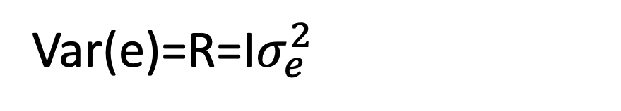
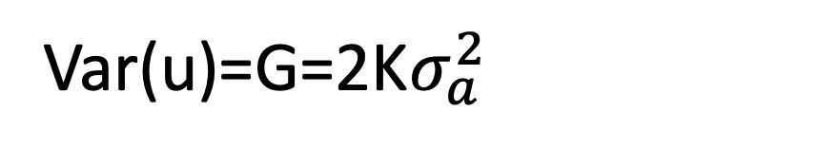
Mixed Linear Model (MLM)
y = Xb + Zu + e
Var(y)=V=Var(u)+Var(e)
Var(u)=G=2K$σ_{a}^{2}$
Var(e)=R=I$σ_{e}^{2}$
u prediction: Best Linear Unbiased Prediction, BLUP)
b prediction: Best Linear Unbiased Estimate, BLUE)

Slide 15
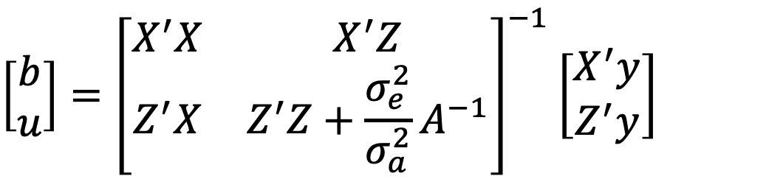
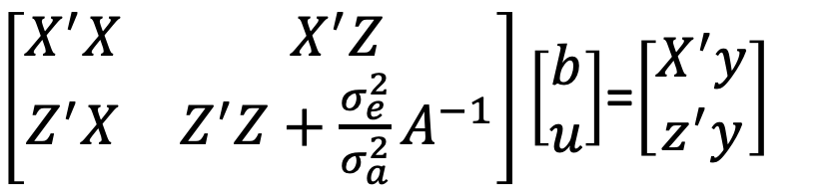
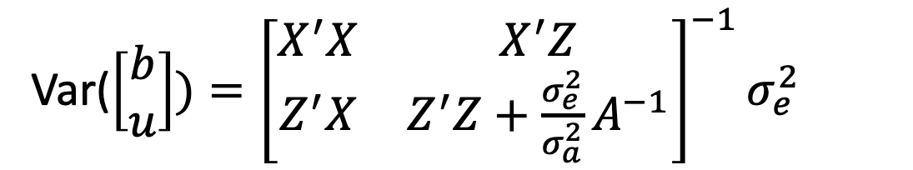
Mixed Model Equation
y = Xb + Zu + e
$\left[\begin{matrix}X^{′}X & X^{′}Z \\ Z^{′}X & Z^{′}Z+{\frac{σ_{e}^{2}}{σ_{a}^{2}}A}^{−1}\end{matrix}\right]\left[\begin{matrix}b \\ u\end{matrix}\right]$=$\left[\begin{matrix}X^{′}y \\ z^{′}y\end{matrix}\right]$
$$\left[\begin{matrix}b \\ u\end{matrix}\right]={\left[\begin{matrix}X^{′}X & X^{′}Z \\ Z^{′}X & Z^{′}Z+{\frac{σ_{e}^{2}}{σ_{a}^{2}}A}^{−1}\end{matrix}\right]}^{−1}\left[\begin{matrix}X^{′}y \\ Z^{′}y\end{matrix}\right]$$
Var($\left[\begin{matrix}b \\ u\end{matrix}\right])={\left[\begin{matrix}X^{′}X & X^{′}Z \\ Z^{′}X & Z^{′}Z+{\frac{σ_{e}^{2}}{σ_{a}^{2}}A}^{−1}\end{matrix}\right]}^{−1}σ_{e}^{2}$

Slide 16
GWAS with MLM in GAPIT
source("http://www.zzlab.net/GAPIT/gapit_functions.txt")
myGAPIT=GAPIT(
  Y=myY,
  GD=myGD,
  GM=myGM,
  QTN.position=mySim$QTN.position,
  PCA.total=3,
  group.from=1000000,
  group.to=1000000,
  group.by=10)
Set group.from and group.to as a big number (e.g. 1M) for MLM in GAPIT

Slide 17
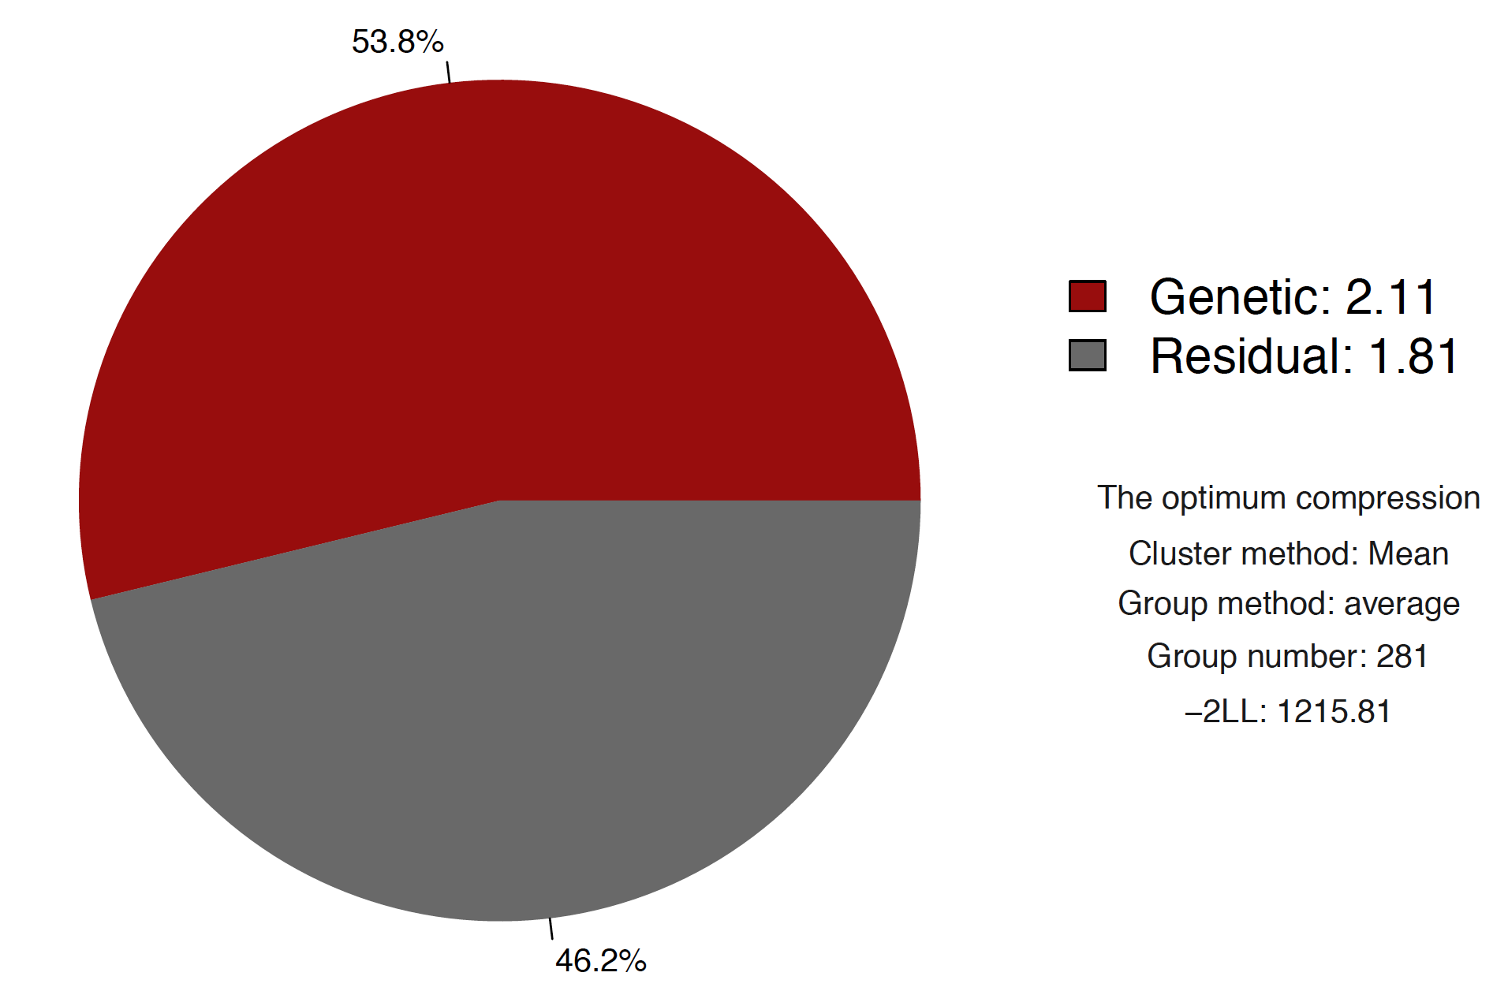
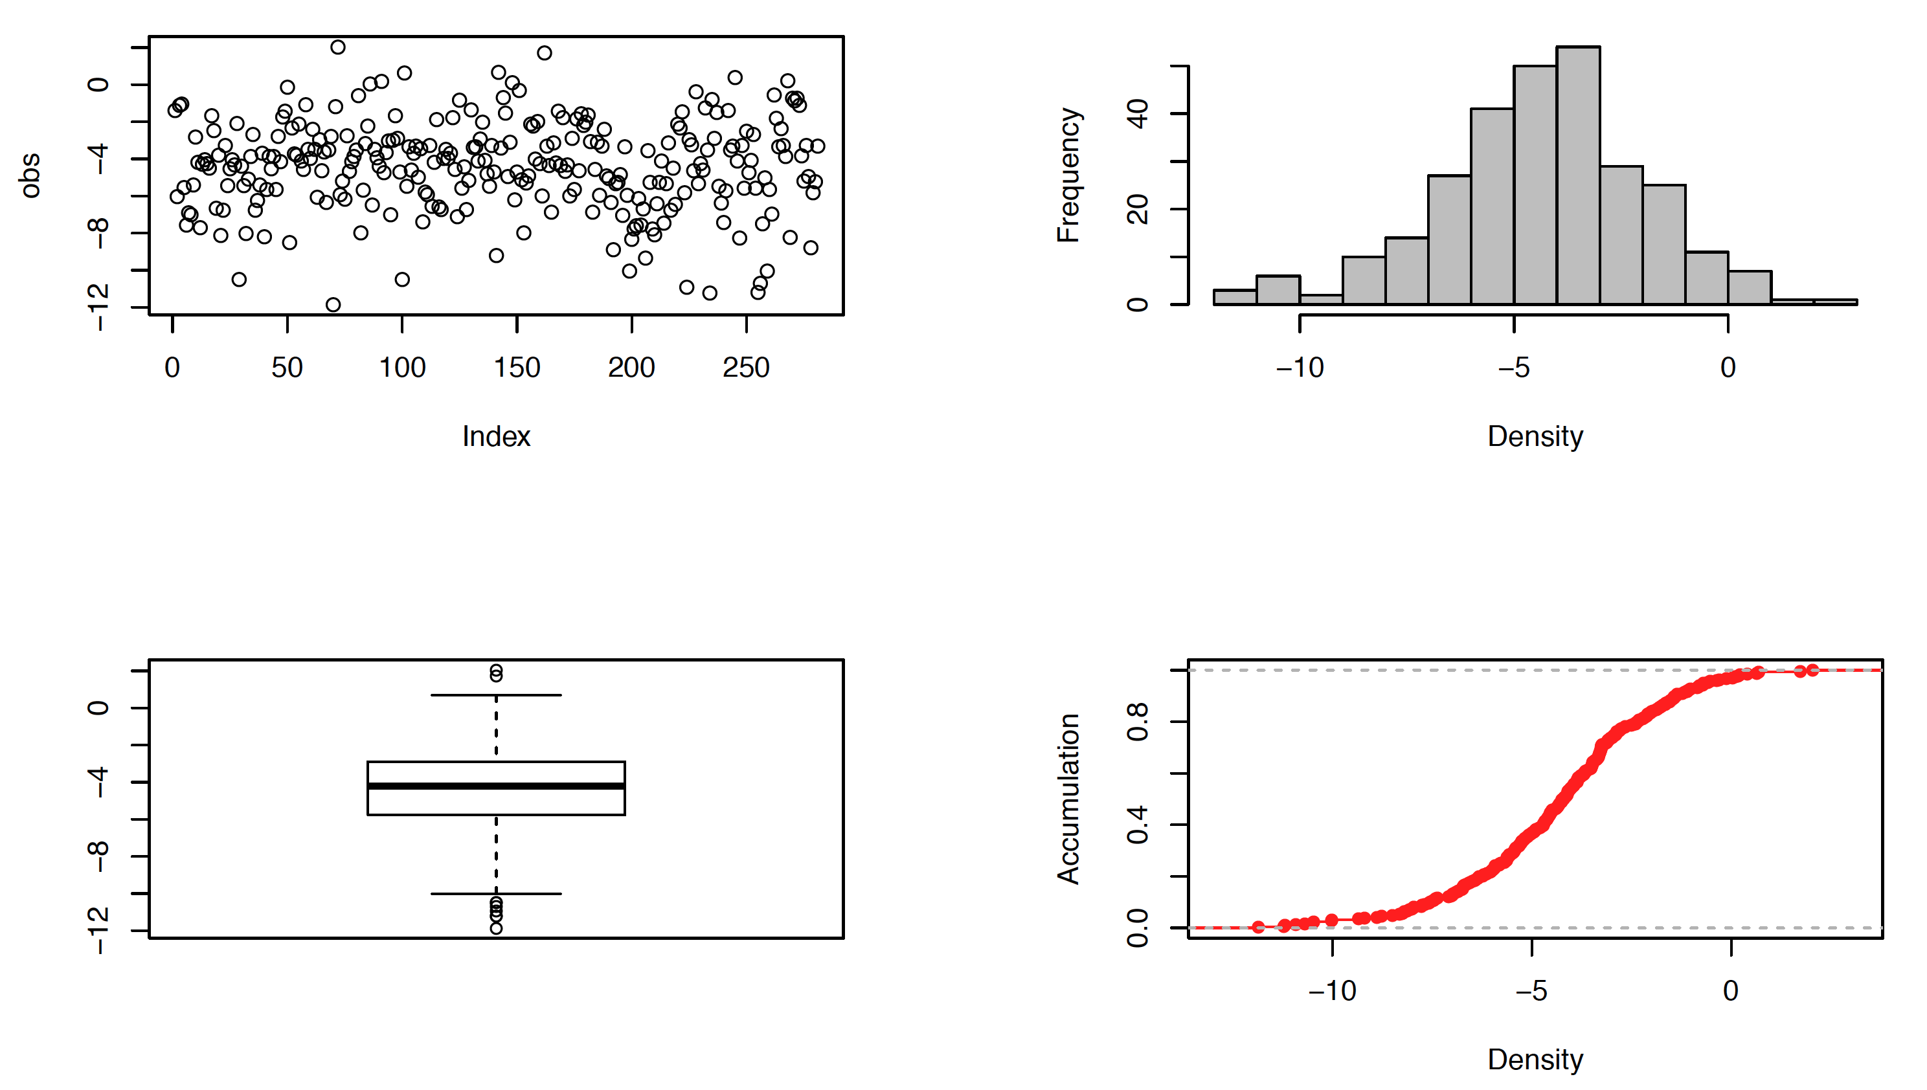
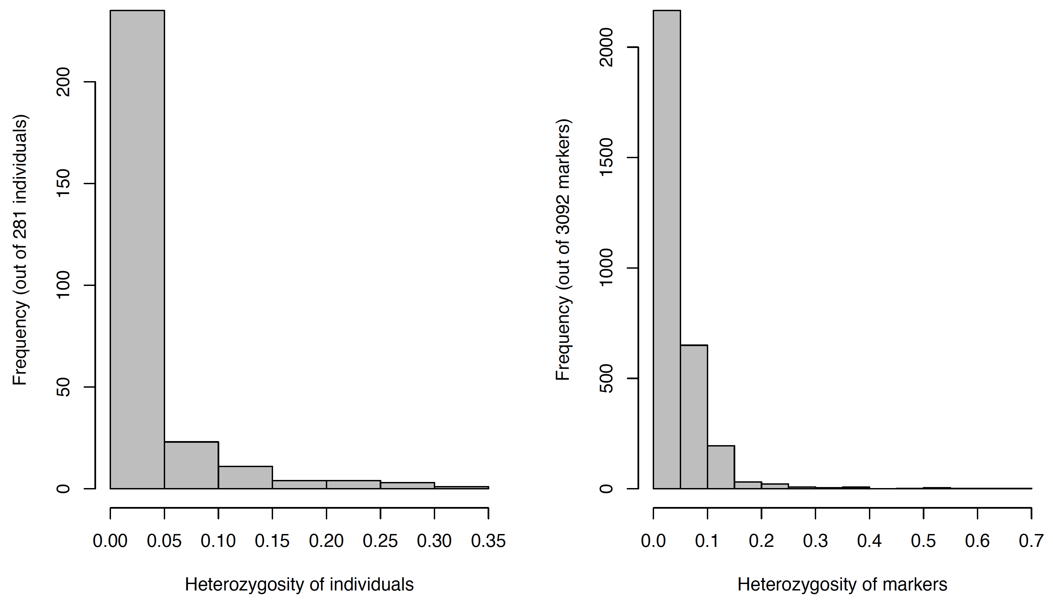
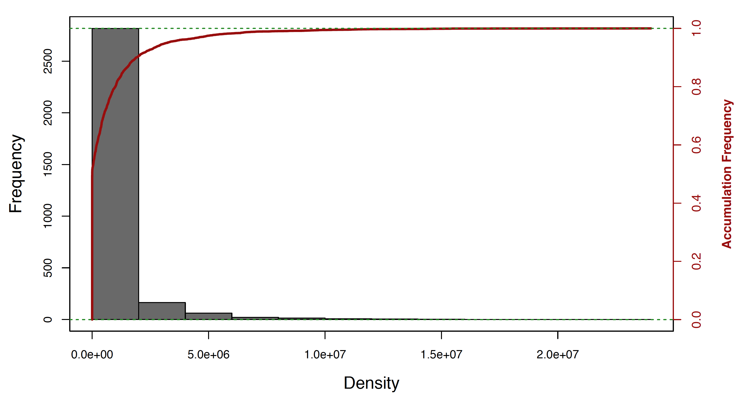
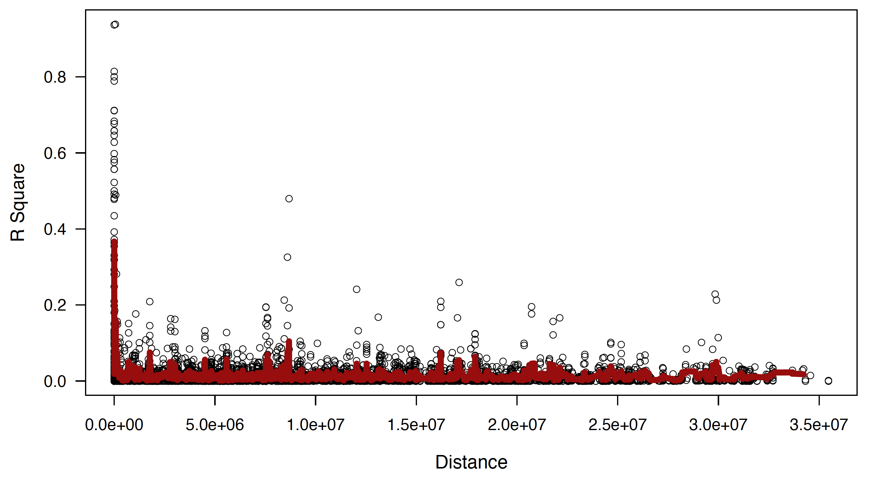
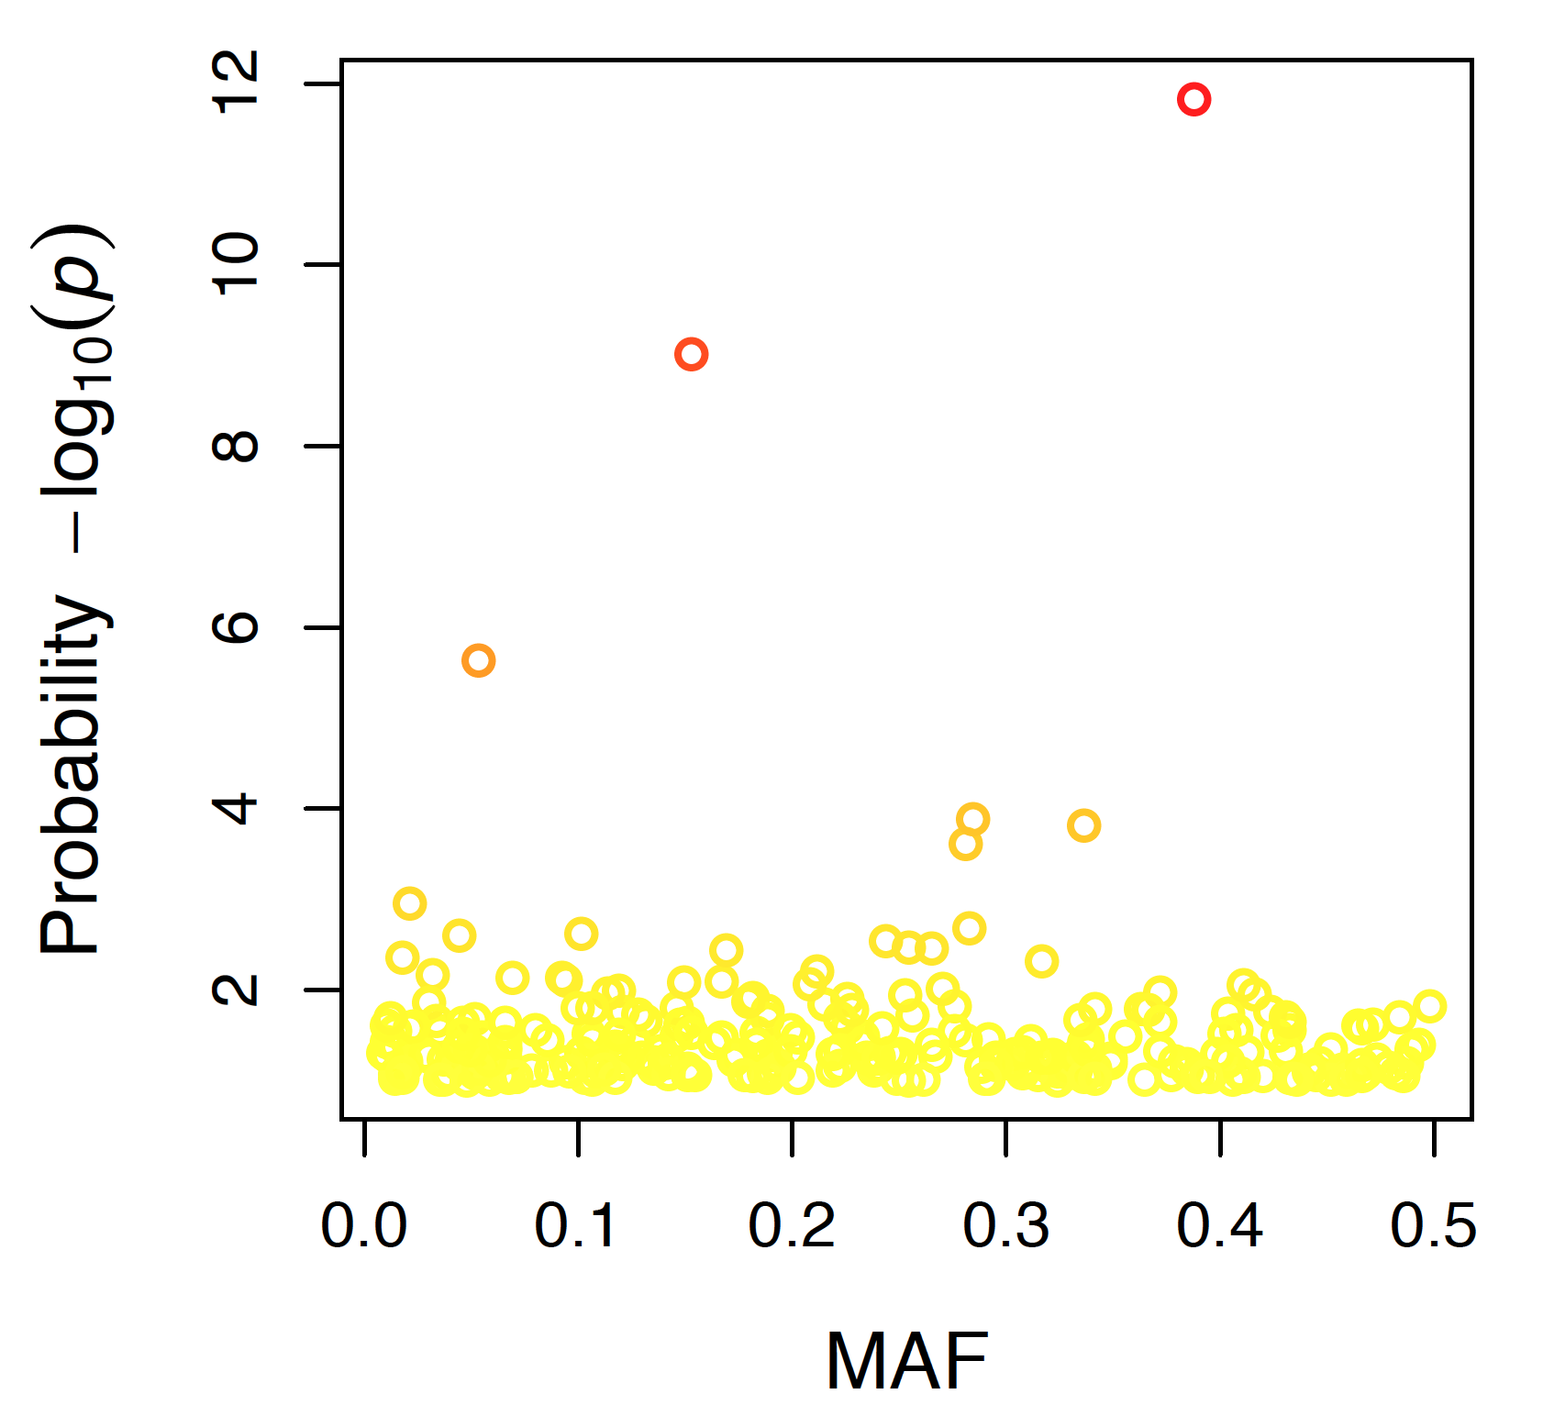
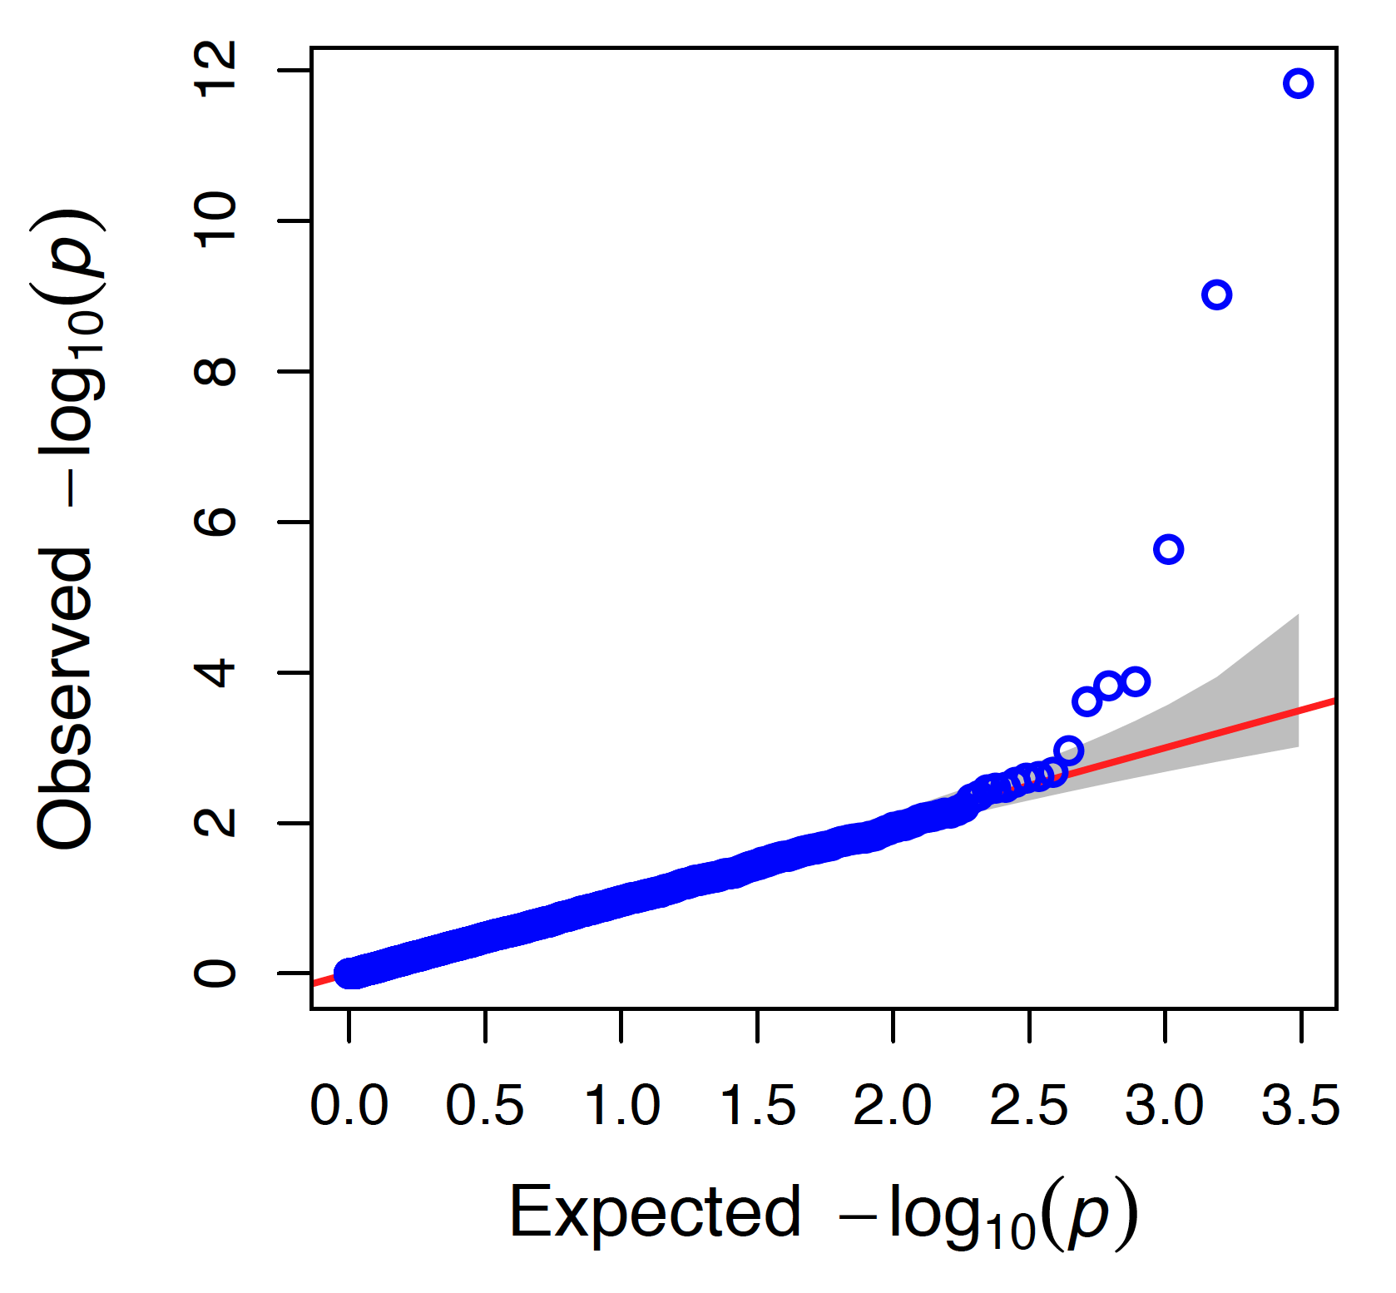
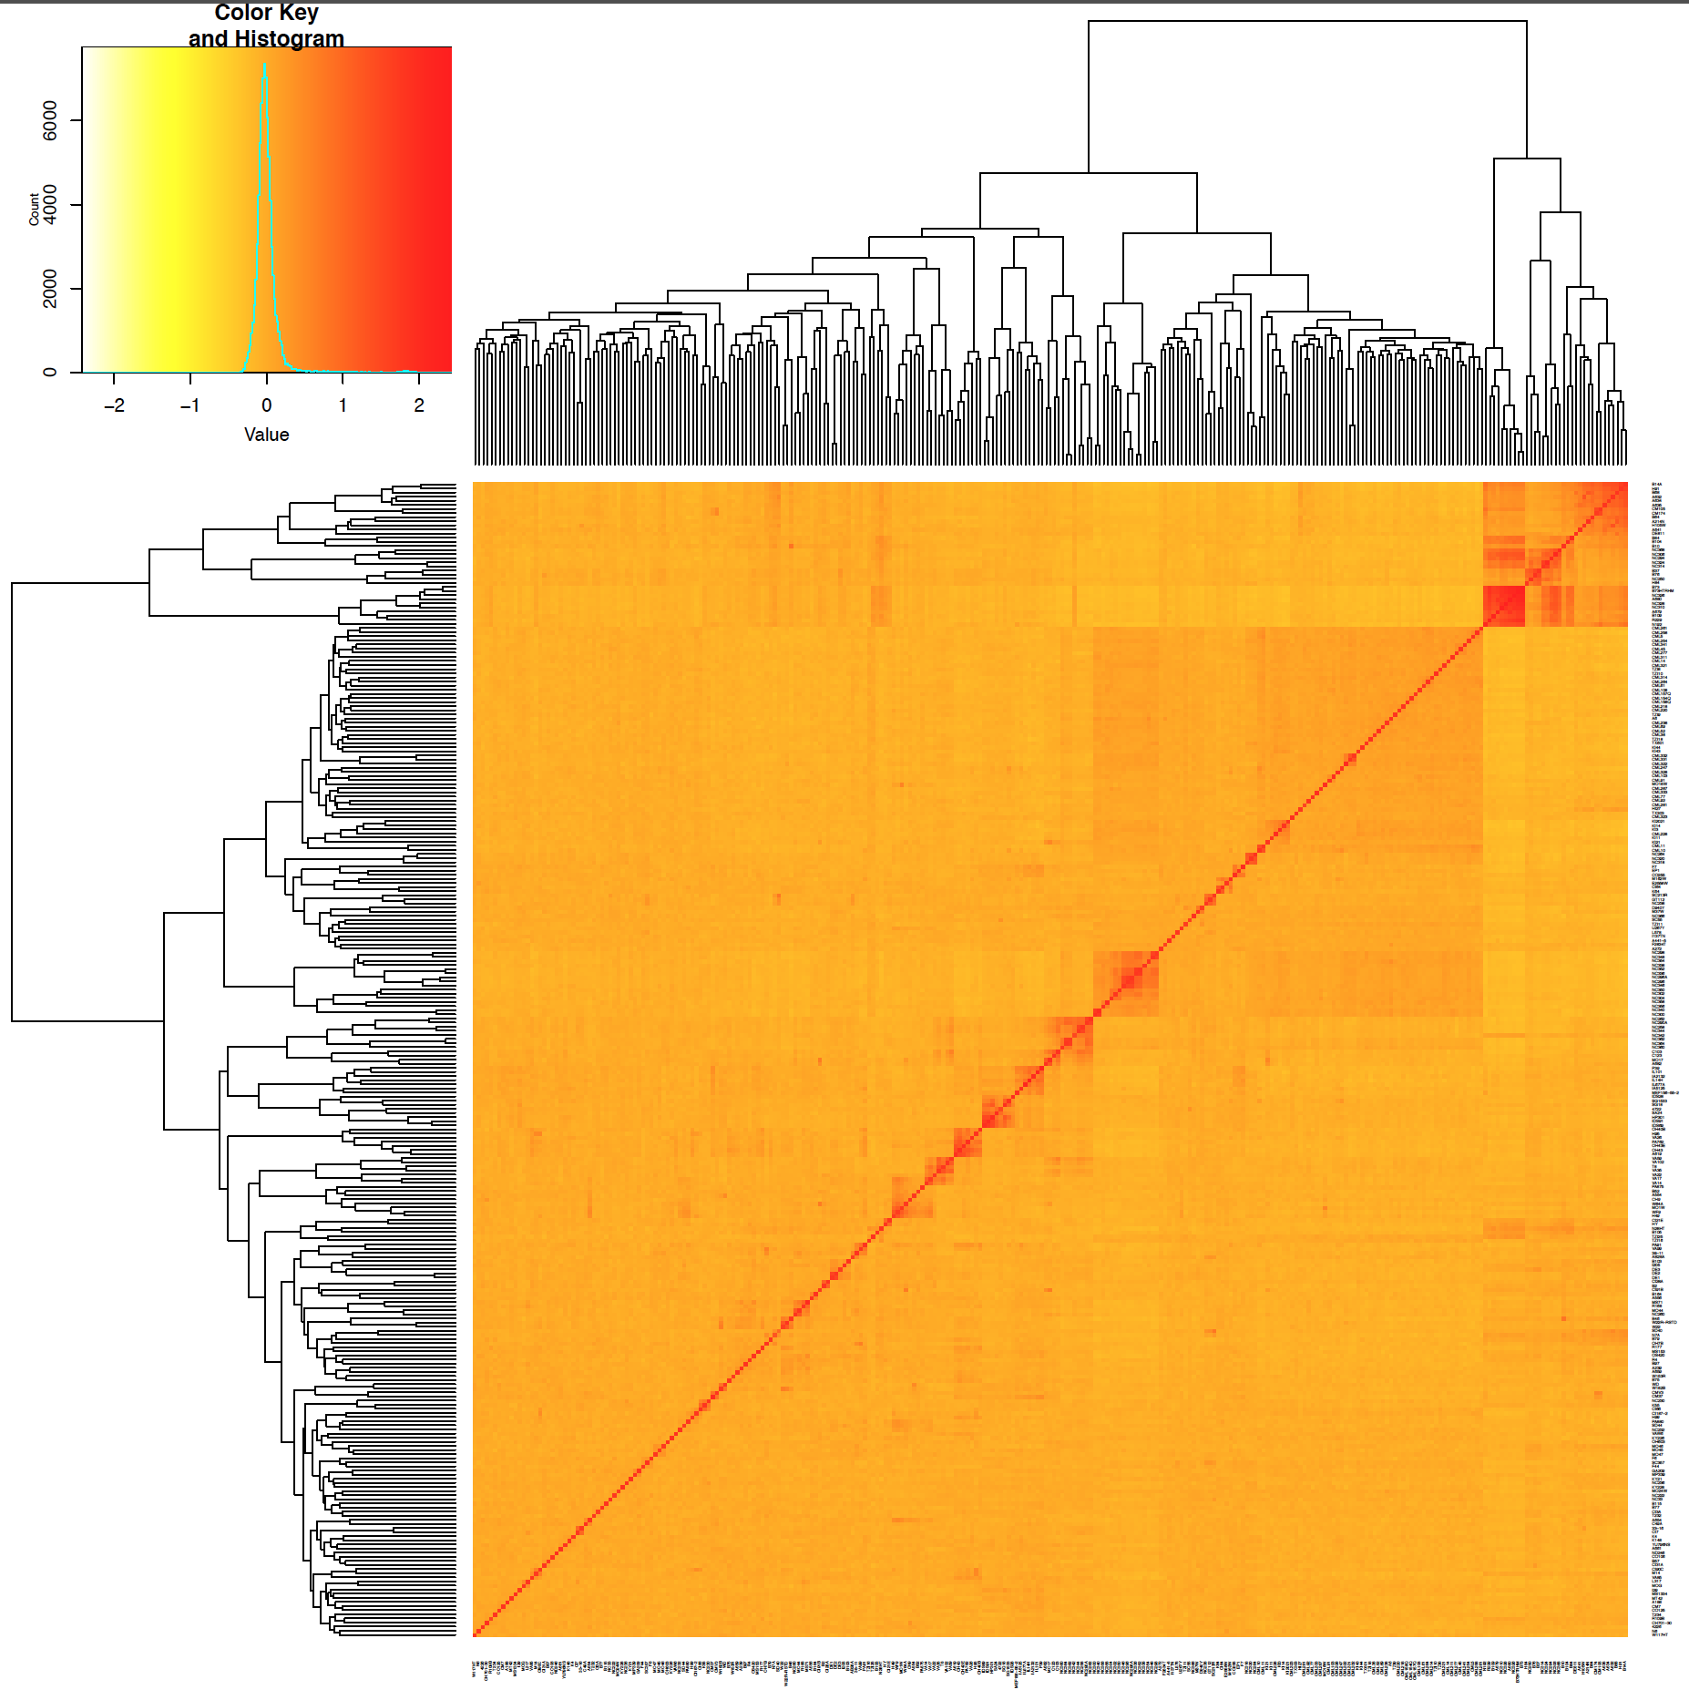
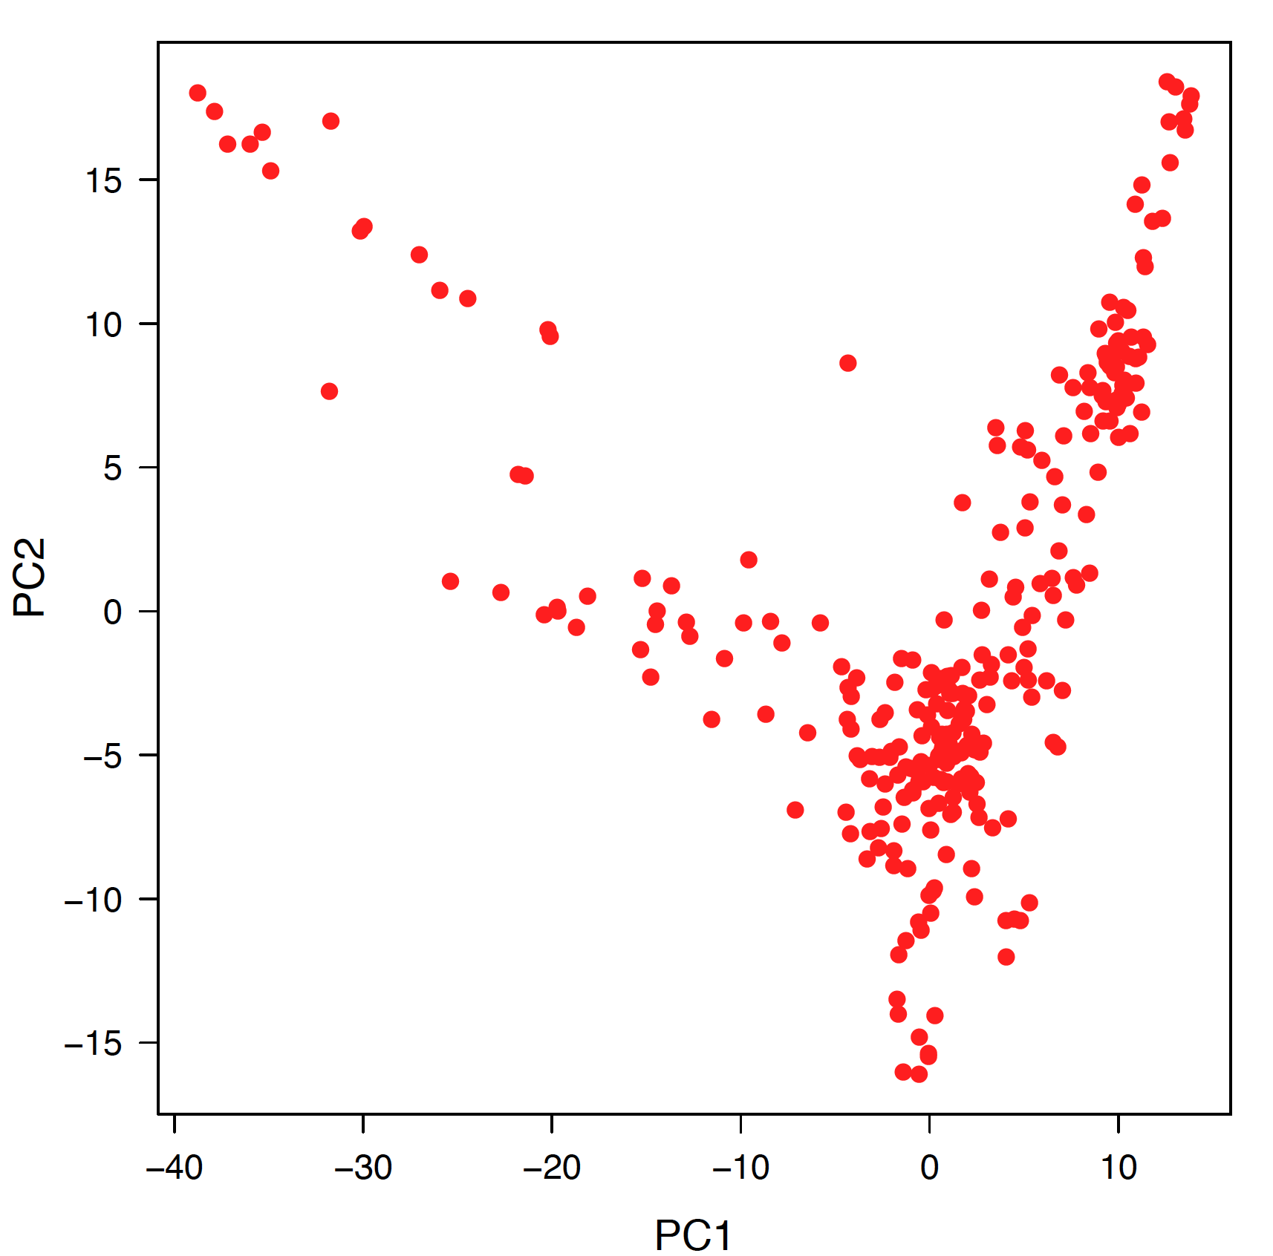
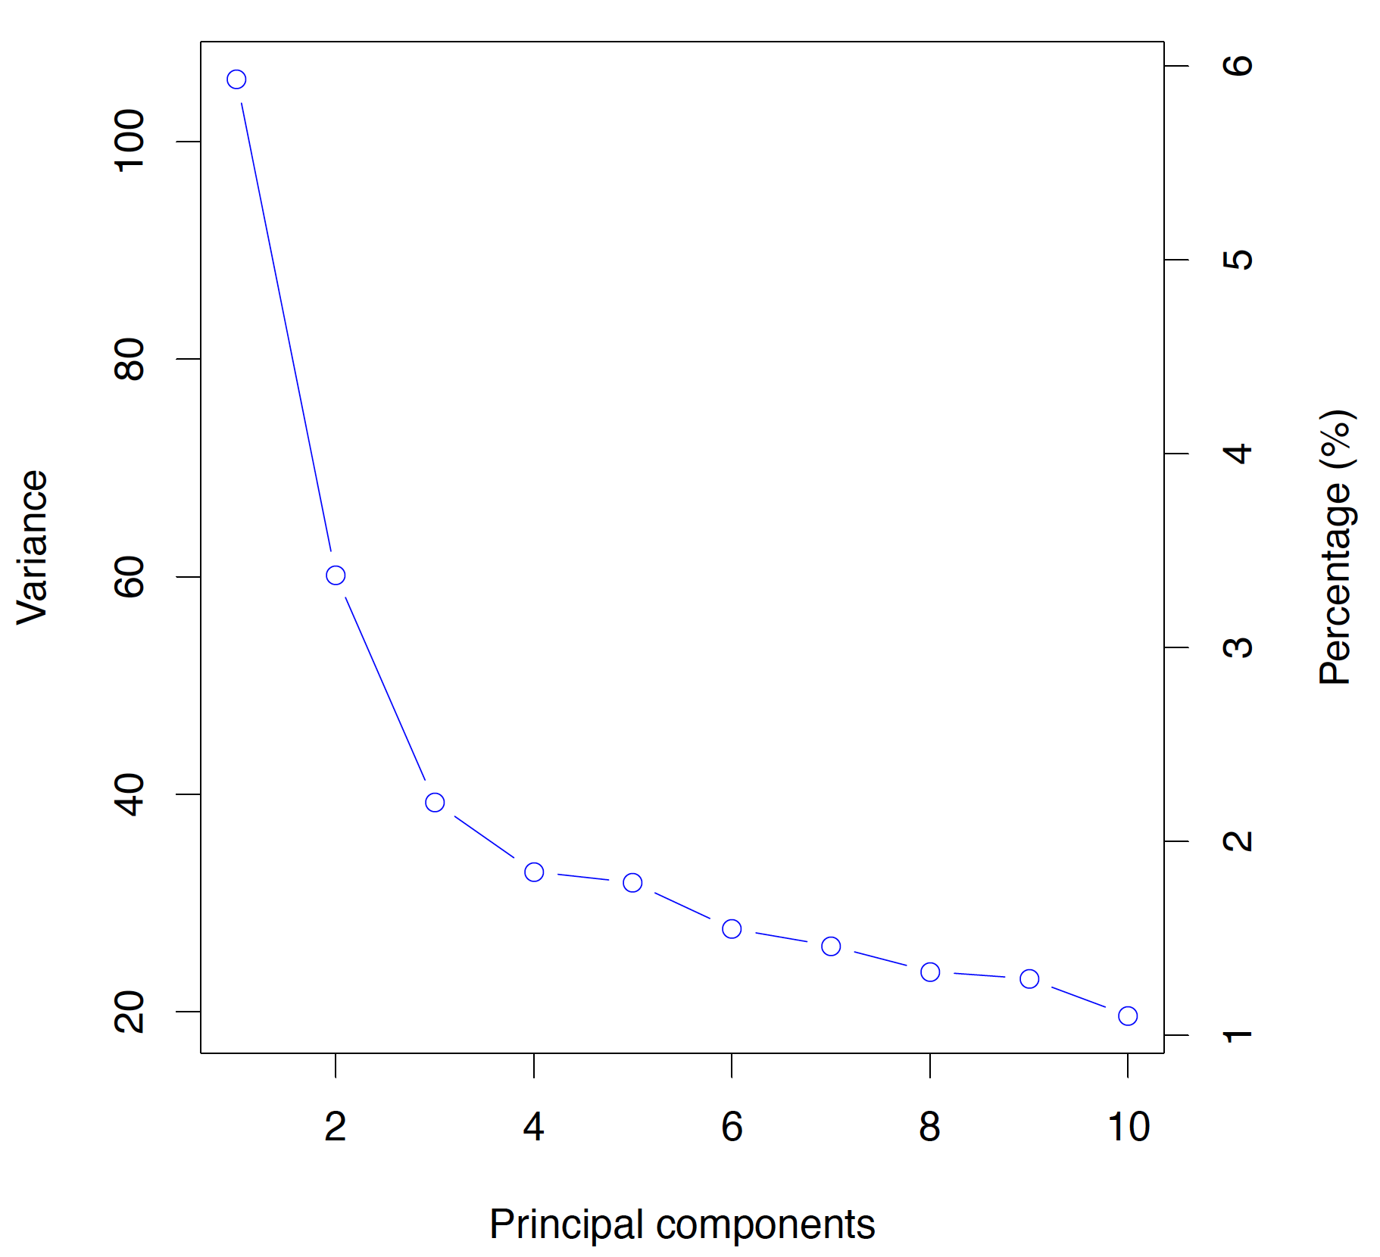
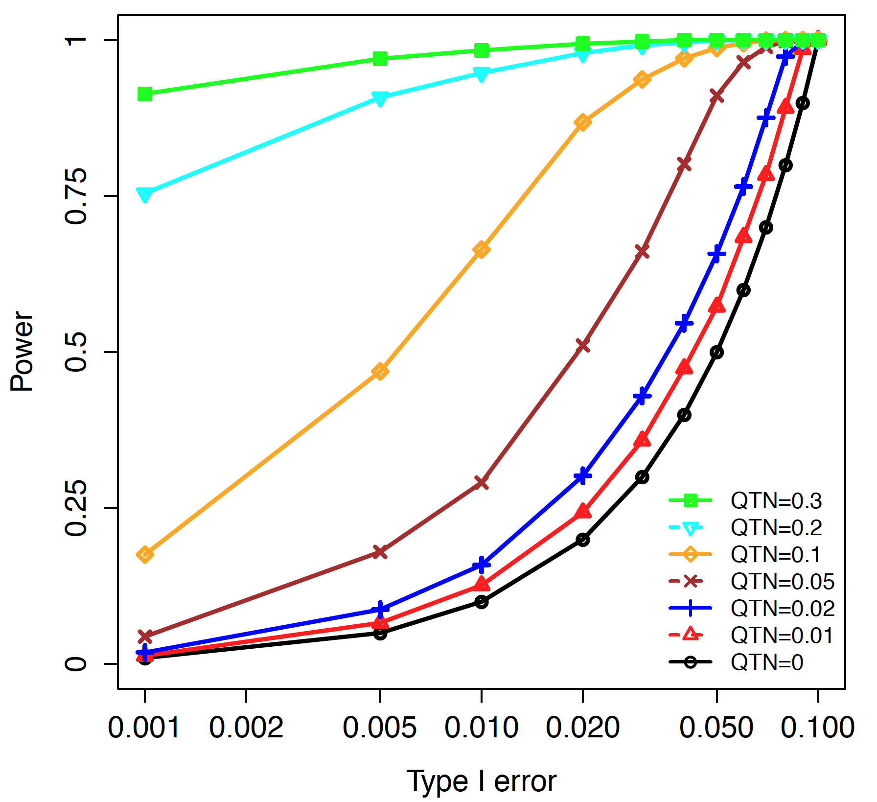
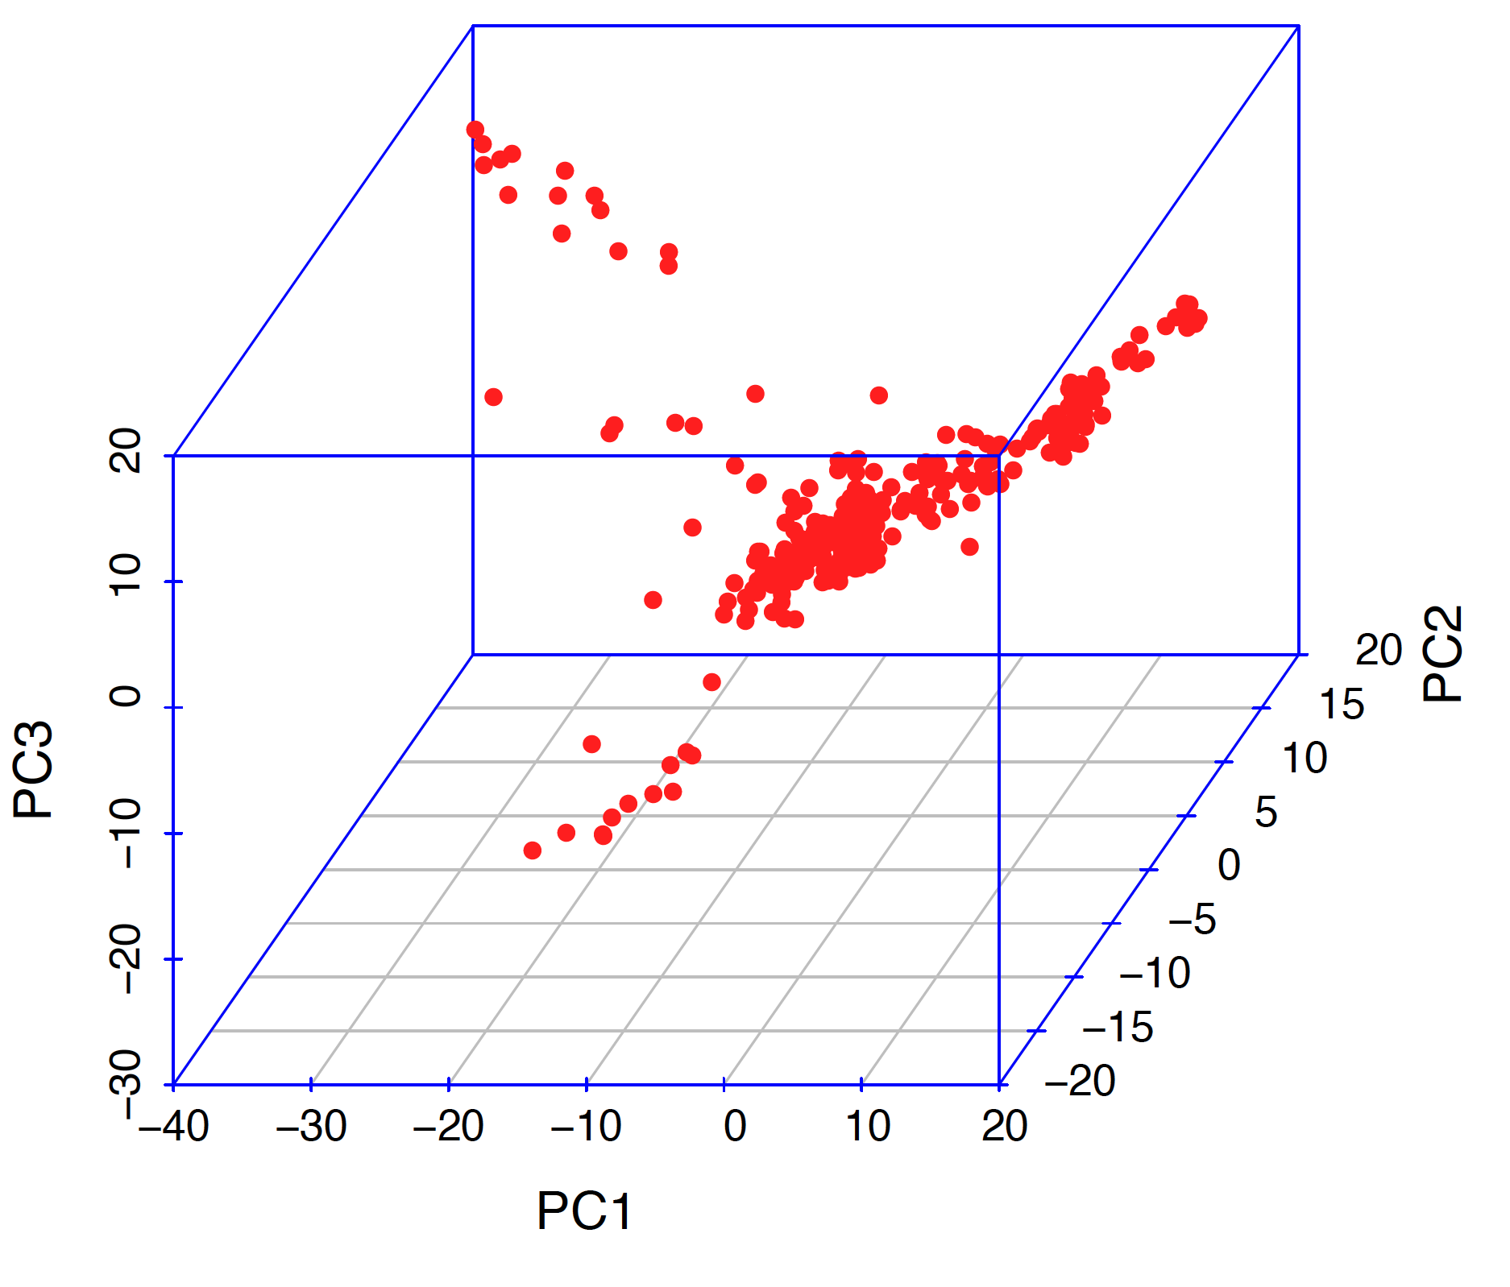
GAPIT Output

Slide 18
GWAS by GLM
library(compiler) #required for cmpfun
source("http://www.zzlab.net/GAPIT/emma.txt")
source("http://www.zzlab.net/GAPIT/gapit_functions.txt")
source("http://zzlab.net/StaGen/2020/R/G2P.R")
myGD=read.table(file="http://zzlab.net/GAPIT/data/mdp_numeric.txt",head=T)
myGM=read.table(file="http://zzlab.net/GAPIT/data/mdp_SNP_information.txt",head=T)
X=myGD[,-1]
index1to5=myGM[,2]<6
X1to5 = X[,index1to5]
set.seed(99164)
mySim=G2P(X=X1to5,h2=.75,alpha=1,NQTN=10,distribution="normal")
setwd("~/Desktop/temp")
myY=cbind(as.data.frame(myGD[,1]), mySim$y)
myGAPIT=GAPIT(
Y=myY,
GD=myGD,
GM=myGM,
QTN.position=mySim$QTN.position,
PCA.total=3,
group.from=1,
group.to=1,
group.by=10,
memo="GLM",
file.output=TRUE,)
Found four without mistake

Slide 19
GWAS by MLM
library(compiler) #required for cmpfun
source("http://www.zzlab.net/GAPIT/emma.txt")
source("http://www.zzlab.net/GAPIT/gapit_functions.txt")
source("http://zzlab.net/StaGen/2020/R/G2P.R")
myGD=read.table(file="http://zzlab.net/GAPIT/data/mdp_numeric.txt",head=T)
myGM=read.table(file="http://zzlab.net/GAPIT/data/mdp_SNP_information.txt",head=T)
X=myGD[,-1]
index1to5=myGM[,2]<6
X1to5 = X[,index1to5]
set.seed(99164)
mySim=G2P(X=X1to5,h2=.75,alpha=1,NQTN=10,distribution="normal")
setwd("~/Desktop/temp")
myY=cbind(as.data.frame(myGD[,1]), mySim$y)
myGAPIT=GAPIT(
Y=myY,
GD=myGD,
GM=myGM,
QTN.position=mySim$QTN.position,
PCA.total=3,
group.from=10000,
group.to=10000,
group.by=10,
memo= ",MLM",
file.output=TRUE,)
Found five without mistake

Slide 20
Outline
From GLM to MLM
Concept and working models
Incorporating kinship for GWAS
BLUE and BLUP
MLM in GAPIT
GLM in GAPIT

