Slide 1


Statistical Genomics
Lecture 19: MLMM
Zhiwu Zhang
Washington State University

Slide 2
Outline
Stepwise regression
Criteria
MLMM

Slide 3
Testing SNPs, one at a time
Phenotype
Population
structure
Unequal
relatedness
Y = SNP + Q (or PCs) + Kinship + e
(fixed effect)
(fixed effect)
(random effect)
General Linear Model (GLM)
Mixed Linear Model (MLM)
(Yu et al. 2005, Nature Genetics)

Slide 4
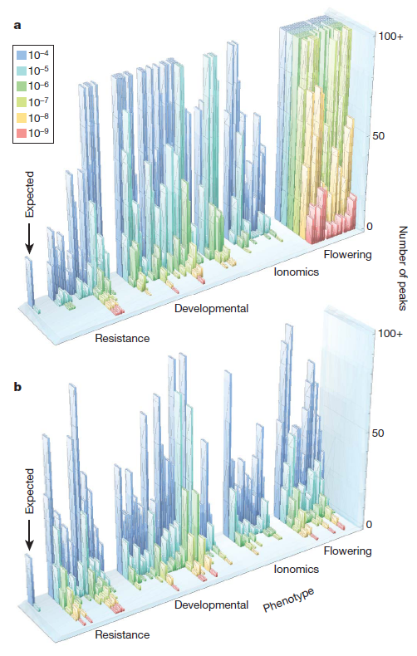

GWAS does not work for traits associated with structure
Atwell et al Nature 2010
a, No correction test
b, Correction with MLM
Magnus Norborg

Slide 5
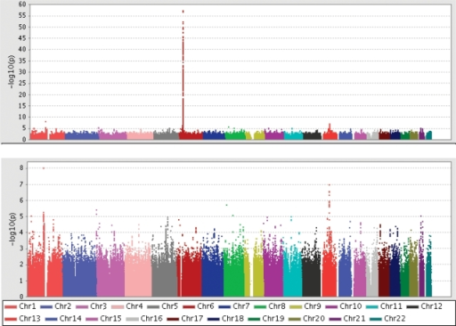
Hind from MHC (Major histocompatibility complex)

Slide 6
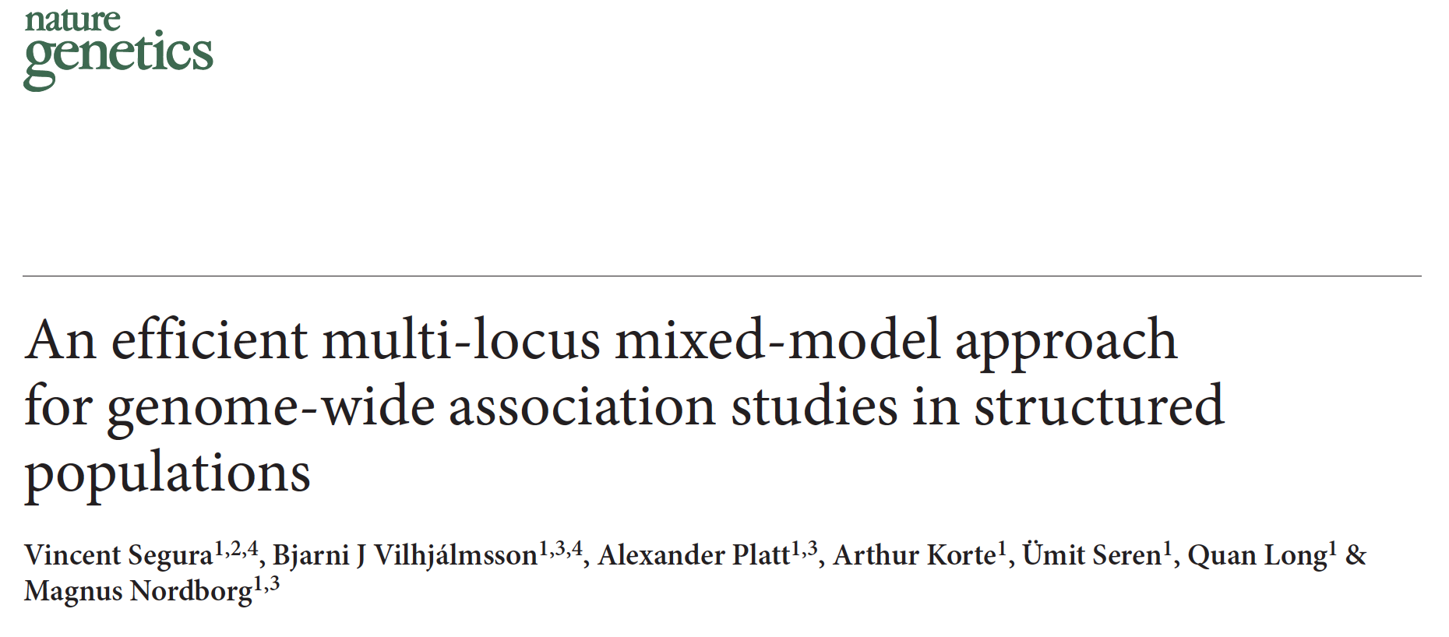
MLMM

Slide 7
Stepwise regression
Choose m predictive variables from M (M>>m) variables
The challenges :
Choosing m from M is an NP problem
Option: approximation
No unique criteria

Slide 8
Stepwise regression procedures
Sequence of F-tests or t-tests
Adjusted R-square
Akaike information criterion (AIC)
Bayesian information criterion (BIC)
Mallows's Cp
PRESS
false discovery rate (FDR)
Why so many?

Slide 9
Stepwise regression: Forward
Test M variables one at a time
Fit the most significant variable as covariate
Test rest variables one at a time
Is the most
influential variable
significant
Yes
No
End

Slide 10
Stepwise regression: Backward
Test m variables simultaneously
Is the least
influential variable
significant
Yes
End
No
Remove it and test the rest (m)

Slide 11
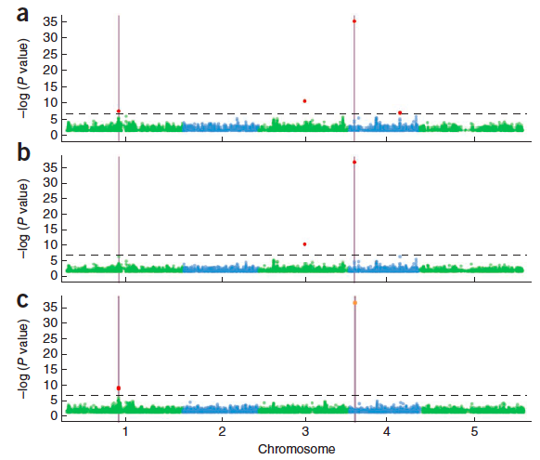
Nature Genetics, 2012, 44, 825-830
Two QTNs
GLM
MLM
MLMM

Slide 12
MLMM
y = SNP + Q + K + e
Most significant SNP as pseudo QTN
y = SNP + QTN1 + Q + K + e
Most significant SNP as pseudo QTN
y = SNP + QTN1 + QTN2 + Q + K + e
So on and so forth until…

Slide 13
Forward regression
y = SNP +QTN1+QTN2+…+ Q + K + e
Var(u)
Var(y)
Stop when the ratio close to zero

Slide 14
Backward elimination
y = QTN₁+QTN₂+…+QTN_{t}+ Q + K + e
Remove the least significant pseudo QTN
y = QTN₁+QTN₂+…+QTN_{t-1}+ Q + K + e
Until all pseudo QTNs are significant

Slide 15
Final p values
Pseudo QTNs:
y = QTN₁+QTN₂+…+ Q + K + e
Other markers:
y = SNP +QTN₁+QTN₂+…+ Q + K + e

Slide 16
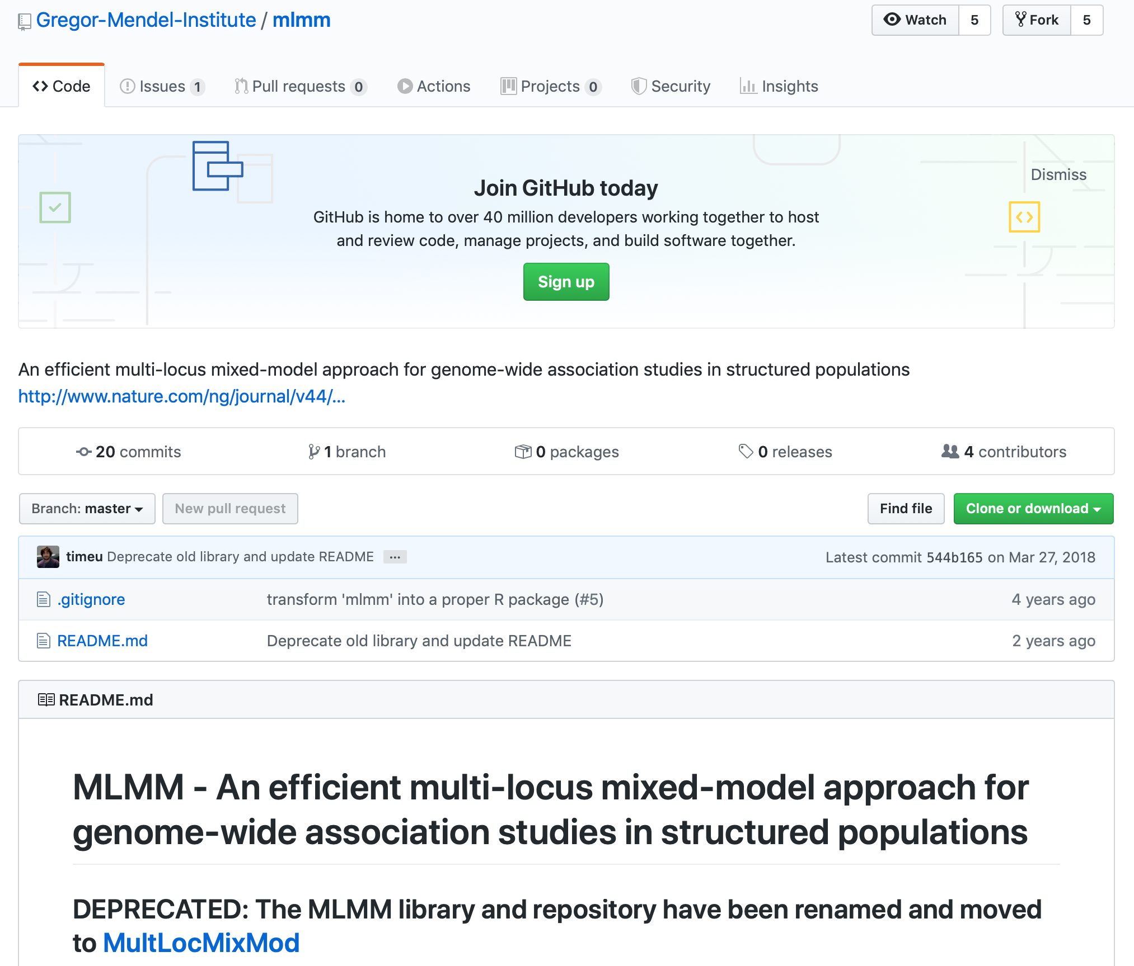
MLMM R on GitHub
https://github.com/Gregor-Mendel-Institute/mlmm

Slide 17
MLMM with mlmm-master
#GAPIT
library(compiler) #required for cmpfun
source("http://www.zzlab.net/GAPIT/GAPIT.library.R")
source("http://www.zzlab.net/GAPIT/gapit_functions.txt")
myGD=read.table(file="http://zzlab.net/GAPIT/data/mdp_numeric.txt",head=T)
myGM=read.table(file="http://zzlab.net/GAPIT/data/mdp_SNP_information.txt",head=T)
setwd('/Users/Zhiwu/Dropbox/Current/ZZLab/WSUCourse/CROPS545/mlmm-master')
source('mlmm_cof.r')
#Siultate 10 QTN on the first chromosomes
X=myGD[,-1]
index1to5=myGM[,2]<6
X1to5 = X[,index1to5]
taxa=myGD[,1]
set.seed(99164)
GD.candidate=cbind(taxa,X1to5)
mySim=GAPIT.Phenotype.Simulation(GD=GD.candidate,GM=myGM[index1to5,],h2=.5,NQTN=10,QTNDist="normal")
#for PC and K
setwd("~/Desktop/temp")
myGAPIT0=GAPIT(GD=myGD,GM=myGM,PCA.total=3,)
myPC=as.matrix(myGAPIT0$PCA[,-1])
myK=as.matrix(myGAPIT0$kinship[,-1])
myX=as.matrix(myGD[,-1])
myy=as.numeric(mySim$Y[,-1])
myMLMM<-mlmm_cof(myy,myX,myPC[,1:2],myK,nbchunks=2,maxsteps=20)
myP=myMLMM$pval_step[[1]]$out[,2]
myGI.MP=cbind(myGM[,-1],myP)
GAPIT.Manhattan(GI.MP=myGI.MP,seqQTN=mySim$QTN.position)
GAPIT.QQ(myP)

Slide 18
MLMM with MultLocMixMod-master
#GAPIT
library(compiler) #required for cmpfun
library(emma)
source("http://www.zzlab.net/GAPIT/GAPIT.library.R")
source("http://www.zzlab.net/GAPIT/gapit_functions.txt")
myGD=read.table(file="http://zzlab.net/GAPIT/data/mdp_numeric.txt",head=T)
myGM=read.table(file="http://zzlab.net/GAPIT/data/mdp_SNP_information.txt",head=T)
setwd('/Users/Zhiwu/Dropbox/Current/ZZLab/WSUCourse/CROPS545/MultLocMixMod-master/R')
source('mlmm_cof.r')
#Siultate 10 QTN on the first chromosomes
X=myGD[,-1]
index1to5=myGM[,2]<6
X1to5 = X[,index1to5]
taxa=myGD[,1]
set.seed(99164)
GD.candidate=cbind(taxa,X1to5)
mySim=GAPIT.Phenotype.Simulation(GD=GD.candidate,GM=myGM[index1to5,],h2=.5,NQTN=10,QTNDist="normal")
#for PC and K
setwd("~/Desktop/temp")
myGAPIT0=GAPIT(GD=myGD,GM=myGM,PCA.total=3,)
myPC=as.matrix(myGAPIT0$PCA[,-1])
myK=as.matrix(myGAPIT0$kinship[,-1])
myX=as.matrix(myGD[,-1])
myy=as.numeric(mySim$Y[,-1])
myMLMM<-mlmm_cof(myy,myX,myPC[,1:2],myK,nbchunks=2,maxsteps=20)
myP=myMLMM$pval_step[[1]]$out[,2]
myGI.MP=cbind(myGM[,-1],myP)
GAPIT.Manhattan(GI.MP=myGI.MP,seqQTN=mySim$QTN.position)
GAPIT.QQ(myP)
Not succeeded yet

Slide 19
MLMM within GAPIT
myGAPIT_MLM <- GAPIT(
Y=mySim$Y,
GD=myGD,#Genotype
GM=myGM,#Map information
PCA.total=3,
QTN.position=mySim$QTN.position,
model="MLMM",# Can choose MLM CMLM GLM SUPER MLMM FarmCPU Blink
file.output=T
)

Slide 20
Outline
Stepwise regression
Criteria
MLMM

