Slide 1
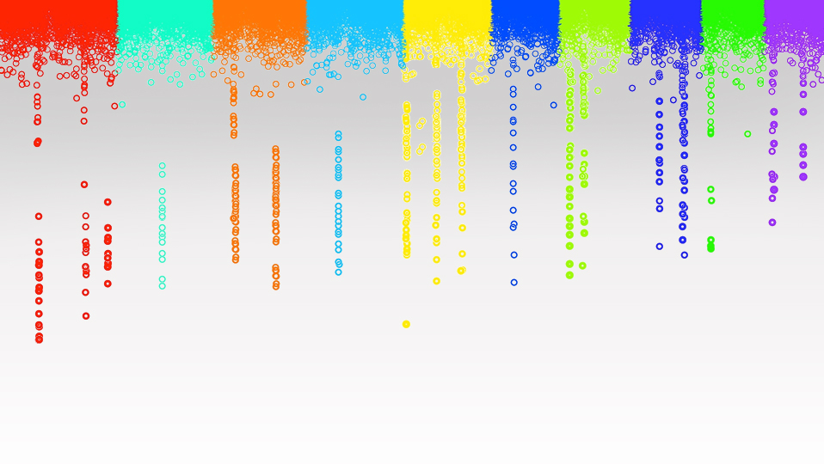

Statistical Genomics
Linkage analysis
Zhiwu Zhang
Washington State University

Slide 2
Outline
Linkage
Recombination
Haldan’s map function
Linkage analysis
Software
RQTL

Slide 3
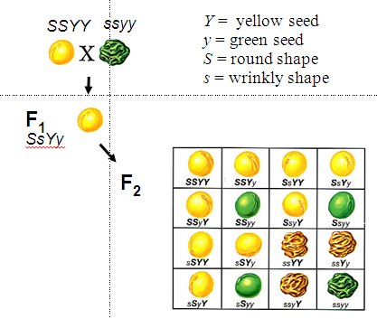
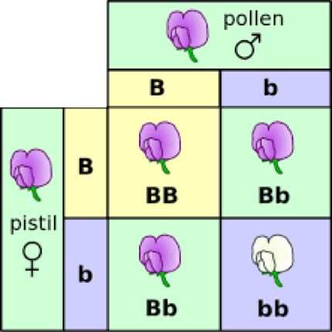
Laws of Inheritance
The Law of Segregation
The Law of Dominance
The Law of Independent Assortment
George Mendel
1865
Rediscovery in 1990
Hugo DeVries
Carl Correns
Erich von Tschermak

Slide 4
Sex chromosome & Linkage
1910
Grandpa
Thomas Hunt Morgan
(Nobel Prize 1933)
Grandson
Fly Room at Columbia University

Slide 5
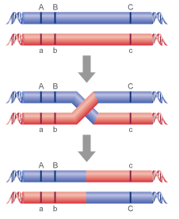
Recombination and genetic map
recombination rate (r): proportion of recombined
r=1%: centi-Morgan

Slide 6
Genetic map
Recombination rate
.5
.5
c
.5
c
.2
a
.4
b
x
b
.2
.4
Genetic distance
0
20cM
6ocM
200cM
a
.5
b
.4
a
.2
c

Slide 7
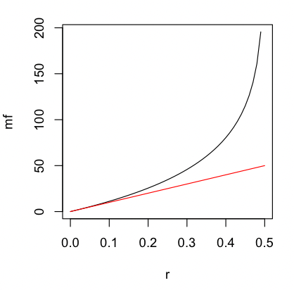
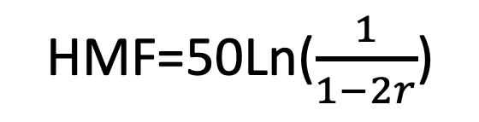
Correction of hidden (double) crossovers
Haldane’s Map Functions
r=seq(0,.5,.01)
mf=-50*(log(1-2*r))
plot(r,mf,type="l")
lines(r,r*100,col="red")
HMF=50Ln($\frac{1}{1−2r}$)
Actual
Genetic distance
(cM)
Observed
recombine
Frequency
(%)
Haldane, J.B.S. 1919, 'The combination of linkage values, and the calculation of distance between the loci of linked factors', Journal of Genetics, vol. 8, pp. 299-309.

Slide 8
Genetic map and Physical Map
Genetic maps are constructed by comparing recombination frequencies between marker pairs (Unit: centi-Morgan)
Physical maps use markers to identify overlapping sequences between larger pieces of DNA (Unit: Base pair).
-By Jamie A O'Rourke
https://doi.org/10.1002/9780470015902.a0000819.pub3
Human: 1 cM corresponds 1 MB on average
Plasmodium falciparum: 1 cM corresponds 15 KB on average
https://en.wikipedia.org/wiki/Centimorgan

Slide 9
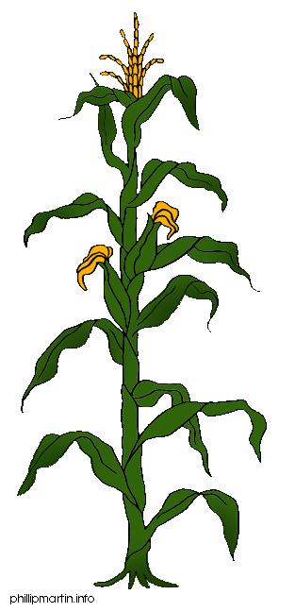
Linkage analysis
Parents
X
F1
F1 gametes
F2 Phenotype
Here lies my QTL
F2 Genotype

Slide 10
Crosses
Breed A
Breed B
M
D
m
d
M
D
m
d
F1
r
M
D
m
d
BCA
F2
M
D
M
D
M
?
M
?
m
?
M
?
m
?
M
?
m
?
m
?

Slide 11
Probability
BCA
M
D
M
D
 | D | d
MM | n1 | n2
Mm | n3 | n4
M
?
m
?
P(?=D | MM)=1-r
P(?=D | Mm)=r
P(?=d | MM)=r
P(?=d | Mm)=1-r
P= r^{(n2+n3)} (1-r)^{(n1+n4)}

Slide 12
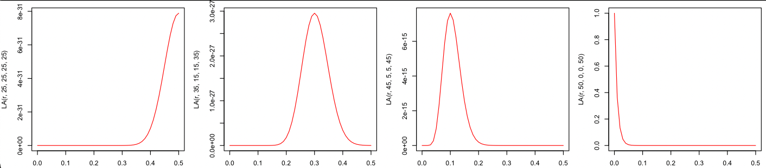
Mapping: vary r to maximize P
P= r^{(n2+n3)} (1-r)^{(n1+n4)}
 | D | d
MM | 25 | 25
Mm | 25 | 25
 | D | d
MM | 35 | 15
Mm | 15 | 35
 | D | d
MM | 45 | 5
Mm | 5 | 45
 | D | d
MM | 50 | 0
Mm | 0 | 50
r=seq(0,.5,.01)
LA=function(r,n1,n2,n3,n4){return(r^(n2+n3)*(1-r)^(n1+n4))}
par(mfrow=c(1,4),mar = c(3,4,1,1))
plot(r,LA(r,25,25,25,25),type="l",col="red")
plot(r,LA(r,35,15,15,35),type="l",col="red")
plot(r,LA(r,45,5,5,45),type="l",col="red")
plot(r,LA(r,50,0,0,50),type="l",col="red")

Slide 13
Multiple markers
M1
M2
M3
M4
Gene
M5
r1
r2
r3
r4
r5
P1
P2
P3
P4
P5
P= P1*P2*P3*P4*P5

Slide 14
Multiple markers
M1
M2
M3
M4
Gene
M5
r1
r2
r3
r4
r5
P1
P2
P3
P4
P5
P= P1*P2*P3*P4*P5

Slide 15
Multiple markers
M1
M2
M3
M4
Gene
M5
r1
r2
r3
r4
r5
P1
P2
P3
P4
P5
P= P1*P2*P3*P4*P5

Slide 16
Multiple genes
M1
M2
Gene
M3
M4
Gene
M5
Population
Single marker to multiple marker
Binary trait to quantitative trait
Single gene to multiple gene
Re-map markers
…

Slide 17
Software for Linkage Analysis
GeneNetwork
HAPPY
MapQTL
Multimapper
MapMaker/QTL
MultiQTL
QTL Café
QTLMap
QTL Cartographer
R/qtlDesign
RQTL

Slide 18
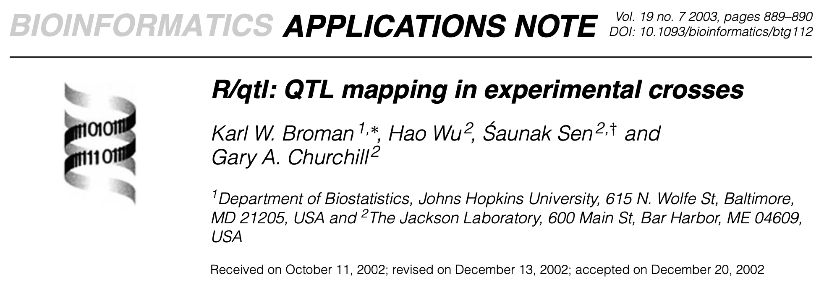
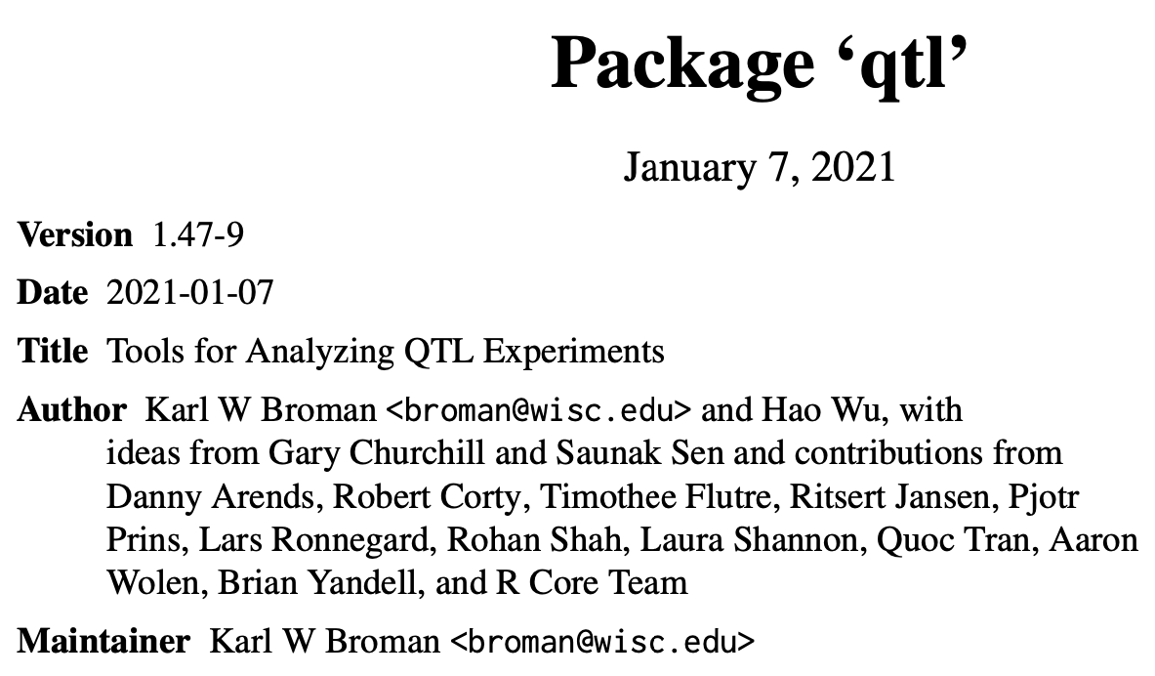
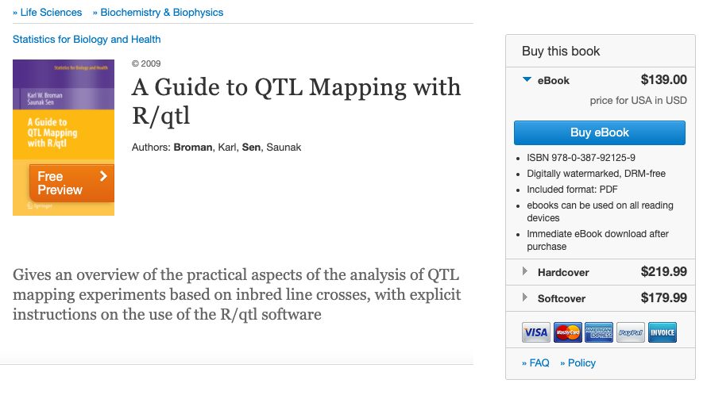
RQTL
2700 citations
https://rqtl.org

Slide 19


Parents
F1
F2 gamete
F2 individuals (10 combinations)
A
A
None crossover
Crossover
A
A
a
a
A
A
a
a
A
a
A
a
A
a
A
a
B
B
b
b
b
b
B
B
B
b
B
B
$$⊗$$
A
A
A
a
a
A
a
a
A
a
B
b
B
b
b
B
B
b
B
B
b
b
b
B
b
B
a
a
Multiple generations/DH
$$⊗$$
b
b
A
a
A
A
a
a
A
a
Recombinant Inbred Lines
(RIL)
B
B
b
b
b
b
B
B

Slide 20
Phenotype simulation
myGD=read.table(file="http://zzlab.net/GAPIT/data/mdp_numeric.txt",head=T)
myGM=read.table(file="http://zzlab.net/GAPIT/data/mdp_SNP_information.txt",head=T)
source("http://zzlab.net/StaGen/2020/R/G2P.R")
source("http://zzlab.net/StaGen/2020/R/GWASbyCor.R")
X=myGD[,-1]
index1to5=myGM[,2]<6
X1to5 = X[,index1to5]
set.seed(99164)
mySim=G2P(X= X1to5,h2=.75,alpha=1,NQTN=10,distribution="norm")
p= GWASbyCor(X=X,y=mySim$y)

Slide 21
Formatting for RQTL
snp_position <- t(myGM[,2:3])
colnames(snp_position) <- myGM[,1]
rownames(snp_position) <- NULL
myX<- myGD[,-1]
myX <- replace(myX, myX == 0, "AA")
myX <- replace(myX, myX == 1, "AB")
myX <- replace(myX, myX == 2, "BB")
myGD_with_posi <- rbind(snp_position, myX)
myY <- cbind(mySim$y,sex="male", pgm="1")
empty_m <- matrix( ,nrow = 2,ncol = 3)
colnames(empty_m) <- colnames(myY)
myYH <- rbind(empty_m,myY)
data_all <- cbind(myYH, myGD_with_posi)
setwd("/Users/zhiwuzhang/Desktop/Temp")
write.csv(data_all,file = "R_qtl_data.csv", row.names=FALSE,na = "")
V1 | sex | pgm | PZB00859.1 | PZA01271.1
 |  |  | 1 | 1
 |  |  | 157104 | 1947984
11.1661365 | male | 1 | BB | AA
10.3747764 | male | 1 | BB | BB
6.23247753 | male | 1 | BB | AA
11.3278416 | male | 1 | BB | BB
11.439109 | male | 1 | AA | AA
14.4603849 | male | 1 | BB | AA
7.88940274 | male | 1 | AA | AA
10.9609674 | male | 1 | AA | AA
3.65271936 | male | 1 | BB | AA
7.95661701 | male | 1 | BB | BB
11.1297326 | male | 1 | BB | AA
11.6405594 | male | 1 | AA | AA
11.5280797 | male | 1 | BB | BB
11.4843363 | male | 1 | BB | AA
11.0464418 | male | 1 | BB | AA
8.99212289 | male | 1 | BB | AA
5.62642265 | male | 1 | AA | AA

Slide 22
Scan with RQTL
#install.packages("qtl")
library("qtl")
# R/qtl read data
cross <- read.cross("csv", file = "R_qtl_data.csv", genotypes = c("AA","AB","BB"))
# R/qtl calculate the LOD
out.mr <- scanone(cross, method="mr")
> dim(out.mr)
[1] 3093 3
> head(out.mr)
chr pos lod
PZB00859.1 1 157104 0.8339674
PZA01271.1 1 1947984 0.5785842
PZA03613.2 1 2914066 0.3206561
PZA03613.1 1 2914171 0.5284641
PZA03614.2 1 2915078 0.7881076
PZA03614.1 1 2915242 0.5354842

Slide 23
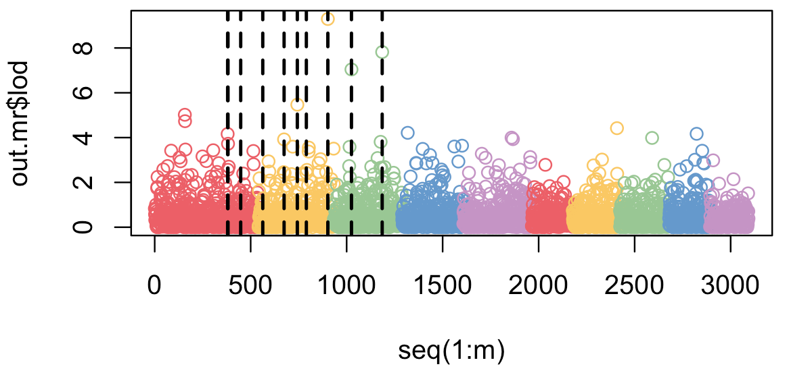
Visualization
color.vector <- rep(c('#EC5f67', '#FAC863', '#99C794', '#6699CC', '#C594C5'),10)
m=nrow(myGM)
plot(out.mr$lod~seq(1:m), col=color.vector[myGM[,2]])
abline(v=mySim$QTN.position, lty = 2, lwd=2, col = "black")

Slide 24
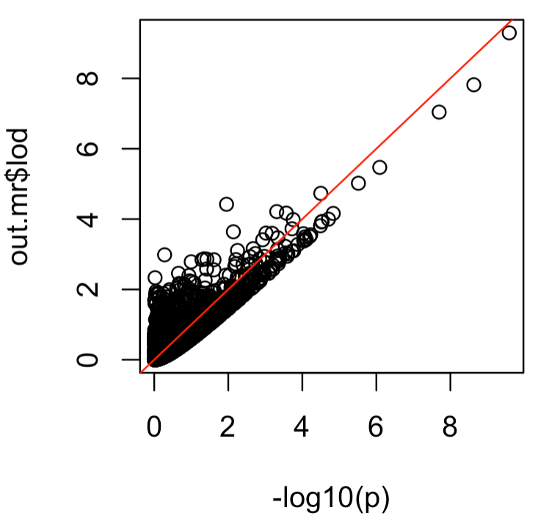
t test vs. RQTL
plot(-log10(p), out.mr$lod,)
abline(a = 0, b = 1, col = "red")
?

Slide 25
Outline
Linkage
Recombination
Haldan’s map function
Linkage analysis
Software
RQTL

