Slide 1
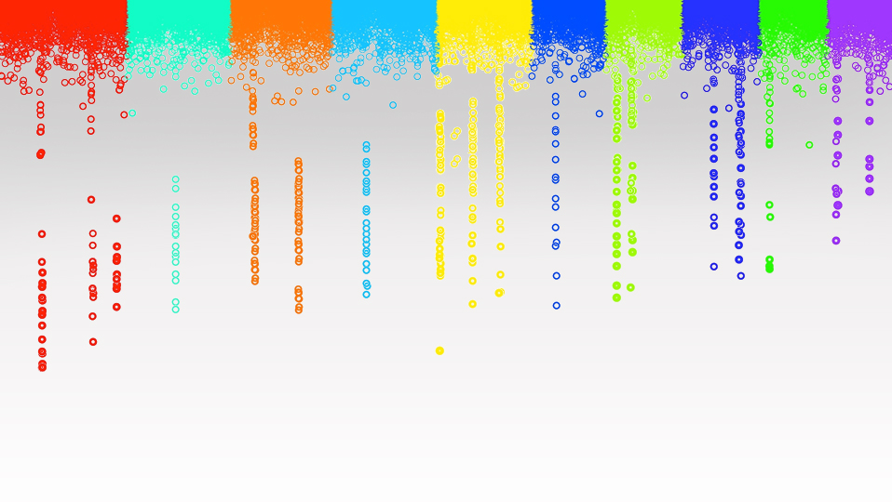

Statistical Genomics
Population Structure
Zhiwu Zhang
Washington State University

Slide 2
Outline
Inflation of P value
Population subdivision
Population structure
Principal component

Slide 3
QTNs 0n CHR 1-5, leave 6-10 empty
myGD=read.table(file="http://zzlab.net/GAPIT/data/mdp_numeric.txt",head=T)
myGM=read.table(file="http://zzlab.net/GAPIT/data/mdp_SNP_information.txt",head=T)
source("http://zzlab.net/StaGen/2023/R/G2P.R")
source("http://zzlab.net/StaGen/2023/R/GWASbyCor.R")
X=myGD[,-1]
index1to5=myGM[,2]<6
X1to5 = X[,index1to5]
set.seed(99164)
mySim=G2P(X= X1to5,h2=.75,alpha=1,NQTN=10,distribution="norm")
p= GWASbyCor(X=X,y=mySim$y)

Slide 4
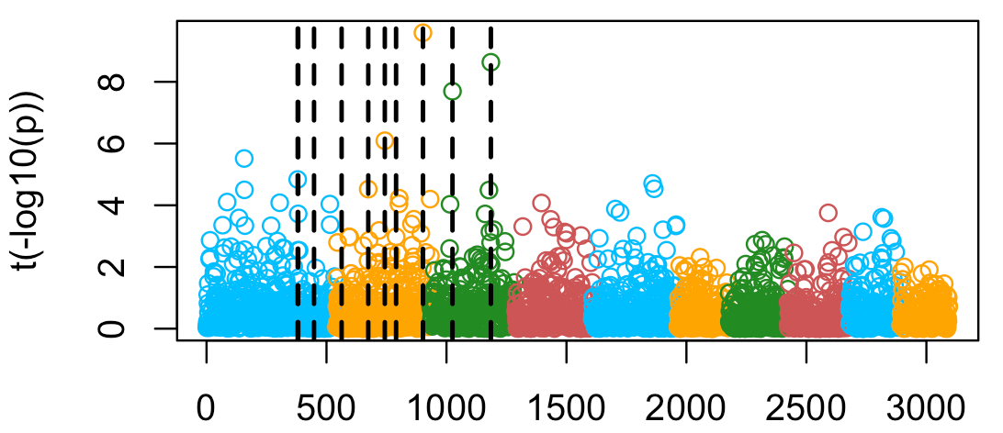
False positives
color.vector <- rep(c("deepskyblue","orange","forestgreen","indianred3"),10)
m=nrow(myGM)
plot(t(-log10(p))~seq(1:m),col=color.vector[myGM[,2]])
abline(v=mySim$QTN.position, lty = 2, lwd=2, col = "black")

Slide 5
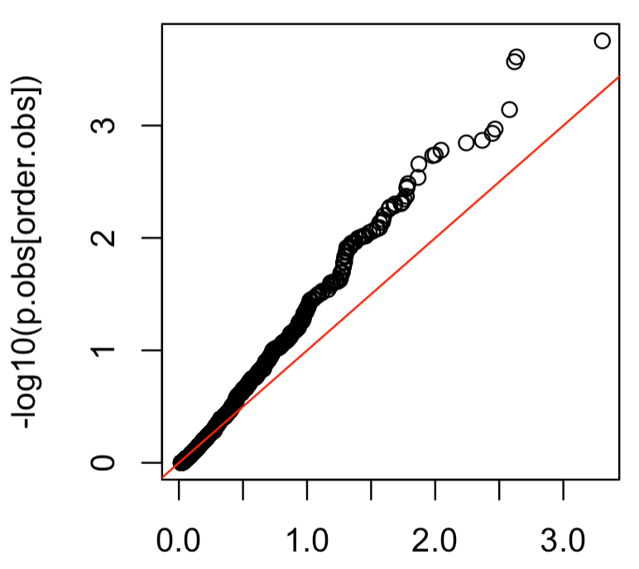
QQ plot
p.obs=p[!index1to5]
m2=length(p.obs)
p.uni=runif(m2,0,1)
order.obs=order(p.obs)
order.uni=order(p.uni)
plot(-log10(p.uni[order.uni]),-log10(p.obs[order.obs]))
abline(a = 0, b = 1, col = "red")

Slide 6
Linkage equilibrium
A
G
Disease
T
G
T
C
Random mating
AG
TG
AC
TC
Control
Case

Slide 7
Association study
Marker | Control | Case
 | 6 | 2
 | 2 | 6
X²=4(2*2/4)=4, df=1, P=4.5%

Slide 8
Linkage disequilibrium (LD)
A
G
Disease
T
G
T
C
Random mating
Breeding and family
Geography
Association
half T as case, none for A
Lead to mistake if G/C is not a marker
AG
TG
TC
Control
Case

Slide 9
CM37
R4
K148
OH7B
Ky228
Mo46
Hi27
DE-3
NC360
NC344
K4
Mo47
Mo45
Yu796-NS
NC362
NC262
CI91B
A682
MO17
Mt42
W401
CMV3
CO106
B97
DE1
NC364
NC342
NC258
CI187-2
NC222
MS153
CI3A
A556
B77
W117HT
B103
Tzi16
Tzi25
B105
SD40
A641
DE811
NC290A
NC236
CM7
B164
N7A
N28HT
A214N
NC250
STIFF STALK
DE-2
B57
C123
I205
H105W
A635
H100
B64
H84
NON STIFF STALK
ND246
CO125
CO109
C103
B79
A634
A632
H91
B68
B84
Hy
Ky21
B14A
B76
A661
WD
CM174
B104
CI21E
A554
B75
CM105
38-11
B37
MS71
Os420
Mo1W
NC260
Mo44
A679
NC328
R229
R168
A680
B73
B109
NC294
NC326
B73Htrhm
N192
NC368
NC314
NC292
NC324
Pa875
W64A
NC308
NC330
NC322
CH9
H49
NC312
NC306
NC372
A619
SD44
WF9
B46
NC268
A239
B10
NC310
VA26
Pa762
OH43
T8
Pa880
C49A
C49
A188
Ky226
Oh43E
Va102
Va35
A654
W153R
Oh40B
Va14
Va17
Va22
Va59
R177
A659
CI-7
H95
W182B
W22
Va99
H99
PA91
CI90C
Va85
M14
33-16
CH701-30
VaW6
4226
NC33
L317
NC232
R109B
B115
MoG
CI66
K55
I137TN
CI31A
CI44
NC230
MEF 156-55-2
81-1
M162W
K64
CI64
IL677A
Ia5125
E2558W
N6
IA2132
SWEET
CML52
IL14H
P39
T234
L578
SC357
IL101
CML14
CML69
Tzi11
CML38
CML287
B52
NC366
EP1
F2
CML103
CML108
SC213R
CO255
F7
CML9
GT112
CML61
CML254
CML5
CML314
T232
GA209
NC238
CML264
CML258
Q6199
CML10
CI28A
B2
Mp339
CML11
CML45
CML341
CML332
MS1334
U267Y
CML261
CML331
Sg1533
SG18
IDS28
Mo24W
F2834T
D940Y
M37W
IDS69
HP301
CML277
CML322
CML321
CML238
IDS91
SA24
CML247
Ki14
Ki11
A6
F44
4722
TROPICAL-
SUBTROPICAL
Ki2021
F6
I-29
CML157Q
Ki43
Ki44
Oh603
POPCORN
Ki21
Ki2007
CML228
NC340
CML323
CML328
NC300
A272
CML218
CML92
Tx303
Ki3
NC302
NC356
CML77
NC320
NC332
NC318
SC55
A441-5
TZI18
NC354
NC338
NC358
CML154Q
TZI10
NC334
NC370
NC264
TX601
CML349
Tzi9
CML220
Mo18W
Ab28A
NC350
CML333
NC304
CML91
CML158Q
MIXED
CML311
TZI8
0.1
Based on 89 SSR loci
CML281
NC296A
NC346
parvi-03
NC336
NC296
NC298
NC352
NC348
ssp. parviglumis
Flint-Garcia et al. (2005) Plant J. 44: 1054
parvi-30
parvi-49
parvi-14
parvi-36

Slide 10
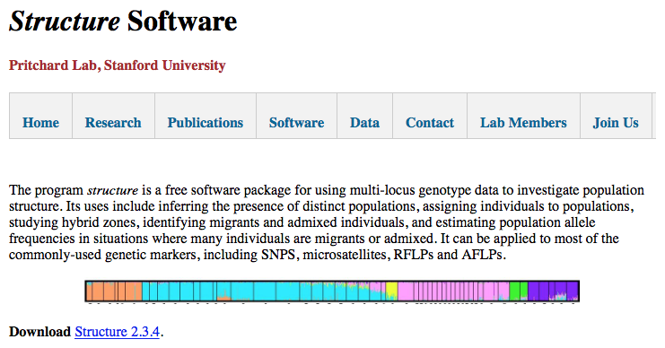
Population structure
Jonathan K. Pritchard, Matthew Stephens and Peter Donnelly. Inference of Population Structure Using Multilocus Genotype Data. Genetics, 2000.

Slide 11
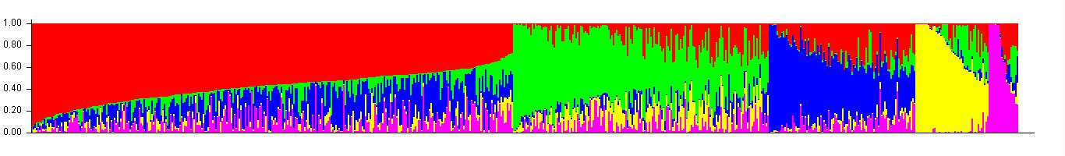
Population structure of maize
Taxa | Q1 | Q2 | Q3
33-16 | 0.014 | 0.972 | 0.014
38-11 | 0.003 | 0.993 | 0.004
4226 | 0.071 | 0.917 | 0.012
4722 | 0.035 | 0.854 | 0.111
A188 | 0.013 | 0.982 | 0.005
B73 | 0.999 | 0.001 | 1.10E-16
B73HTRHM | 0.999 | 0.001 | 1.10E-16
B75 | 0.005 | 0.993 | 0.002
WD | 0.014 | 0.97 | 0.016
WF9 | 0.005 | 0.994 | 0.001
YU796NS | 0.189 | 0.785 | 0.026

Slide 12
Relationship among variables

Slide 13
Principal components

Slide 14
Principal Component Analysis (PCA)
X-Y: Correlated
PCs
  Uncorrelated
  Var(PC1)>Var(PC2)
Y
PC2
PC1
X

Slide 15
Principal Component Analysis
data
n individual by p features
Covariance or correlation
eigen value
Eigen
Vector
(loading)
X→A
→ λ V
AV=λV
n by p
p by p
p by p
p by p
Y=XV
Principal
Components
n by p
n by p
p by p
https://www.youtube.com/watch?v=PFDu9oVAE-g&t=443s

Slide 16
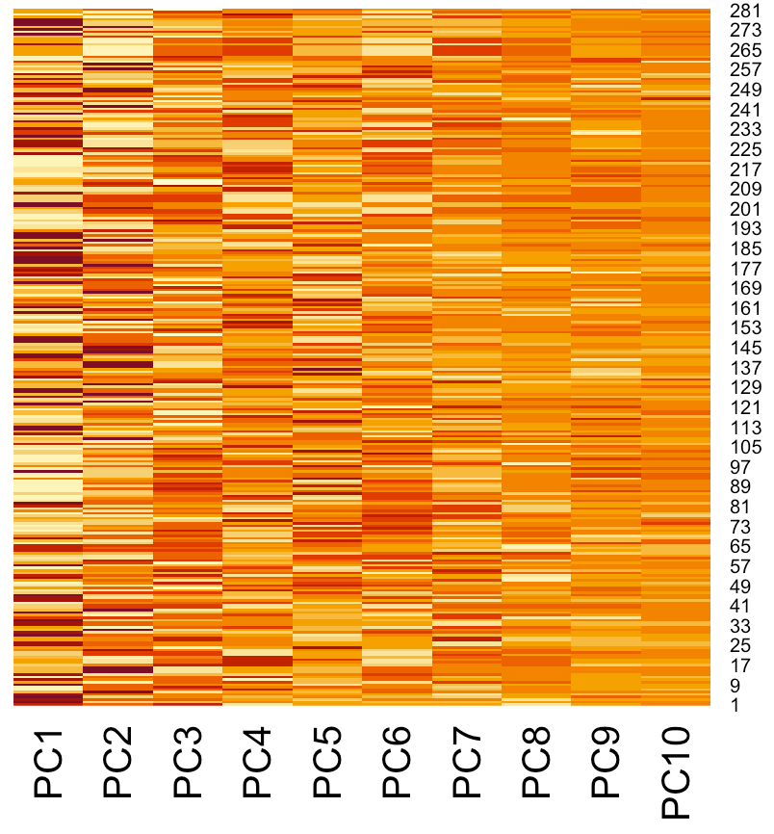
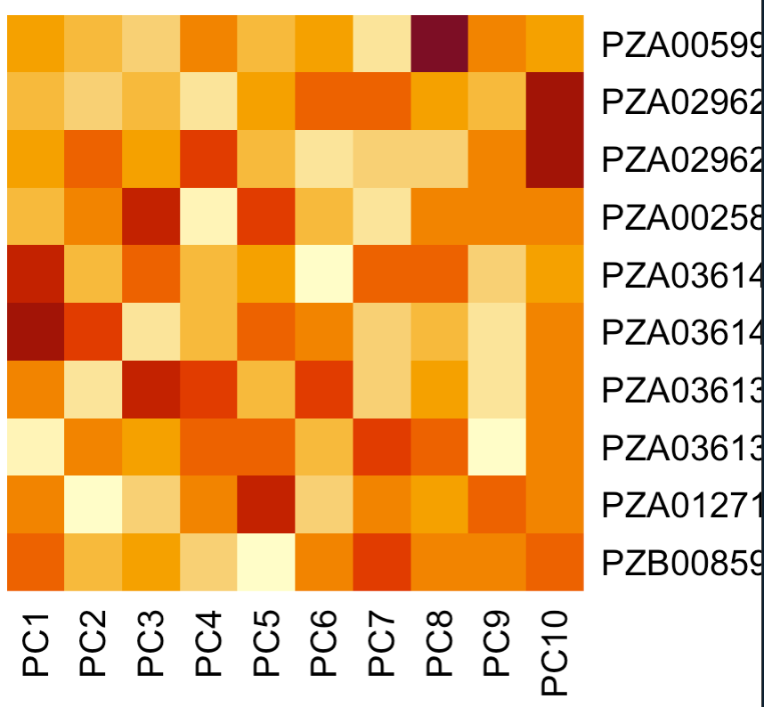
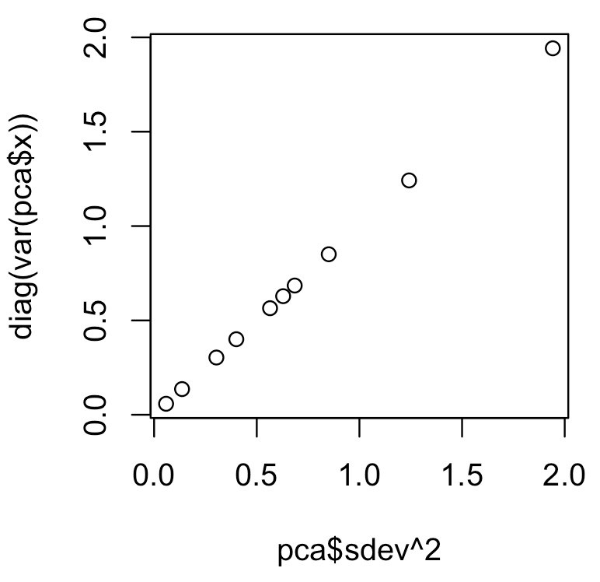
PCA in R using first 10 SNPs
pca=prcomp(X[,1:10])
str(pca)
heatmap(pca$x,Colv = NA,Rowv = NA)
heatmap(pca$rotation,Colv = NA,Rowv = NA)
plot(pca$sdev^2, diag(var(pca$x)))
List of 5
$ sdev : num [1:10] 1.394 1.114 0.922 0.828 0.793 ...
$ rotation: num [1:10, 1:10] -0.0574 0.058 -0.5834 0.1601 0.5196 ...
..- attr(*, "dimnames")=List of 2
.. ..$ : chr [1:10] "PZB00859.1" "PZA01271.1" "PZA03613.2" "PZA03613.1" ...
.. ..$ : chr [1:10] "PC1" "PC2" "PC3" "PC4" ...
$ center : Named num [1:10] 1.52 1.02 1.42 1.5 1.06 ...
..- attr(*, "names")= chr [1:10] "PZB00859.1" "PZA01271.1" "PZA03613.2" "PZA03613.1" ...
$ scale : logi FALSE
$ x : num [1:281, 1:10] 1.45 2.05 1.98 1.78 2.05 ...
..- attr(*, "dimnames")=List of 2
.. ..$ : NULL
.. ..$ : chr [1:10] "PC1" "PC2" "PC3" "PC4" ...pp
- attr(*, "class")= chr "prcomp"

Slide 17
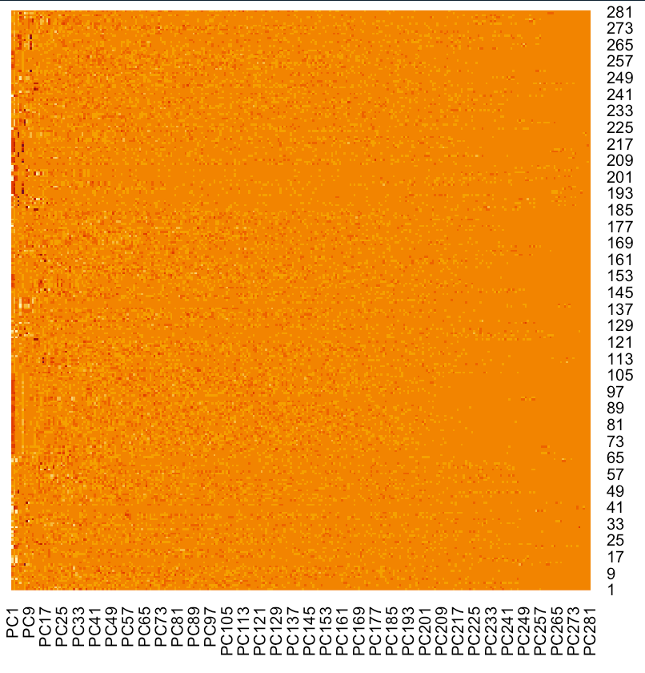
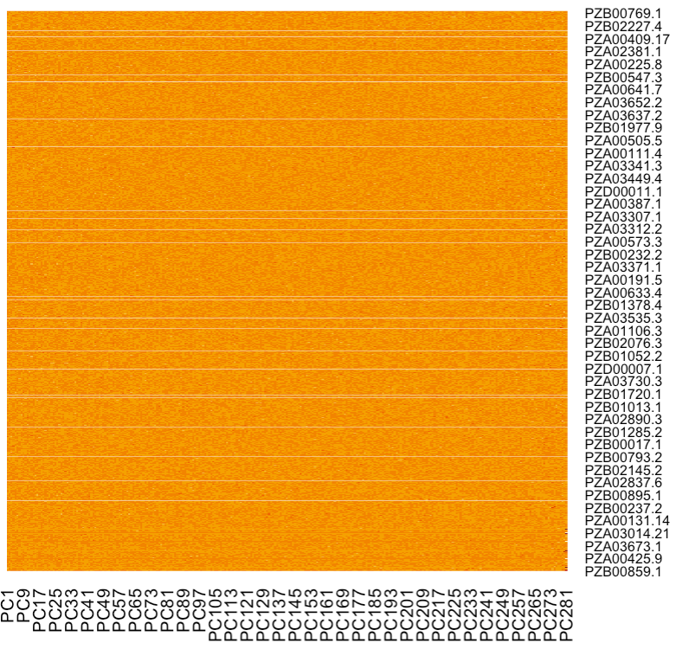
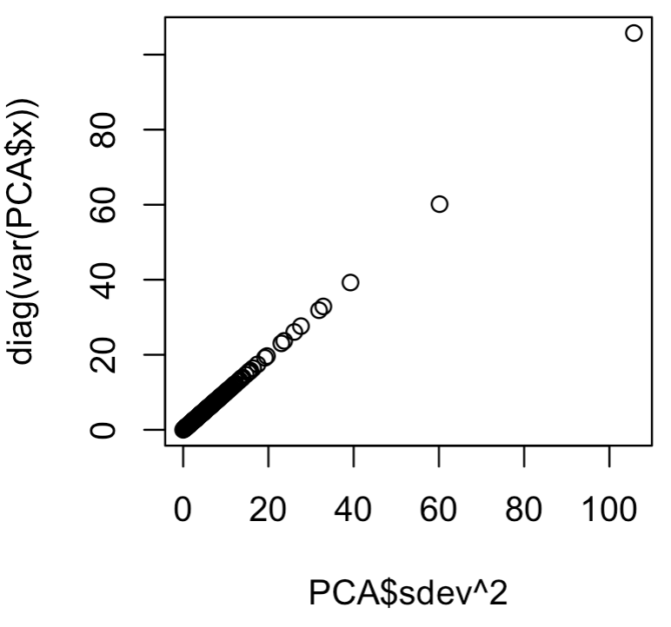
PCA in R using all SNPs
PCA=prcomp(X)
str(pca)
heatmap(PCA$x,Colv = NA,Rowv = NA)
heatmap(PCA$rotation,Colv = NA,Rowv = NA)
plot(PCA$sdev^2, diag(var(PCA$x)))
List of 5
$ sdev : num [1:281] 10.28 7.76 6.27 5.73 5.65 ...
$ rotation: num [1:3093, 1:281] 0.00103 0.02962 0.00296 0.03495 -0.01134 ...
..- attr(*, "dimnames")=List of 2
.. ..$ : chr [1:3093] "PZB00859.1" "PZA01271.1" "PZA03613.2" "PZA03613.1" ...
.. ..$ : chr [1:281] "PC1" "PC2" "PC3" "PC4" ...
$ center : Named num [1:3093] 1.52 1.02 1.42 1.5 1.06 ...
..- attr(*, "names")= chr [1:3093] "PZB00859.1" "PZA01271.1" "PZA03613.2" "PZA03613.1" ...
$ scale : logi FALSE
$ x : num [1:281, 1:281] 1.68 -1.6 -0.9 2.13 0.63 ...
..- attr(*, "dimnames")=List of 2
.. ..$ : NULL
.. ..$ : chr [1:281] "PC1" "PC2" "PC3" "PC4" ...
- attr(*, "class")= chr "prcomp"

Slide 18
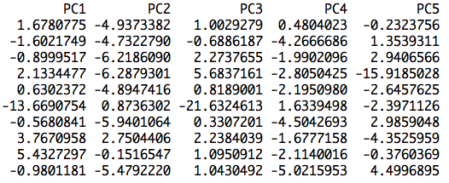
Extraction
> dim(PCA$sdev)
NULL
> str((PCA$sdev))
num [1:281] 10.28 7.76 6.27 …
> dim(PCA$rotation)
[1] 3093 281
> dim(PCA$x)
[1] 281 281
Eigen value: $sdev squared
Eigen vector: $rotation
Principal component: $x
dim(PCA$sdev)
str((PCA$sdev))
dim(PCA$rotation)
dim(PCA$x)
heatmap(PCA$x, Colv = NA)
PCA$x[1:10,1:5]

Slide 19
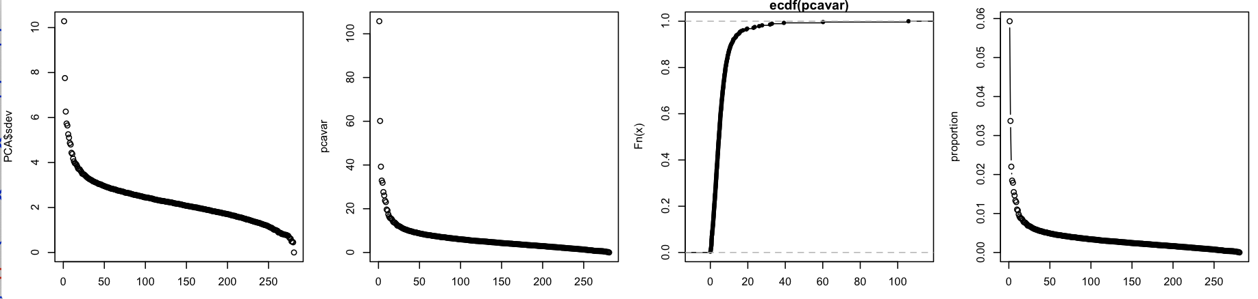
Contribution
par(mfrow=c(1,4),mar = c(3,4,1,1))
plot(PCA$sdev)
plot(pcavar)
plot(ecdf(pcavar))
plot(proportion,type="b")
pcavar =PCA$sdev^2
proportion= pcavar/sum(pcavar)

Slide 20
Visualization
plot(PCA$x[,1],PCA$x[,2],col="red")

Slide 21
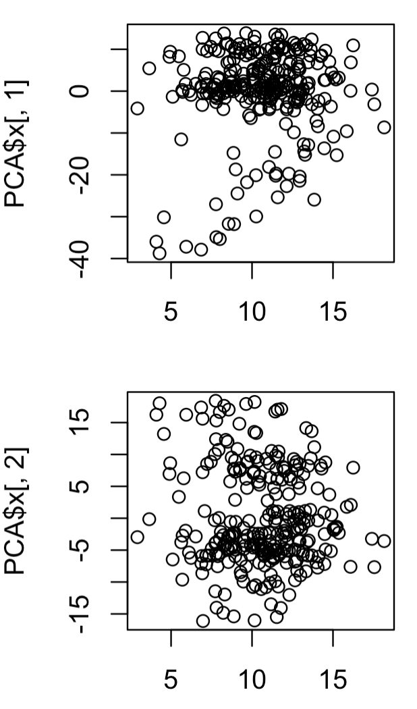
Association with phenotypes
PC1
r=0.09
par(mfrow=c(2,1),mar = c(3,4,1,1))
plot(mySim$y,PCA$x[,1])
cor(mySim$y,PCA$x[,1])
plot(mySim$y,PCA$x[,2])
cor(mySim$y,PCA$x[,2])
PC2
r=-0.08
Phenotype

Slide 22
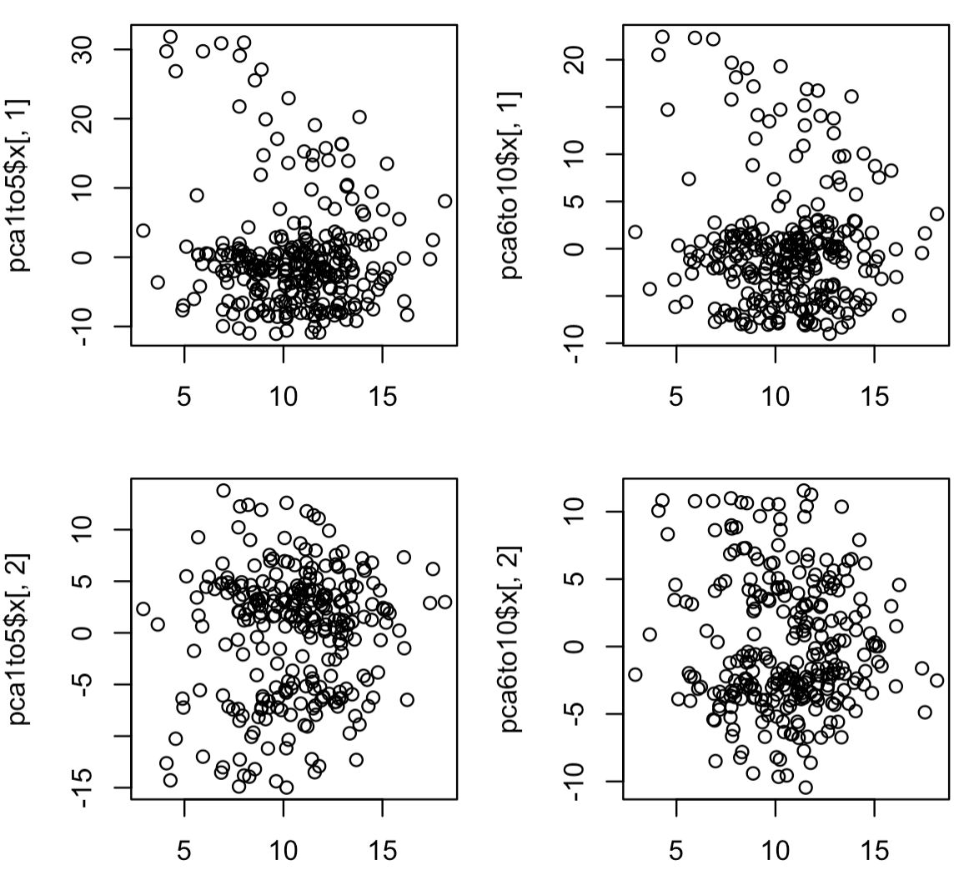
Association
CHR1-5
CHR6-10
r=-0.11
r=-0.07
pca1to5=prcomp(X[,index1to5])
pca6to10=prcomp(X[,!index1to5])
par(mfrow=c(2,2), mar = c(3,4,1,1))
plot(mySim$y, pca1to5$x[,1])
cor(mySim$y, pca1to5$x[,1])
plot(mySim$y, pca6to10$x[,1])
cor(mySim$y, pca6to10$x[,1])
plot(mySim$y, pca1to5$x[,2])
cor(mySim$y, pca1to5$x[,2])
plot(mySim$y, pca6to10$x[,2])
cor(mySim$y, pca6to10$x[,2])
PC1
PC2
r=0.09
r=-0.06
Phenotype

Slide 23
Outline
Inflation of P value
Population subdivision
Population structure
Principal component

