Slide 1
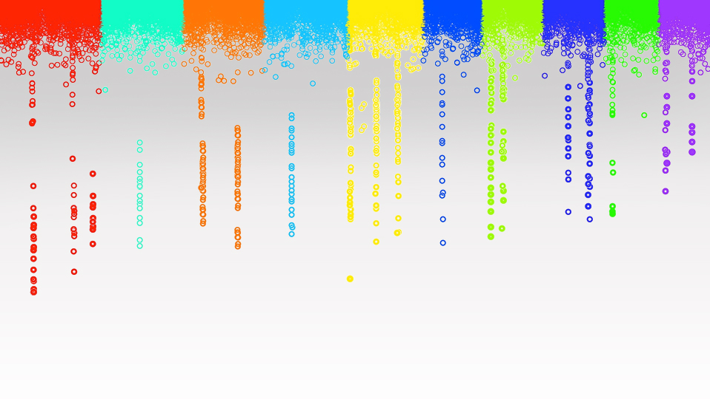
Genomic Prediction
Workshop
Zhiwu Zhang
Washington State University

Slide 2
Academic milestones
2007: Implemented Mixed Linear Model in TASSEL for GWAS (6352 citations)
2007: Reinvention of gBLUP (60)
2010: Invention of Compressed Mixed Linear Model for GWAS (1920)
2012: Implemented gBLUP and Genome Wide Association Study in GAPIT (1786)
2014: Invention of SUPER method for Genome Wide Association Study (221)
2016: Invention of FarmCPU method for Genome Wide Association Study (899)
2018: Invention of Compressed BLUP and SUPER BLUP (58)
2019: Invention of BLINK method for Genome Wide Association Study (259)

Slide 3
Objectives
Develop concepts and analytical skills for modern breeding by using genomic prediction in framework of mixed linear models and Bayesian approaches.
Add data value for publications
Creative and critical thinking

Slide 4
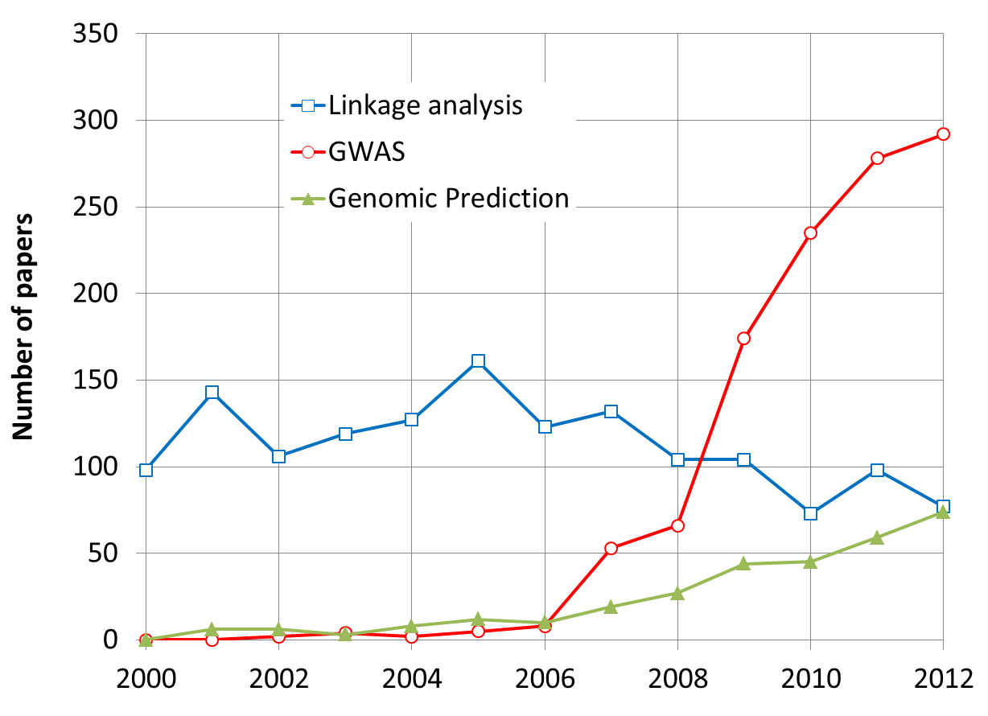
More Research on GWAS and GS
By May 31, 2013

Slide 5
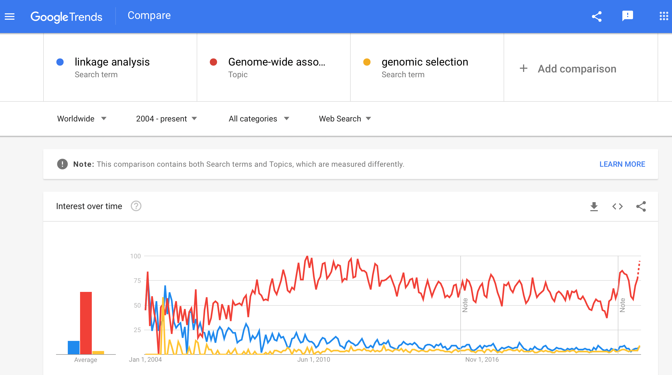

Slide 6
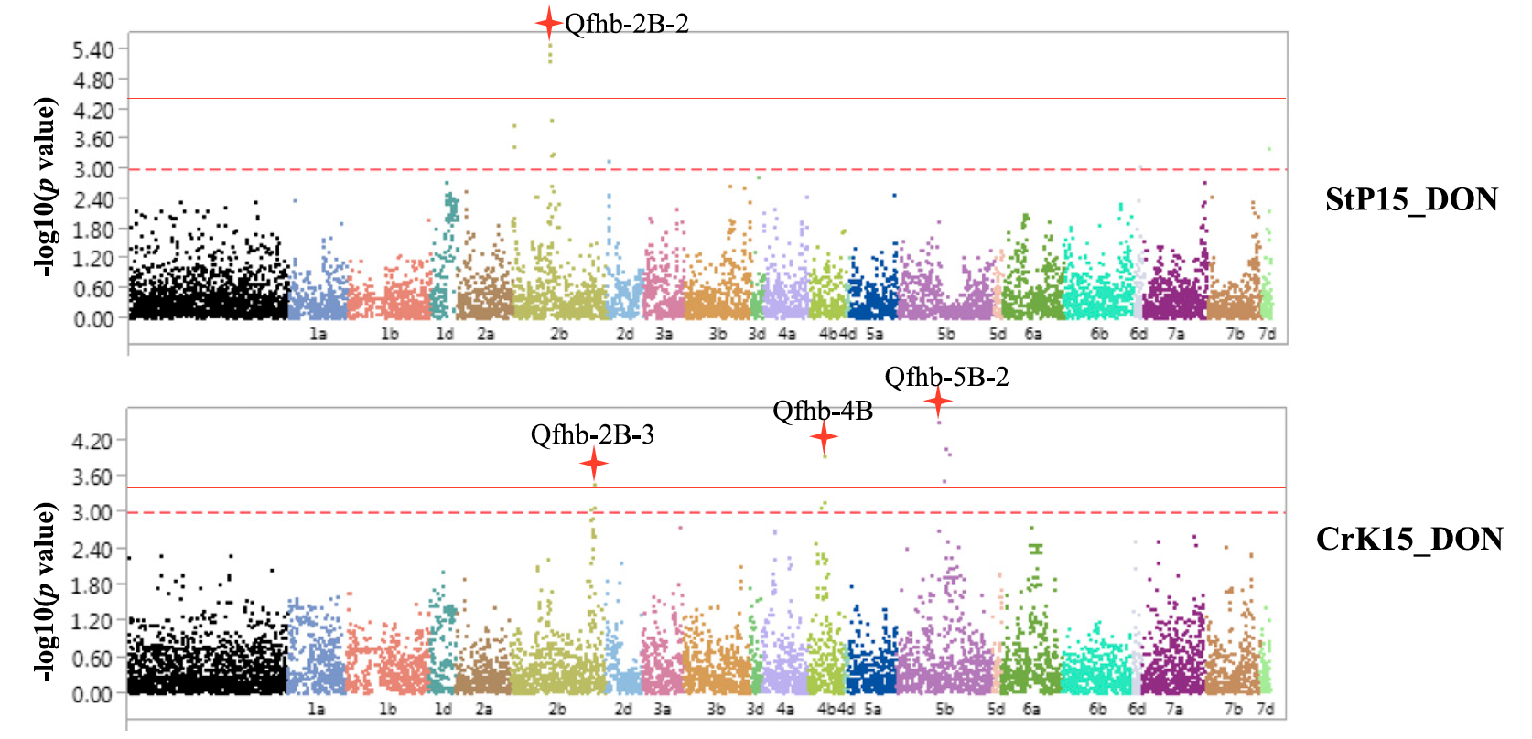
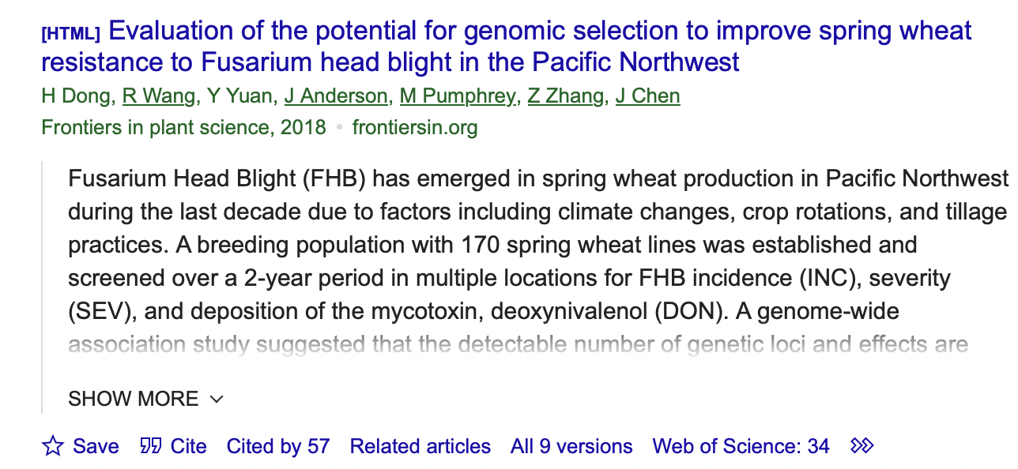
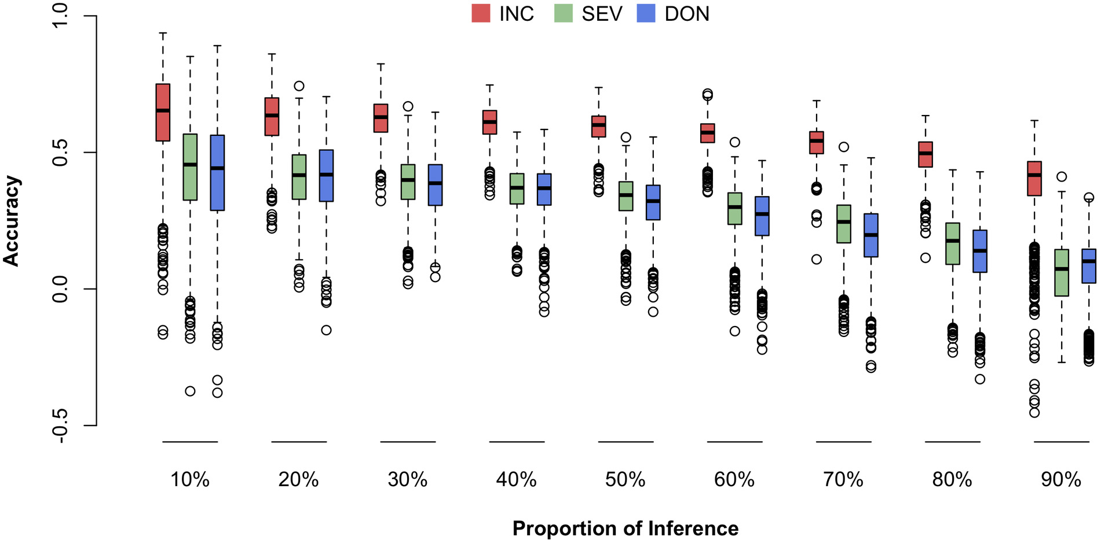
GWAS vs. GS

Slide 7
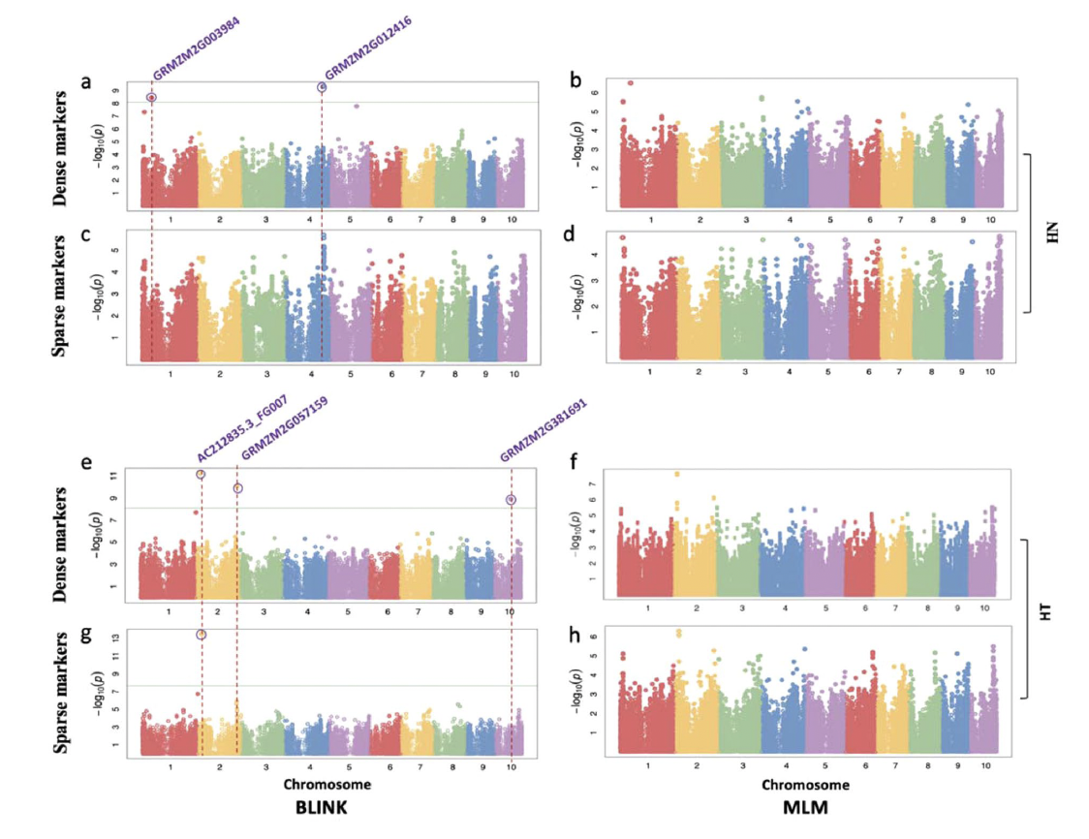
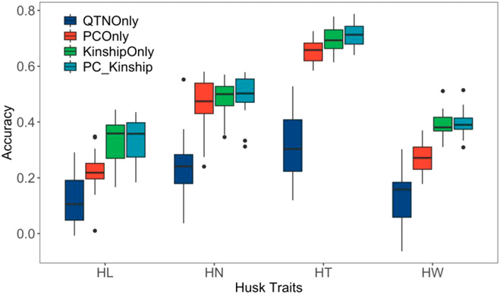
GWAS vs. GS

Slide 9
Genomic Prediction Workshop

Slide 10
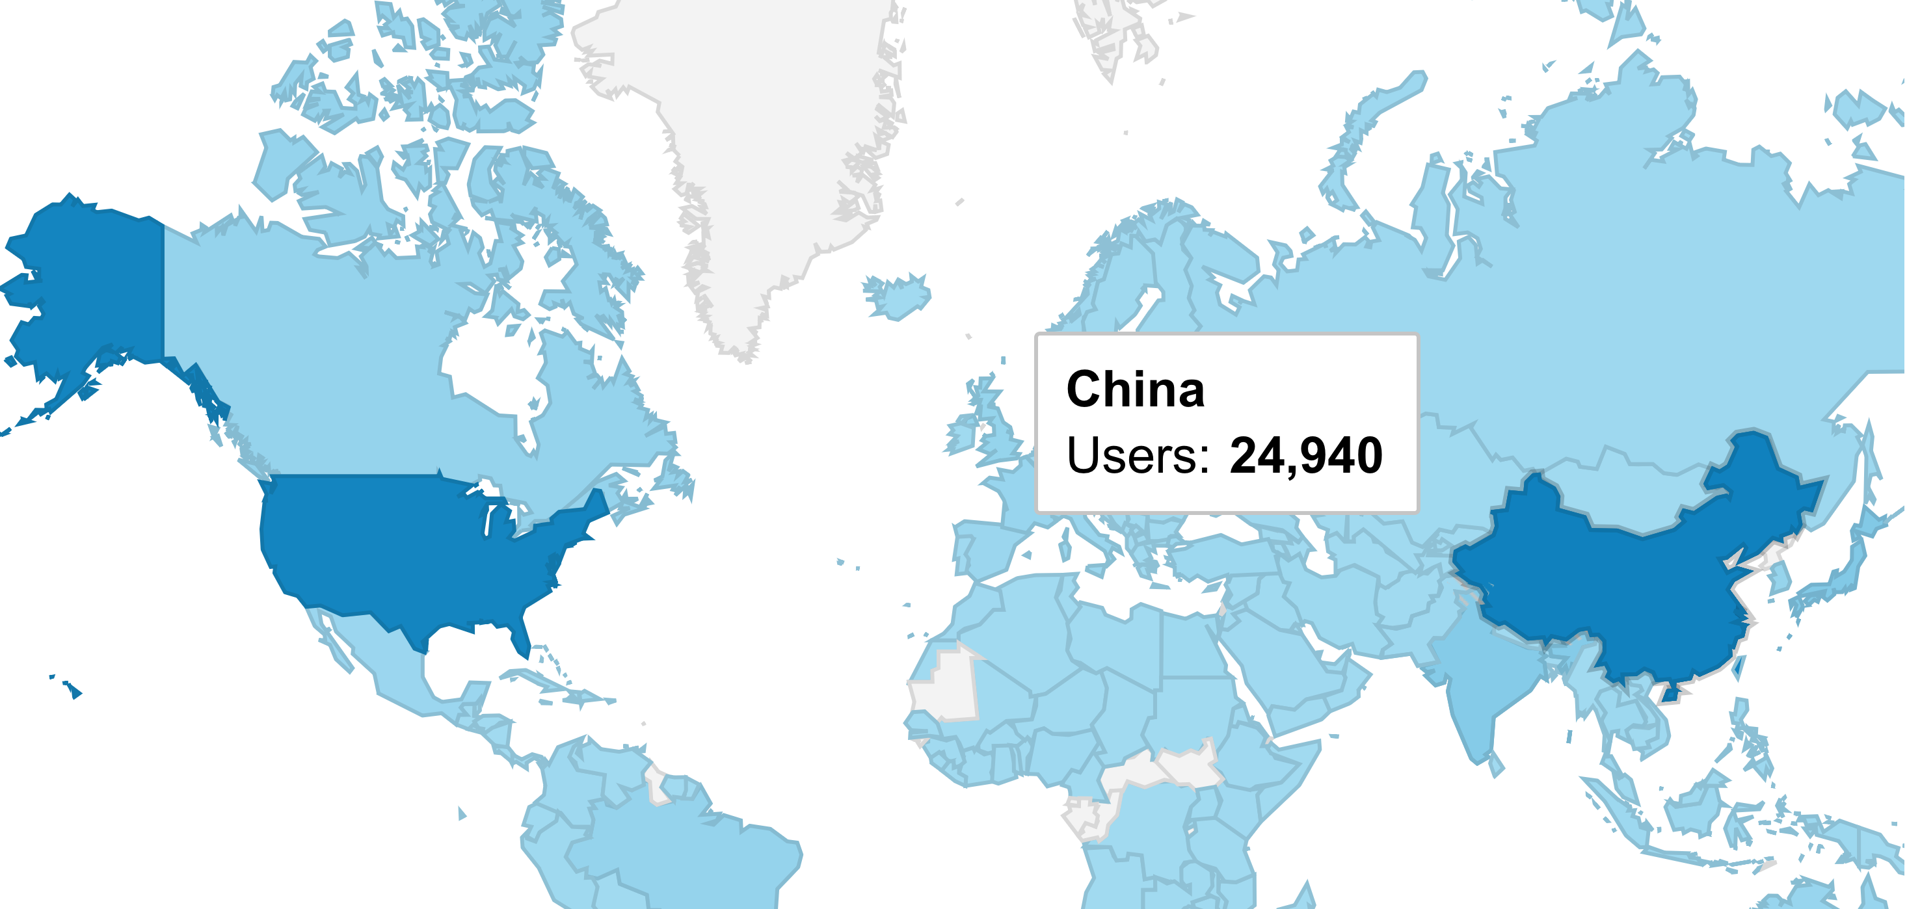
ZZLab.net Worldwide Usage

Slide 11
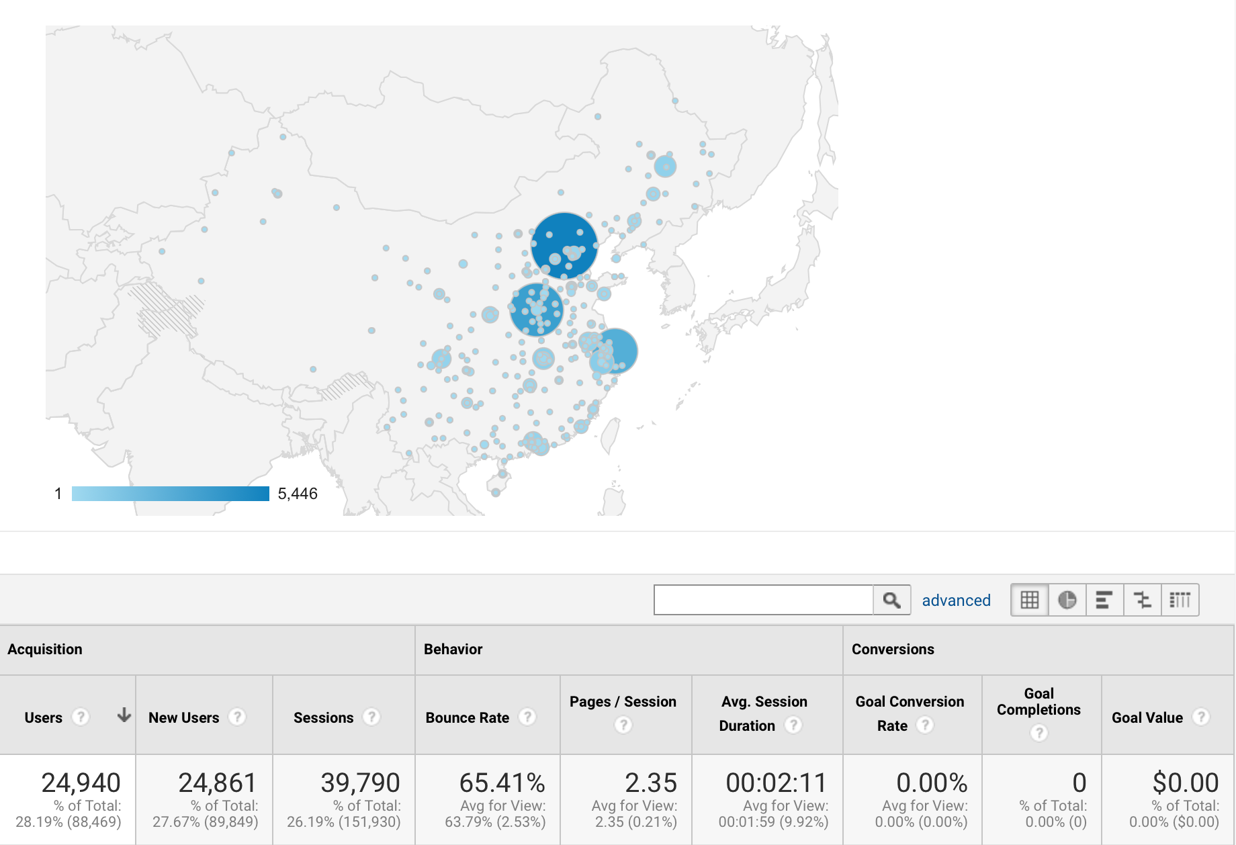
Usage in China
Workshop
GWAS?
郑州
上海
深圳
其它

