Slide 1
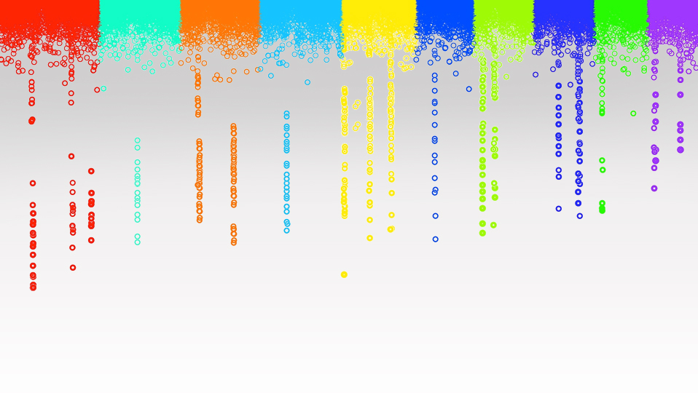

Statistical Genomics
Phenotype and simulation
Zhiwu Zhang
Washington State University

Slide 2
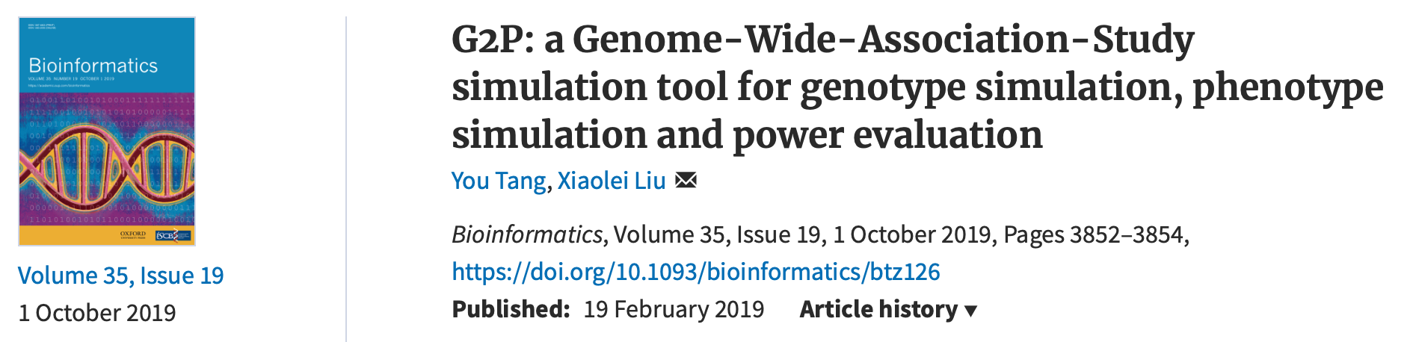

Outline
Accumulation of gene effect
Genetic architecture
Gene effect distribution
Phenotype distribution
Heritability
R function

Slide 3
How phenotypes get normal distributed?
x~B(n, p)
n trials each with p successful rate.
The total number of successes is a random variable, x
p=0.5,
Left-fail
Right-success
x=rbinom(10000,5,0.5)
1
Gene 1
Gene 2
1
2
1
Gene 3
1
3
3
1
Gene 4
1
4
6
4
1
Gene 5
1
5
10
10
5
1
Even genes have the same effect
0
1
2
3
4
5
Outcome

Slide 4
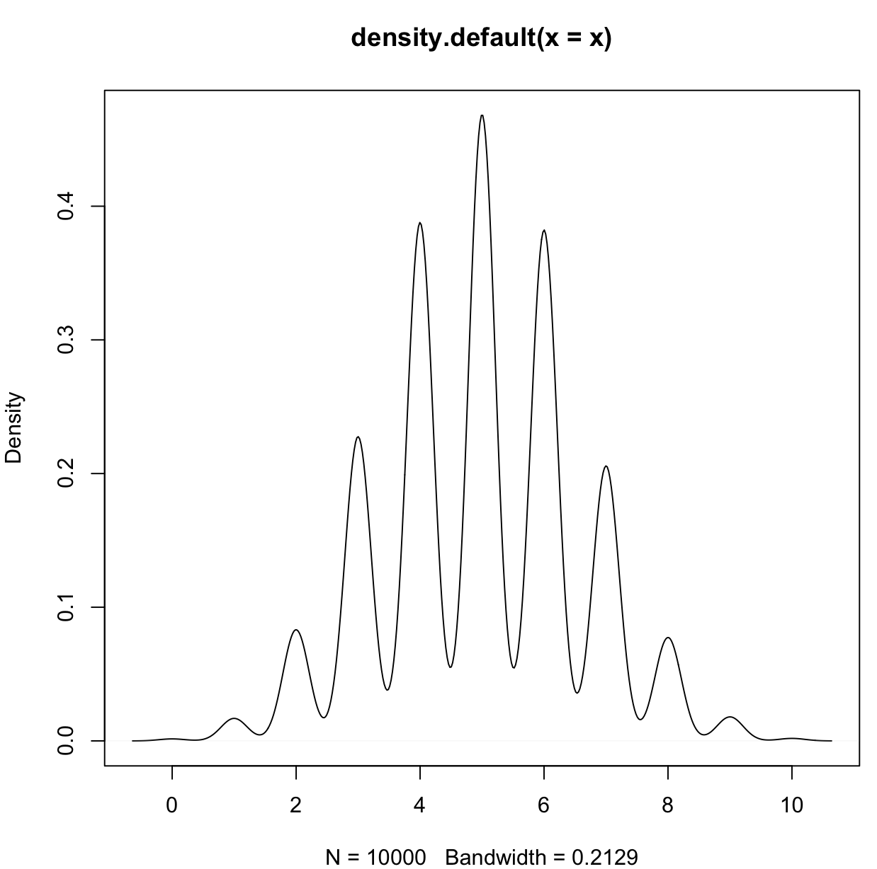
Ten gens with same effect (unit=1)
Distribution of total effect of 10 genes
individual=10000
gene=10
x=rbinom(n=individual, gene,.5)
hist(x)
plot(density(x))
How to be closer to normal distribution?

Slide 5
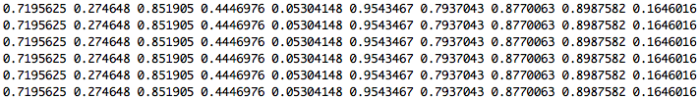
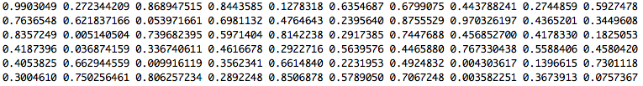
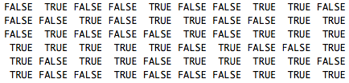
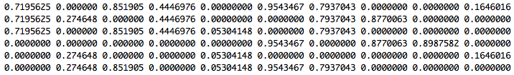
Ten gens with different effect (0~1)
Excel!
Gene effect
Assign to six individuals
Uniform random variable
< 0.5?
Gene effects among the six individuals
SUM
Individuals' total effect

Slide 6
Ten gens with different effects
#x=rep(1,m)
x=runif(m)
gene=matrix(x,n,m,byrow = T)
head(gene)
galton=matrix(runif(n*m),n,m)
head(galton)
galton.binary=galton<.5
head(galton.binary)
gene[galton.binary]=0
head(gene)
y=rowSums(gene)
y[1:6]
hist(y)
plot(density(y))

Slide 7
10 genes
100 genes
Same effect
Different effects

Slide 8
Complex traits
Controlled by multiple genes
Influenced by environment
Also known as quantitative traits
Most traits are continuous, e.g. yield and height,
Some are categorical, e.g. node number, score of disease resistance
Some binary traits are still quantitative traits, e.g. diabetes
Economically important

Slide 9
Dissecting phenotype
Y= G + E + GxE + Residual
G = Additive + Dominance + Epistasis
E: Environment, e.g. year and location
Residual: e.g. measurement error

Slide 10
QTL and QTN
Quantitative Trait Loci (QTL)
Specific regions in the genome that are associated with quantitative traits
The regions were traditionally considered as 10-15 cM. The regions evolved to 3-5 cM in fine mapping.
  Suppose maize genome contains 50,000 genes and has genetic map =1700 cM
  Each QTL we identify has roughly 100-150 genes
Gene cloning: identification the QTL regions at gene level
Ultimate goal: functional mutations
Quantitative Trait Nucleotide: QTN

Slide 11
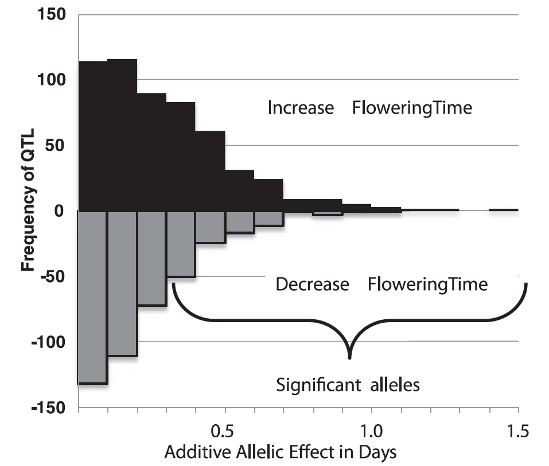
Gene effects
Flowering time is controlled by >50 genes
Most have small effects
The largest one only 1.5 increase days
Buckler et al, Science, 2009

Slide 12
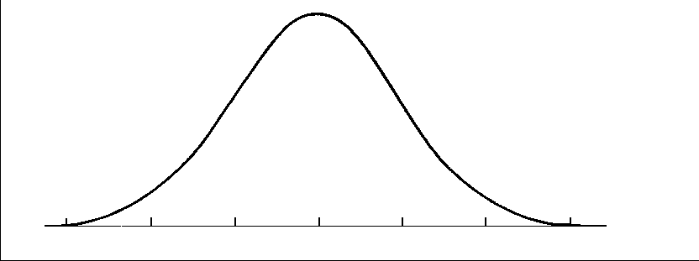
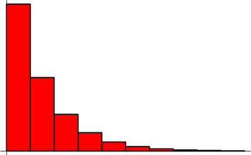
Distribution of QTN effect
Normal distribution
Geometry distribution

Slide 13
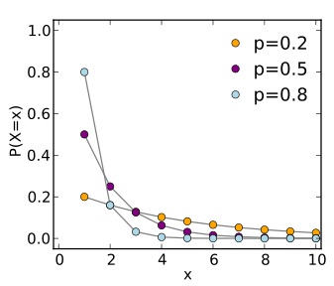
Theoretical geometric distribution
The probability distribution of the number (X) of Bernoulli trials needed to get one success
Prob (X=k)=(1-p)^{k-1} p

Slide 14
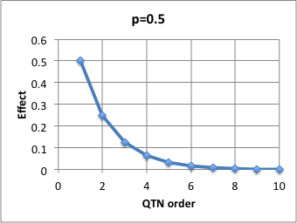
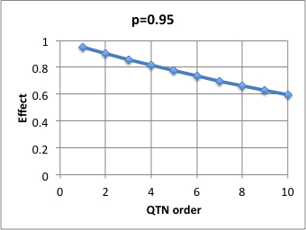
Approximated geometric distribution
Effect(X=k)=p^{k}
Effect of k^{th} QTN

Slide 15
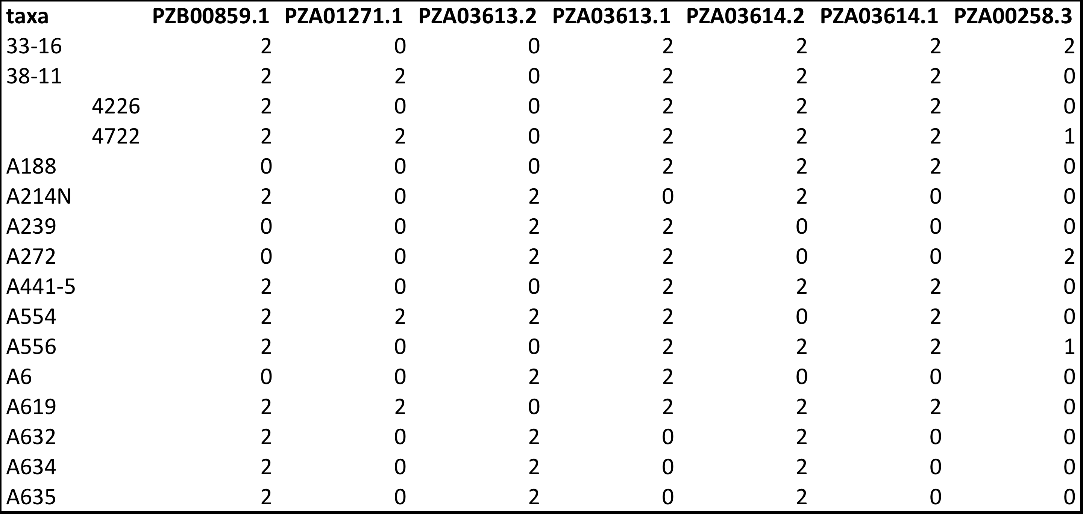
Genotype in Numeric format
myGD=read.table(file="http://zzlab.net/GAPIT/data/mdp_numeric.txt",head=T)

Slide 16
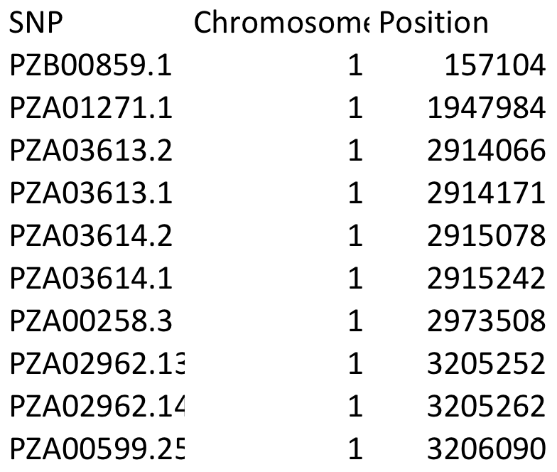
Genetic map
myGM=read.table(file="http://zzlab.net/GAPIT/data/mdp_SNP_information.txt",head=T)

Slide 17
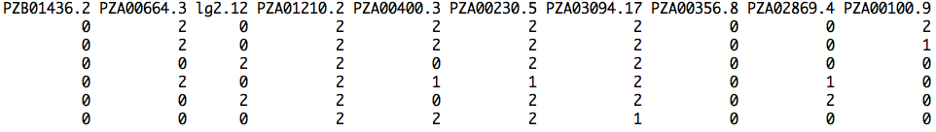
Sampling QTNs
#Sampling QTN
NQTN=10
X=myGD[,-1]
n=nrow(X)
m=ncol(X)
QTN.position=sample(m,NQTN,replace=F)
SNPQ=as.matrix(X[,QTN.position])
QTN.position
head(SNPQ)

Slide 18
QTN positions
plot(myGM[,c(2,3)])
lines(myGM[QTN.position,c(2,3)],type="p",col="red")
points(myGM[QTN.position,c(2,3)],type="p",col="blue",cex = 5)

Slide 19
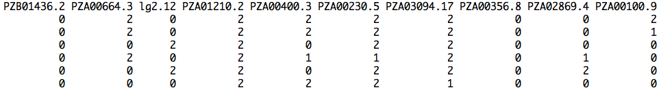

Additive genetic effect
addeffect=rnorm(NQTN,0,1)
addeffect
effect=SNPQ%*%addeffect
head(effect)

Slide 20
genetic effect distribution
par(mfrow=c(2,2))
plot(effect)
hist(effect)
boxplot(effect)
plot(ecdf(effect))

Slide 21
Phenotype = genetic + residual
y1 = g1 + e1
y2 = g2 + e2
y3 = g3 + e3
y4 = g4 + e4
y5 = g5 + e5
y6 = g6 + e6
…
Var(g): Calculated variance among individuals genetic effects
Var(g)
h²= --------------------------------------
Var(g) + Var(e)
y = g + e
Var(e) =(Var(g) - Var(g) h² ) / h²

Slide 22
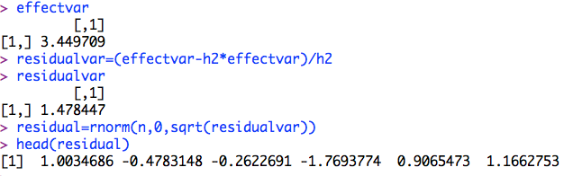
Residual
h2=.7
effectvar=var(effect )
effectvar
residualvar=(effectvar-h2*effectvar)/h2
residualvar
residual=rnorm(n,0,sqrt(residualvar))
head(residual)

Slide 23
Residual distribution
par(mfrow=c(2,2))
plot(residual)
hist(residual)
boxplot(residual)
plot(ecdf(residual))

Slide 24
Phenotype
y=effect+residual
par(mfrow=c(2,2))
plot(y)
hist(y)
boxplot(y)
plot(ecdf(y))

Slide 25
Heritability
plot(density(y),ylim=c(0,.5))
lines(density(effect),col="blue")
lines(density(residual),col="red")
va=var(effect)
ve=var(residual)
vp=var(y)
v=matrix(c(va,ve,vp),1,3)
colnames(v)=c("A", "E","P")
barplot(v,col="gray")

Slide 26
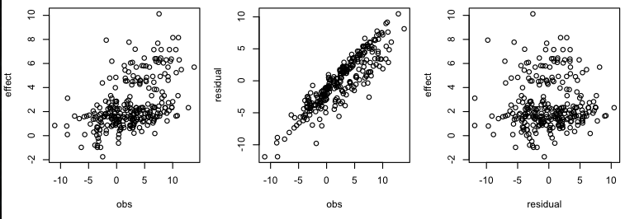
Correlations
#Plot
par(mfrow=c(1,3),mar = c(30,4,10,1))
plot(y,effect)
plot(y,residual)
plot(residual,effect)
cor(y,effect)

Slide 27
How to do this again and again?
Function to simulate phenotypes

Slide 28
G2P=function(X,h2,alpha,NQTN,distribution){
n=nrow(X)
m=ncol(X)
#Sampling QTN
QTN.position=sample(m,NQTN,replace=F)
SNPQ=as.matrix(X[,QTN.position])
QTN.position
#QTN effects
if(distribution=="norm")
{addeffect=rnorm(NQTN,0,1)
}else
{addeffect=alpha^(1:NQTN)}
#Simulate phenotype
effect=SNPQ%*%addeffect
effectvar=var(effect)
residualvar=(effectvar-h2*effectvar)/h2
residual=rnorm(n,0,sqrt(residualvar))
y=effect+residual
return(list(addeffect = addeffect, y=y, add = effect, residual = residual, QTN.position=QTN.position, SNPQ=SNPQ))
}

Slide 29
Load R function
source('~/Dropbox/Current/ZZLab/WSUCourse/CROPS545/Demo/G2P.R')

Slide 30
source('~/Dropbox/Current/ZZLab/WSUCourse/CROPS545/Demo/G2P.R')
par(mfrow=c(3,1),mar = c(3,4,1,1))
myG2P=G2P(X,.75,1,10,"norm")
str(myG2P)
va=var(myG2P$add)
ve=var(myG2P$residual)
vp=var(myG2P$y)
v=matrix(c(va,ve,vp),1,3)
colnames(v)=c("A", "E","P")
barplot(v,col="gray")
myG2P=G2P(X,.5,1,10,"norm")
va=var(myG2P$add)
ve=var(myG2P$residual)
vp=var(myG2P$y)
v=matrix(c(va,ve,vp),1,3)
colnames(v)=c("A", "E","P")
barplot(v,col="gray")
myG2P=G2P(X,.25,1,10,"norm")
va=var(myG2P$add)
ve=var(myG2P$residual)
vp=var(myG2P$y)
v=matrix(c(va,ve,vp),1,3)
colnames(v)=c("A", "E","P")
barplot(v,col="gray")
va decreases with decreasing h2

Slide 31
Check on gene effect distribution
#Check gene effect distribution
par(mfrow=c(3,3),mar = c(3,4,1,1))
myG2P=G2P(X,.5,1,10,"geom")
hist(myG2P$add)
hist(myG2P$residual)
hist(myG2P$y)
myG2P=G2P(X,.5,.95,10,"geom")
hist(myG2P$add)
hist(myG2P$residual)
hist(myG2P$y)
myG2P=G2P(X,.5,.5,10,"geom")
hist(myG2P$add)
hist(myG2P$residual)
hist(myG2P$y)

Slide 32
Effect of Number of Genes
#Check on distribution
par(mfrow=c(3,3),mar = c(3,4,1,1))
myG2P=G2P(X,.5,1,2,"norm")
hist(myG2P$add)
hist(myG2P$residual)
hist(myG2P$y)
myG2P=G2P(X,.5,1,10,"norm")
hist(myG2P$add)
hist(myG2P$residual)
hist(myG2P$y)
myG2P=G2P(X,.5,1,100,"norm")
hist(myG2P$add)
hist(myG2P$residual)
hist(myG2P$y)

Slide 33
Effect of Number of Genes
#Desect phenotype
par(mfrow=c(3,1))
myG2P=G2P(X,.5,1,2,"norm")
plot(density(myG2P$y),ylim=c(0,1.5))
lines(density(myG2P$add),col="blue")
lines(density(myG2P$residual),col="red")
myG2P=G2P(X,.5,1,10,"norm")
plot(density(myG2P$y),ylim=c(0,.3))
lines(density(myG2P$add),col="blue")
lines(density(myG2P$residual),col="red")
myG2P=G2P(X,.5,1,100,"norm")
plot(density(myG2P$y),ylim=c(0,.1))
lines(density(myG2P$add),col="blue")
lines(density(myG2P$residual),col="red")

Slide 34
Highlight
Accumulation of gene effect
Genetic architecture
Gene effect distribution
Phenotype distribution
Heritability
R function

