Slide 1


Statistical Genomics
Correlation test
Zhiwu Zhang
Washington State University

Slide 2
Outline
T-test on correlation coefficient
GWAS by correlation
True positives
False positives
Power
False negatives
Type I error

Slide 3
Observed and expected frequency
 | AA | TT | SUM
Herbicide Resistant | 35 | 5 | 40
Non herbicide Resistant | 35 | 25 | 60
SUM | 70 | 30 | 100
 | AA | TT | SUM
Herbicide Resistant | 28 | 12 | 40
Non herbicide Resistant | 42 | 18 | 60
SUM | 70 | 30 | 100
49/28+49/12+49/42+49/18=9.72, P=0.002

Slide 4
Observed and expected frequency
 | AA | TT | SUM
Herbicide Resistant | 35 | 5 | 40
Non herbicide Resistant | 35 | 25 | 60
SUM | 70 | 30 | 100
Herbcide | Marker | Count
1 | 2 | 35
1 | 0 | 5
0 | 2 | 35
0 | 0 | 25
r=31%

Slide 5
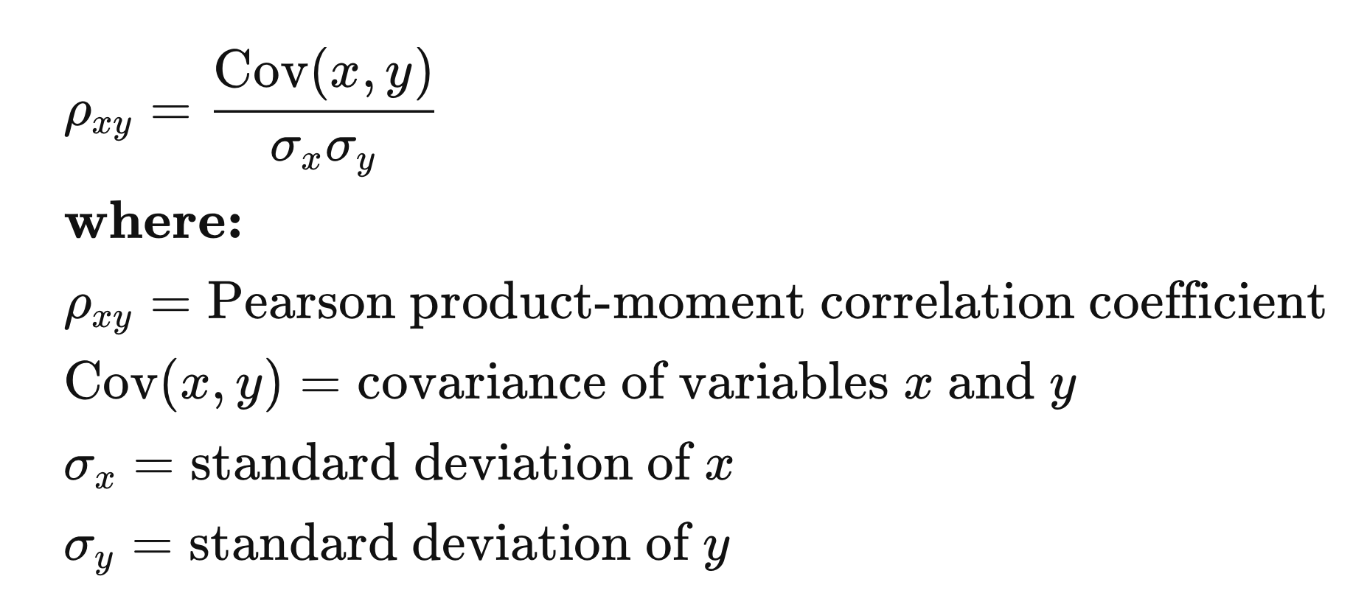
Calculation Coefficient: Standardized Covariate

Slide 6
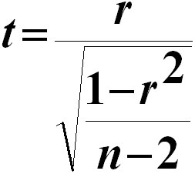
t-test on Correlation Coefficient
(Karl) Pearson correlation coefficient: r
Suitable for continued variables
Range from -1 to 1
t=3.2278
p=0.0017 (vs. 0.002 from Chi-square test)

Slide 7
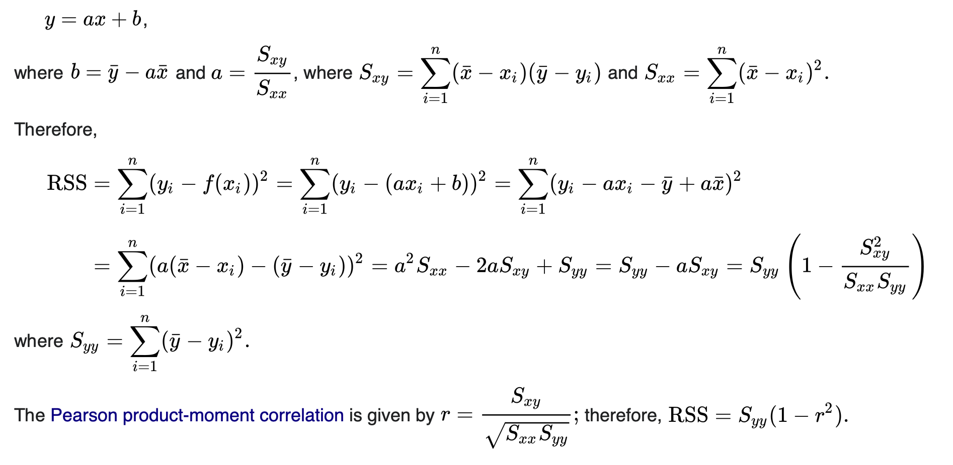
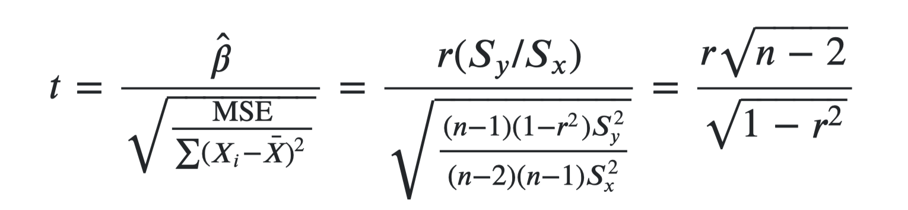
Derivation of t-test on Correlation Coefficient
https://stats.stackexchange.com/questions/344006/understanding-t-test-for-linear-regression
https://stats.stackexchange.com/questions/270612/why-test-statistic-for-the-pearson-correlation-coefficient-is-frac-r-sqrtn-2

Slide 8
Approximation of t distribution
cort=function(n=10000,df=100){
z=replicate(n,{
x=rnorm(df+2)
y=rnorm(df+2)
r=cor(x,y)
t=r/sqrt((1-r^2)/(df))
})
return(z)}
x=cort(10000,5)
t=rt(100000,5)
plot(density(x),col="blue")
lines(density(t),col="red")

Slide 9
Influence of DF
par(mfrow=c(3,1))
df=1
x=cort(10000,df)
t=rt(100000,df)
plot(density(x),col="blue")
lines(density(t),col="red")
df=3
x=cort(10000,df)
t=rt(100000,df)
plot(density(x),col="blue")
lines(density(t),col="red")
df=5
x=cort(10000,df)
t=rt(100000,df)
plot(density(x),col="blue")
lines(density(t),col="red")

Slide 10
Can we use correlation to map genes?
Try it
Sample ten SNPs as QTNs (mutations of genes)
Assign gene effects and make total genetic effects
Add residuals to make phenotypes with 75% heritability
Test all the SNPs and see how many can be found among the top ten associations.

Slide 11
G2P=function(X,h2,alpha,NQTN,distribution){
n=nrow(X)
m=ncol(X)
#Sampling QTN
QTN.position=sample(m,NQTN,replace=F)
SNPQ=as.matrix(X[,QTN.position])
QTN.position
#QTN effects
if(distribution=="norm")
{addeffect=rnorm(NQTN,0,1)
}else
{addeffect=alpha^(1:NQTN)}
#Simulate phenotype
effect=SNPQ%*%addeffect
effectvar=var(effect)
residualvar=(effectvar-h2*effectvar)/h2
residual=rnorm(n,0,sqrt(residualvar))
y=effect+residual
return(list(addeffect = addeffect, y=y, add = effect, residual = residual, QTN.position=QTN.position, SNPQ=SNPQ))
}

Slide 12
Read data and source code in R
myGD=read.table(file="http://zzlab.net/GAPIT/data/mdp_numeric.txt",head=T)
myGM=read.table(file="http://zzlab.net/GAPIT/data/mdp_SNP_information.txt",head=T)
source("http://zzlab.net/StaGen/2020/R/G2P.R")

Slide 13
Let us have more fun!
Have the ten genes on chromosome 1-5 only, nothing on 6 to 10.
Any associations on chromosome 6-10 should be false positives
X=myGD[,-1]
index1to5=myGM[,2]<6
X1to5 = X[,index1to5]

Slide 14
Phenotype simulation
set.seed(99164)
mySim=G2P(X= X1to5,h2=.75,alpha=1,NQTN=10,distribution="normal")
str(mySim)
List of 6
$ addeffect : num [1:10] -0.622 -1.212 -2.064 0.99 -0.418 ...
$ y : num [1:281, 1] -1.37 -6.02 -1.11 -1.02 -5.52 ...
$ add : num [1:281, 1] -2.419 -4.763 -2.519 -0.546 -2.782 ...
$ residual : num [1:281] 1.045 -1.258 1.414 -0.477 -2.733 ...
$ QTN.position: int [1:10] 687 1060 320 1927 992 698 587 92 204 1306
$ SNPQ : int [1:281, 1:10] 0 0 2 0 0 0 0 0 0 0 ...
..- attr(*, "dimnames")=List of 2
.. ..$ : NULL
.. ..$ : chr [1:10] "PZA00730.2" "PZA00363.6" "PHM15871.11" "PZB02189.1" ...

Slide 15
QTN positions
plot(myGM[,c(2,3)])
lines(myGM[mySim$QTN.position,c(2,3)],type="p",col="red")
points(myGM[mySim$QTN.position,c(2,3)],type="p",col="blue",cex = 5)

Slide 16
Association test by correlation
r=cor(mySim$y,X)
n=nrow(X)
t=r/sqrt((1-r^2)/(n-2))
p=2*(1-pt(abs(t),n-2))

Slide 17
Manhattan plots
color.vector <- rep(c("deepskyblue","orange","forestgreen","indianred3"),10)
m=ncol(X)
plot(t(-log10(p))~seq(1:m),col=color.vector[myGM[,2]])
abline(v=mySim$QTN.position, lty = 2, lwd=1.5, col = "black")

Slide 18
Two additional findings
sort(p)[1:5]
zeros=p==0
p[zeros]=1e-10
plot(t(-log10(p))~seq(1:m),col=color.vector[myGM[,2]])
abline(v=mySim$QTN.position, lty = 2, lwd=1.5, col = "black")

Slide 19
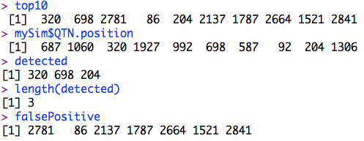
The top ten associations
index=order(p)
top10=index[1:10]
detected=intersect(top10,mySim$QTN.position)
falsePositive=setdiff(top10, mySim$QTN.position)
top10
mySim$QTN.position
detected
length(detected)
falsePositive

Slide 20
The top ten associations
True positives, false positives, and false negatives
plot(t(-log10(p))~seq(1:m),col=color.vector[myGM[,2]])
abline(v=mySim$QTN.position, lty = 2, lwd=2, col = "black")
abline(v= falsePositive, lty = 2, lwd=2, col = "red")

Slide 21
Which belongs to Type I error?
True positives
True negatives
False positives
False negatives
Power is proportional to which?

Slide 22
Outline
T-test on correlation coefficient
GWAS by correlation
True positives
False positives
Power
False negatives
Type I error

