Slide 1
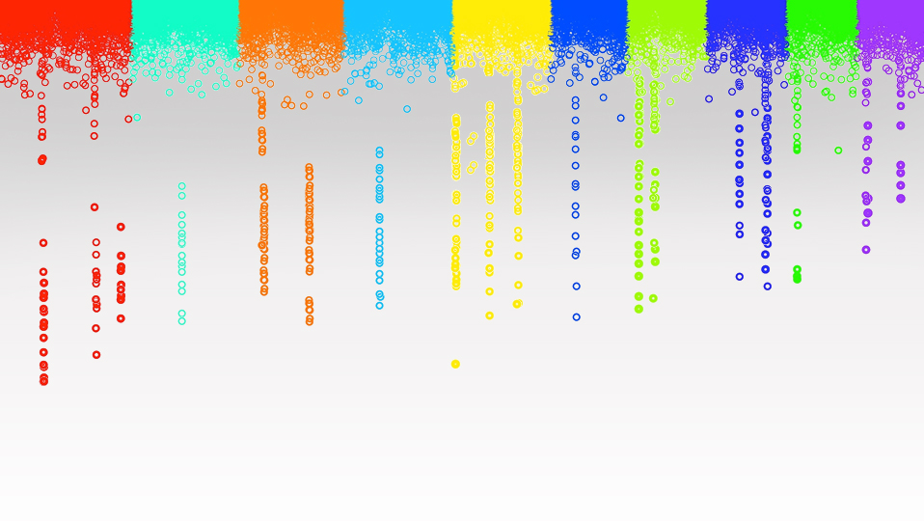
Statistical Genomics
Incorporating GWAS into GS
Zhiwu Zhang
Washington State University

Slide 2
Outline
False positives
BLINK adaptation to abnormal data
Incorporation of GWAS into GS

Slide 3
False Positives
Type I error: 5% or 1%
Small sample size
Rare allele
Phenotypic outliers
Genotypic outliers

Slide 4
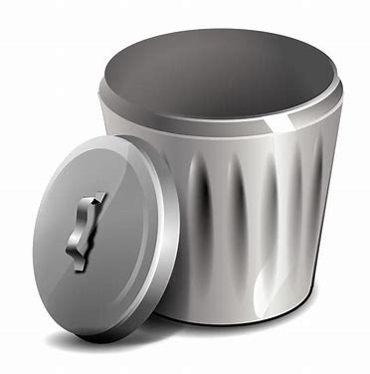
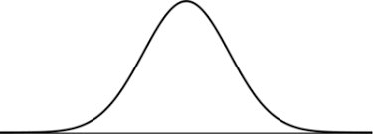
Phenotypic Outliers

Slide 5
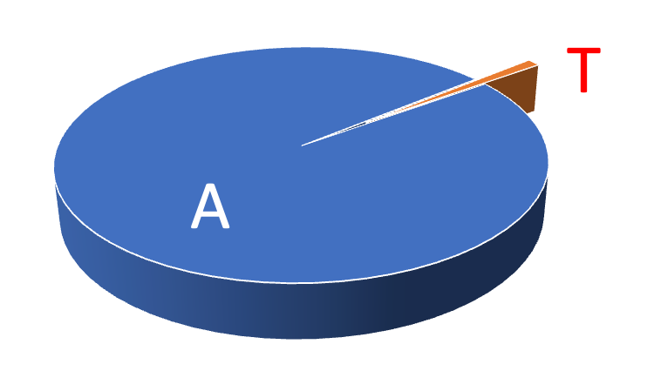
Rare allele: Low MAF
<1%
or
<5%

Slide 6
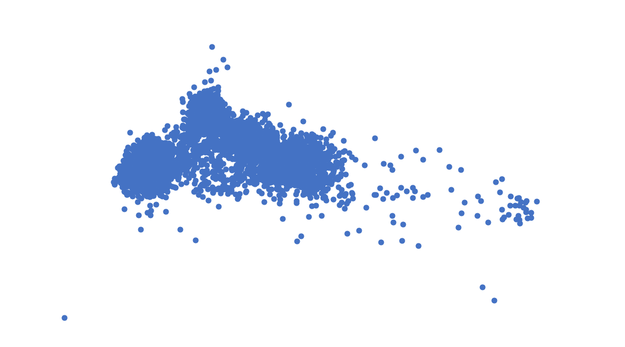
Genotypic Outliers

Slide 7
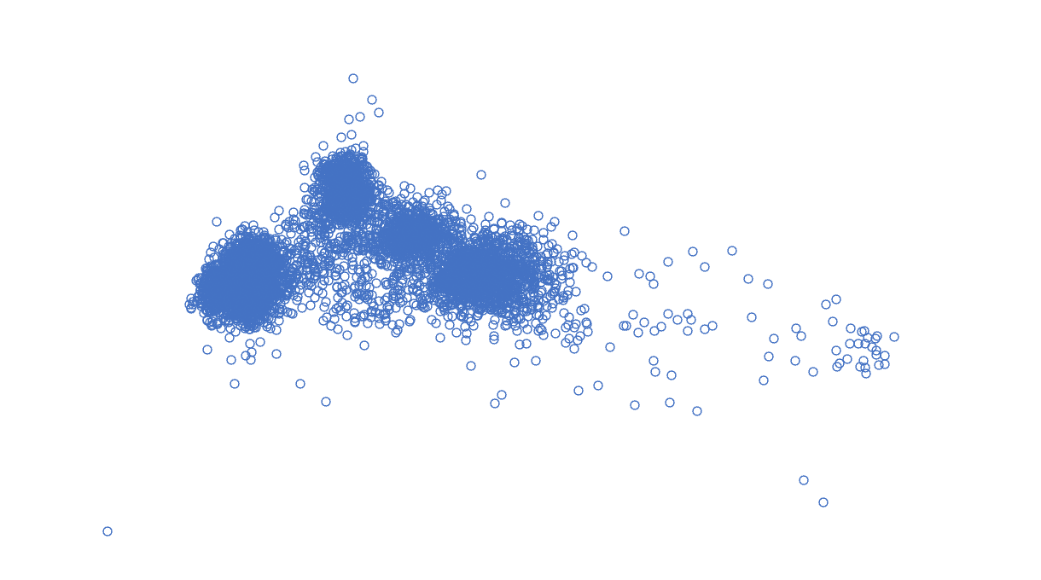

Slide 8
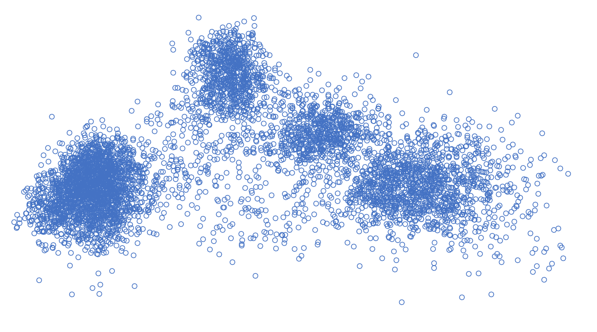
2
3
4
1

Slide 9
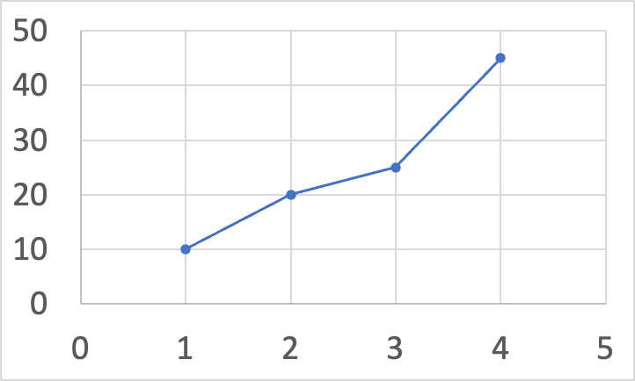
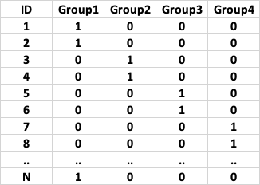
Modeling Group Effects

Slide 10
BLINK Adaptation to Abnormal Data
Multiple alleles
Additive and dominant effects
Multiple environments/traits
Models (e.g., different number of PCs)
Very complex (Rice example)

Slide 11
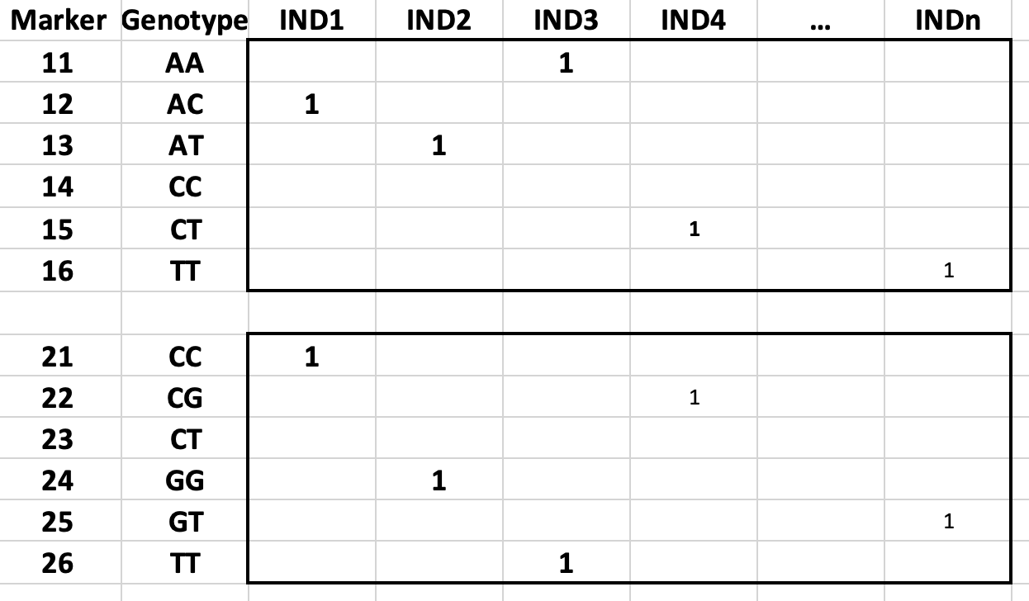
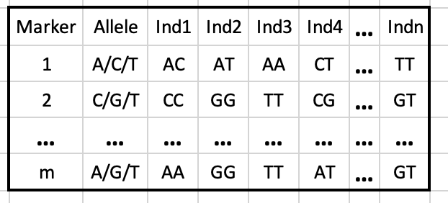
Multiple Alleles
Cutoff=1%/6m

Slide 12
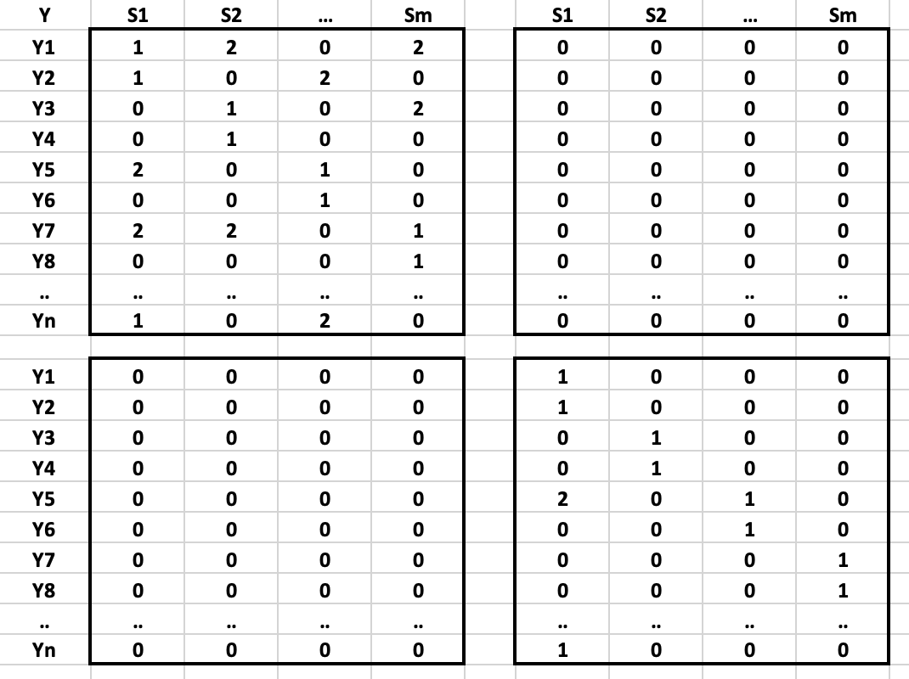
Additive and Dominant Effects
Additive
Dominant
Cutoff=1%/2m

Slide 13
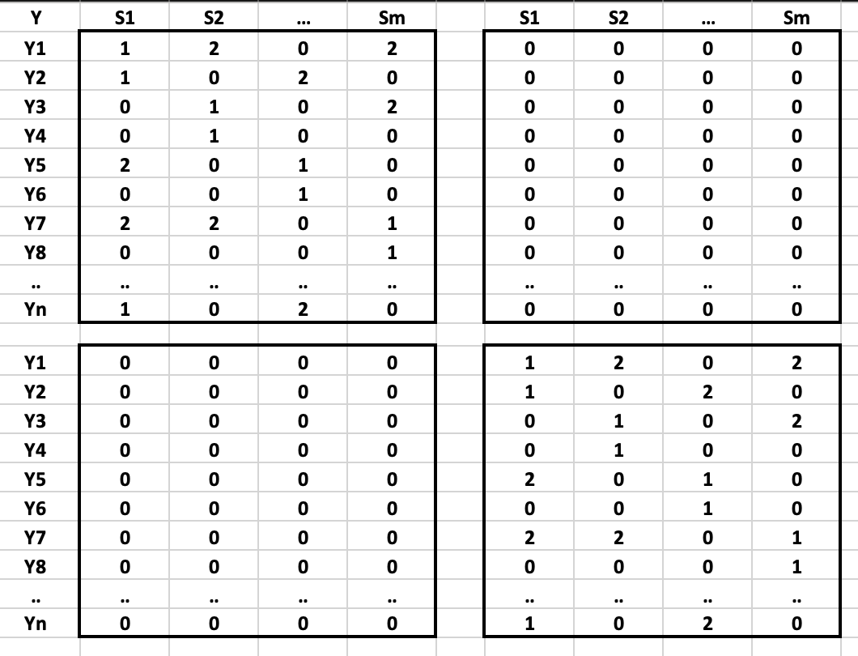
Multiple Locations/Years/Traits
Year1
Year2

Slide 14
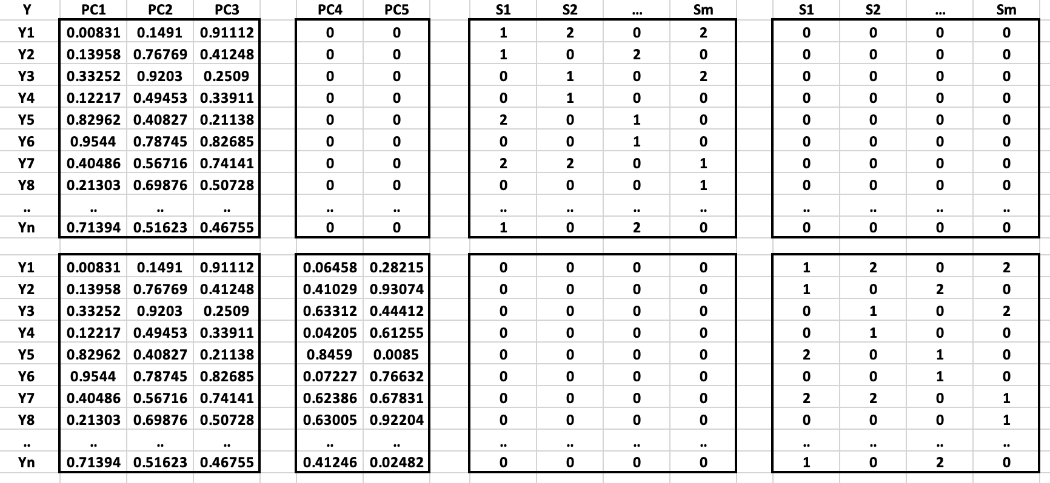
Multiple Models
Model 1: y=SNP+PC1+PC2+PC3+e
Model 2: y=SNP+PC1 +PC2+PC3 +PC4+PC5+e
G1
G2
Model 1
Model 2

Slide 15
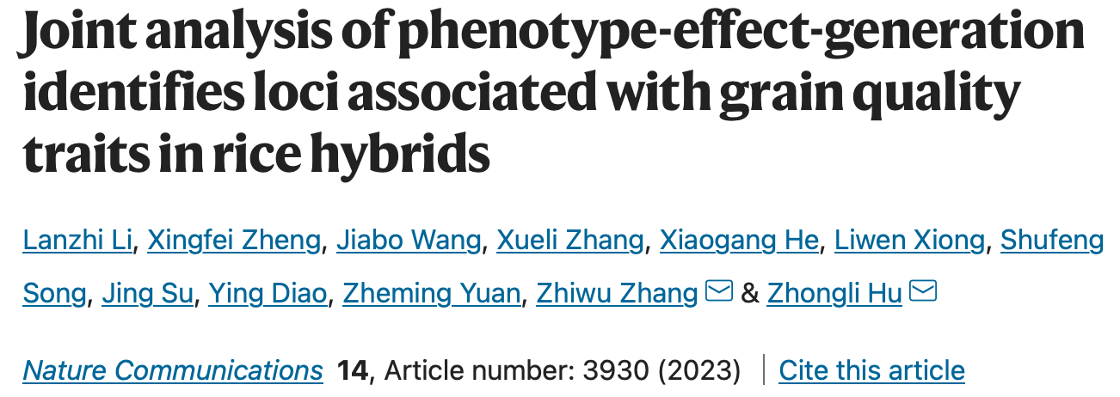
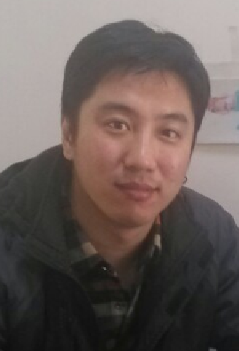
Lanzhi Li
Jiabo Wang

Slide 16
Three dimensions of data
Phenotype
Hybrid
H
Derivation
Generation
Inbred
G
T
Observation
V
Additive
Dominant
Effects

Slide 17
Phenotype relationship
Source
Path
Additive
Dominance
V
A_{v}
D_{v}
T
A_{T}
D_{T}
G
A_{v}
D_{v}
H
A_{T}
D_{T}
Y
A
D

Slide 18
Statistical model
Y
=
Bb
+
Aa
+
e
Model
Y
=
Bb
+
Dd
+
e
Phenotype
Covariates
Testing marker
Residual
Predicted phenotype

Slide 19
Phenotype
Source
Path
Additive
Dominance
V
A_{v}
D_{v}
Relationship
T
A_{T}
D_{T}
Hybrid
G
A_{v}
D_{v}
H
Derivation
Generation
H
A_{T}
D_{T}
Inbred
Y
A
D
Data
G
T
Observation
Y
=
Bb
+
Aa
+
e
V
Model
Y
=
Bb
+
Dd
+
e
Additive
Dominant
Effects
Phenotype
Covariates
Testing marker
Residual
Predicted phenotype

Slide 20
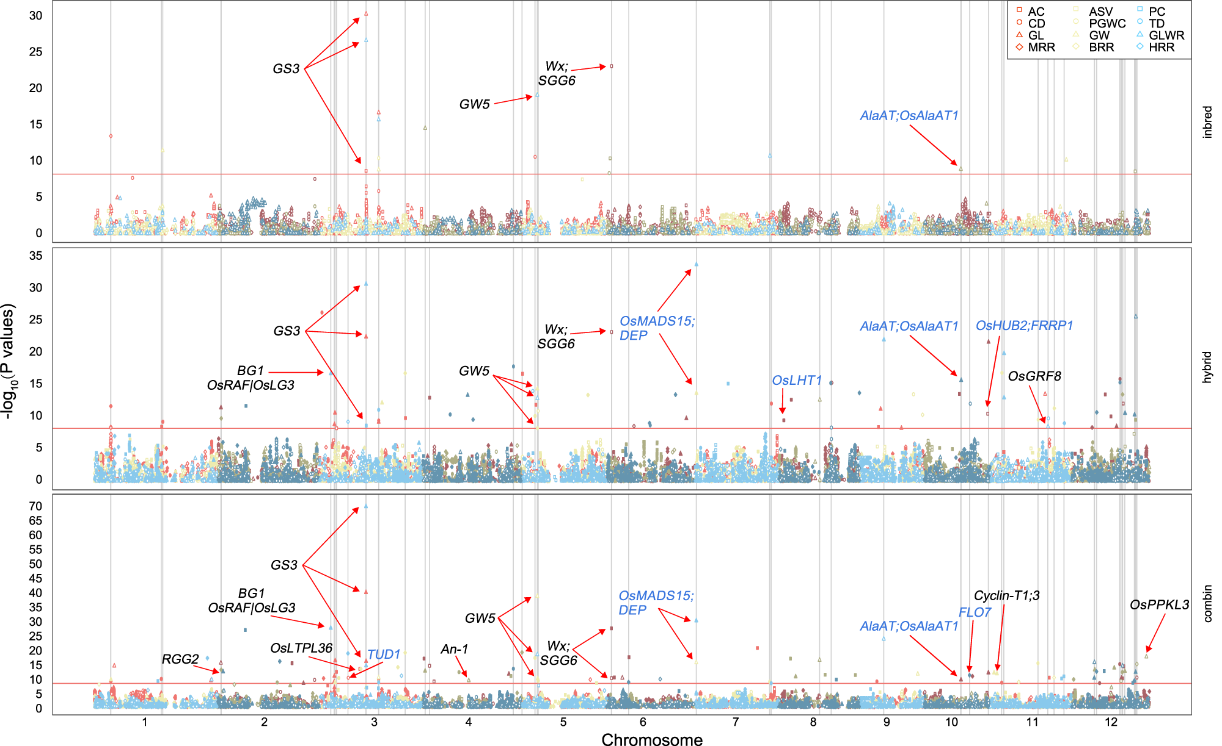

Slide 21
Incorporation of Prior information into GS
Filter markers by GO terms
Fit as fixed effect
Weight kinship by GWAS

Slide 22
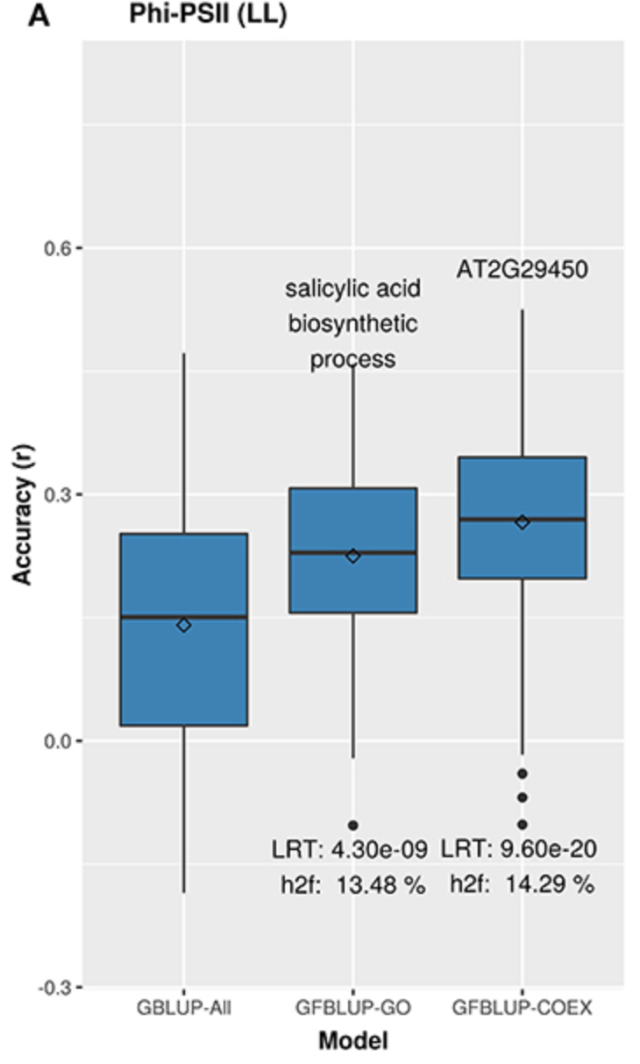

Slide 23
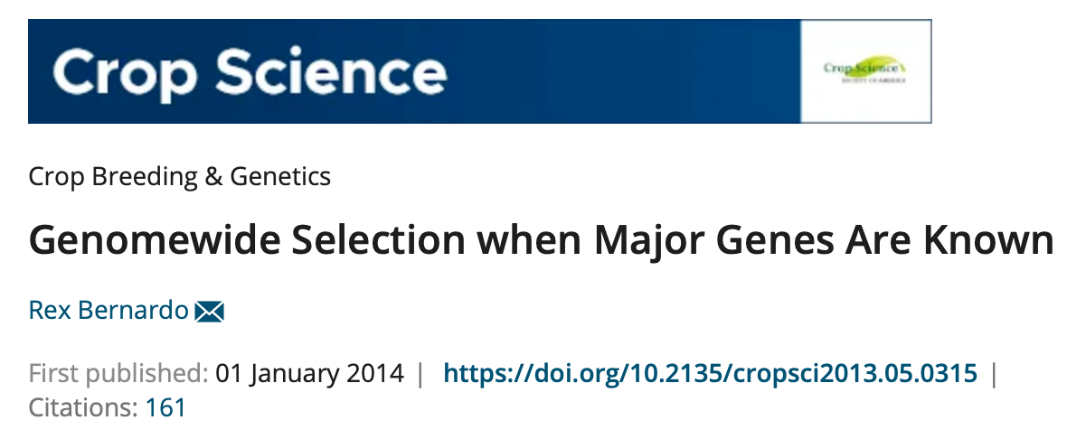

Slide 25
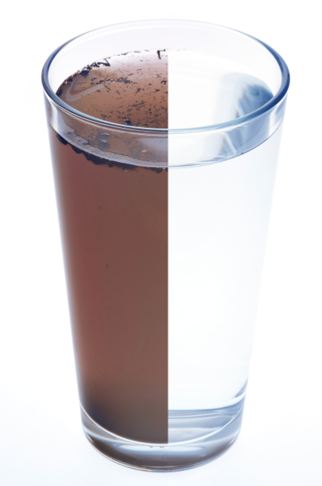
Muddy Water
Unclear experiment design
Too good to be true
Artifact of improvement

Slide 26
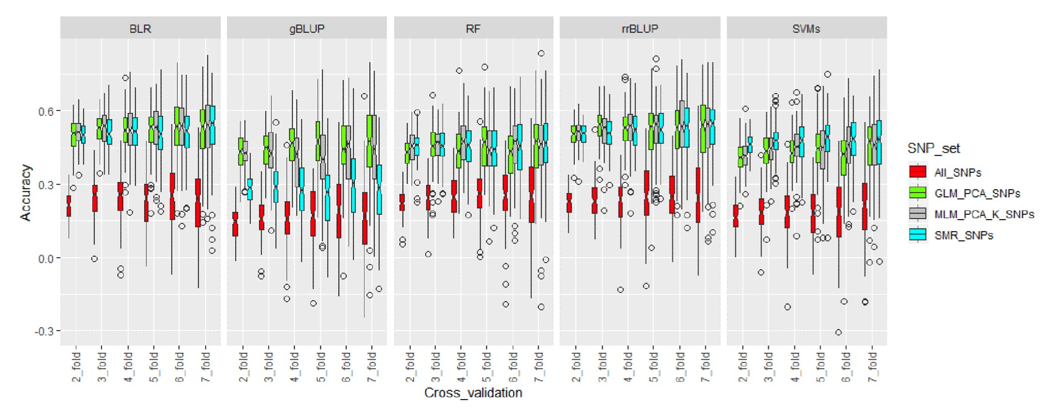
Ravelombola, W. S. et al. Genome-wide association study and genomic selection for tolerance of soybean biomass to soybean cyst nematode infestation. PLoS One 15, (2020).
Genomic selection accuracy increased to almost 2-fold at each level of cross validation when the GWAS-derived SNPs were incorporated into the genomic selection model.

Slide 27
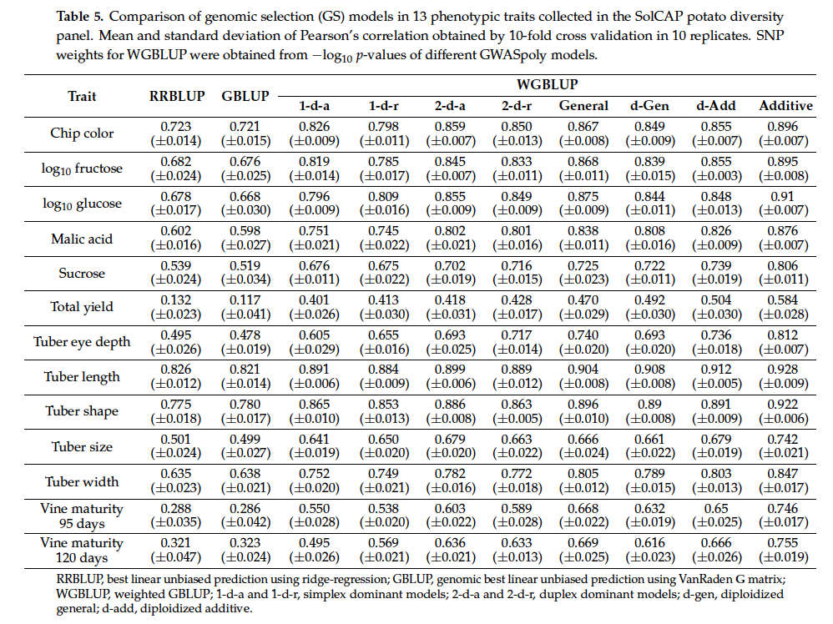
Medina, C. A., Kaur, H., Ray, I. & Yu, L. X. Strategies to increase prediction accuracy in genomic selection of complex traits in alfalfa (Medicago sativa l.). Cells vol. 10 Preprint at https://doi.org/10.3390/cells10123372 (2021).

Slide 29
Valid procedure
Observation
GWAS
training
population
Entire
population
SNPs
Associated SNPs and effects
Valid procedure
SNPs
testing
population
Prediction
Restart
here
Observation
Accuracy

Slide 30
Invalid procedure
Observations and SNPs
GWAS
Associated SNPs
Entire
population
training
population
Observations
SNP effects
SNPs
Contaminated
Prediction
Restart
here
testing
population
Observations
Accuracy

Slide 31
Observation
GWAS
training
population
Entire
population
SNPs
Associated SNPs and effects
Valid procedure
SNPs
testing
population
Prediction
Restart
here
Observation
Accuracy
Observations and SNPs
GWAS
Associated SNPs
Invalid procedure
Observations
Entire
population
training
population
SNP effects
SNPs
Contaminated
Prediction
Restart
here
testing
population
Observations
Accuracy

Slide 32
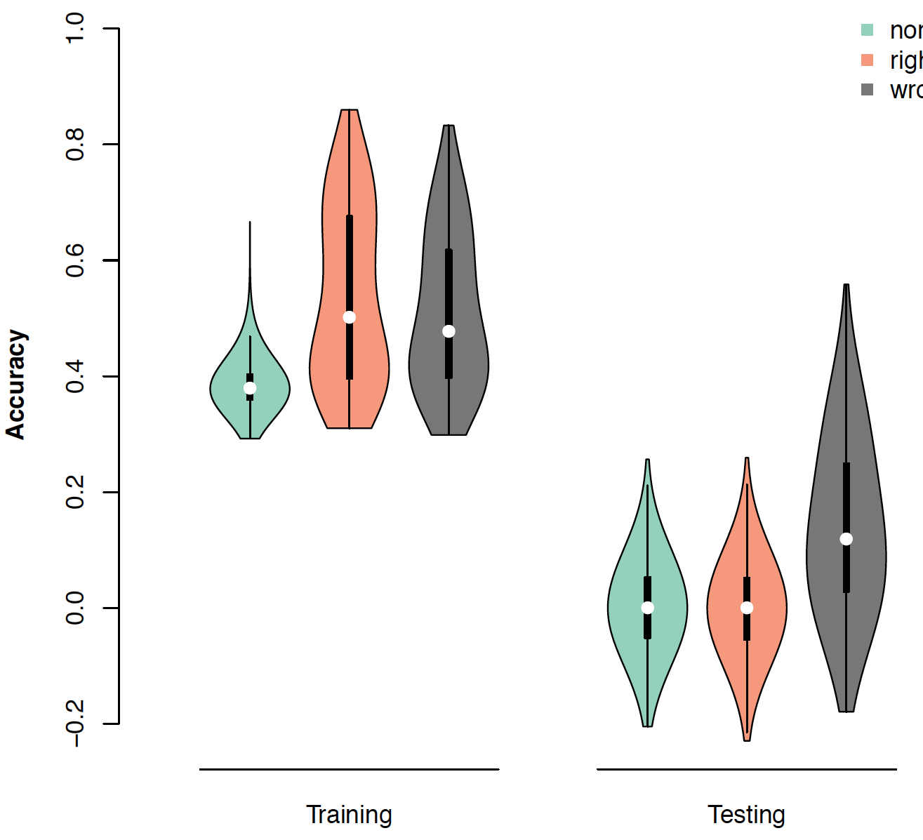
Invalid procedure create artifact prediction accuracy
RR
GWAS-RR/Valid
GWAS-RR/Invalid
Artifact

Slide 33
Incorporation of GWAS into GS
Statistical power differences among GWAS methods
Prediction accuracy of incorporating different GWAS methods

Slide 34
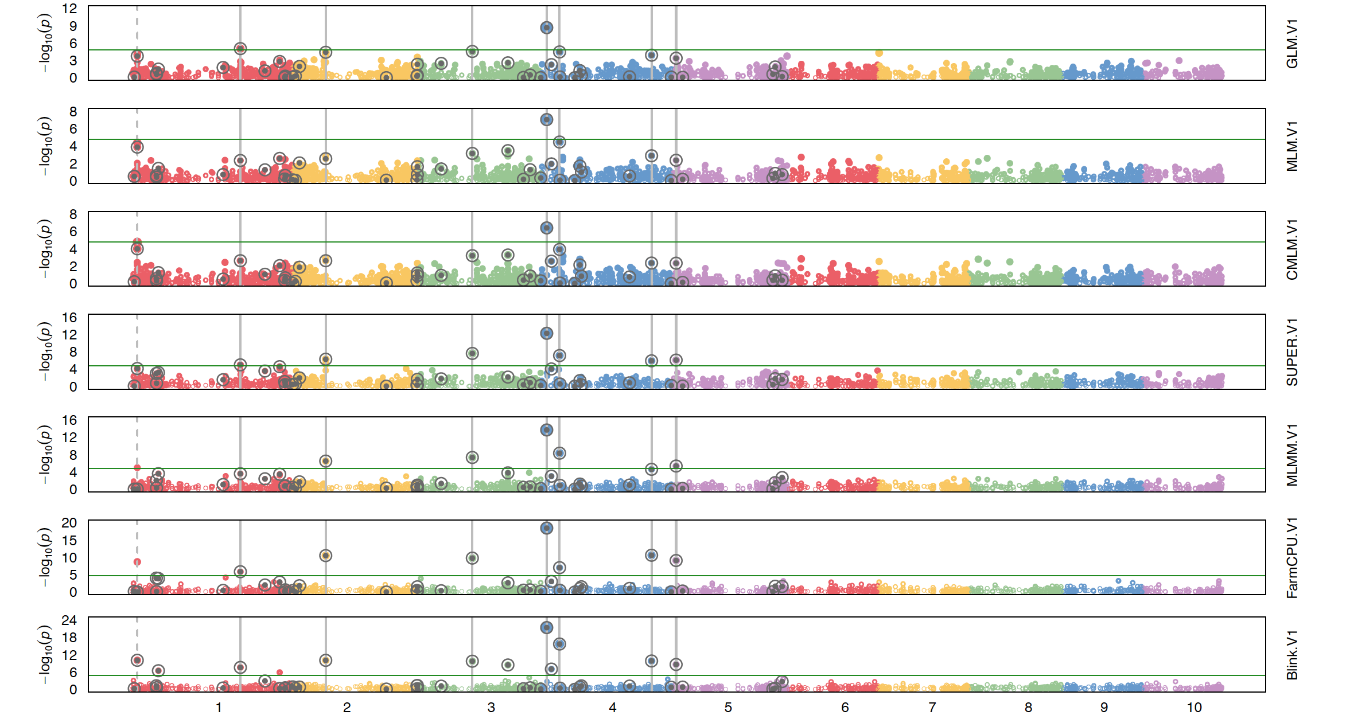
source("http://zzlab.net/GAPIT/gapit_functions.txt") #Import demo data myGD=read.table(file="http://zzlab.net/GAPIT/data/mdp_numeric.txt",head=T) myGM=read.table(file="http://zzlab.net/GAPIT/data/mdp_SNP_information.txt",head=T)
#Simultate 10 QTN on the first half chromosomes
index1to5=myGM[,2]<6 set.seed(99164) mySim=GAPIT.Phenotype.Simulation(GD=myGD[,c(TRUE,index1to5)],GM=myGM[index1to5,],h2=.7,NQTN=40, effectunit =.95,QTNDist="normal")
#GWAS with GAPIT
myGAPIT=GAPIT(Y=mySim$Y,GD=myGD,GM=myGM,PCA.total=3, QTN.position=mySim$QTN.position, model=c("GLM", "MLM", "CMLM", "SUPER", "MLMM", "FarmCPU", "Blink"))

Slide 35
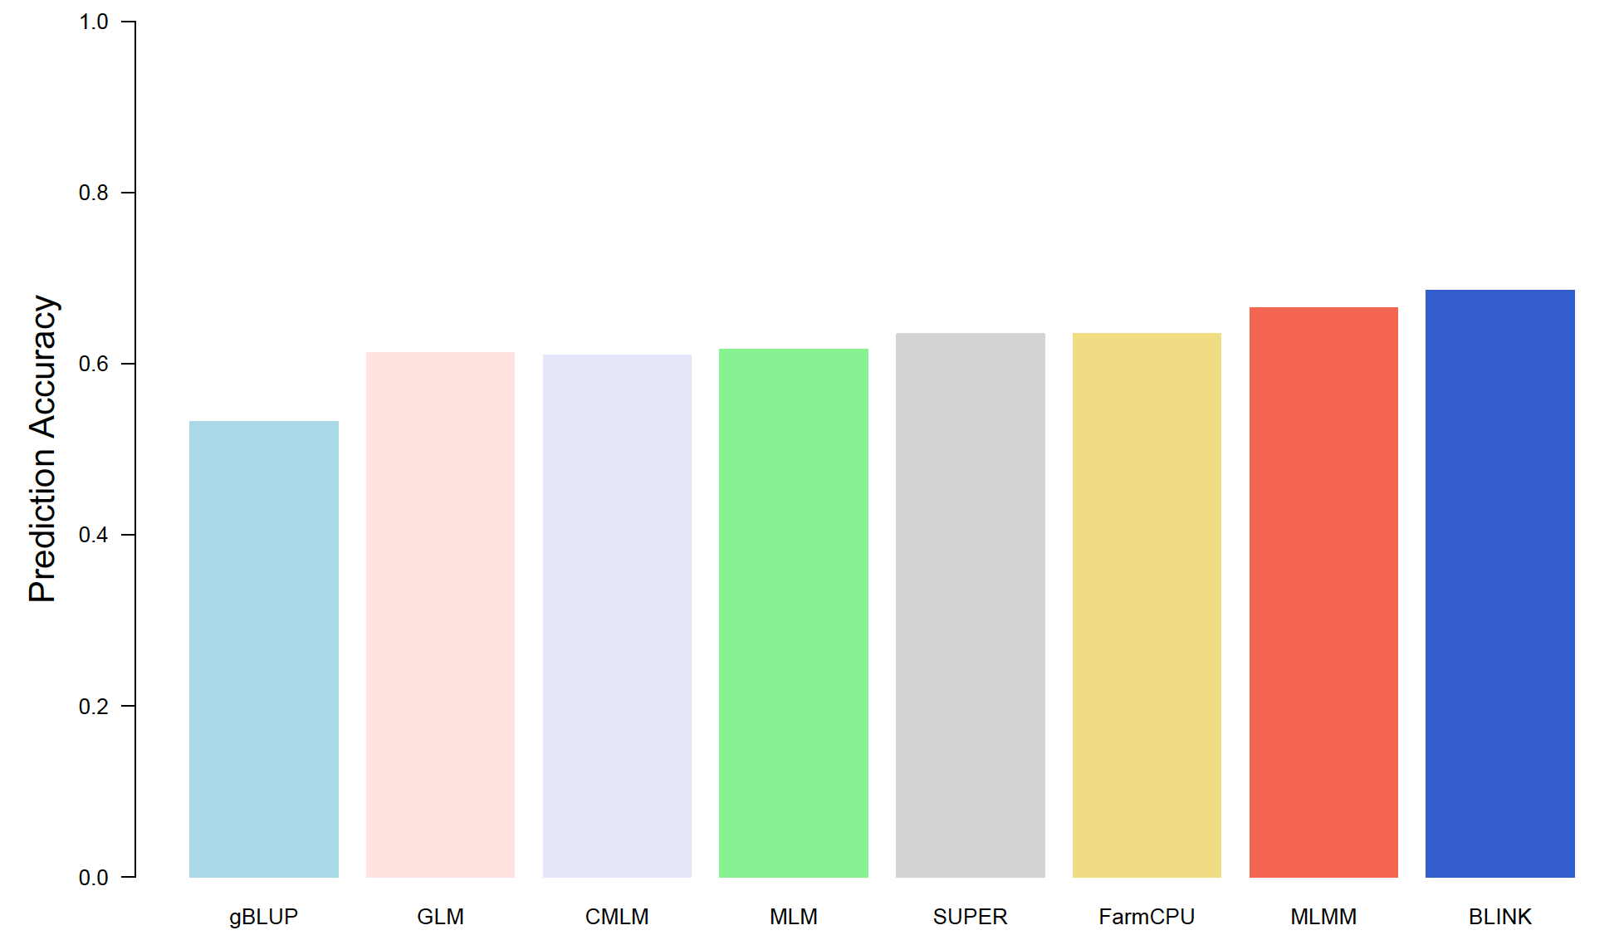
Incorporating GWAS in GS
GWAS+gBLUP

