Slide 1
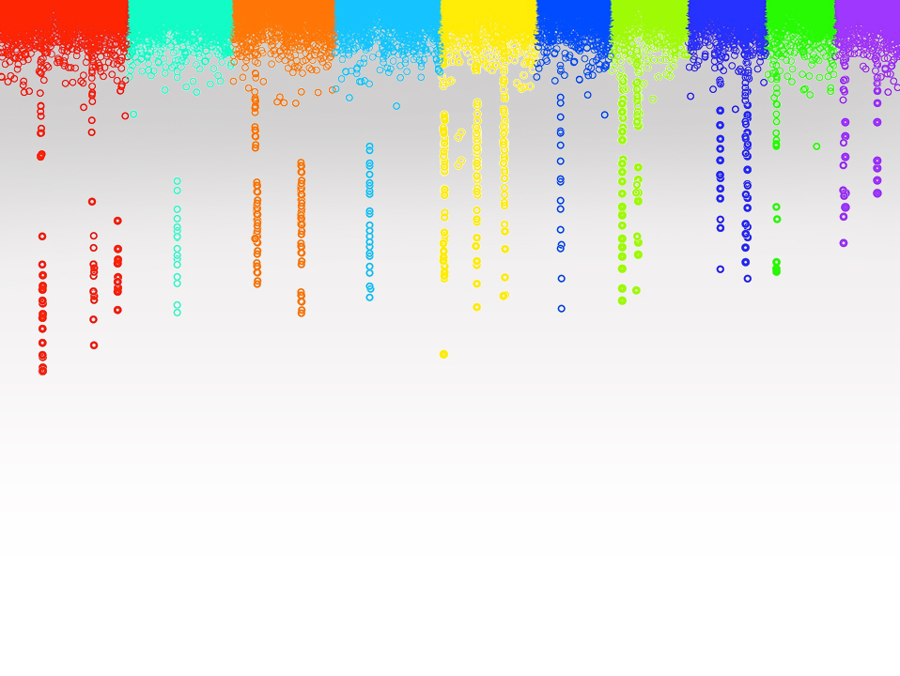

Workshop
Assessment of statistical power, false positive rate and type I error of GWAS
Zhiwu Zhang
Washington State University

Slide 2
Objectives
Simulation of phenotypes
True and false positives
Effect of population structure
Power, FDR and type I error
Comparison of methods
Experimental design

Slide 3
Complex traits
Controlled by multiple genes
Influenced by environment
Also known as quantitative traits
Most traits are continuous, e.g. yield and height,
Some are categorical, e.g. node number, score of disease resistance
Some binary traits are still quantitative traits, e.g. diabetes
Economically important

Slide 4
Dissecting phenotype
Y= G + E + GxE + Residual
G = Additive + Dominance + Epistasis
E: Environment, e.g. year and location
Residual: e.g. measurement error

Slide 5
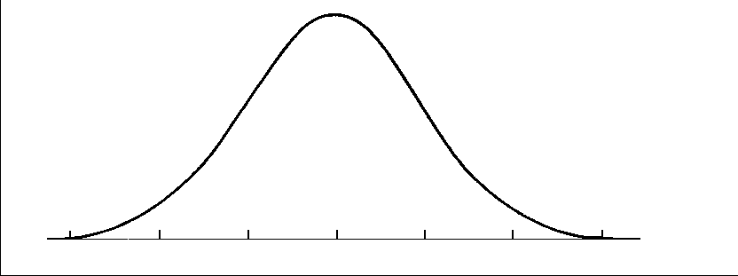
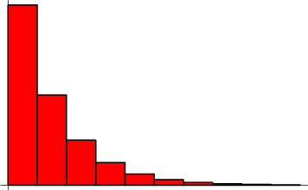
Distribution of QTN effect
Normal distribution
Geometry distribution

Slide 6
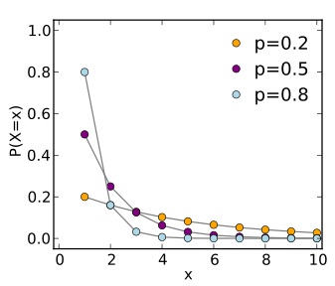
Theoretical geometric distribution
The probability distribution of the number X of Bernoulli trials needed to get one success
Prob (X=k)=(1-p)^{k-1} p

Slide 7
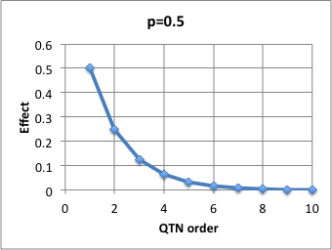
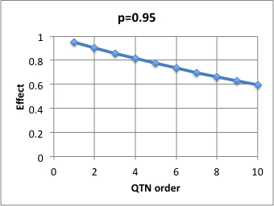
Approximated geometric distribution
Effect(X=k)=p^{k}

Slide 8
Demo code
http://zzlab.net/GAPIT/data/Workshop_Iowa.R

Slide 9
Preparation for GAPIT
#Import GAPIT
#source("http://www.bioconductor.org/biocLite.R")
#biocLite("multtest")
#install.packages("gplots")
#install.packages("scatterplot3d")#The downloaded link at: http://cran.r-project.org/package=scatterplot3d
rm(list=ls())
library('MASS') # required for ginv
library(multtest)
library(gplots)
library(compiler) #required for cmpfun
library("scatterplot3d")

Slide 10
Data preparation
#Import demo data
myGD=read.table(file="http://zzlab.net/GAPIT/data/mdp_numeric.txt",head=T)
myGM=read.table(file="http://zzlab.net/GAPIT/data/mdp_SNP_information.txt",head=T)
#myGD=read.table(file="~/Dropbox/Current/ZZLab/WSUCourse/CROPS545/Demo/mdp_numeric.txt",head=T)
#myGM=read.table(file="~/Dropbox/Current/ZZLab/WSUCourse/CROPS545/Demo/mdp_SNP_information.txt",head=T)

Slide 11
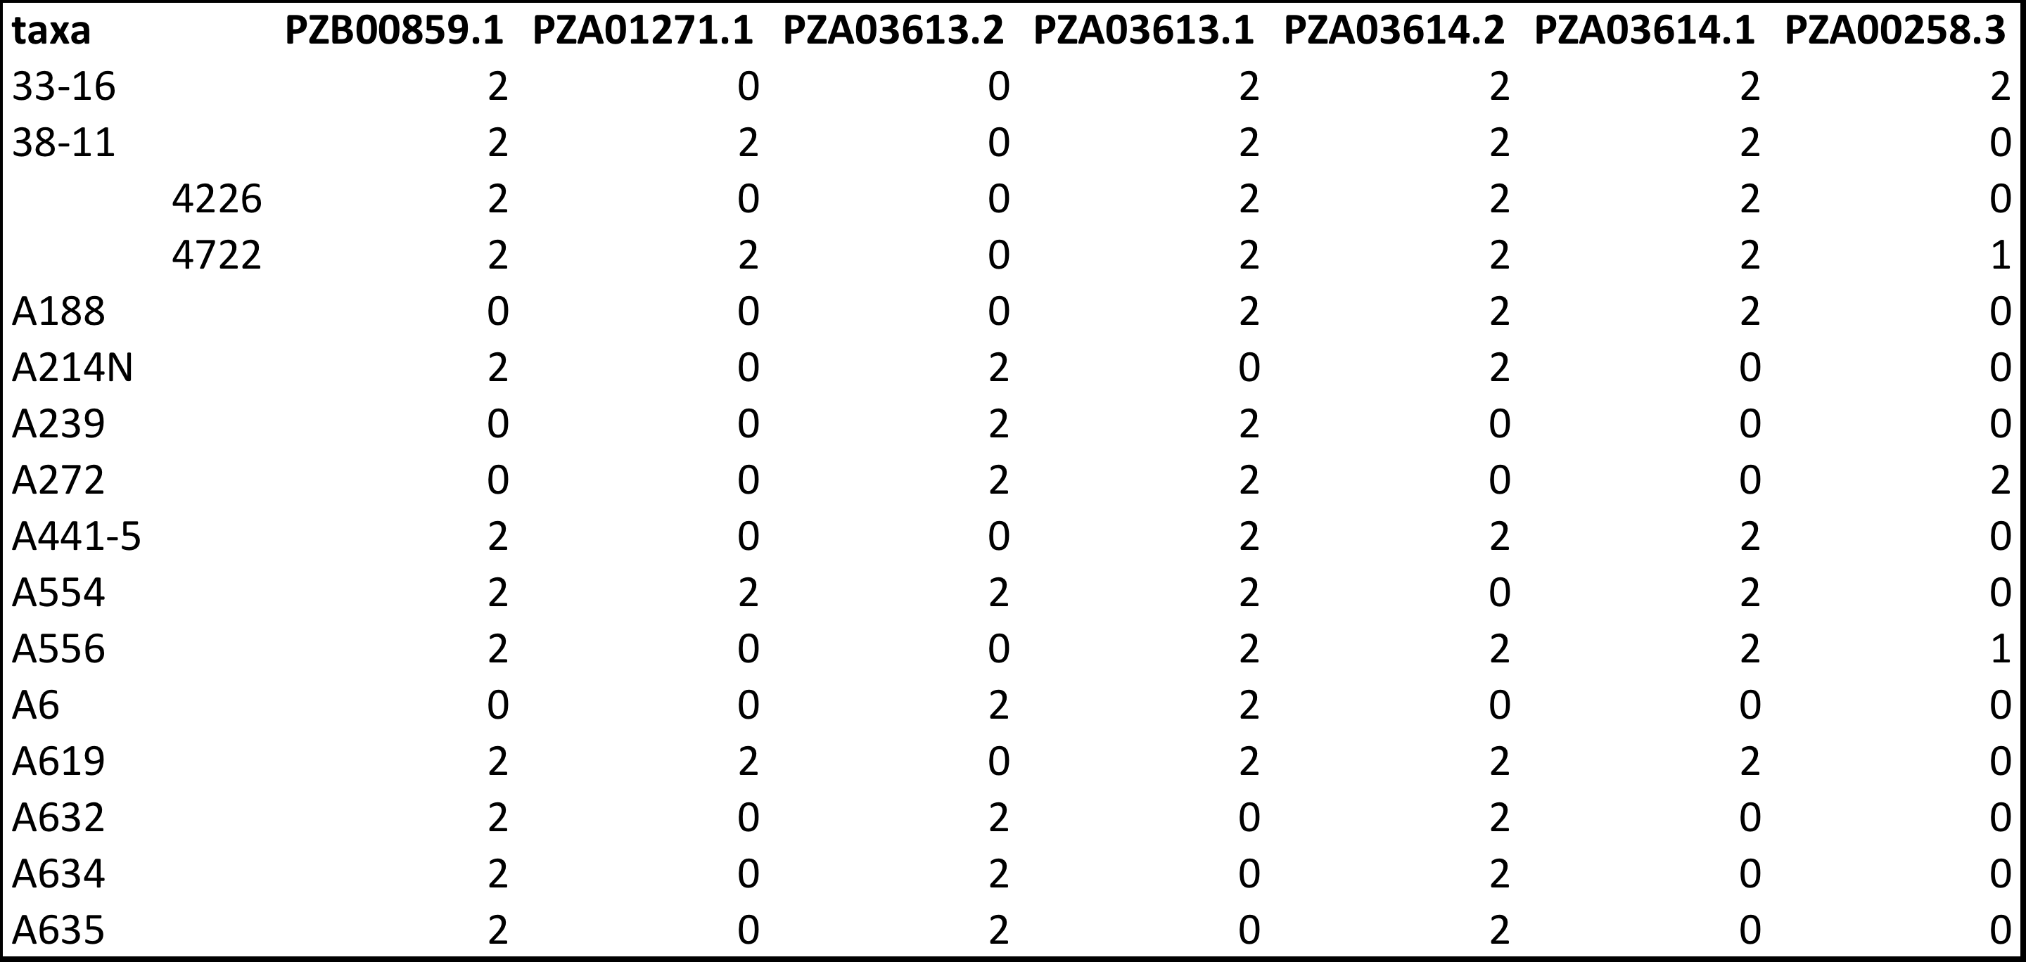
Genotype in Numeric format
myGD=read.table(file="http://zzlab.net/GAPIT/data/mdp_numeric.txt",head=T)

Slide 12
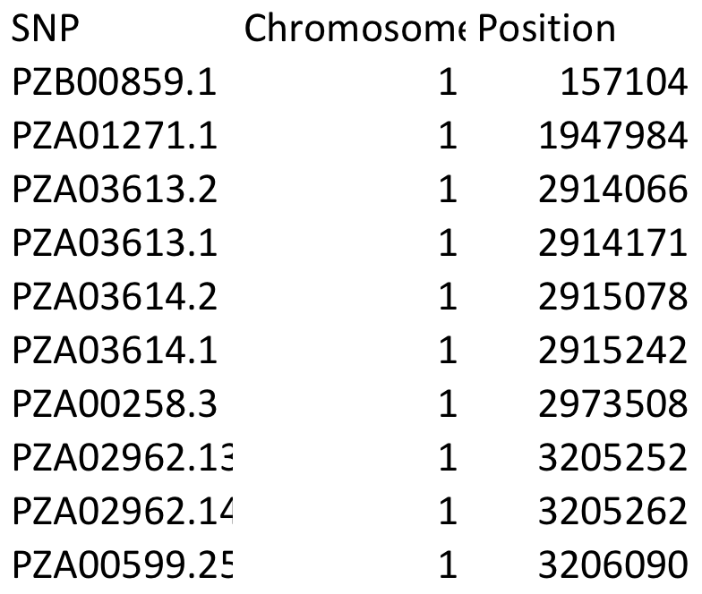
Genetic map
myGM=read.table(file="http://zzlab.net/GAPIT/data/mdp_SNP_information.txt",head=T)

Slide 13
GAPIT.Phenotype.Simulation
#Simultate 10 QTN on the first half chromosomes
X=myGD[,-1]
index1to5=myGM[,2]<6
X1to5 = X[,index1to5]
taxa=myGD[,1]
set.seed(99164)
GD.candidate=cbind(taxa,X1to5)
mySim=GAPIT.Phenotype.Simulation(GD=GD.candidate,GM=myGM[index1to5,],h2=.5,NQTN=10,QTNDist="normal")

Slide 14
Simulation object
str(mySim)
List of 5
$ Y :'data.frame': 281 obs. of 2 variables:
..$ GD[, 1]: Factor w/ 281 levels "33-16","38-11",..: 1 2 3 4 5 6 7 8 9 10 ...
..$ V1 : num [1:281] 2.7 2.96 3.36 2.76 4.88 ...
$ u : num [1:281, 1] 3.94 5.67 2.2 3.92 3.73 ...
$ e : num [1:281] -1.25 -2.71 1.16 -1.16 1.15 ...
$ QTN.position: int [1:10] 1315 31 1023 40 895 140 18 1017 1278 1827
$ effect : num [1:10] -0.27 0.187 0.348 0.996 0.242 ...

Slide 15
QTN positions
plot(myGM[,c(2,3)])
points(myGM[mySim$QTN.position,c(2,3)],type="p",col="red",cex=3)

Slide 16
Simulation results
par(mfrow=c(2,2), mar = c(3,4,1,1))
plot(mySim$effect)
plot(mySim$Y[,2],mySim$u)
plot(mySim$Y[,2],mySim$e)
plot(mySim$e,mySim$u)

Slide 17
LM for GWAS
Q+K
Phenotype
Population
structure
Unequal
relatedness
Y = SNP + Q (or PCs) + e
+ Kinship
(fixed effect)
(fixed effect)
(random effect)
General Linear Model (GLM)
Mixed Linear Model (MLM)
(Yu et al. 2005, Nature Genetics)

Slide 18
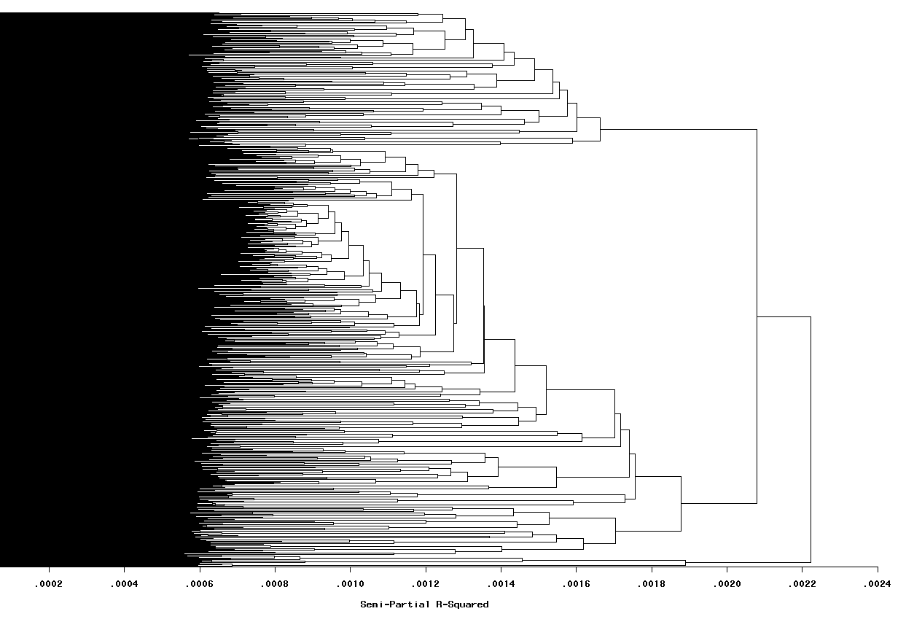
Group by kinship

Slide 19
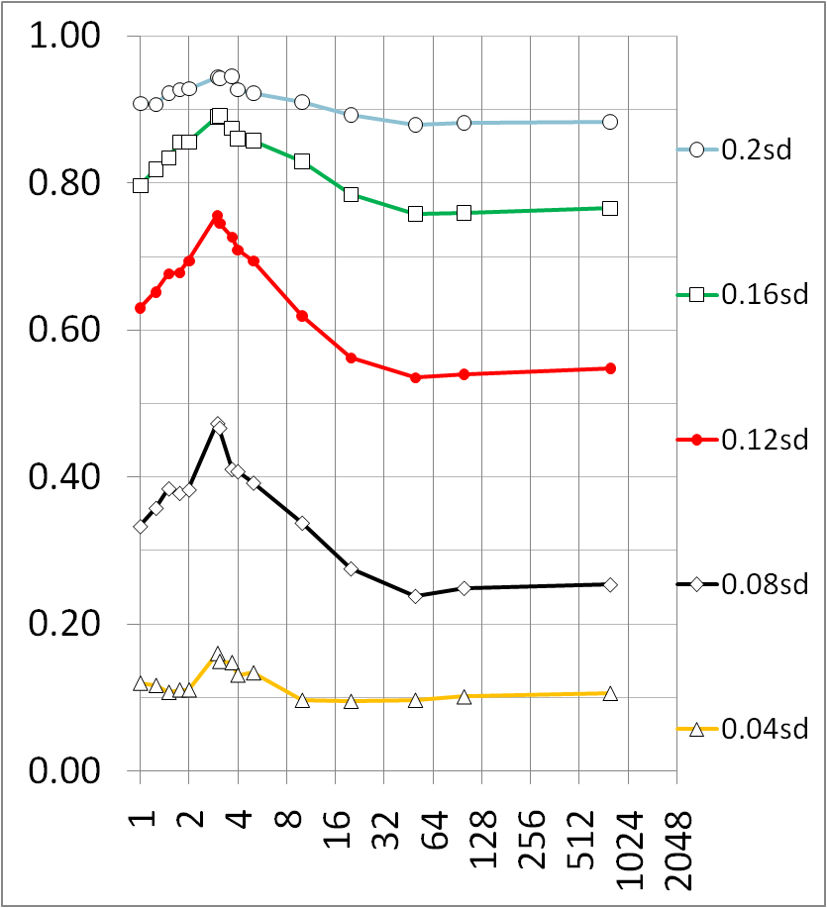
Compression improves power
Zhang et al., Nature Genetics, 2010
Average number of individuals per group

Slide 20
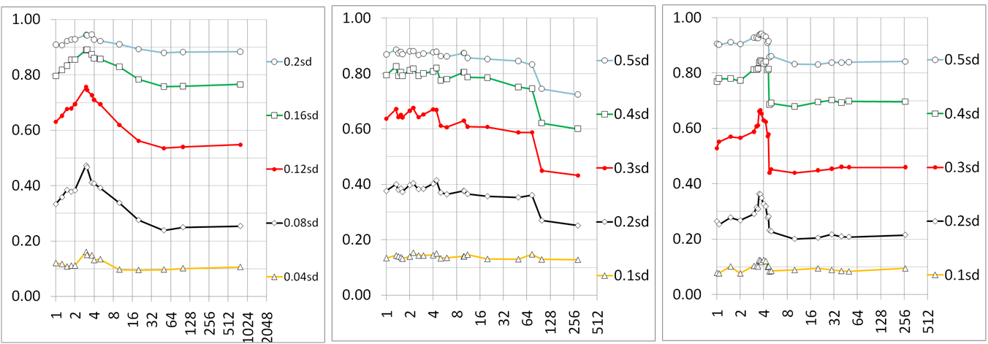
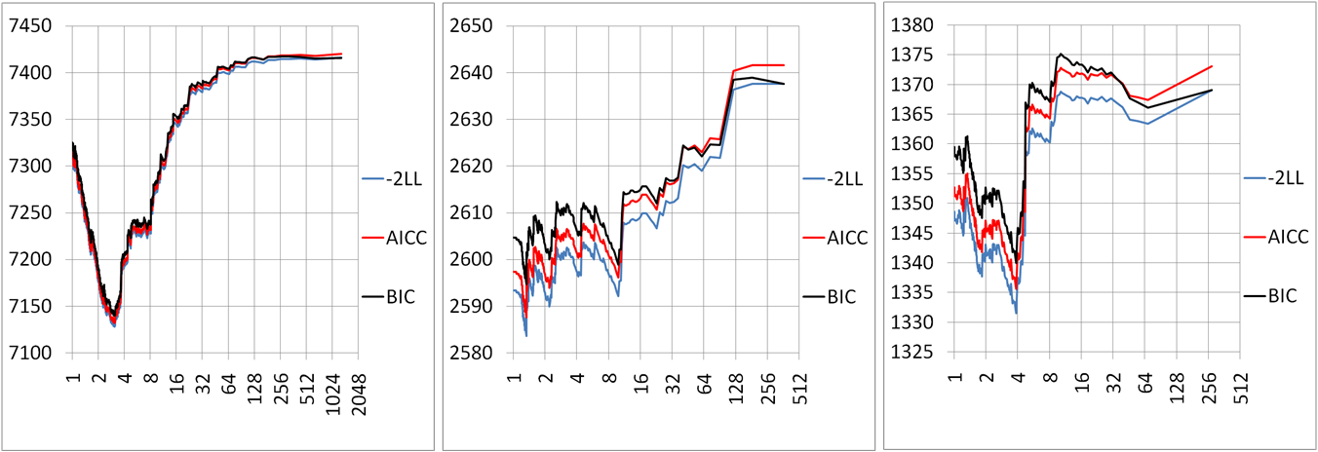
Fit matches power
Average number of individuals per group

Slide 21
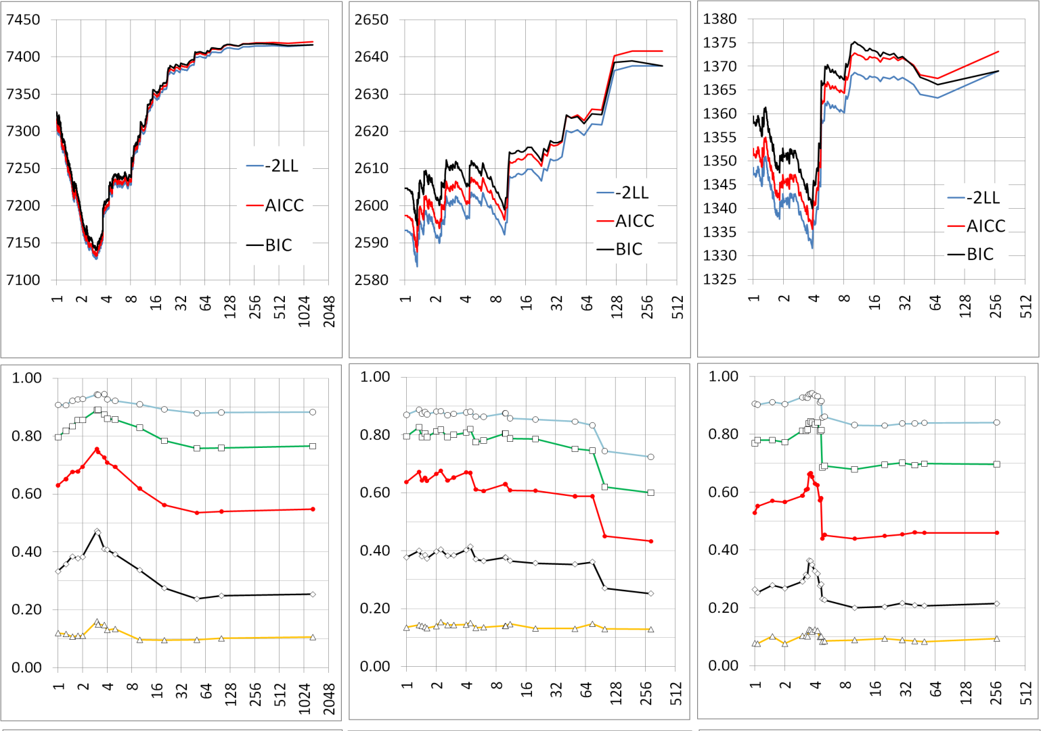
Human (n=1315)
Dog (n=292)
Maize (n=277)
Fit of Model
0.20sd (0.83%)
0.5sd (4.99%)
0.5sd (4.99%)
0.16sd (0.53%)
0.4sd (3.25%)
0.4sd (3.25%)
0.3sd (1.85%)
Statistical power
0.12sd (0.30%)
0.3sd (1.85%)
0.2sd (0.83%)
0.08sd (0.13%)
0.2sd (0.83%)
0.04sd 0(.03%)
0.1sd (0.21%)
0.1sd (0.21%)
Compression level
Compression is robust across species

Slide 22
Compressed MLM is more general
Zhang et al., Nature Genetics, 2010
GLM
(1 group)
SA, GC, PCA and QTDT
Compressed MLM
Compressed MLM (s groups)
Sire model
n ≥ s ≥ 1
Full MLM
(n groups)
Henderson’s MLM
Unified MLM
Pedigree
based kinship
Marker
based kinship

Slide 23
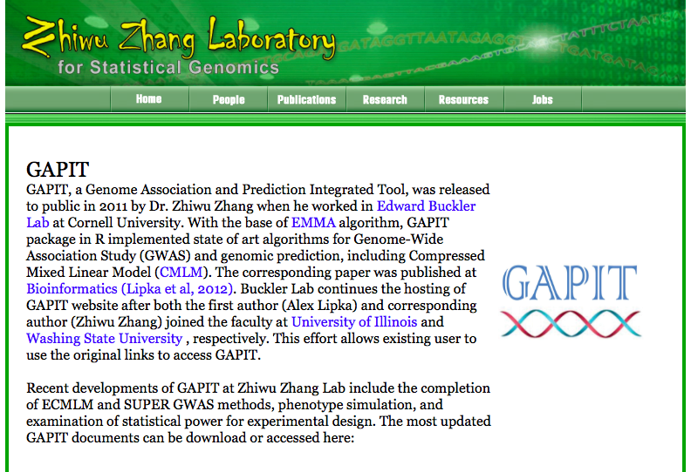
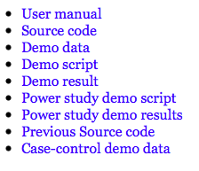
ZZLab.Net

Slide 24
Modeling in GAPIT
Model | PCA.total | group.from | group.to
t | 0 | 1 | 1
GLM | >0 | 1 | 1
MLM | >0 | n | n
CMLM | >0 | 1 | n

Slide 25
Run GAPIT
setwd("~/Desktop/temp")
myGAPIT=GAPIT(
Y=mySim$Y,
GD=myGD,
GM=myGM,
QTN.position=mySim$QTN.position,
PCA.total=0,
group.from = 1,
group.to = 1,
group.by = 10,
#sangwich.top="MLM", #options are GLM,MLM,CMLM, FaST and SUPER
#sangwich.bottom="SUPER", #options are GLM,MLM,CMLM, FaST and SUPER
memo="ttest")

Slide 26
Manhattan plot

Slide 27
Power, type I error and FDR
Power: Proportion of QTNs identified
Type I error: empirical null distribution of non QTN SNPs
FDR: Proportion of false positives

Slide 28
Mapping resolution
10Kb is really good, 100Kb is OK
Bins with QTNs for power
Bins without QTNs for type I error

Slide 29
GAPIT.FDR.TypeI Function
myStat=GAPIT.FDR.TypeI(
WS=c(1e0,1e3,1e4,1e5),
GM=myGM,
seqQTN=mySim$QTN.position,
GWAS=myGAPIT$GWAS)
str(myStat)

Slide 30
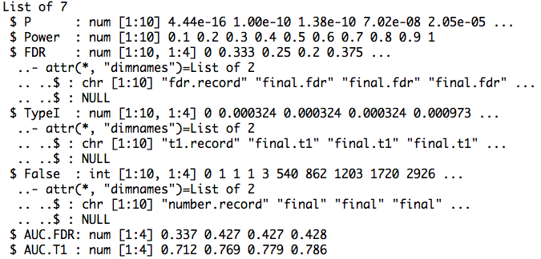
Return

Slide 31
Area Under Curve (AUC)
par(mfrow=c(1,2),mar = c(5,2,5,2))
plot(myStat$FDR[,1],myStat$Power,type="b")
plot(myStat$TypeI[,1],myStat$Power,type="b")

Slide 32
Replicates
nrep=5
set.seed(99164)
statRep=replicate(nrep,{
mySim=GAPIT.Phenotype.Simulation(GD=GD.candidate,GM=myGM[index1to5,],h2=.5,NQTN=10,QTNDist="norm")
myGAPIT=GAPIT(
Y=mySim$Y,
GD=myGD,
GM=myGM,
QTN.position=mySim$QTN.position,
PCA.total=0,
group.from = 1,
group.to = 1,
group.by = 10,
#sangwich.top="MLM", #options are GLM,MLM,CMLM, FaST and SUPER
#sangwich.bottom="SUPER", #options are GLM,MLM,CMLM, FaST and SUPER
file.output = F,
memo="ttest")
myStat=GAPIT.FDR.TypeI(WS=c(1e0,1e3,1e4,1e5),GM=myGM,seqQTN=mySim$QTN.position,GWAS=myGAPIT$GWAS)
})

Slide 33
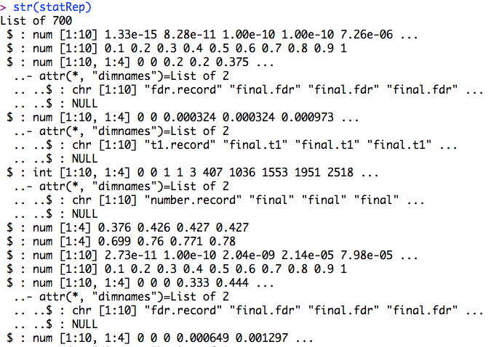
str(statRep)

Slide 34
Means over replicates
power=statRep[[2]]
#FDR
s.fdr=seq(3,length(statRep),7)
fdr=statRep[s.fdr]
fdr.mean=Reduce ("+", fdr) / length(fdr)

Slide 35
Plots of power vs. FDR
theColor=rainbow(4)
plot(fdr.mean[,1],power , type="b", col=theColor [1],xlim=c(0,1))
for(i in 2:ncol(fdr.mean)){
lines(fdr.mean[,i], power , type="b", col= theColor [i])
}

Slide 36
Compare methods

Slide 37
Experimental design
Methods: t, GLM, MLM, CMLM…
Sample size
Populations: Association, RILs...
Marker sensity
Heritability
Number of genes
Major genes

