Slide 1
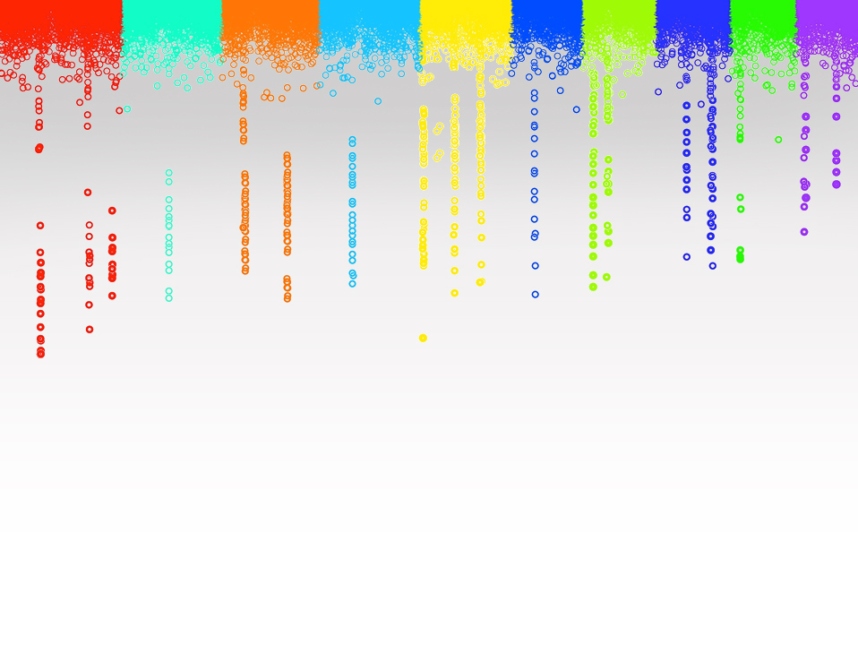
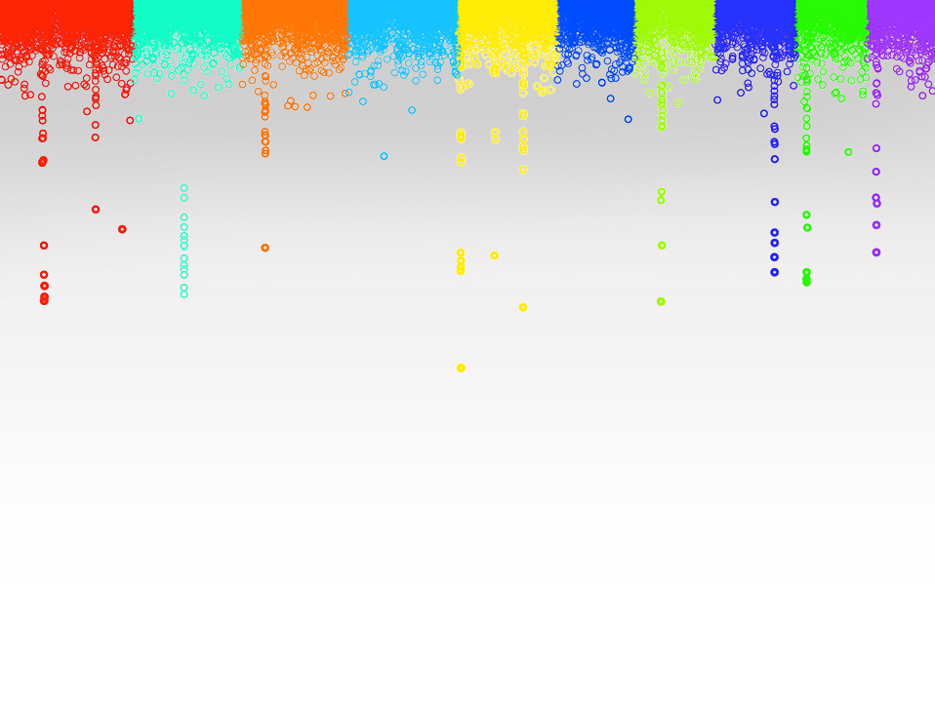
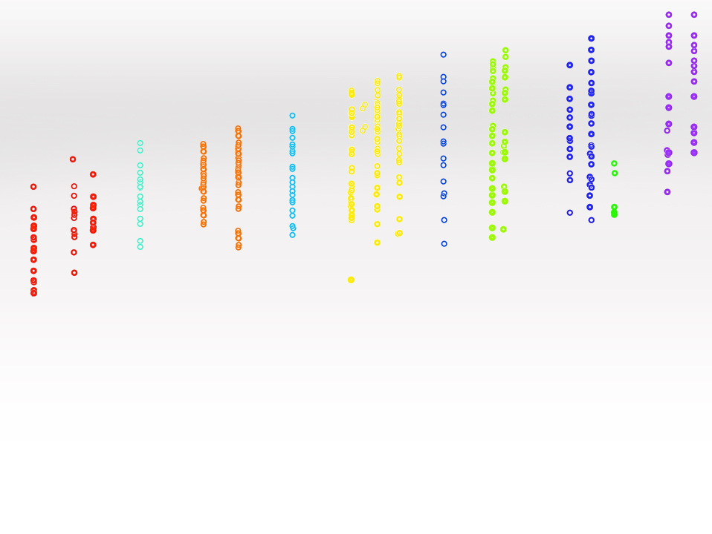
Statistical Genomics
Zhiwu Zhang
Washington State University

Slide 2
Outline
Administration
Why this course
Overview

Slide 3
Objectives
GWAS/GS: mechanism, pros and cons
Experiment design: false discoveries, power and accuracy
Analyses: methods and tools
Reasoning and critical thinking
Motivated through reinventing

Slide 4
Attendants
Registered
Graduate students
Faculty and staff (WSU employee benefit)
Visitors (permission required from both host and instructor)
Equal opportunity: Speak, homework, and exam

Slide 5
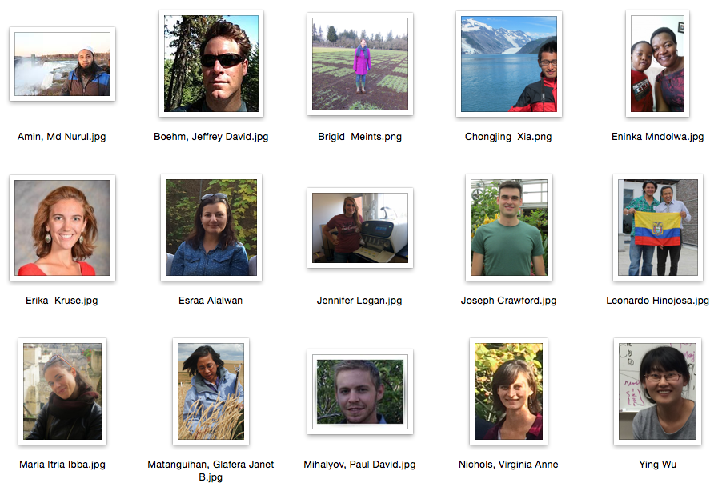
Email and Picture

Slide 6
Grade
Percentage | Letter
93%-100% | A
90%-93% | A-
87%-90% | B+
83%-87% | B
80%-83% | B-
77%-80% | C+
73%-77% | C
70%-73% | C-
66%-70% | D+
60%-66% | D
0%-60% | F

Slide 7
Present
30 classes: January 11-April 29
Twice a week: W/F, 3:10-4:25 PM
Late: ¼ off
Leave earlier: ¼ off
Observed without excuse

Slide 8
Participation
 | Score
No question, no discussion | 0%
Question or discussion occasionally | 25%
Question actively | 50%
Discussion actively | 75%
Question AND discussion actively | 100%

Slide 9
Homework
Assignments: six in total
Due Wednesday 3:10PM every other week, except spring break and final
Submit by email
PDF Report and R source code only
PDF report is limited to five pages.
No late submission accepted. Answers are given on Friday

Slide 10
Homework components each takes 20%
Hypotheses
What did you observed (Results)
How to replicate your findings (Method)
Presentation: Description, figures and tables
R source code

Slide 11
Hypothesis (demo)

Slide 12
Result (demo)

Slide 13
Method (demo)

Slide 14
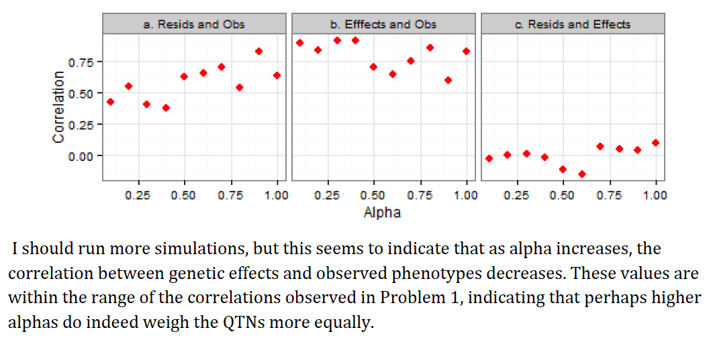
Presentation (demo)

Slide 15
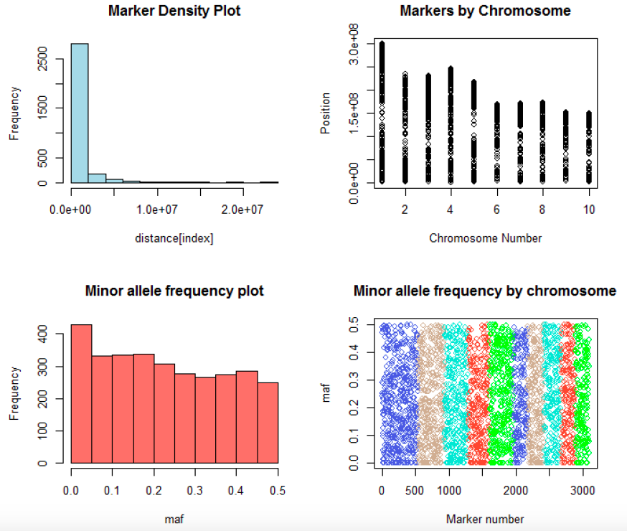

Slide 16
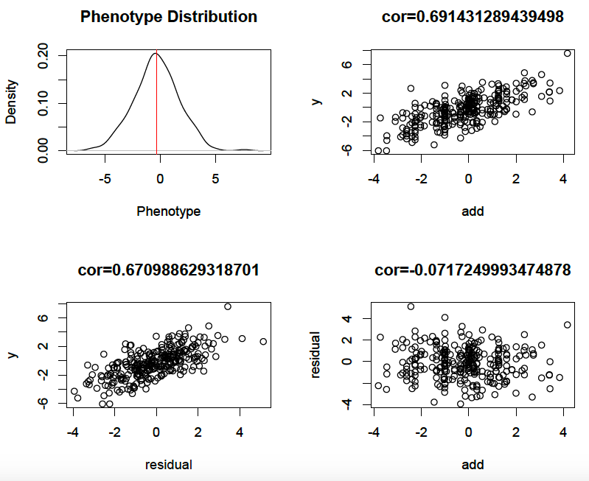

Slide 17
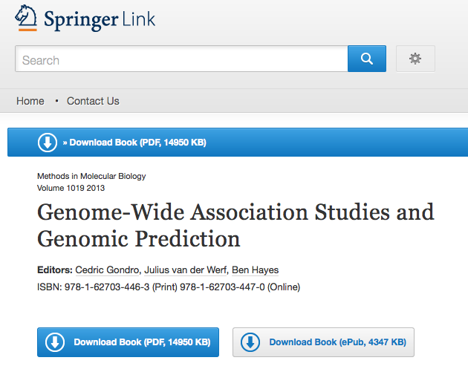
Text book
http://link.springer.com/book/10.1007%2F978-1-62703-447-0

Slide 18
References (examples)
Meuwissen, T. H., Hayes, B. J. & Goddard, M. E. Prediction of total genetic value using genome-wide dense marker maps. Genetics 157, 1819–1829 (2001).
Elshire, R. J. et al. A robust, simple genotyping-by-sequencing (GBS) approach for high diversity species. PLoS One 6, e19379 (2011).
Marchini, J. & Howie, B. Genotype imputation for genome-wide association studies. Nat Rev Genet 11, 499–511 (2010).
Yu, J. et al. A unified mixed-model method for association mapping that accounts for multiple levels of relatedness. Nat. Genet. 38, 203–208 (2006).
Kang, H. M. et al. Efficient control of population structure in model organism association mapping. Genetics 178, 1709–1723 (2008).
Zhang, Z. et al. Mixed linear model approach adapted for genome-wide association studies. Nat Genet 42, 355–360 (2010).
Kang, H. M. et al. Variance component model to account for sample structure in genome-wide association studies. Nat Genet 42, 348–354 (2010).
Wang, Q., Tian, F., Pan, Y., Buckler, E. S. & Zhang, Z. A SUPER Powerful Method for Genome Wide Association Study. PLoS One 9, e107684 (2014).
Lippert, C. et al. FaST linear mixed models for genome-wide association studies. Nature Methods 8, 833–835 (2011).
Segura, V. et al. An efficient multi-locus mixed-model approach for genome-wide association studies in structured populations. Nature Genetics 44, 825–830 (2012).
Zhang, Z., Todhunter, R. J., Buckler, E. S. & Van Vleck, L. D. Technical note: Use of marker-based relationships with multiple-trait derivative-free restricted maximal likelihood. J. Anim. Sci. 85, 881–885 (2007).
VanRaden, P. M. Efficient methods to compute genomic predictions. J Dairy Sci 91, 4414–4423 (2008).

Slide 19
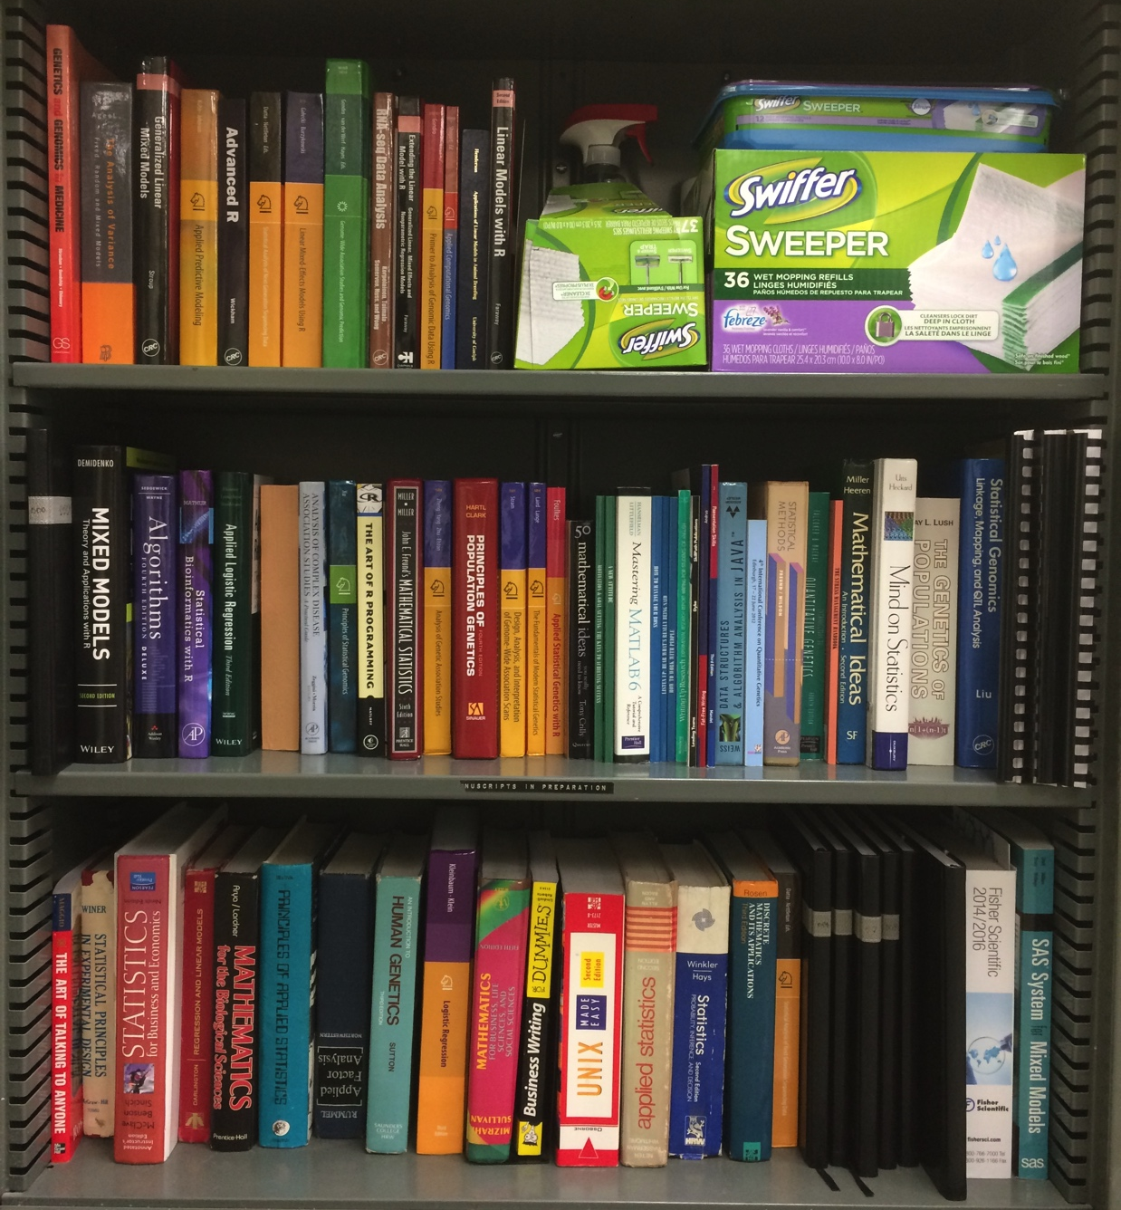
Books at ZZLab

Slide 20
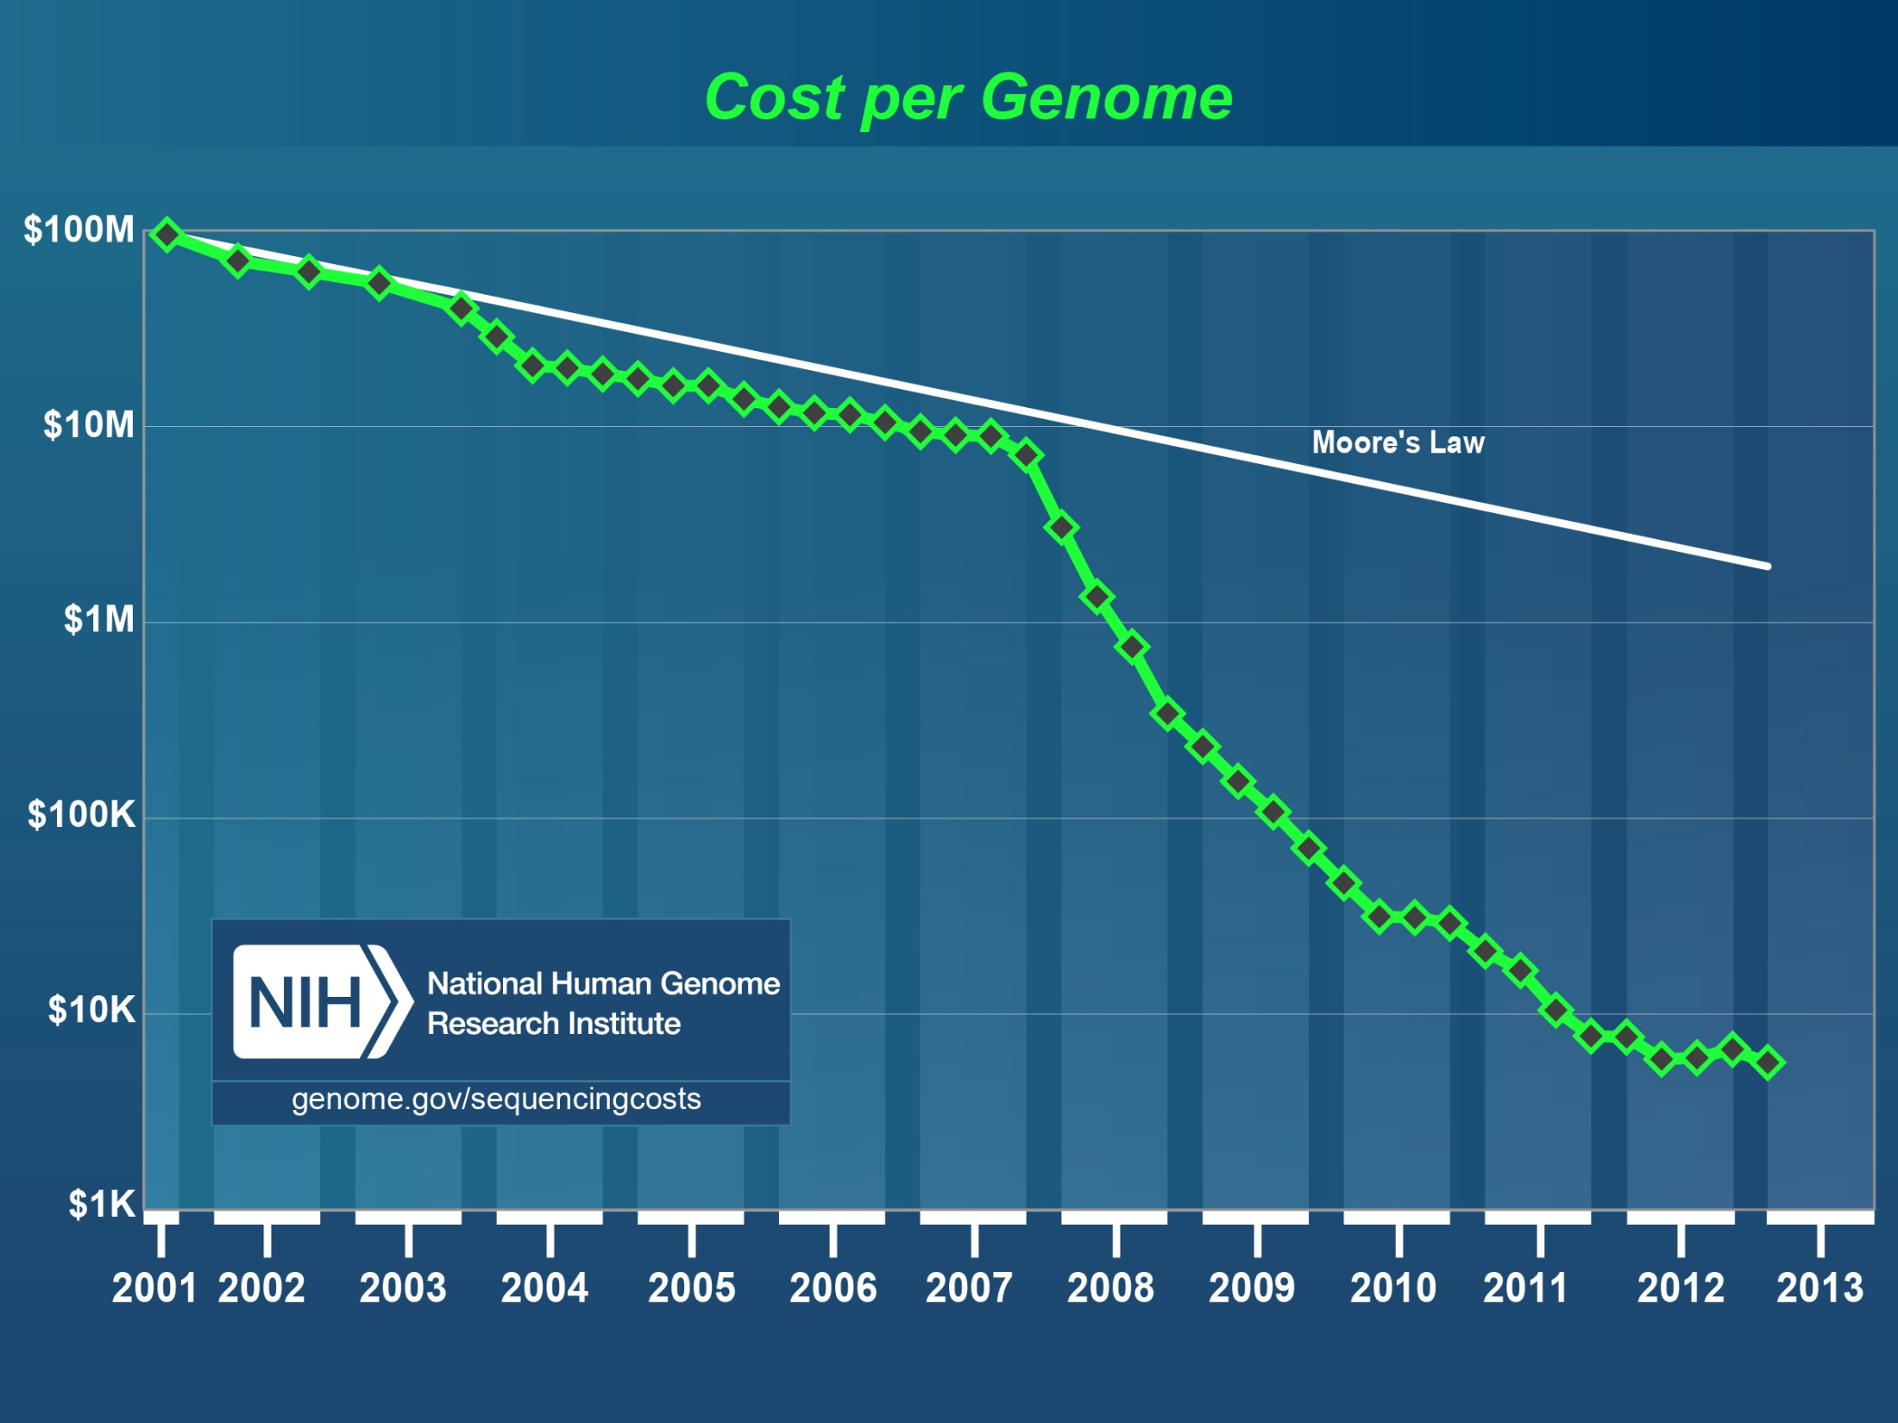
Human
genome
2nd
Generation Sequencing
http://luckyrobot.com/wp-content/uploads/2013/04/nih-cost-genome.jpg

Slide 21
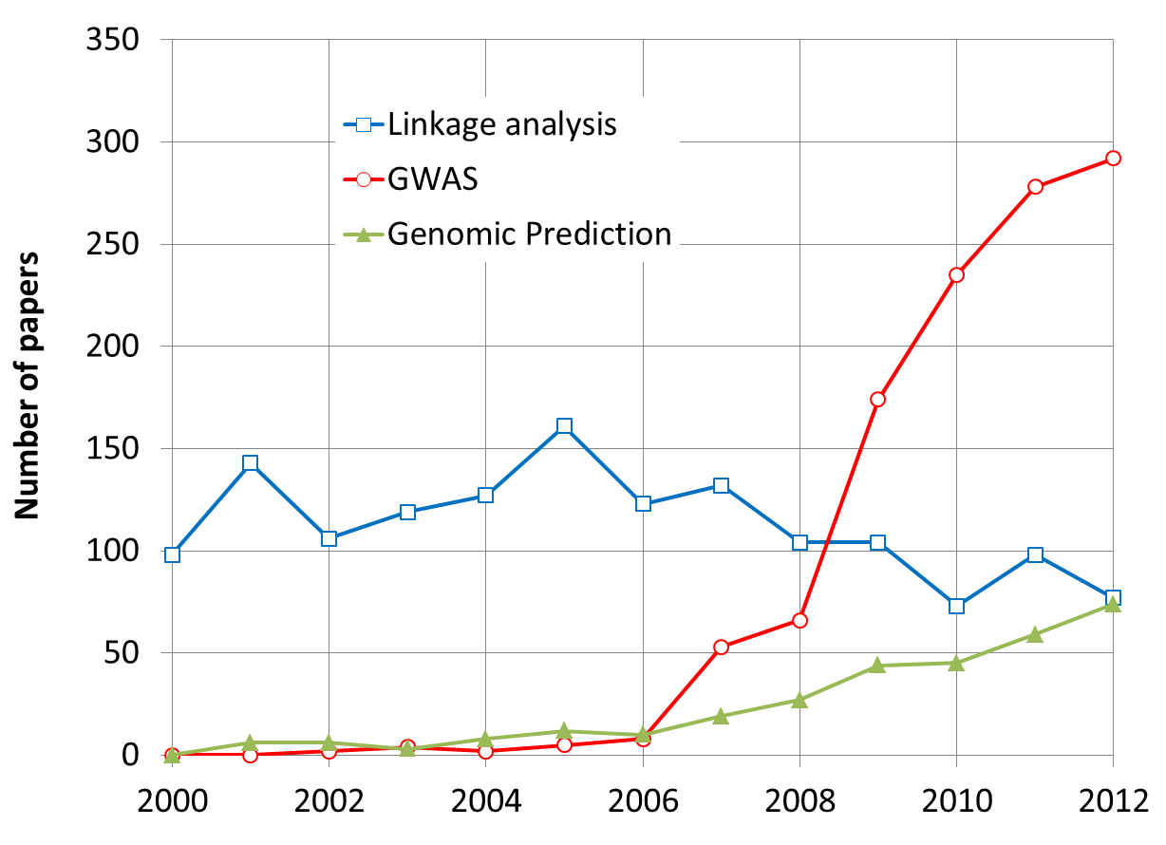
More Research on GWAS and GS
By May 31, 2013

Slide 22
Problems in GWAS
Computing difficulties: millions of markers, individuals, and traits
False positives, ex: “Amgen scientists tried to replicate 53 high-profile cancer research findings, but could only replicate 6”, Nature, 2012, 483: 531
False negatives

Slide 23
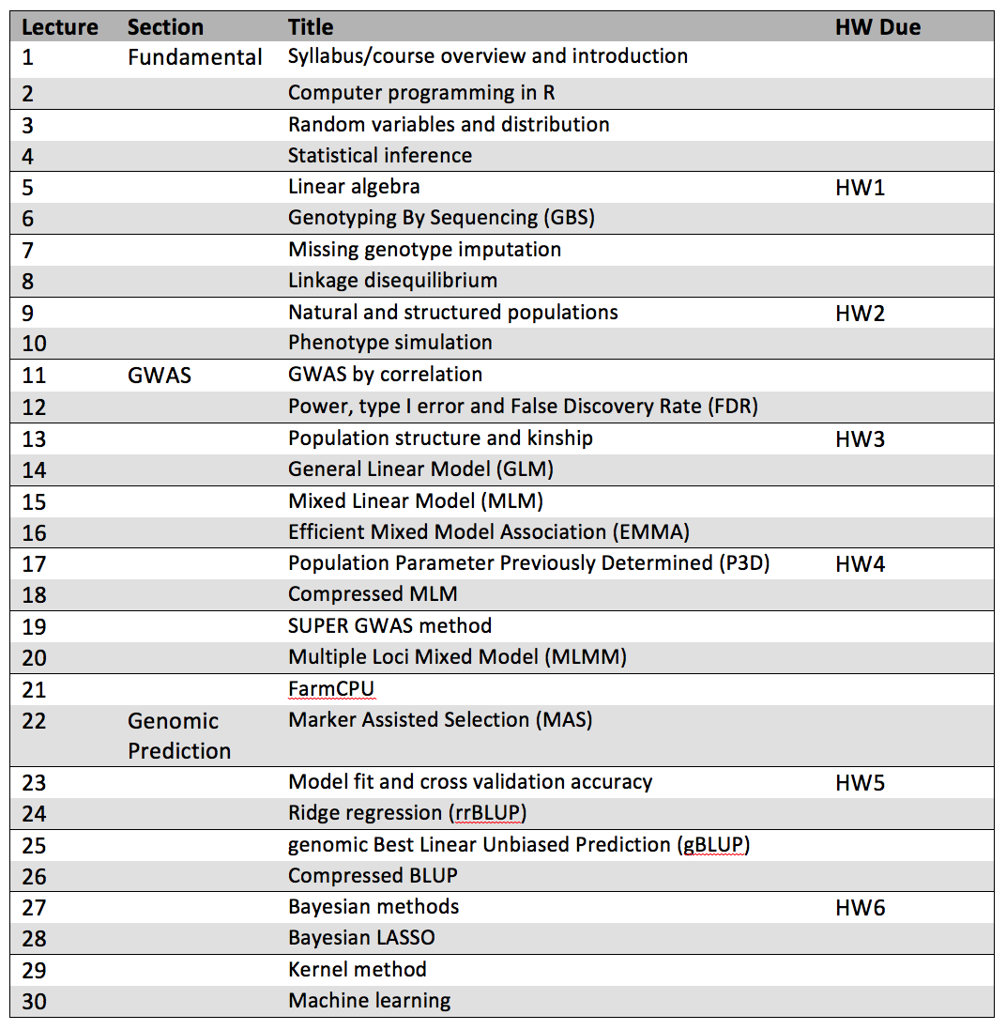

Slide 24
Fundamental

Slide 25
GWAS

Slide 26
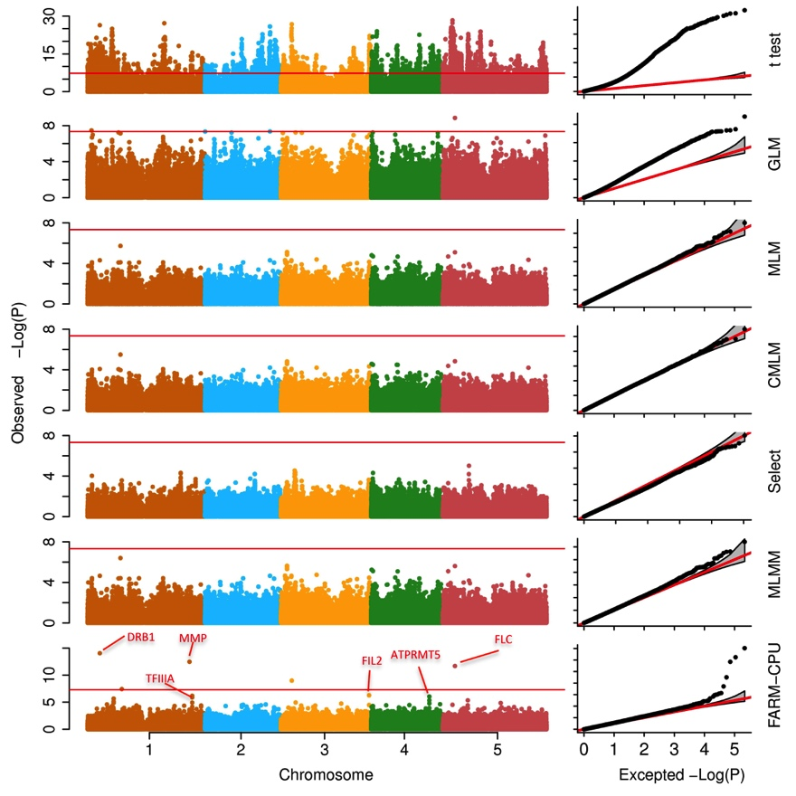
Associations on flowering time

Slide 27
Genomic prediction

Slide 28
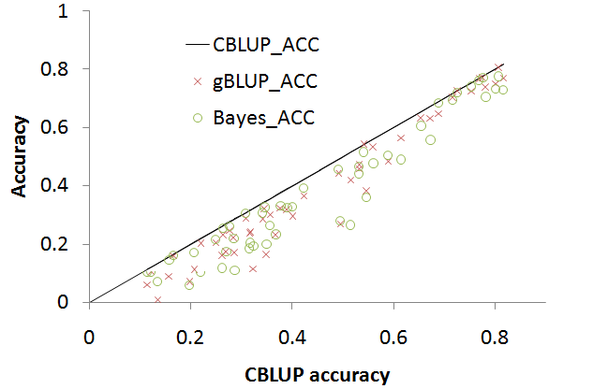
Genomic prediction

Slide 29
Highlight
Active participation + 6 HWs + Midterm/Final exam
GWAS and GS: Very active for research and application
Rapid development

