Slide 1


Statistical Genomics
Lecture 5: Linear Algebra
Zhiwu Zhang
Washington State University

Slide 2
Administration
Homework1, due next Wednesday, Feb 1, 3:10PM

Slide 3
Outline
Example of first question on homework1
Expectation and Variance of random variable
Expectation and Variance of function of random variable
Covariance
Matrix and manipulations
Special matrices: Identity, symmetric, diagonal, singular, and orthogonal
Rank

Slide 4
Question 1 in Homework1
Start from random variables with standard normal distribution, define your own random variable that is function of the normal distributed variables. Name the random variable as your last name and develop a R function to generate the random variable. The input of your R function should include n, which is number variables to be generated, and parameters for the distribution of the random variable you defined. Note: try not to be the same as the known distributions such as Chi-square, F and t.

Slide 5

Example of Chi-square distribution
#There is a function in R
x=rchisq(n=10000,df=5)
#Expectation is df and var=2df
par(mfrow=c(2,2),mar = c(3,4,1,1))
plot(x)
hist(x)
plot(density(x))
plot(ecdf(x))
mean(x)
var(x)

Slide 6
Self-defined function of Chi-square
rZhang=function(n=10,df=2){
y=replicate(n,{
x=rnorm(df,0,1)
y=sum(x^2)
})
return(y)
}
x1=rchisq(n=10000,df=5)
x2=rZhang(n=10000,df=5)
plot(density(x1),col="blue")
lines(density(x2),col="red")

Slide 7
Expectation=Mean when sample size goes to infinity
par(mfrow=c(3,1),mar = c(3,4,1,1))
x=rchisq(n=10,df=5)
hist(x)
abline(v=mean(x), col = "red")
x=rchisq(n=100,df=5)
hist(x)
abline(v=mean(x), col = "red")
x=rchisq(n=10000,df=5)
hist(x)
abline(v=mean(x), col = "red")

Slide 8
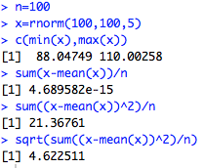
Variance
Range
Average deviation from mean, but it is always zero
Average squared deviation from mean: Variance
Square root of variance = standard deviation
n=100
x=rnorm(100,100,5)
c(min(x),max(x))
sum(x-mean(x))/(n-1)
sum((x-mean(x))^2)/
sqrt(sum((x-mean(x))^2)/(n-1))

Slide 9
Expectation and variance of linear function of random variables
n=10000
df=10
x=rchisq(n,df)
mean(x)
var(x)
y=5*x
mean(y)
var(y)
z=5+x
mean(z)
var(z)
y=ax, E(y)=aE(x), Var(y)=a^2*Var(x)
y=x+a, E(y)=E(x)+a, Var(y)=Var(x)

Slide 10
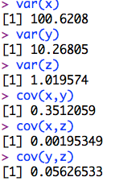
Covariance
n=10000
x=rpois(n, 100)
y=rchisq(n,5)
z=rt(n,100)
par(mfrow=c(3,1),mar = c(3,4,1,1))
plot(x,y)
plot(x,z)
plot(y,z)
var(x)
var(y)
var(z)
cov(x,y)
cov(x,z)
cov(y,z)

Slide 11
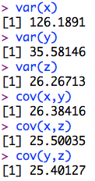
Covariance
n=10000
a=rnorm(n,100,5)
x=a+rpois(n, 100)
y=a+rchisq(n,5)
z=a+rt(n,100)
par(mfrow=c(3,1),mar = c(3,4,1,1))
plot(x,y)
plot(x,z)
plot(y,z)
var(x)
var(y)
var(z)
cov(x,y)
cov(x,z)
cov(y,z)

Slide 12
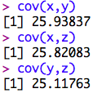
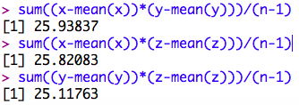
Formula of covariance
Cov(x,y)= sum( (x- mean(x)) * (y- mean(y)) )/(n-1)
sum((x-mean(x))*(y-mean(y)))/(n-1)
sum((x-mean(x))*(z-mean(z)))/(n-1)
sum((y-mean(y))*(z-mean(z)))/(n-1)

Slide 13
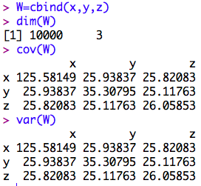
Calculation in R
W=cbind(x,y,z)
dim(W)
cov(W)
var(W)

Slide 14
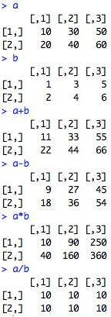
Element-wise Matrix manipulations
Add/
subtraction
(dot)product
(dot)division
a=matrix(seq(10,60,10),2,3)
b=matrix(seq(1,6),2,3)
a
b
a+b
a-b
a*b
a/b

Slide 15

Multiplication
AS | 1
BS | 2
MS | 3
PhD | 4
 | Salary | SQF
Mean | 20000 | 1000
Edu | 10000 | 300
Age | 1000 | 20
Mean | Education | Age
1 | 1 | 30
1 | 4 | 50
Salary | SQF
60000 | 1900
110000 | 3200
c=matrix(c(1,1,1,4,30,50),2,3)
b=matrix(c(20000,10000,1000,1000,300,20),3,2)
t=c%*%b

Slide 16
Inverse
IF:
1
 | 1
 |  | …
 |  |  | 1
A
B
=
B is inverse of A
vice versa
Inverse is for square matrix only

Slide 17
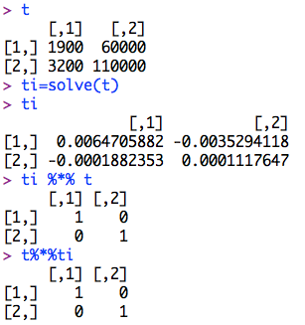
Inverse in R: solve()
t
ti=solve(t)
ti
ti %*% t
t%*%ti

Slide 18
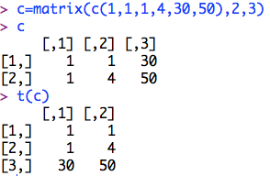
Transpose
Transpose
c=matrix(c(1,1,1,4,30,50),2,3)
c
t(c)

Slide 19
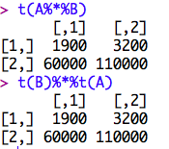
Properties of transpose
(A^{T})^{T}=A
(A+B)^{T}=A^{T}+B^{T}
(AB)^{T}=B^{T}A^{T}
(cB)^{T}=cB^{T} , where c is scalar
A=matrix(c(1,1,1,4,30,50),2,3)
B=matrix(c(1000,300,20,20000,10000,1000),3,2)
t(A%*%B)
t(B)%*%t(A)

Slide 20
Special matrix
Symmetric: A=Transpose(A)
Diagonal matrix: all elements are 0 except diagonals
Identity: Diagonals=1 and res=0
Orthogonal: A multiply by transpose (A) = Identity
Singular: A square matrix does not have a inverse

Slide 21
Rank
The size of the largest non-singular sub matrix
Full rank matrix: rank=dimension

Slide 22
Highlight
Example of first question on homework1
Expectation and Variance of random variable
Expectation and Variance of function of random variable
Covariance
Matrix and manipulations
Special matrices: Identity, symmetric, diagonal, singular, and orthogonal
Rank

