Slide 1


Statistical Genomics
Lecture 7: Impute
Zhiwu Zhang
Washington State University

Slide 2
Administration
Homework2 posted, due Feb 17, Wednesday, 3:10PM
Midterm exam: February 26, Friday, 50 minutes (3:35-4:25PM), 25 questions.
Final exam: May 3, 120 minutes (3:10-5:10PM) for 50 questions.

Slide 3
Outline
Why imputation
How to impute
Stochastic imputation
KNN
BEAGLE

Slide 4
Why imputation
Most of analyses do not allow missing data
Increase marker density
Meta analyses for multiple studies
Improve GWAS and GS

Slide 5
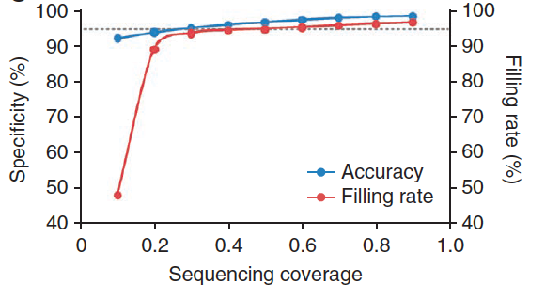
Imputation improve density
Coverage: 1X
Missing rate: 38
Imputed by KNN
Filling rate: 97%
Accuracy: 98%
3M SNPs remain
Huang et al. 2010, Nature Genetics

Slide 6
Example of meta analysis
Guo et. al. Osteoarthritis Cartilage. 2011, 19(4): 420–429
Fig. 5. Missing rate of SNPs. There were 21,455 SNPs on Illumina array that was used to derive the predictive formula. Aboutw40% of these SNPs were not present on the Affymetrix array that was used to genotype the dogs for independent validation (including the first and the third most influential SNPs on the Illumina array). The cumulative missing rates of SNPs are plotted against their order (descending log scale) based on their scaling factor.

Slide 7
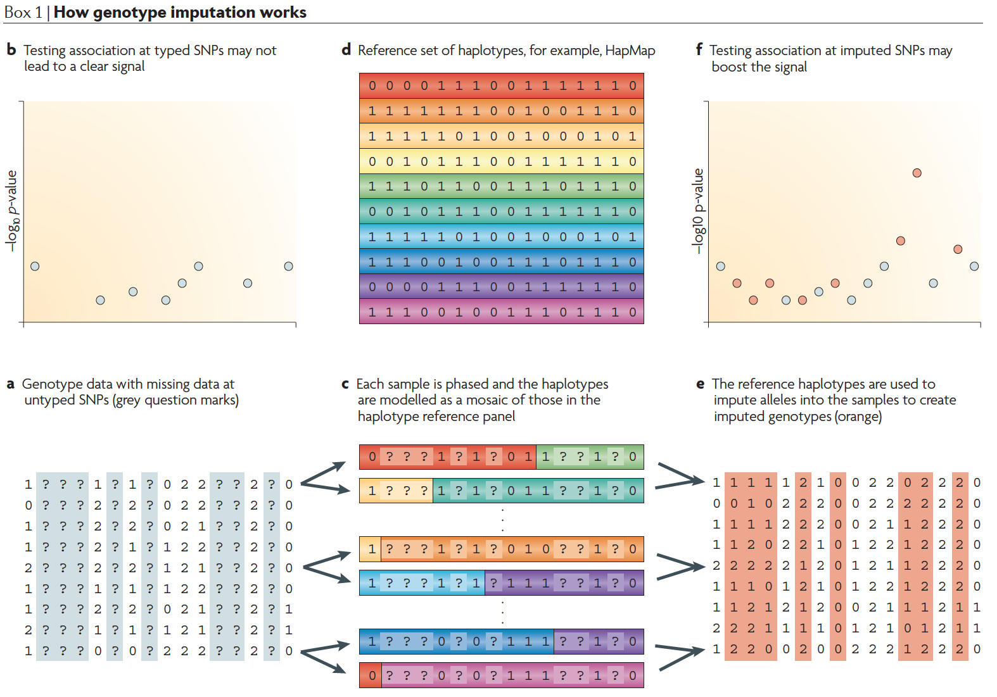
Boost statistical power
Marchini et. al. Nat Rev Genet. 2010 Jul;11(7):499-511

Slide 8
How to impute
Fill with mean
By major allele
Stochastic imputation with allele frequency
KNN
Haplotype
Much more

Slide 9
Stochastic imputation with allele frequency
In case of inbred with alleles A or B, the frequency of A is f(A). If x has uniform distribution U(0,1), then missing allele N can be imputed as

Slide 10
Data and uniform distribution
#Import data
myGD=read.table(file="http://zzlab.net/GAPIT/data/mdp_numeric.txt",head=T)
X.raw=myGD[,-1]
X=X.raw
#Set missing values
mr=.2 #missing rate
n=nrow(X)
m=ncol(X)
dp=m*n #total data points
uv=runif(dp)
hist(uv)

Slide 11
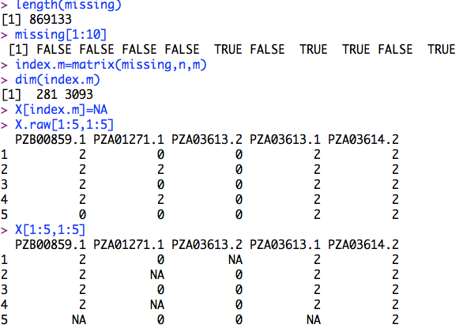
Missing value simulation
missing=uv<mr
length(missing)
missing[1:10]
index.m=matrix(missing,n,m)
dim(index.m)
X[index.m]=NA
X.raw[1:5,1:5]
X[1:5,1:5]

Slide 12
Missing value imputation
#Define StochasticImpute funciton
StochasticImpute=function(X){
n=nrow(X)
m=ncol(X)
fn=colSums(X, na.rm=T) # sum of genotypes for all individuals
fc=colSums(floor(X/3+1),na.rm=T) #count number of non missing individuals
fa=fn/(2*fc) #Frequency of allele "2"
for(i in 1:m){
index.a=runif(n)<fa[i]
index.na=is.na(X[,i])
index.m2=index.a & index.na
index.m0=!index.a & index.na
X[index.m2,i]=2
X[index.m0,i]=0
}
return(X)}

Slide 13

Two types of imputation accuracy
#Impute
XI= StochasticImpute(X)
#Correlation
accuracy.r=cor(X.raw[index.m], XI[index.m])
#Proportion of match
index.match=X.raw==XI
index.mm=index.match&index.m
accuracy.m=length(X[index.mm])/length(X[index.m])
accuracy.r
accuracy.m

Slide 14
Replication
nrep=100
myimp=replicate(nrep,{
uv=runif(dp)
#hist(uv)
missing=uv<mr
length(missing)
missing[1:10]
index.m=matrix(missing,n,m)
dim(index.m)
X[index.m]=NA
X.raw[1:5,1:5]
X[1:5,1:5]
#=======================================
#Impute with StochasticImpute
XI= StochasticImpute(X)
#Calcuate accuracy
accuracy.r=cor(X.raw[index.m], XI[index.m])
index.match=X.raw==XI
index.mm=index.match&index.m
accuracy.m=length(X[index.mm])/length(X[index.m])
accuracy.r
accuracy.m
acc=c(accuracy.r, accuracy.m)
})
plot(myimp[1,],myimp[2,])

Slide 15
K Nearest Neighbors: vote
Income
One neighbor: green goes to blue
Five neighbors: green goes to red
Education

Slide 16
Predict income by regression
Income
One neighbor: income is estimated by the nearest neighbor
Two neighbors: income is estimated as the average of the two nearest neighbors
Regression is better than average
Education

Slide 17
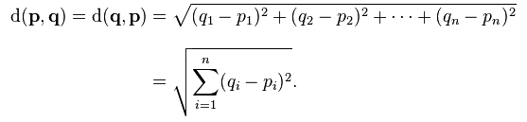
Euclidean distance
Vote: n=2 for education and income
Predict income by education: n=2 for education and income
Impute missing genotypes: n is number of markers

Slide 18

"impute" R package
#install.packages("impute")
## try http:// if https:// URLs are not supported
source("https://bioconductor.org/biocLite.R")
biocLite("impute")
library(impute)
#Impute and calculate correlation
XI= StochasticImpute(X)
X.knn= impute.knn(as.matrix(t(X)), k=10)
accuracy.r.si=cor(X.raw[index.m], XI[index.m])
accuracy.r.knn=cor(X.raw[index.m], t(X.knn$data)[index.m])
accuracy.r.si
accuracy.r.knn

Slide 19

BEAGLE
Java package
JDK required
First release: 2006
Current version: 4.1
Version used in class: 3.3.2
Multiple papers
Brian Browning
University of Washington
Department of Medicine, Division of Medical Genetics
Health Sciences Building, K-253
Box 357720
Seattle, WA 98195-7720
Phone: (206) 685-8482
Fax: (206) 543-3050
E-mail: browning@uw.edu
https://faculty.washington.edu/browning/beagle/b3.html

Slide 20
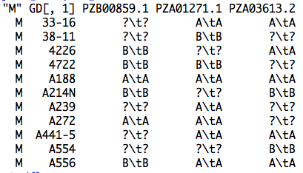
Input file

Slide 21
Output file
#Convert to BEAGLE input format
index0=X==0
index1=X==1
index2=X==2
indexna=is.na(X)
X2=X
X2[index0]="A\tA"
X2[index1]="A\tB"
X2[index2]="B\tB"
X2[indexna]="?\t?"
myGD2=cbind("M",myGD[,1],X2)
setwd("/Users/Zhiwu/Dropbox/Current/ZZLab/WSUCourse/CROPS545/Demo")
write.table(myGD2,file="test.bgl",quote=F,sep="\t",col.name=F,row.name=F)

Slide 22
Run BEAGLE
Command line
From R
#Impute with BEAGLE
system("java -Xmx12g -jar /Users/Zhiwu/Dropbox/Current/ZZLab/WSUCourse/CROPS545/Demo/Beagle/beagle.jar unphased=test.bgl missing=? out=test1" )

Slide 23
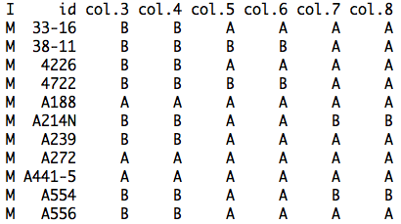
Output of BEAGLE

Slide 24
Format conversion
#Convert output format
genotype.full <- read.delim("test1.test.bgl.phased.gz",sep=" ",head=T)
genotype.c=as.matrix(genotype.full[,-(1:2)])
index.A=genotype.c=="A"
index.B=genotype.c=="B"
nr=nrow(genotype.c)
nc=ncol(genotype.c)
genotype.n=matrix(0,nr,nc)
genotype.n[index.A]=0
genotype.n[index.B]=1
n2=ncol(genotype.n)
odd=seq(1,n2-1,2)
even=seq(2,n2,2)
g0=genotype.n[,odd]
g1=genotype.n[,even]
X.bgl=g0+g1

Slide 25

Accuracy of BEAGLE
#Impute and calculate correlation
accuracy.r=cor(X.raw[index.m], X.bgl[index.m])
index.match=X.raw==X.bgl
index.mm=index.match&index.m
accuracy.m=length(X[index.mm])/length(X[index.m])
accuracy.r
accuracy.m

Slide 26
Highlight
Why imputation
How to impute
Stochastic imputation
KNN
BEAGLE

