Slide 1


Statistical Genomics
Lecture 8: Genetic architecture and
simulation of phenotype
Zhiwu Zhang
Washington State University

Slide 2
Administration
Homework 2, due Feb 17, Wednesday, 3:10PM
Office hour: Monday, 1:30-2:30
Midterm exam: February 26, Friday, 50 minutes (3:35-4:25PM), 25 questions.
Final exam: May 3, 120 minutes (3:10-5:10PM) for 50 questions.

Slide 3
Outline
Accumulation of gene effect
Genetic architecture
Gene effect distribution
Phenotype distribution
Heritability
R function

Slide 4
How phenotypes get normal distributed?
x~B(n, p)
n trials each with p successful rate.
The total number of successes is a random variable, x
p=0.5,
Left-fail
Right-success
x=rbinom(10000,5,.0)
1
Gene 1
Gene 2
1
2
1
Gene 3
1
3
3
1
Gene 4
1
4
6
4
1
Gene 5
1
5
9
9
5
1
Even genes have the same effect
0
1
2
3
4
5
Outcome

Slide 5
quartz() #Mac
par(mfrow=c(4,4),mar = c(3,4,1,1))
n=10000
m=10
x=rbinom(n,m,.5)
hist(x)
plot(density(x))

Slide 6
Ten gens with same effect

Slide 7
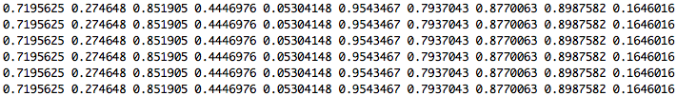
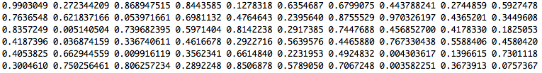
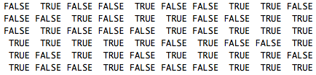
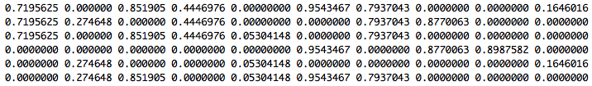
Ten gens with different effect
Gene effect
Assign to individuals
Uniform random variable
Individual gene effect
Individual total effect

Slide 8
Ten gens with different effects
#x=rep(1,m)
x=runif(m)
gene=matrix(x,n,m,byrow = T)
head(gene)
galton=matrix(runif(n*m),n,m)
head(galton)
galton.binary=galton<.5
head(galton.binary)
gene[galton.binary]=0
head(gene)
y=rowSums(gene)
y[1:6]
hist(y)
plot(density(y))

Slide 9
Ten gens with different effects

Slide 10
10 genes
100 genes
Same effect
Different effects

Slide 11
Complex traits
Controlled by multiple genes
Influenced by environment
Also known as quantitative traits
Most traits are continuous, e.g. yield and height,
Some are categorical, e.g. node number, score of disease resistance
Some binary traits are still quantitative traits, e.g. diabetes
Economically important

Slide 12
Dissecting phenotype
Y= G + E + GxE + Residual
G = Additive + Dominance + Epistasis
E: Environment, e.g. year and location
Residual: e.g. measurement error

Slide 13
QTL and QTN
Quantitative Trait Loci (QTL)
Specific regions in the genome that are associated with quantitative traits
The regions were traditionally considered as 10-15 cM. The regions evolved to 3-5 cM in fine mapping.
  Suppose maize genome contains 50,000 genes and has genetic map =1700 cM
  Each QTL we identify has roughly 100-150 genes
Gene cloning: identification the QTL regions at gene level
Ultimate goal: functional mutations
Quantitative Trait Nucleotide: QTN

Slide 14
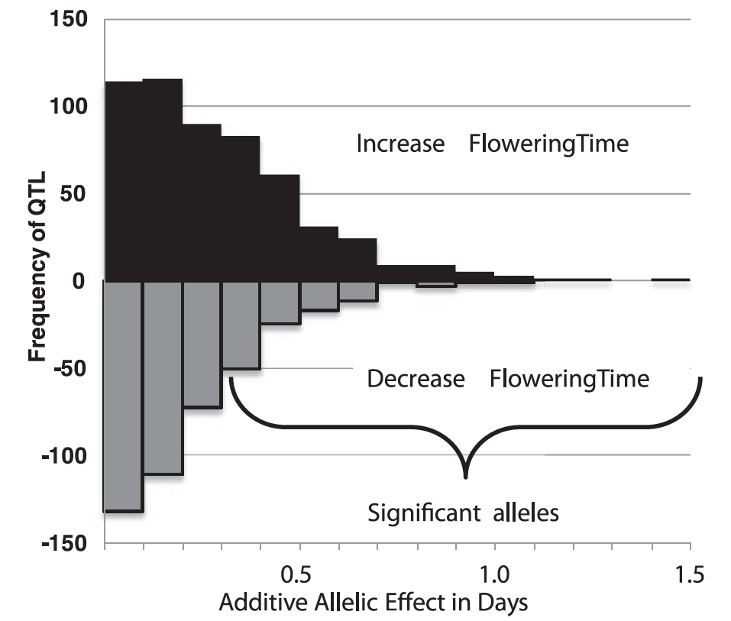
Gene effects
Flowering time is controled by >50 genes
Most have small effects
The largest one only 1.5 increase days
Buckler et al, Science, 2009

Slide 15
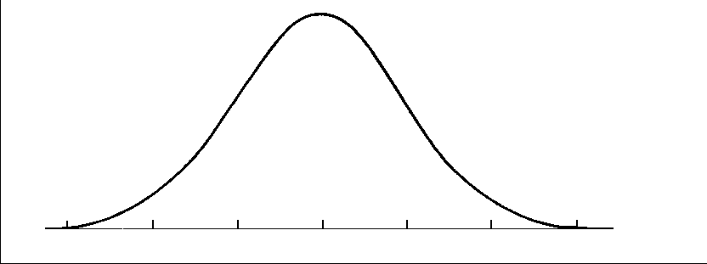
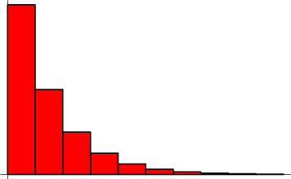
Distribution of QTN effect
Normal distribution
Geometry distribution

Slide 16
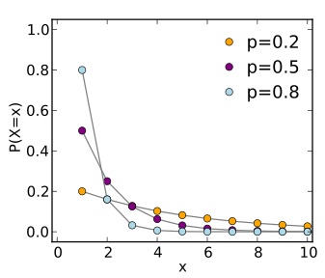
Theoretical geometric distribution
The probability distribution of the number X of Bernoulli trials needed to get one success
Prob (X=k)=(1-p)^{k-1} p

Slide 17
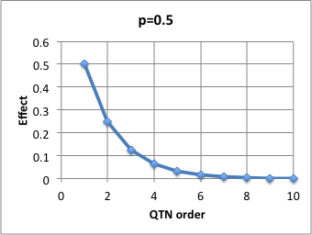
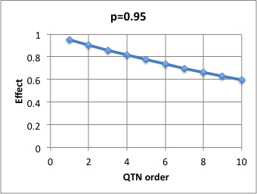
Approximated geometric distribution
Effect(X=k)=p^{k}

Slide 18
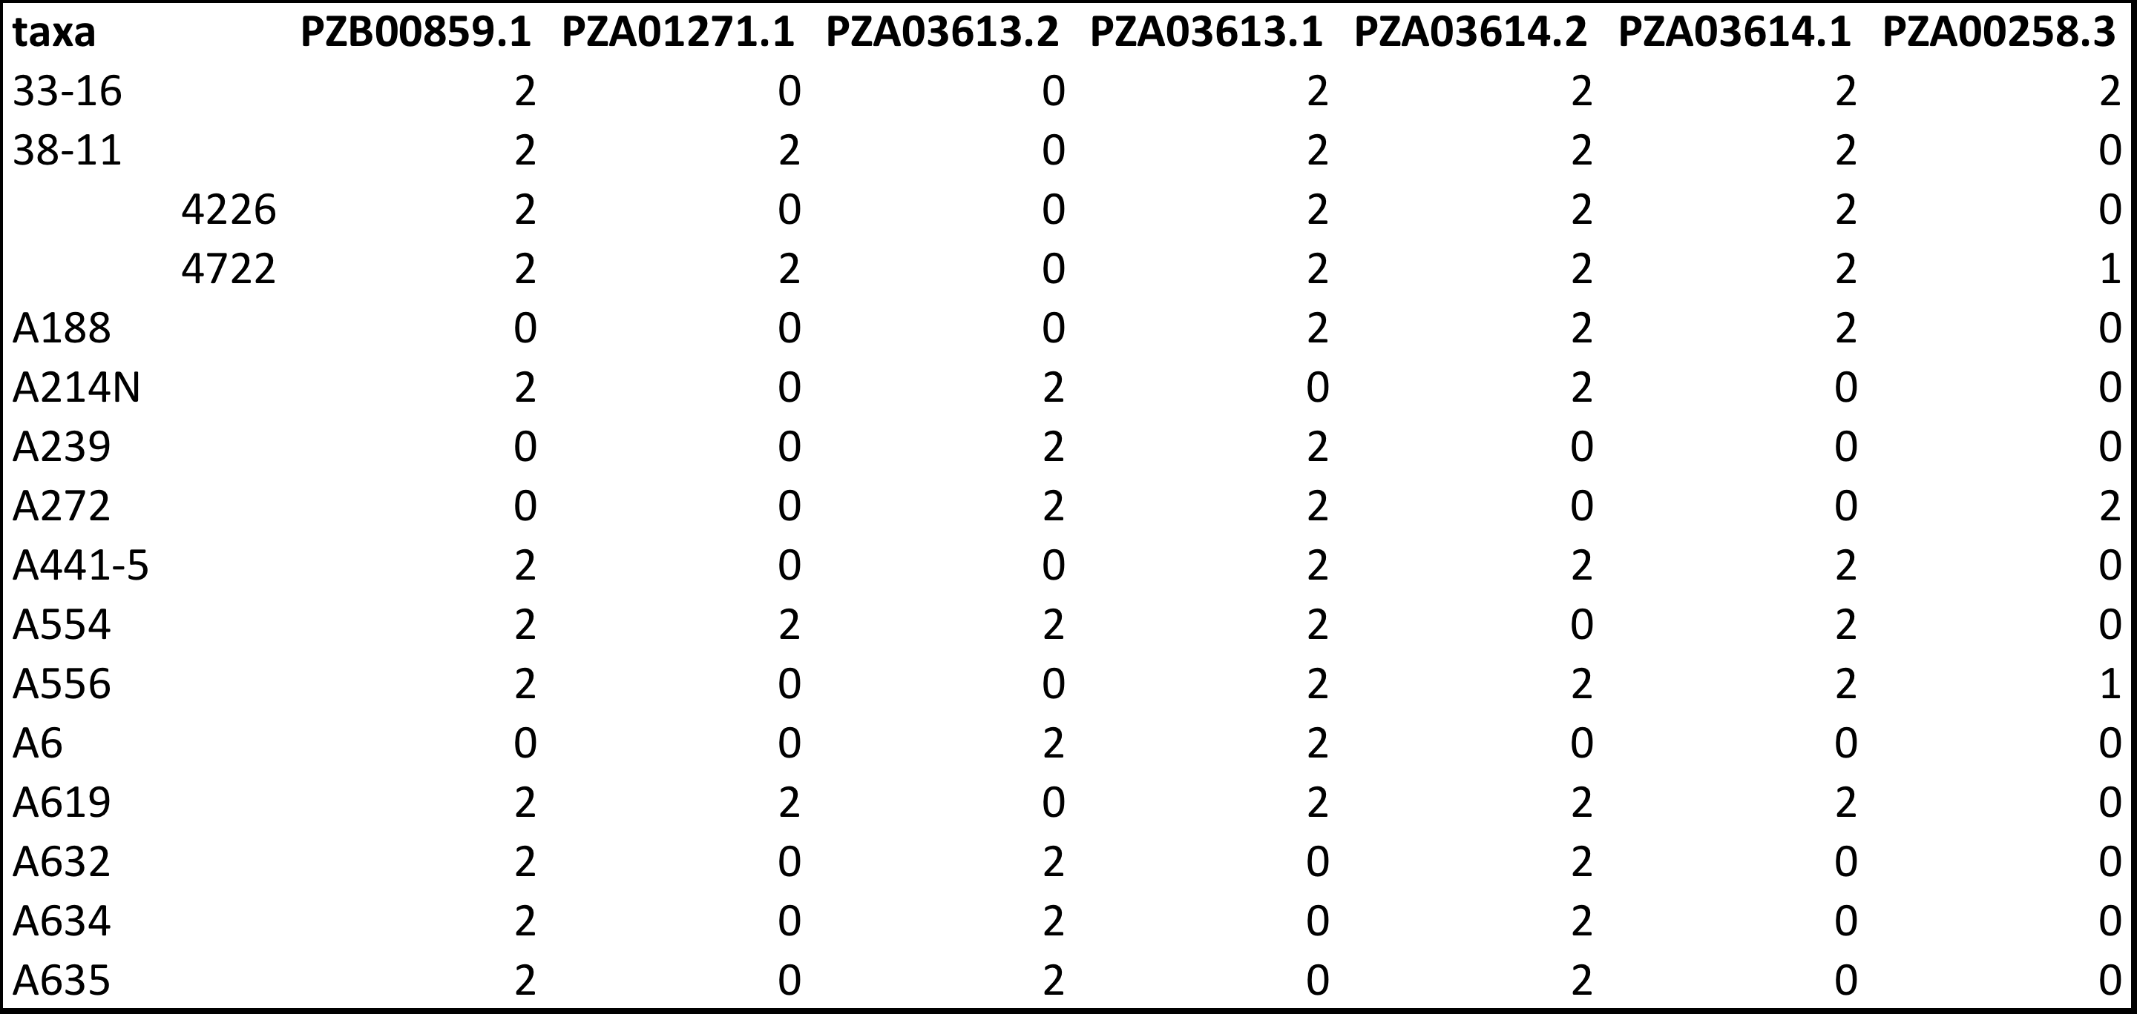
Genotype in Numeric format
myGD=read.table(file="http://zzlab.net/GAPIT/data/mdp_numeric.txt",head=T)

Slide 19
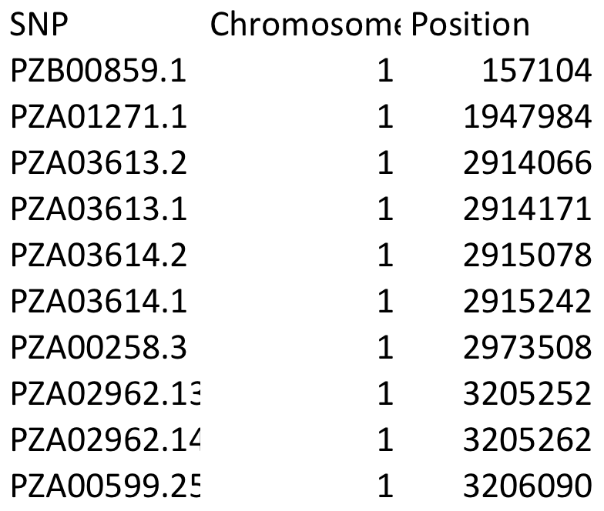
Genetic map
myGM=read.table(file="http://zzlab.net/GAPIT/data/mdp_SNP_information.txt",head=T)

Slide 20
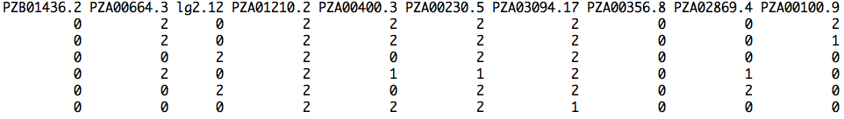
Sampling QTNs
#Sampling QTN
NQTN=10
X=myGD[,-1]
n=nrow(X)
m=ncol(X)
QTN.position=sample(m,NQTN,replace=F)
SNPQ=as.matrix(X[,QTN.position])
QTN.position
head(SNPQ)

Slide 21
QTN positions
plot(myGM[,c(2,3)])
lines(myGM[QTN.position,c(2,3)],type="p",col="red")
points(myGM[QTN.position,c(2,3)],type="p",col="blue",cex = 5)

Slide 22
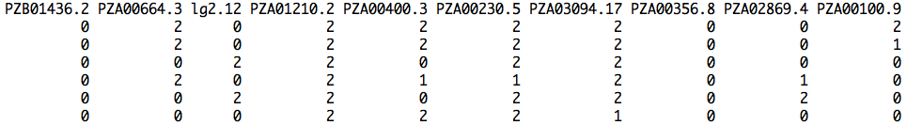

Additive genetic effect
addeffect=rnorm(NQTN,0,1)
addeffect
effect=SNPQ%*%addeffect
head(effect)

Slide 23
genetic effect distribution
par(mfrow=c(2,2))
plot(effect)
hist(effect)
boxplot(effect)
plot(ecdf(effect))

Slide 24
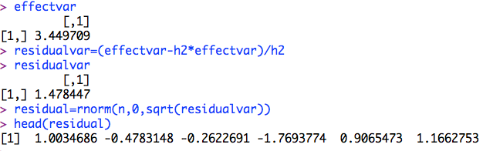
Residual
h2=.7
effectvar=var(effect )
effectvar
residualvar=(effectvar-h2*effectvar)/h2
residualvar
residual=rnorm(n,0,sqrt(residualvar))
head(residual)

Slide 25
Residual distribution
par(mfrow=c(2,2))
plot(residual)
hist(residual)
boxplot(residual)
plot(ecdf(residual))

Slide 26
Phenotype
y=effect+residual
par(mfrow=c(2,2))
plot(y)
hist(y)
boxplot(y)
plot(ecdf(y))

Slide 27
Heritability
va=var(effect)
ve=var(residual)
vp=var(y)
v=matrix(c(va,ve,vp),1,3)
colnames(v)=c("A", "E","P")
barplot(v,col="gray")
plot(density(y),ylim=c(0,.5))
lines(density(effect),col="blue")
lines(density(residual),col="red")

Slide 28
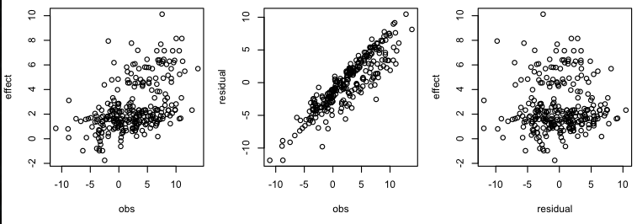
Correlations
#Plot
par(mfrow=c(1,3),mar = c(30,4,10,1))
plot(y,effect)
plot(y,residual)
plot(residual,effect)
cor(y,effect)

Slide 29
How to do this again and again?
Function

Slide 30
Function to simulate phenotypes
G2P=function(X,h2,alpha,NQTN,distribution){
n=nrow(X)
m=ncol(X)
#Sampling QTN
QTN.position=sample(m,NQTN,replace=F)
SNPQ=as.matrix(X[,QTN.position])
QTN.position
#QTN effects
if(distribution=="norm")
{addeffect=rnorm(NQTN,0,1)
}else
{addeffect=alpha^(1:NQTN)}
#Simulate phenotype
effect=SNPQ%*%addeffect
effectvar=var(effect)
residualvar=(effectvar-h2*effectvar)/h2
residual=rnorm(n,0,sqrt(residualvar))
y=effect+residual
return(list(addeffect = addeffect, y=y, add = effect, residual = residual, QTN.position=QTN.position, SNPQ=SNPQ))
}

Slide 31
Load R function
source('~/Dropbox/Current/ZZLab/WSUCourse/CROPS545/Demo/G2P.R')

Slide 32
source('~/Dropbox/Current/ZZLab/WSUCourse/CROPS545/Demo/G2P.R')
par(mfrow=c(3,1),mar = c(3,4,1,1))
myG2P=G2P(X,.75,1,10,"norm")
str(myG2P)
va=var(myG2P$add)
ve=var(myG2P$residual)
vp=var(myG2P$y)
v=matrix(c(va,ve,vp),1,3)
colnames(v)=c("A", "E","P")
barplot(v,col="gray")
myG2P=G2P(X,.5,1,10,"norm")
va=var(myG2P$add)
ve=var(myG2P$residual)
vp=var(myG2P$y)
v=matrix(c(va,ve,vp),1,3)
colnames(v)=c("A", "E","P")
barplot(v,col="gray")
myG2P=G2P(X,.25,1,10,"norm")
va=var(myG2P$add)
ve=var(myG2P$residual)
vp=var(myG2P$y)
v=matrix(c(va,ve,vp),1,3)
colnames(v)=c("A", "E","P")
barplot(v,col="gray")
va decreases with decreasing h2

Slide 33
Effect of Number of Genes
#Desect phenotype
par(mfrow=c(3,1))
myG2P=G2P(X,.5,1,2,"norm")
plot(density(myG2P$y),ylim=c(0,1.5))
lines(density(myG2P$add),col="blue")
lines(density(myG2P$residual),col="red")
myG2P=G2P(X,.5,1,10,"norm")
plot(density(myG2P$y),ylim=c(0,.3))
lines(density(myG2P$add),col="blue")
lines(density(myG2P$residual),col="red")
myG2P=G2P(X,.5,1,100,"norm")
plot(density(myG2P$y),ylim=c(0,.1))
lines(density(myG2P$add),col="blue")
lines(density(myG2P$residual),col="red")

Slide 34
Effect of Number of Genes
#Check on distribution
par(mfrow=c(3,3),mar = c(3,4,1,1))
myG2P=G2P(X,.5,1,2,"norm")
hist(myG2P$add)
hist(myG2P$residual)
hist(myG2P$y)
myG2P=G2P(X,.5,1,10,"norm")
hist(myG2P$add)
hist(myG2P$residual)
hist(myG2P$y)
myG2P=G2P(X,.5,1,100,"norm")
hist(myG2P$add)
hist(myG2P$residual)
hist(myG2P$y)

Slide 35
Check on gene effect distribution
#Check gene effect distribution
par(mfrow=c(3,3),mar = c(3,4,1,1))
myG2P=G2P(X,.5,1,10,"geom")
hist(myG2P$add)
hist(myG2P$residual)
hist(myG2P$y)
myG2P=G2P(X,.5,.95,10,"geom")
hist(myG2P$add)
hist(myG2P$residual)
hist(myG2P$y)
myG2P=G2P(X,.5,.5,10,"geom")
hist(myG2P$add)
hist(myG2P$residual)
hist(myG2P$y)

Slide 36
Highlight
Accumulation of gene effect
Genetic architecture
Gene effect distribution
Phenotype distribution
Heritability
R function

