Slide 1


Statistical Genomics
Lecture 9: Linkage Disequilibrium
Zhiwu Zhang
Washington State University

Slide 2
Administration
Homework 2, due Feb 17, Wednesday, 3:10PM
Add page and line numbers on reports
Midterm exam: February 26, Friday, 50 minutes (3:35-4:25PM), 25 questions.
Final exam: May 3, 120 minutes (3:10-5:10PM) for 50 questions.

Slide 3
Outline
Trait-marker association
Hardy-Weinberg principle
Linkage an recombination
LD measurements
  D
  D’
  R2
  Causes of LD
LD decade

Slide 4
Observed and expected frequency
 | AA | TT | SUM
Herbicide Resistant | 35 | 5 | 40
Non herbicide Resistant | 35 | 25 | 60
SUM | 70 | 30 | 100
 | AA | TT | SUM
Herbicide Resistant | 28 | 12 | 40
Non herbicide Resistant | 42 | 18 | 60
SUM | 70 | 30 | 100

Slide 5
Approximate Distributions
Poisson distribution: Mean=Var=Expected
(Observed-Expected)/Sqrt(Expected) ~ N(0,1)
SUM(Observed-Expected)²/ Expected ~ X²(df)
df=number of independent cells
df=1 for two marker loci (approximation).

Slide 6
Observed and expected frequency
 | AA | TT | SUM
Herbicide Resistant | 35 | 5 | 40
Non herbicide Resistant | 35 | 25 | 60
SUM | 70 | 30 | 100
 | AA | TT | SUM
Herbicide Resistant | 28 | 12 | 40
Non herbicide Resistant | 42 | 18 | 60
SUM | 70 | 30 | 100
49/28+49/12+49/42+49/18=9.72

Slide 7
P value by using R
1-pchisq(9.72,1)
0.001822735
par(mfrow=c(2,2),mar = c(3,4,1,1))
x=rchisq(10000,1)
d=density(x)
plot(x)
plot(d)
hist(x)
plot(ecdf(x))
index=x>9.72
length(x[index])/10000
0.002

Slide 8

Permutation test
x2=replicate(10000,{
t=100
s=sample(4,t,replace=T)
x=table(s)
fh=(x[1]+x[3])/t
fa=(x[1]+x[2])/t
e1=t*fh*fa
e2=t*(1-fh)*fa
e3=t*fh*(1-fa)
e4=t*(1-fh)*(1-fa)
e=c(e1,e2,e3,e4)
d=(x-e)^2/e
sum(d)
})
28 25 33 14
xc=rchisq(10000,1)
plot(density(x2),col="blue")
lines(density(xc),col="red")
index=x2>9.72
length(x2[index])/10000
P(>9.72)= 0.0025

Slide 9
Association scale
 | AA | TT | SUM
Herbicide Resistant | 35 | 5 | 40
Non herbicide Resistant | 35 | 25 | 60
SUM | 70 | 30 | 100
 | AA | TT | SUM
Herbicide Resistant | 19 | 1 | 20
Non herbicide Resistant | 16 | 14 | 30
SUM | 35 | 15 | 50
Stronger

Slide 10
Observed and expected frequency
 | AA | TT | SUM
Herbicide Resistant | 19 | 1 | 20
Non herbicide Resistant | 16 | 14 | 30
SUM | 35 | 15 | 50
Observed
 | AA | TT | SUM
Herbicide Resistant | 14 | 6 | 20
Non herbicide Resistant | 21 | 9 | 30
SUM | 35 | 15 | 50
Expected
25/14+25/6+25/21+25/9=9.92 (similar to weaker association)

Slide 11
Problems with
Chi-square association test
No indication on association scales: LD
Not for continued traits: GWAS

Slide 12
The Hardy–Weinberg principle
Allele and genotype frequencies in a population will remain constant from generation to generation in the absence of other evolutionary influences.
These influences include non-random mating, mutation, selection, genetic drift, gene flow and meiotic drive.
f(A)=p, f(a)=q, then f(AA)=p², f(aa)=q², f(Aa)=2pq

Slide 13
Linkage equilibrium
Random join between alleles at two or more loci
P_{AB}=P_{A}P_{B}
D(ifference)=0

Slide 14
Linkage Disequilibrium (LD)
Loci and allele | A | a | B | b
frequency | .6 | .4 | .7 | .3
Gametic type | AB | Ab | aB | ab
Observed | 0.5 | 0.1 | 0.2 | 0.2
Frequency equilibrium | 0.42 | 0.18 | 0.28 | 0.12
Difference | 0.08 | -0.08 | -0.08 | 0.08
D =P_{AB}-P_{A}P_{B} =P_{ab}-P_{a}P_{b}
=-(P_{Ab}-P_{A}P_{b}) =-(P_{aB}-P_{a}P_{B})

Slide 15
D parameter
Deviation of gamete frequency from the random association
Positive if product of frequencies of coupling gametes minus the product of repulsion gametes
Negative, otherwise

Slide 16
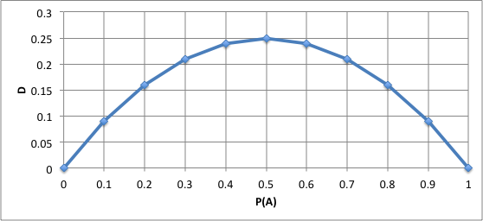
D depends on allele frequency
Vary even with complete LD
P_{Ab}=P_{aB}=0
P_{AB}=1-P_{ab}=P_{A}=P_{B}
D=P_{A}-P_{A}P_{A}

Slide 17
Property of D
Deviation between observed and expected
Extreme values: -0.25 and 0.25
Non LD: D=0
Dependency on allele frequency

Slide 18
D’
Lewontin (1964) proposed standardizing D to the maximum possible value it can take:
D’=D/D_{Max} =0.08/0.18=0.44
D_{max}: the maximum D for given allele frequency
D_{max}= min(P_{A}P_{B}, P_{a}P_{b}) if D is negative, or min(P_{A}P_{b}, P_{a}P_{B}) if D is positive
Range of D’: -1 to 1

Slide 19
R²
Hill and Robertson (1968) proposed the following measure of linkage disequilibrium:
r² (Δ²)=D²/(P_{A}P_{B}P_{a}P_{b})
Square makes positive
The product of allele frequency creates penalty for 50% allele frequency.
Range: 0 to 1

Slide 20
Causes of LD
Mutation
Selection
Inbreeding
Genetic drift
Gene flow/admixture

Slide 21
Mutation and selection
mutation
A____Q
Generation 1
A____q
A____q
A____q
A____q
A____q
A____q
Generation 2
A____q
A____Q
Selection
A____Q
A____q
A____q
A____q
Generation 3
A____Q
A____Q
Selection
A____Q
A____q
A____Q
A____q

Slide 22
Change in D over time
c: recombination rate
D_{t}=D₀(1-c)^{t}
t=log(D_{t}/D₀)/log(1-c)
if c=10%, it takes 6.5 generation for D to be cut in half
if two SNPs 1kb apart
1Mb=1cM,
c=10⁻²/10⁶=10⁻⁸/bp=10⁻⁵/kb
It takes 69,319 generations for D to be cut in half

Slide 23
Change in D over time
t=seq(1:50)
D0=.25
c=.01
Dt=(1-c)^t*D0
plot(t,Dt,type="l",col="red",ylim=c(0,.25))
c=.05
Dt=(1-c)^t*D0
lines(t,Dt,type="l",col="blue")
c=.1
Dt=(1-c)^t*D0
lines(t,Dt,type="l",col="green")
c=.25
Dt=(1-c)^t*D0
lines(t,Dt,type="l",col="black")

Slide 24
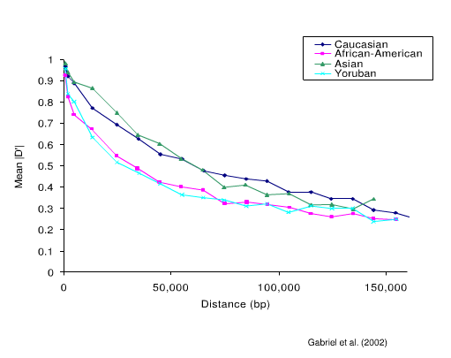
LD decay over distance

Slide 25
Highlight
Trait-marker association
Hardy-Weinberg principle
Linkage an recombination
LD measurements
  D
  D’
  R2
  Causes of LD
LD decade

