Slide 1


Statistical Genomics
Lecture 11: Power, type I error and FDR
Zhiwu Zhang
Washington State University

Slide 2
Administration
Homework 2, due Feb 17, Wednesday, 3:10P
Homework 3 posted, due Mar 2, Wednesday, 3:10PM
Midterm exam: February 26, Friday, 50 minutes (3:35-4:25PM), 25 questions.

Slide 3
Outline
Simulation of phenotype from genotype
GWAS by correlation
Power
FDR
Cutoff
Null distribution of p values
Resolution
QTN bins and non-QTN bins

Slide 4
GWAS by correlation
myGD=read.table(file="http://zzlab.net/GAPIT/data/mdp_numeric.txt",head=T)
myGM=read.table(file="http://zzlab.net/GAPIT/data/mdp_SNP_information.txt",head=T)
setwd("~/Dropbox/Current/ZZLab/WSUCourse/CROPS545/Demo")
source("G2P.R")
source("GWASbyCor.R")
X=myGD[,-1]
index1to5=myGM[,2]<6
X1to5 = X[,index1to5]
set.seed(99164)
mySim=G2P(X= X1to5,h2=.75,alpha=1,NQTN=10,distribution="norm")
p= GWASbyCor(X=X,y=mySim$y)

Slide 5
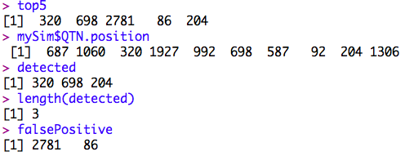
The top five associations
index=order(p)
top5=index[1:5]
detected=intersect(top5,mySim$QTN.position)
falsePositive=setdiff(top5, mySim$QTN.position)
top5
mySim$QTN.position
detected
length(detected)
falsePositive
Power=3/10
False Discovery Rate (FDR) =2/5

Slide 6
The top five associations
color.vector <- rep(c("deepskyblue","orange","forestgreen","indianred3"),10)
m=nrow(myGM)
plot(t(-log10(p))~seq(1:m),col=color.vector[myGM[,2]])
abline(v=mySim$QTN.position, lty = 2, lwd=2, col = "black")
abline(v= falsePositive, lty = 2, lwd=2, col = "red")
Cutoff
Resolution

Slide 7
Cutoff from null distribution of P values: CHR 6-10
N | Observed | Expected
1 | 9.80E-08 | 0.000926784
2 | 7.76E-07 | 0.001853568
3 | 3.07E-06 | 0.002780352
4 | 5.20E-06 | 0.003707136
5 | 7.26E-06 | 0.00463392
6 | 8.64E-06 | 0.005560704
7 | 9.72E-06 | 0.006487488
8 | 1.67E-05 | 0.007414273
9 | 1.91E-05 | 0.008341057
10 | 2.13E-05 | 0.009267841
11 | 3.28E-05 | 0.010194625
12 | 3.45E-05 | 0.011121409
13 | 3.98E-05 | 0.012048193
14 | 4.46E-05 | 0.012974977
15 | 5.39E-05 | 0.013901761
1074 | 0.9918845 | 0.9953661
1075 | 0.9954024 | 0.9962929
1076 | 0.9960631 | 0.9972196
1077 | 0.9970031 | 0.9981464
1078 | 0.9992356 | 0.9990732
1079 | 0.9999589 | 1
index.null=!index1to5 & !is.na(p)
p.null=p[index.null]
m.null=length(p.null)
index.sort=order(p.null)
p.null.sort=p.null[index.sort]
head(p.null.sort)
tail(p.null.sort)
seq=seq(1:m.null)
table=cbind(seq, p.null.sort, seq/m.null)
head(table,15)
tail(table)
1% of observed p values are below 0.0000328
P value of 3.28E-5 is equivalent to 1% type 1 error

Slide 8
What about QTNs every where?
set.seed(99164)
mySim=G2P(X= myGD[,-1],h2=.75,alpha=1,NQTN=10,distribution="norm")
p= GWASbyCor(X=X,y=mySim$y)
plot(t(-log10(p))~seq(1:m),col=color.vector[myGM[,2]])
abline(v=mySim$QTN.position, lty = 2, lwd=2, col = "black")

Slide 9
Resolution and bin approach
10Kb is really good, 100Kb is OK
Bins with QTNs for power
Bins without QTNs for type I error

Slide 10
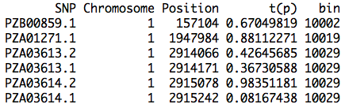
Bins (e.g. 100Kb)
bigNum=1e9
resolution=100000
bin=round((myGM[,2]*bigNum+myGM[,3])/resolution)
result=cbind(myGM,t(p),bin)
head(result)
Minimum p value within bin

Slide 11
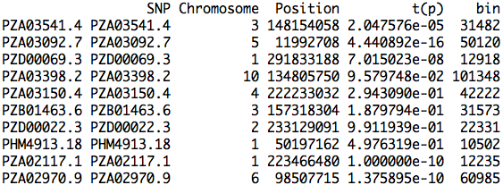
Bins of QTNs
QTN.bin=result[mySim$QTN.position,]
QTN.bin

Slide 12
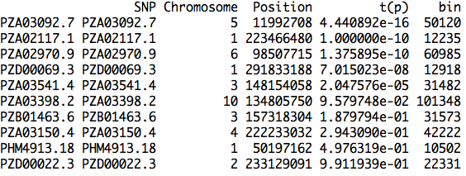
Sorted bins of QTNs
index.qtn.p=order(QTN.bin[,4])
QTN.bin[index.qtn.p,]

Slide 13
FDR and type I error
Total number of bins: 3054 (size of 100kb)
N | bin | t(p)
1 | 50120 | 4.44E-16
2 | 12235 | 1.00E-10
3 | 60985 | 1.38E-10
4 | 12918 | 7.02E-08
5 | 31482 | 2.05E-05
6 | 101348 | 9.58E-02
7 | 31573 | 1.88E-01
8 | 42222 | 2.94E-01
9 | 10502 | 4.98E-01
10 | 22331 | 9.91E-01
Power
0.1
0.2
0.3
0.4
0.5
0.6
0.7
0.8
0.9
1
#False bins
0
0
0
0
2
416
608
782
1001
1335
FDR
0
0
0
0
0.285714286
0.985781991
0.988617886
0.989873418
0.991089109
0.992565056
TypeI Error
0
0
0
0
0.000654879
0.1362148
0.19908317
0.256057629
0.327766863
0.437131631
0.285714286=2/(2+5)
0.000654879=2/3054

Slide 14
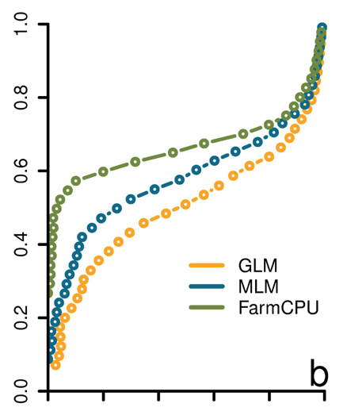
ROC curve
Receiver Operating Characteristic
"The curve is created by plotting the true positive rate against the false positive rate at various threshold settings." -Wikipedia
Power
FDR
Liu et. al. PLoS Genetics, 2016

Slide 15
GAPIT.FDR.TypeI Function
library(compiler) #required for cmpfun
source("http://www.zzlab.net/GAPIT/gapit_functions.txt")
myStat=GAPIT.FDR.TypeI(
WS=c(1e0,1e3,1e4,1e5), GM=myGM,
seqQTN=mySim$QTN.position,
GWAS=result)
str(myStat)

Slide 16
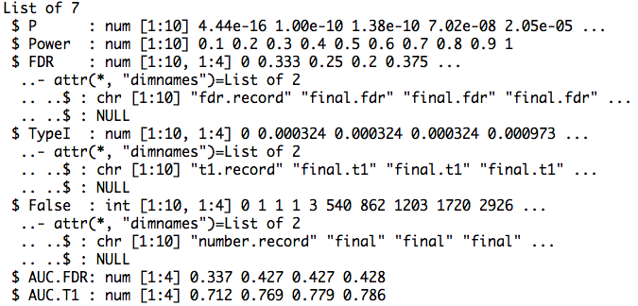
Return

Slide 17
Area Under Curve (AUC)
par(mfrow=c(1,2),mar = c(5,2,5,2))
plot(myStat$FDR[,1],myStat$Power,type="b")
plot(myStat$TypeI[,1],myStat$Power,type="b")

Slide 18
Replicates
nrep=100
set.seed(99164)
statRep=replicate(nrep, {
mySim=G2P(X=myGD[,-1],h2=.5,alpha=1,NQTN=10,distribution="norm")
p=p= GWASbyCor(X=myGD[,-1],y=mySim$y)
seqQTN=mySim$QTN.position
myGWAS=cbind(myGM,t(p),NA)
myStat=GAPIT.FDR.TypeI(WS=c(1e0,1e3,1e4,1e5), GM=myGM,seqQTN=mySim$QTN.position,GWAS=myGWAS,maxOut=100,MaxBP=1e10)
})

Slide 19
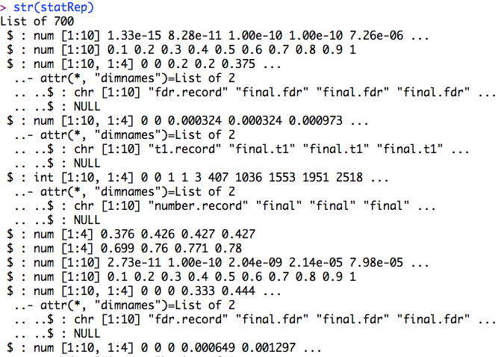
str(statRep)

Slide 20
Means over replicates
power=statRep[[2]]
#FDR
s.fdr=seq(3,length(statRep),7)
fdr=statRep[s.fdr]
fdr.mean=Reduce ("+", fdr) / length(fdr)
#AUC: power vs. FDR
s.auc.fdr=seq(6,length(statRep),7)
auc.fdr=statRep[s.auc.fdr]
auc.fdr.mean=Reduce ("+", auc.fdr) / length(auc.fdr)

Slide 21
Plots of power vs. FDR
theColor=rainbow(4)
plot(fdr.mean[,1],power , type="b", col=theColor [1],xlim=c(0,1))
for(i in 2:ncol(fdr.mean)){
lines(fdr.mean[,i], power , type="b", col= theColor [i])
}

Slide 22
Plots of AUC
barplot(auc.fdr.mean,
names.arg=c("1bp", "1K", "10K","100K"),
xlab="Resolution",
ylab="AUC")

Slide 23
ROC with different heritability
h²= 25% vs. 75%
10 QTNs
Normal distributed QTN effect
100kb resolution
Power against Type I error

Slide 24
Simulation and GWAS
nrep=100
set.seed(99164)
#h2=25%
statRep25=replicate(nrep, {
mySim=G2P(X=myGD[,-1],h2=.25,alpha=1,NQTN=10,distribution="norm")
p=p= GWASbyCor(X=myGD[,-1],y=mySim$y)
seqQTN=mySim$QTN.position
myGWAS=cbind(myGM,t(p),NA)
myStat=GAPIT.FDR.TypeI(WS=c(1e0,1e3,1e4,1e5), GM=myGM,seqQTN=mySim$QTN.position,GWAS=myGWAS,maxOut=100,MaxBP=1e10)})
)})
#h2=75%
statRep75=replicate(nrep, {
mySim=G2P(X=myGD[,-1],h2=.75,alpha=1,NQTN=10,distribution="norm")
p=p= GWASbyCor(X=myGD[,-1],y=mySim$y)
seqQTN=mySim$QTN.position
myGWAS=cbind(myGM,t(p),NA)
myStat=GAPIT.FDR.TypeI(WS=c(1e0,1e3,1e4,1e5), GM=myGM,seqQTN=mySim$QTN.position,GWAS=myGWAS,maxOut=100,MaxBP=1e10)})

Slide 25
Means and plot
power25=statRep25[[2]]
s.t1=seq(4,length(statRep25),7)
t1=statRep25[s.t1]
t1.mean.25=Reduce ("+", t1) / length(t1)
power75=statRep75[[2]]
s.t1=seq(4,length(statRep75),7)
t1=statRep75[s.t1]
t1.mean.75=Reduce ("+", t1) / length(t1)
plot(t1.mean.25[,4],power25, type="b", col="blue",xlim=c(0,1))
lines(t1.mean.75[,4], power75, type="b", col= "red")

Slide 26
Highlight
Simulation of phenotype from genotype
GWAS by correlation
Power
FDR
Cutoff
Null distribution of p values
Resolution
QTN bins and non-QTN bins

