Slide 1
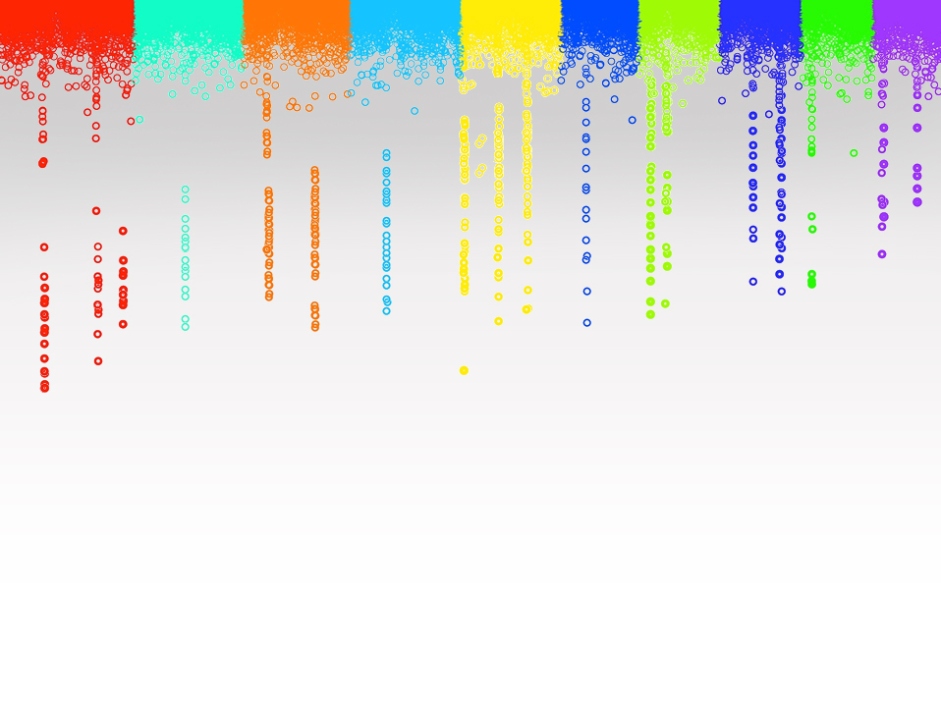
Statistical Genomics
Lecture 17: Likelihood and estimates of variances
Zhiwu Zhang
Washington State University

Slide 2
Administration
Homework 4, due March 23, Wednesday, 3:10PM
Hypotheses, Results, Methods, Conclusion and Discussion
Results/Discussion: Reasoning and Explanation
Final exam: May 3, 120 minutes (3:10-5:10PM), 50 questions, reasoning

Slide 3
Outline
Solve MLM with unknown heritability
Likelihood(Uni-variate)
Multi-variate likelihood
Full and REML
EMMA

Slide 4
Teaching model
Hypothesis: The current way is the best to teach
Work: Reject the null hypothesis
Goal: Improve power

Slide 5
Mixed Model Equation
y = Xb + Zu + e
$\left[\begin{matrix}X^{′}X & X^{′}Z \\ Z^{′}X & Z^{′}Z+{\frac{σ_{e}^{2}}{σ_{a}^{2}}A}^{−1}\end{matrix}\right]\left[\begin{matrix}b \\ u\end{matrix}\right]$=$\left[\begin{matrix}X^{′}y \\ z^{′}y\end{matrix}\right]$
$$δ=\frac{σ_{e}^{2}}{σ_{a}^{2}}$$
$$h^{2}=\frac{σ_{a}^{2}}{σ_{a}^{2}+σ_{e}^{2}}$$
$$δ=\frac{{1−h}_{}^{2}}{h_{}^{2}}$$

Slide 6
Unknown heritability
$$h^{2}=\frac{σ_{a}^{2}}{σ_{a}^{2}+σ_{e}^{2}}$$
$$δ=\frac{σ_{e}^{2}}{σ_{a}^{2}}$$
$$h^{2}=\frac{1}{1+δ}$$

Slide 7
A variable was observed as 95 from a normal distribution. The mean and SD of the distribution are most likely to be:
100 and 1
100 and 2
85 and 5
85 and 10

Slide 8
By approximation
100 and 1: 5 SD from mean, P<<1%
100 and 2: 2.5 SD from mean, 1%<P<5%
85 and 5 : 2 SD from mean, P=5%
85 and 10 : 1 SD from mean, P=32%

Slide 9
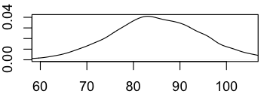
Visualization
x=rnorm(10000,100,1)
plot(density(x),xlim=c(60,105))
x=rnorm(10000,100,2)
plot(density(x),xlim=c(60,105))
x=rnorm(10000,85,5)
plot(density(x),xlim=c(60,105))
x=rnorm(10000,85,10)
plot(density(x),xlim=c(60,105))

Slide 10
By density function
$f(x; μ,σ^{2})=\frac{1}{\sqrt{2π}σ}$ exp(-$\frac{1}{2σ^{2}}{(x−μ\text{) }}^{2})$
$$\frac{1}{\sqrt{2π}σ}\int_{−∞}^{∞}{exp\text{(−}\frac{1}{2σ^{2}}{(x−μ\text{) }}^{2}) }=1$$

Slide 11
Density function of uni-variate normal distribution
$f(x,μ,σ^{2})=\frac{1}{\sqrt{2π}σ}$ exp(-$\frac{1}{2σ^{2}}{(x−μ\text{) }}^{2})$
dnormal=function(x=0,mean=0,sd=1){
p=1/(sqrt(2*pi)*sd)*exp(-(x-mean)^2/(2*sd^2))
return(p)
}

Slide 12
Density function of normal distribution
x=c(95,95,95,95)
mean=c(100,100,85,85)
sd=c(1,2,5,10)
dnormal(x,mean,sd)
dnorm(x,mean,sd)

Slide 13
Two variables were observed as 95 and 97 from a normal distribution. The mean and SD of the distribution are most likely to be:
100 and 1
100 and 2
85 and 5
85 and 10
mean=c(100,100,85,85)
sd=c(1,2,5,10)
x1=rep(95,4)
x2=rep(97,4)
p1=dnormal(x1,mean,sd)
p2=dnormal(x2,mean,sd)
p1*p2
A: 6.5pe-09
B: 5.7e-04
C: 4.8e-05
D: 4.7e-04

Slide 14
Three individuals have kinship of and observations of 95, 100 and 70, respectively. The population has mean of 90. Square root of genetic and residual variances are most likely to be:
95 and 5
5 and 95
50 and 50
I do not know

Slide 15
Variance in MLM
y = Xb + Zu + e
Var(y)=V=Var(u)+Var(e)
Var(u)=G=2K$σ_{a}^{2}$=A$σ_{a}^{2}$
Var(e)=R=I$σ_{e}^{2}$

Slide 16
Density function of multi-variate normal distribution
$f(x; μ, H)=\frac{1}{({2π)}^{n/2}{\left|V\right|}^{1/2}}$ exp(- $\frac{1}{2}{(x−μ\text{) }}^{T}{\left|V\right|}^{−1}(x−μ\text{)})$
dmnormal=function(x=0,mean=0,V=NULL){
n=length(x)
p=1/(sqrt(2*pi)^n*sqrt(det(V)))*exp(-t(x-mean)%*%solve(V)%*%(x-mean)/2)
return(p)
}

Slide 17
Density function of multi-variate normal distribution
x=matrix(c(100,95,70),3,1)
mean=rep(90,3)
K=matrix(c(1,.75,.25,.75,1,.25,.25,.25,1),3,3)
va=95
ve=5
V=2*K*va+ve
dmnormal(x,mean,V)
va=5
ve=95
V=2*K*va+ve
dmnormal(x,mean,V)
va=50
ve=50
V=2*K*va+ve
dmnormal(x,mean,V)

Slide 18
Log Likelihood
$f(x; μ, H)=\frac{1}{({2π)}^{n/2}{\left|V\right|}^{1/2}}$ exp(- $\frac{1}{2}{(x−μ\text{) }}^{T}{\left|V\right|}^{−1}(x−μ\text{)})$
$$σ_{}^{2}=σ_{a}^{2}, H=σ_{}^{−1}V$$

Slide 19
Full and REsidual Maximum Likelihood
q is rand of X

Slide 20
Differences between Full ML and REML
Features | Full ML | REML
Likelihood | y | residual: y-Xb
Fixed effect | Depend on | Removed
Model comparison | Fixed effects | random effect
Bias | Negatively | Unbiased

Slide 21
Optimization in two dimensions
http://www.cc.gatech.edu/~dellaert/FrankDellaert/Notes/Entries/2002/2/1_Expectation_Maximization.html
Va
Ve

Slide 22
Expectation and Maximization (EM)
y = Xb + Zu + e
Expectation (E) step
$$\left[\begin{matrix}\hat{b} \\ \hat{u}\end{matrix}\right]={\left[\begin{matrix}X^{′}X & X^{′}Z \\ Z^{′}X & Z^{′}Z+{\frac{σ_{e}^{2}}{σ_{a}^{2}}A}^{−1}\end{matrix}\right]}^{−1}\left[\begin{matrix}X^{′}y \\ Z^{′}y\end{matrix}\right]$$
$$\left[\begin{matrix}C^{11} & C^{12} \\ C^{21} & C^{22}\end{matrix}\right]$$

Slide 23
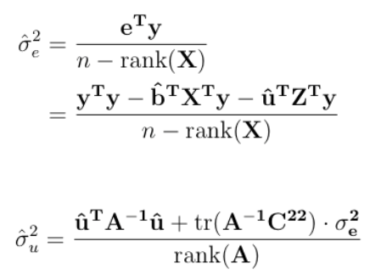
Expectation and Maximization (EM)
Maximization (M) step

Slide 24
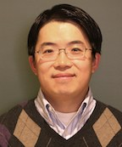
EMMA: two dimensions to one dimension optimization
Kang, H. M. et al. Efficient control of population structure in model organism association mapping. Genetics 178, 1709–1723 (2008).
Kang
$$H=σ_{}^{−1}V$$
$$=A+δI$$
$=U_{F}^{}diag({\text{ξ}}_{1}$+$δ$, …, ${\text{ξ}}_{n}$+$δ)U_{F}^{′}$
U_{F} and ξ are eigen vector and values of spectral decomposition of A matrix

Slide 25
Hilight
Solve MLM with unknown heritability
Likelihood (Uni-variate)
Multi-variate likelihood
Full and REML
EMMA

