Slide 1


Statistical Genomics
Lecture 19: SUPER
Zhiwu Zhang
Washington State University

Slide 2
Administration
Homework 5, due April 13, Wednesday, 3:10PM
Final exam: May 3, 120 minutes (3:10-5:10PM), 50

Slide 3
Read material
Statistics (lecture slides)
R programming(lecture slides)
Genetics: GBS, populations structure, kinship
Imputation
GWAS: GLM, MLM, CMLM, ECMLM, SUPER, MLMM, EMMA, EMMAx/P3D, FarmCPU, PC+K
GS: gBLUP

Slide 4
Outline
Kinship based on QTN
Confounding between QTN and kinship
Complimentary kinship
SUPER

Slide 5
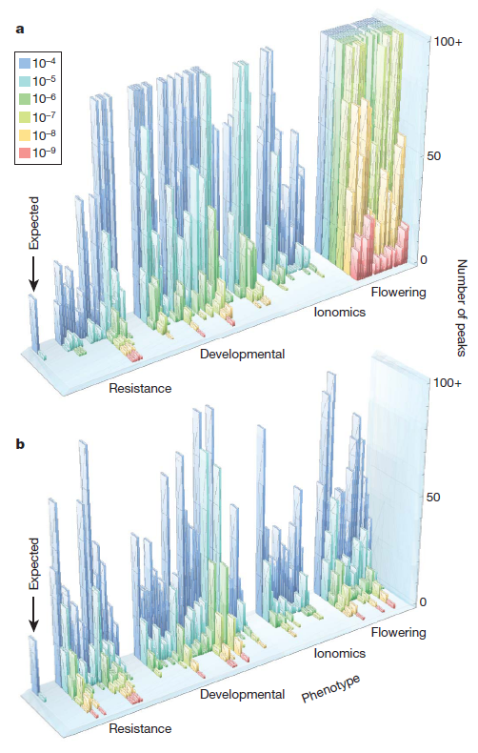

GWAS does not work for traits associated with structure
Atwell et al Nature 2010
a, No correction test
b, Correction with MLM
Magnus Norborg

Slide 6

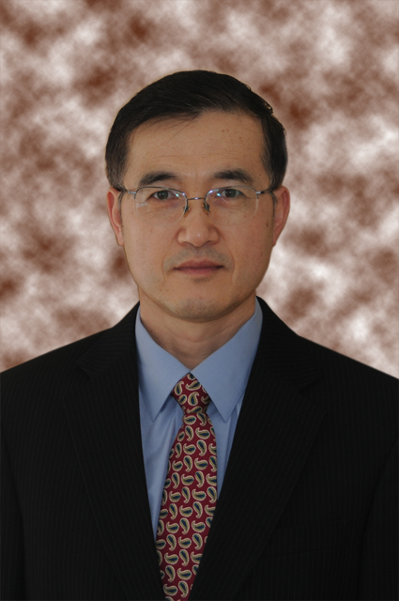


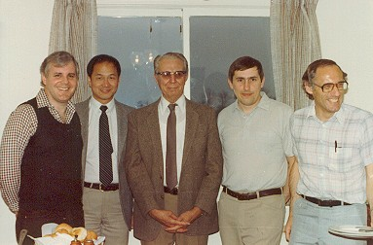
MLM Tree
John
Pollak
Dick
Quaas
Ivan
Mao
Larry
Schaeffer
Brian Kennedy
Jim Wilton
Charles
Henderson
1983

Slide 7
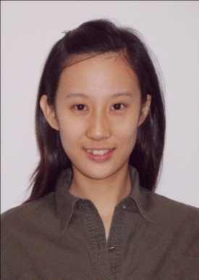
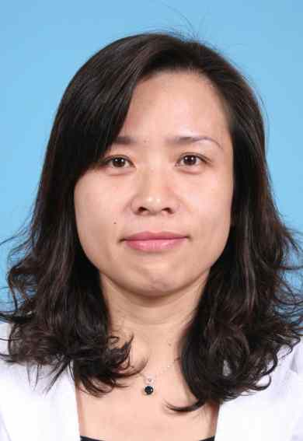

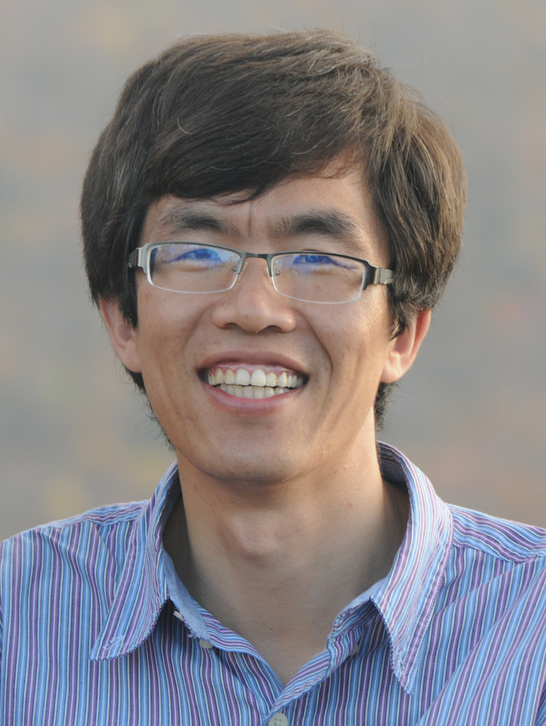

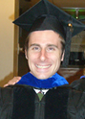
Growing tree: Method and software
Meng Li
CMLM
Yumei Yang
iBLUP
Xiaolei Liu
FarmCPU
Qishan Wang
SUPER
Meng Huang
BLINK
gBLUP
CMLM
P3D
Alex Lipka
GAPIT
Jiabo Wang
cBLUP

Slide 8
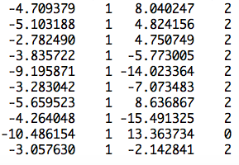
More covariates
observation
mean
PC2
SNP
Ind1 | Ind2 | … | Ind9 | Ind10
u1 | u2 | … | u9 | u10
1 | 0 | … | 0 | 0
0 | 1 | … | 0 | 0
0 | 0 | … | 1 | 0
0 | 0 | … | 0 | 1
u=
]
[
]
[
b=
b0
b1
b2
y
1
x1
x2
=X
Z
[
]
y = Xb + Zu +e

Slide 9
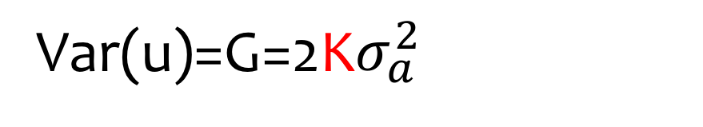
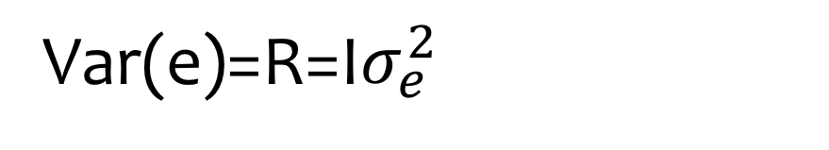
Variance in MLM
y = Xb + Zu + e
Var(y)=V=Var(u)+Var(e)
Var(u)=G=2K$σ_{a}^{2}$
Var(e)=R=I$σ_{e}^{2}$
u prediction: Best Linear Unbiased Prediction, BLUP)
b prediction: Best Linear Unbiased Estimate, BLUE)

Slide 10
Kinship defined by single marker
Sensitive
Resistance
 | S1 | S2 | S3 | S4 | R1 | R2 | R3 | R4
S1 | 1 | 1 | 1 | 1 | 0 | 0 | 0 | 0
S2 | 1 | 1 | 1 | 1 | 0 | 0 | 0 | 0
S3 | 1 | 1 | 1 | 1 | 0 | 0 | 0 | 0
S4 | 1 | 1 | 1 | 1 | 0 | 0 | 0 | 0
R1 | 0 | 0 | 0 | 0 | 1 | 1 | 1 | 1
R2 | 0 | 0 | 0 | 0 | 1 | 1 | 1 | 1
R3 | 0 | 0 | 0 | 0 | 1 | 1 | 1 | 1
R4 | 0 | 0 | 0 | 0 | 1 | 1 | 1 | 1
Adding additional markers bluer the picture

Slide 11
Derivation of kinship
QTNs
All SNPs
Kinship
Non-QTNs SNP

Slide 12
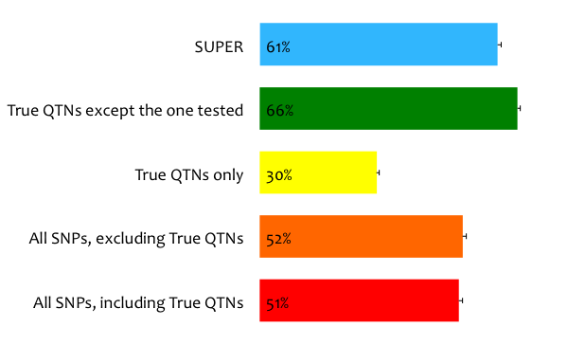
Statistical power of kinship from
Notes:
A simulation study shoed that the statistical power is 42% if all SNPs were used to derive the kinship. The power reduced to 21% if the kinship was derived from the QTNs only. The power jump over to 50% when the kinship was derived from all QTNs except the one of test.

Slide 13
Kinship evolution
All traits
QTNs
Pedigree
Markers
QTNs
QTNs
Single trait
QTNs
Remove QTN one at a time
Average
Realized
Notes:
Settlement of kinship at trait base. Pedigree is the first information used to estimate kinship which are general expectation for a pair of individuals, e.g. full sib A and B have kinship of 50%. The introduction of genetic diagnostic markers increases the certainty for a specific Mendilian trait, e.g. full sibs are identical and have kinship of 1 for color. The certainty also are also increased for complex traits with multiple markers covering entire genome and became the general realized kinship, e.g. full sibs A and B have kinship of 60% instead of 50%. With dense markers, a trait specific realized kinship exist (theoretically) by using all the QTNs underlying the trait. A kinship with all QTNs (full) is ideal for genome prediction. However, its complimentary (using all QTNs except the one of test) should be used for association study to remove the confronting between the kinship and the tested SNPs.

Slide 14
Statistical power of kinship from
Notes:
A simulation study shoed that the statistical power is 42% if all SNPs were used to derive the kinship. The power reduced to 21% if the kinship was derived from the QTNs only. The power jump over to 50% when the kinship was derived from all QTNs except the one of test.

Slide 15
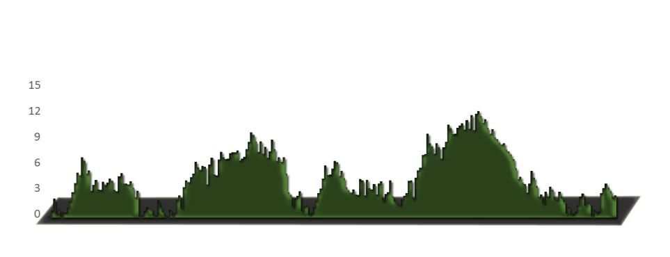
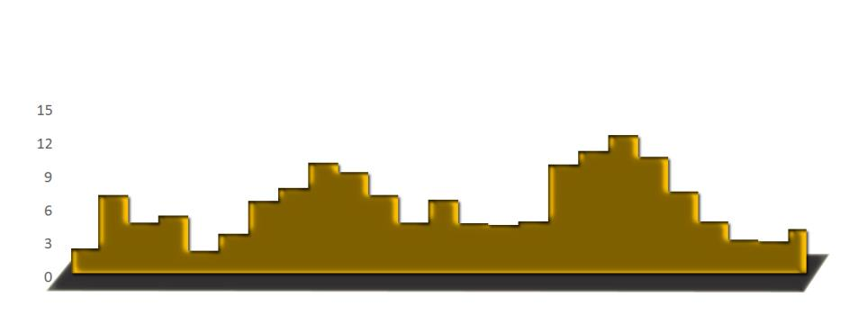
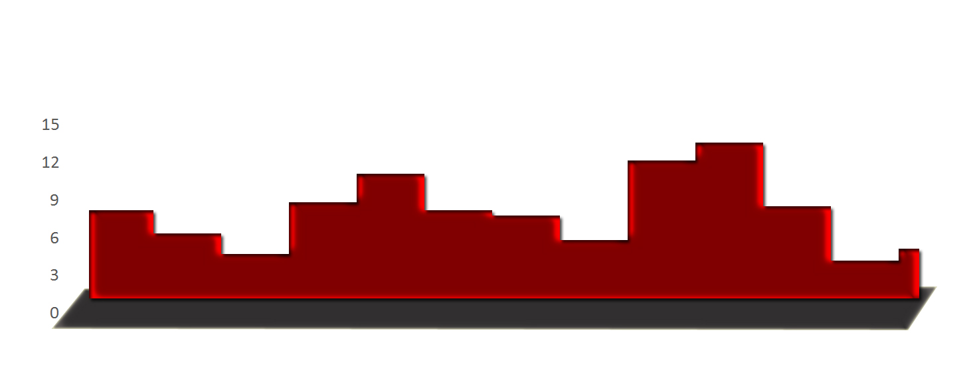
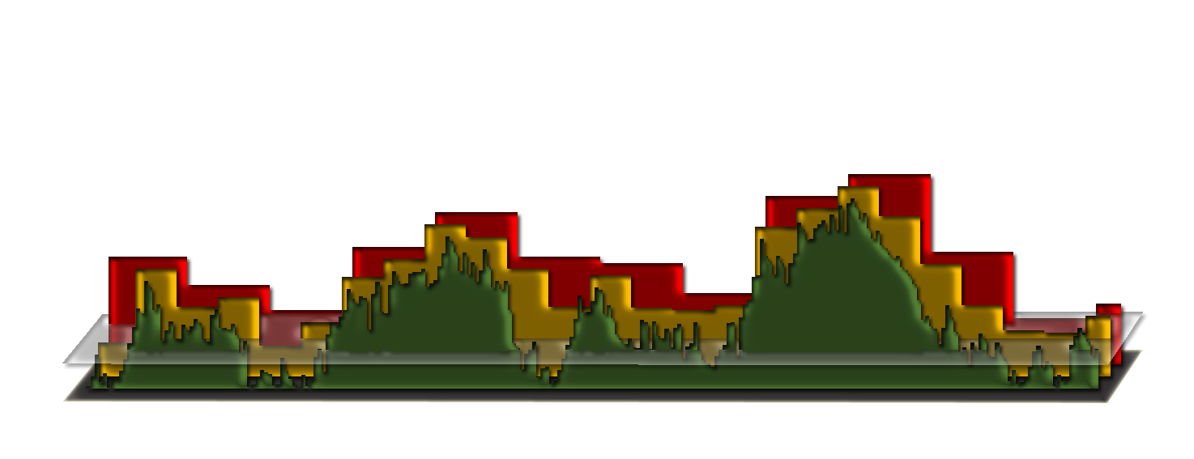
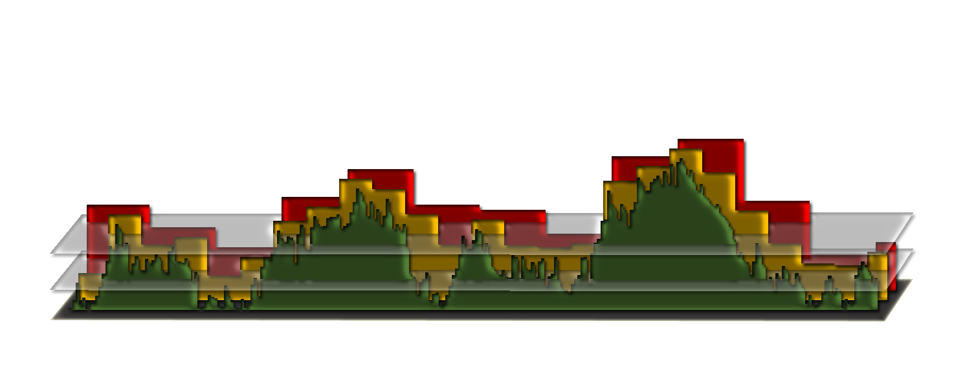
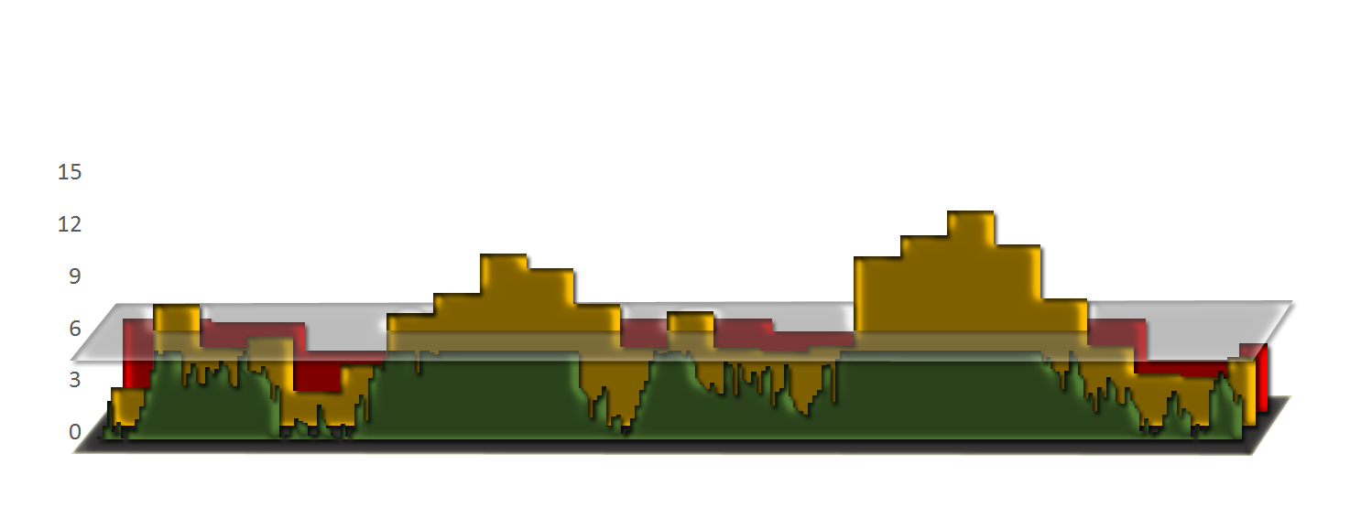
Bin approach

Slide 16
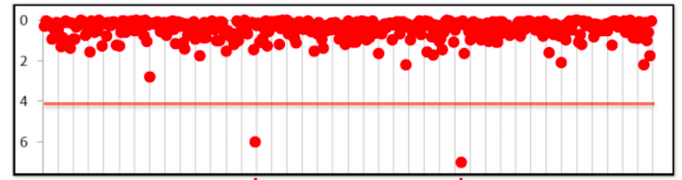
Mimic QTN-1
1. Choose t associated SNPs as QTNs each represent an interval of size s.
2. Build kinship from the t QTNs
3. Optimization on t and s
4. For a SNP, remove the QTNs in LD with the SNP, e.g. R square > 1%
5. Use the remaining QTNs to build kinship for testing the SNP

Slide 17
Statistical power of kinship from
SUPER
(Settlement of kinship Under Progressively Exclusive Relationship)
Qishan Wang
PLoS One, 2014
Notes:
A simulation study shoed that the statistical power is 42% if all SNPs were used to derive the kinship. The power reduced to 21% if the kinship was derived from the QTNs only. The power jump over to 50% when the kinship was derived from all QTNs except the one of test.

Slide 18
Threshold of excluding pseudo QTNs
Notes:
A simulation study shoed that the statistical power is 42% if all SNPs were used to derive the kinship. The power reduced to 21% if the kinship was derived from the QTNs only. The power jump over to 50% when the kinship was derived from all QTNs except the one of test.

Slide 19
Impact of initial P values
Notes:
A simulation study shoed that the statistical power is 42% if all SNPs were used to derive the kinship. The power reduced to 21% if the kinship was derived from the QTNs only. The power jump over to 50% when the kinship was derived from all QTNs except the one of test.

Slide 20
Sandwich Algorithm in GAPIT
Input
KI
GP
GK
GD
KI
GK
CMLM/
MLM/GLM
SUPER/
FaST
GP
Optimization of bin size and number
GK
KI
CMLM/
MLM/GLM
SUPER/
FaST
GP
KI: Kinship of Individual
GP: Genotype Probability
GD: Genotype Data
GK: Genotype for Kinship

Slide 21
SUPER in GAPIT
#RUN SUPER
myGAPIT=GAPIT(
Y=mySim$Y,
GD=myGD,
GM=myGM,
QTN.position=mySim$QTN.position,
PCA.total=3,
sangwich.top="MLM", #options are GLM,MLM,CMLM, FaST and SUPER
sangwich.bottom="SUPER", #options are GLM,MLM,CMLM, FaST and SUPER
LD=0.1,
memo="SUPER")
#GAPIT
library('MASS') # required for ginv
library(multtest)
library(gplots)
library(compiler) #required for cmpfun
library("scatterplot3d")
source("http://www.zzlab.net/GAPIT/emma.txt")
source("http://www.zzlab.net/GAPIT/gapit_functions.txt")
source("~/Dropbox/GAPIT/Functions/gapit_functions.txt")
myGD=read.table(file="http://zzlab.net/GAPIT/data/mdp_numeric.txt",head=T)
myGM=read.table(file="http://zzlab.net/GAPIT/data/mdp_SNP_information.txt",head=T)
#Siultate 10 QTN on the first chromosomes
X=myGD[,-1]
index1to5=myGM[,2]<6
X1to5 = X[,index1to5]
taxa=myGD[,1]
set.seed(99164)
GD.candidate=cbind(taxa,X1to5)
mySim=GAPIT.Phenotype.Simulation(GD=GD.candidate,GM=myGM[index1to5,],h2=.5,NQTN=10,QTNDist="norm")

Slide 22
GAPIT.FDR.TypeI Function
myStat=GAPIT.FDR.TypeI(WS=c(1e0,1e3,1e4,1e5),
GM=myGM,
seqQTN=mySim$QTN.position,
GWAS=myGAPIT$GWAS)

Slide 23
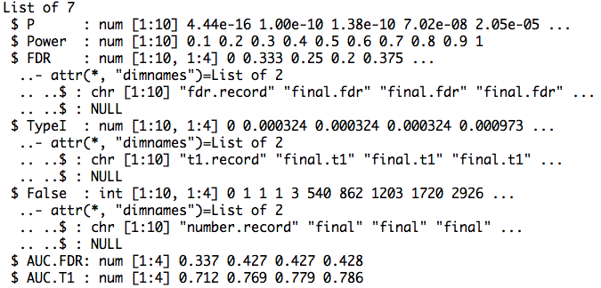
Return

Slide 24
Area Under Curve (AUC)
par(mfrow=c(1,2),mar = c(5,2,5,2))
plot(myStat$FDR[,1],myStat$Power,type="b")
plot(myStat$TypeI[,1],myStat$Power,type="b")

Slide 25
Replicates
nrep=3
set.seed(99164)
statRep=replicate(nrep, {
mySim=GAPIT.Phenotype.Simulation(GD=GD.candidate,GM=myGM[index1to5,],h2=.5,NQTN=10,QTNDist="norm")
myGAPIT=GAPIT( Y=mySim$Y, GD=myGD, GM=myGM, QTN.position=mySim$QTN.position, PCA.total=3, sangwich.top="MLM", #options are GLM,MLM,CMLM, FaST and SUPER
sangwich.bottom="SUPER", #options are GLM,MLM,CMLM, FaST and SUPER LD=0.1, memo="SUPER")
myStat=GAPIT.FDR.TypeI(WS=c(1e0,1e3,1e4,1e5),GM=myGM,seqQTN=mySim$QTN.position,GWAS=myGAPIT$GWAS)
})

Slide 26
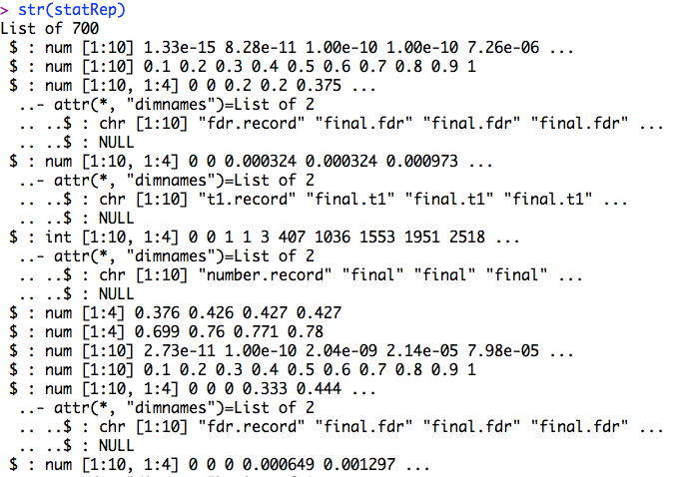
str(statRep)

Slide 27
Means over replicates
power=statRep[[2]]
#FDR
s.fdr=seq(3,length(statRep),7)
fdr=statRep[s.fdr]
fdr.mean=Reduce ("+", fdr) / length(fdr)
#AUC: power vs. FDR
s.auc.fdr=seq(6,length(statRep),7)
auc.fdr=statRep[s.auc.fdr]
auc.fdr.mean=Reduce ("+", auc.fdr) / length(auc.fdr)

Slide 28
Plots of power vs. FDR
theColor=rainbow(4)
plot(fdr.mean[,1],power , type="b", col=theColor [1],xlim=c(0,1))
for(i in 2:ncol(fdr.mean)){
lines(fdr.mean[,i], power , type="b", col= theColor [i])
}

Slide 29
Highlight
Kinship based on QTN
Confounding between QTN and kinship
Complimentary kinship
SUPER

