Slide 1


Statistical Genomics
Lecture 24: gBLUP
Zhiwu Zhang
Washington State University

Slide 2
Administration
Homework 5, due April 13, Wednesday, 3:10PM
Final exam: May 3, 120 minutes (3:10-5:10PM), 50
Evaluation due April 18.

Slide 3
Outline
MAS
works for a few genes
Over-fit
CV
Inaccurate
Does not works for polygenes
Whole genome
Concept in 1990s implement in 2000s
RR and Bayes
gBLUP
=RR
Pedigree+Marker
cBLUP/sBLUP

Slide 4
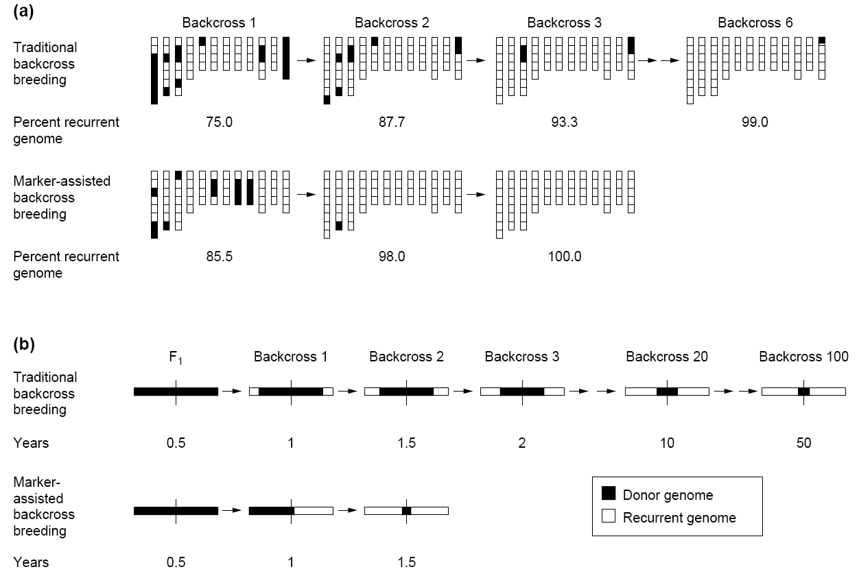
Transfer of single target gene
30 progeny per backcross
Traditional method take 100 generations to integrate a gene flanked by two markers
This can be done now in two generations
Tanksley et al. Biotechnology 1989

Slide 5
MAS works only for a few genes
y=x₁b₁ + x₂b₂ + … + x_{p}b_{p} + e
y: observation, dependent variable
x: Explainary/independent variables
e: Residuals/errors
Obj: e₁² + e₂² + … + e_{n}² =Minimum

Slide 6
MAS by GAPIT
Setup GAPIT
Import data
Simulate phenotype
Validation

Slide 7
Setup GAPIT
#source("http://www.bioconductor.org/biocLite.R")
#biocLite("multtest")
#install.packages("gplots")
#install.packages("scatterplot3d")#The downloaded link at: http://cran.r-project.org/package=scatterplot3d
library('MASS') # required for ginv
library(multtest)
library(gplots)
library(compiler) #required for cmpfun
library("scatterplot3d")
source("http://www.zzlab.net/GAPIT/emma.txt")
source("http://www.zzlab.net/GAPIT/gapit_functions.txt")

Slide 8
mdp_env.txt
Taxa | SS | NSS | Tropical | Early | Block
33-16 | 0.014 | 0.972 | 0.014 | 0 | 0
38-11 | 0.003 | 0.993 | 0.004 | 0 | 1
4226 | 0.071 | 0.917 | 0.012 | 0 | 0
4722 | 0.035 | 0.854 | 0.111 | 0 | 1
A188 | 0.013 | 0.982 | 0.005 | 0 | 1
A214N | 0.762 | 0.017 | 0.221 | 0 | 0
A239 | 0.035 | 0.963 | 0.002 | 0 | 1
A272 | 0.019 | 0.122 | 0.859 | 1 | 0
A441-5 | 0.005 | 0.531 | 0.464 | 0 | 1
A554 | 0.019 | 0.979 | 0.002 | 0 | 0
A556 | 0.004 | 0.994 | 0.002 | 0 | 1
A6 | 0.003 | 0.03 | 0.967 | 1 | 0
A619 | 0.009 | 0.99 | 0.001 | 0 | 0
A632 | 0.993 | 0.004 | 0.003 | 0 | 0

Slide 9
Import data and simulate phenotype
myGD=read.table(file="http://zzlab.net/GAPIT/data/mdp_numeric.txt",head=T)
myGM=read.table(file="http://zzlab.net/GAPIT/data/mdp_SNP_information.txt",head=T)
myCV=read.table(file="http://zzlab.net/GAPIT/data/mdp_env.txt",head=T)
#Simultate 10 QTN on the first half chromosomes
X=myGD[,-1]
index1to5=myGM[,2]<6
X1to5 = X[,index1to5]
taxa=myGD[,1]
set.seed(99164)
GD.candidate=cbind(taxa,X1to5)
mySim=GAPIT.Phenotype.Simulation(GD=GD.candidate,GM=myGM[index1to5,],h2=.5,NQTN=2, effectunit =.95,QTNDist="normal",CV=myCV,cveff=c(.01,.01))
setwd("~/Desktop/temp")

Slide 10
GWAS
myGAPIT <- GAPIT(Y=mySim$Y,GD=myGD,GM=myGM, PCA.total=3,CV=myCV,group.from=1,group.to=1,group.by=10,QTN.position=mySim$QTN.position,memo="GLM",)

Slide 11
Prediction with PC and ENV
ry2=cor(myGAPIT$Pred[,8],mySim$Y[,2])^2
ru2=cor(myGAPIT$Pred[,8],mySim$u)^2
par(mfrow=c(2,1), mar = c(3,4,1,1))
plot(myGAPIT$Pred[,8],mySim$Y[,2])
mtext(paste("R square=",ry2,sep=""), side = 3)
plot(myGAPIT$Pred[,8],mySim$u)
mtext(paste("R square=",ru2,sep=""), side = 3)

Slide 12
Top five SNPs
ntop=5
index=order(myGAPIT$P)
top=index[1:ntop]
myQTN=cbind(myGAPIT$PCA[,1:4], myCV[,2:3],myGD[,c(top+1)])
myGAPIT2 <- GAPIT(
Y=mySim$Y,
GD=myGD,
GM=myGM,
CV=myQTN,
group.from=1,
group.to=1,
group.by=10,
QTN.position=mySim$QTN.position,
SNP.test=FALSE,
memo="GLM+QTN",
)

Slide 13
Validation
#Real Cross validation
set.seed(99164)
n=nrow(mySim$Y)
testing=sample(n,round(n/5),replace=F)
training=-testing
myGAPIT3 <- GAPIT(
Y=mySim$Y[training,],
GD=myGD,
GM=myGM,
CV=myCV,
PCA.total=3,
group.from=1,
group.to=1,
group.by=10,
QTN.position=mySim$QTN.position,
#SNP.test=FALSE,
memo="GWAS",
)

Slide 14
Estimate QTN effects in training
ntop=5
index=order(myGAPIT3$P)
top=index[1:ntop]
myQTN=cbind(myGAPIT3$PCA[,1:4], myCV[,2:3],myGD[,c(top+1)])
myGAPIT4 <- GAPIT(
Y=mySim$Y[training,],
GD=myGD,
GM=myGM,
CV=myQTN,
group.from=1,
group.to=1,
group.by=1,
SNP.test=FALSE,
memo="GLM+QTN",)

Slide 15
Model fit in training
ry2=cor(myGAPIT4$Pred[training,8],mySim$Y[training,2])^2
ru2=cor(myGAPIT4$Pred[training,8],mySim$u[training])^2
par(mfrow=c(2,1), mar = c(3,4,1,1))
plot(myGAPIT4$Pred[training,8],mySim$Y[training,2])
mtext(paste("R square=",ry2,sep=""), side = 3)
plot(myGAPIT4$Pred[training,8],mySim$u[training])
mtext(paste("R square=",ru2,sep=""), side = 3)

Slide 16
Accuracy in testing
#Testing
#calculate prediction
effect=myGAPIT4$effect.cv
X=as.matrix(cbind(1, myQTN[,-1]))
Pred=X%*%effect
ry2=cor(Pred[testing],mySim$Y[testing,2])^2
ru2=cor(Pred[testing],mySim$u[testing])^2
par(mfrow=c(2,1), mar = c(3,4,1,1))
plot(Pred[testing],mySim$Y[testing,2])
mtext(paste("R square=",ry2,sep=""), side = 3)
plot(Pred[testing],mySim$u[testing])
mtext(paste("R square=",ru2,sep=""), side = 3)

Slide 17
20 QTNs
2% environment
20 QTNs
50% environment

Slide 18
Concept of using all markers regardless significant or not
Bill Hill
Mike Godard
Chris Haley
Peter M Visscher
Ben Hayes

Slide 19


Pioneers of implementation
RR and Bayes

Slide 20
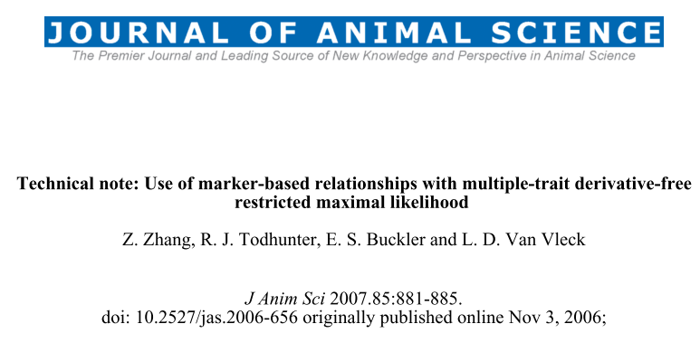
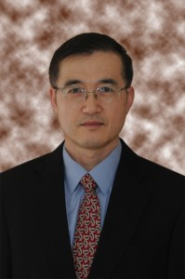
gBLUP

Slide 21
Multiple Trait Derivative Free REML (MTDFREML)
Welcome to the Multiple Trait Derivative Free REML (MTDFREML) home page. The programs were developed by Keith Boldman and Dale Van Vleck. Evolutionary development and debugging support have also been provided by by Lisa Kriese and Curt Van Tassell.
Please contact Curt Van Tassell (e-mail curtvt@aipl.arsusda.gov) or Dale Van Vleck. (e-mail lvanvleck@unlnotes.unl.edu) with any problems with the programs or discovered bugs.
Obtaining the MTDFREML programs
Get the manual
Sample analyses
Enter user information using web browser that handles forms
FTP the userinfo.txt file to enter user information (then mail completed form)
Get the Microsoft Powerstation fix for Windows 95 (compressed)
Get the Microsoft 5.1 fix for insufficient file handles (compressed)

Slide 22
Marker based kinship in MTDFREML
Pedigree
Marker
MTDF-NRM
MTDF-ARM
Arbitrary
Relationship
Matrix
kinship
MTDF-PREP
Equations
MTDF-RUN
BLUP and variance
Zhang et al., J. Anim Sci., 2007

Slide 23
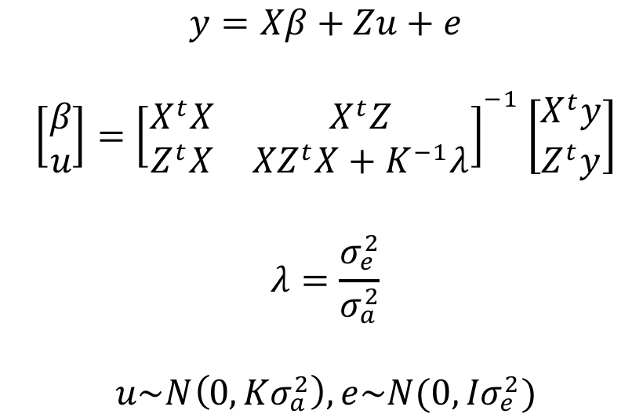
Mixed Linear Model (MLM)

Slide 24
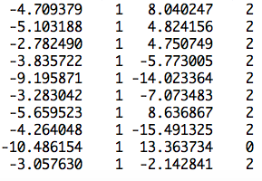
Z matrix
observation
mean
PC2
SNP
Ind1 | Ind2 | … | Ind9 | Ind10
u1 | u2 | … | u9 | u10
1 | 0 | … | 0 | 0
0 | 1 | … | 0 | 0
0 | 0 | … | 1 | 0
0 | 0 | … | 0 | 1
u=
]
[
]
[
b=
b0
b1
b2
y
1
x1
x2
=X
Z
[
]
y = Xb + Zu +e

Slide 25
Generic Z matrix
Ind1 | Ind2 | … | Ind9 | Ind10
u1 | u2 | … | u9 | u10
1 | 0 | … | 0 | 0
0 | 1 | … | 0 | 0
0 | 0 | … | 1 | 0
0 | 0 | … | 0 | 1
Ind11 | Ind12 | … | Ind19 | Ind20
u11 | u12 | … | u19 | u20
0 | 0 | … | 0 | 0
0 | 0 | … | 0 | 0
0 | 0 | … | 0 | 0
0 | 0 | … | 0 | 0
u=
]
[
]
Z_{R}
Z_{R}

Slide 26

Efficient kinship algorithm
M: n individual by m SNPs
M: -1, 0 and 1
Pi: frequency of 2nd allele for SNP i
P: Column of i is 2(pi-.5)
Z=M-P
J. Dairy Sci. 2008. 91 (11) 4414-4423. Efficient Methods to Compute Genomic Predictions P. M. VanRaden
Paul VanRaden: Image Number K7168-6

Slide 27
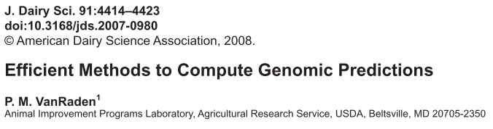

VanRaden kinship
MM^{t}, Efficient
gBLUP=Ridge Regression

Slide 28
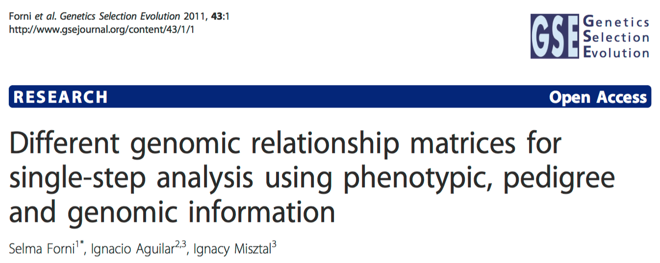
Pedigree + Marker

Slide 29
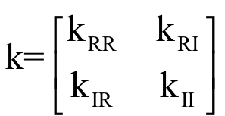
Henderson's formula

Slide 30
gBLUP by GAPIT
myGAPIT5 <- GAPIT(
Y=mySim$Y[training,],
GD=myGD,
GM=myGM,
PCA.total=3,
CV=myCV,
group.from=1000,
group.to=1000,
group.by=10,
SNP.test=FALSE,
memo="gBLUP",
)

Slide 31
Training
ry2=cor(myGAPIT5$Pred[training,8],mySim$Y[training,2])^2
ru2=cor(myGAPIT5$Pred[training,8],mySim$u[training])^2
ry2.blup=cor(myGAPIT5$Pred[training,5],mySim$Y[training,2])^2
ru2.blup=cor(myGAPIT5$Pred[training,5],mySim$u[training])^2
par(mfrow=c(2,2), mar = c(3,4,1,1))
plot(myGAPIT5$Pred[training,8],mySim$Y[training,2])
mtext(paste("R square=",ry2,sep=""), side = 3)
plot(myGAPIT5$Pred[training,8],mySim$u[training])
mtext(paste("R square=",ru2,sep=""), side = 3)
plot(myGAPIT5$Pred[training,5],mySim$Y[training,2])
mtext(paste("R square=",ry2.blup,sep=""), side = 3)
plot(myGAPIT5$Pred[training,5],mySim$u[training])
mtext(paste("R square=",ru2.blup,sep=""), side = 3)

Slide 32
phenotype
True BV
predicted
phenotype
predicted
BV

Slide 33
Testing
ry2=cor(myGAPIT5$Pred[testing,8],mySim$Y[testing,2])^2
ru2=cor(myGAPIT5$Pred[testing,8],mySim$u[testing])^2
ry2.blup=cor(myGAPIT5$Pred[testing,5],mySim$Y[testing,2])^2
ru2.blup=cor(myGAPIT5$Pred[testing,5],mySim$u[testing])^2
par(mfrow=c(2,2), mar = c(3,4,1,1))
plot(myGAPIT5$Pred[testing,8],mySim$Y[testing,2])
mtext(paste("R square=",ry2,sep=""), side = 3)
plot(myGAPIT5$Pred[testing,8],mySim$u[testing])
mtext(paste("R square=",ru2,sep=""), side = 3)
plot(myGAPIT5$Pred[testing,5],mySim$Y[testing,2])
mtext(paste("R square=",ry2.blup,sep=""), side = 3)
plot(myGAPIT5$Pred[testing,5],mySim$u[testing])
mtext(paste("R square=",ru2.blup,sep=""), side = 3)

Slide 34
phenotype
True BV
predicted
phenotype
predicted
BV

Slide 35
Highlight
The power of molecular breeding
Method development
gBLUP
Prediction of individuals without phenotypes

