Slide 1
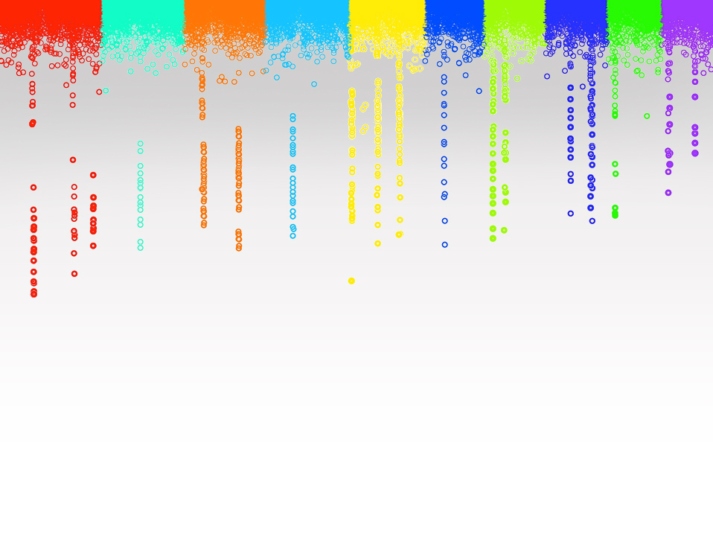
Statistical Genomics
Lecture 26: Kernel method
Zhiwu Zhang
Washington State University

Slide 2
Administration
Homework 6 (last) posted, due April 29, Friday, 3:10PM
Final exam: May 3, 120 minutes (3:10-5:10PM), 50
Evaluation due April 18 (Next Monday).

Slide 3
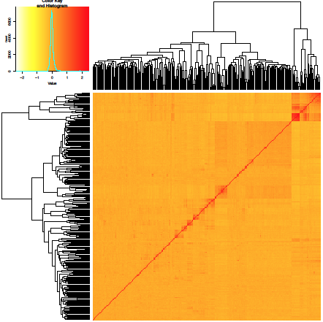
Outline
Kernel
Machine learning
Cross validation

Slide 4
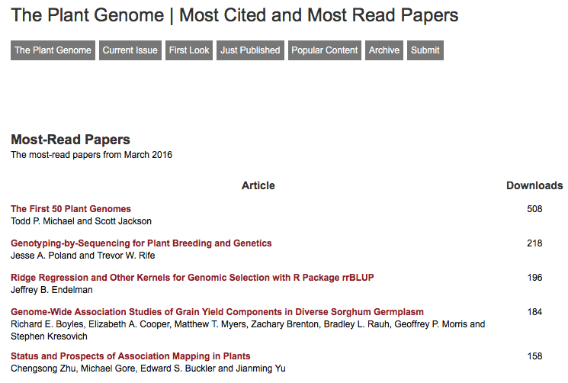

Slide 5
rrBLUP vs. gBLUP
rrBLUP
b~N(0, K σ_{r}²)
y=x₁b₁ + x₂b₂ + … + x_{p}b_{p} + e
gBLUP
~N(0,
σ_{a}²)
U
K

Slide 6
u=Ms
if A=MM$′$
Otherwise, what A should be? can it make a better u?

Slide 7
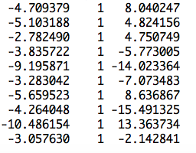
BLUP of individuals
observation
mean
PC2
Ind1 | Ind2 | … | Ind19 | Ind20
u1 | u2 | … | u19 | u20
1 | 0 | … | 0 | 0
0 | 1 | … | 0 | 0
0 | 0 | … | 0 | 0
0 | 0 | … | 0 | 0
u=
]
[
[
b=
b0
b1
]
y
1
x1
x2
=X
Z
[
]
y = Xb + Zu +e

Slide 8
BLUP on individuals
y = Xb + Zu + e
u~N(0, A$σ_{a}^{2}),\text{e}\text{\sim }\text{N}\text{(0,} \text{I}σ_{e}^{2}),$
$\left[\begin{matrix}X^{′}X & X^{′}Z \\ Z^{′}X & Z^{′}Z+{\frac{σ_{e}^{2}}{σ_{a}^{2}}A}^{−1}\end{matrix}\right]\left[\begin{matrix}b \\ u\end{matrix}\right]$=$\left[\begin{matrix}X^{′}y \\ Z^{′}y\end{matrix}\right]$

Slide 9
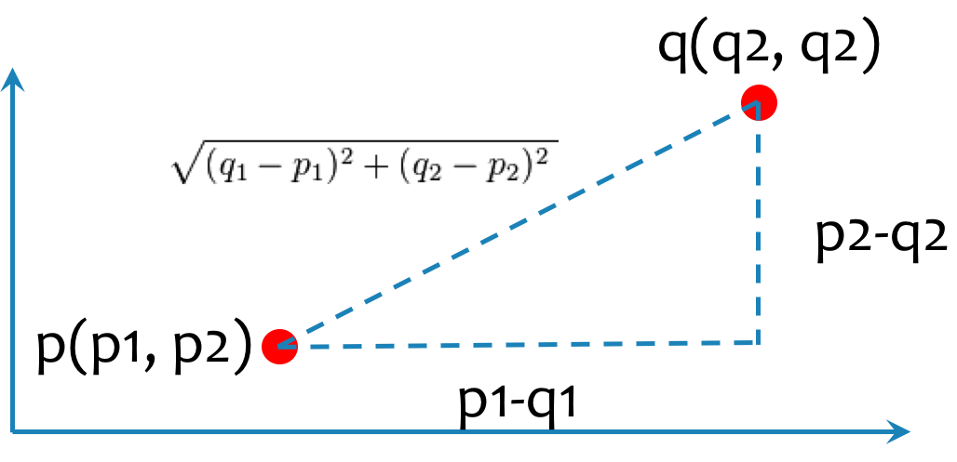
A matrix / Kernel
Twice of Co-Ancestry/kinship
Many formats
Euclidean distance
Nel's distance
VanRaden kinship
ZHANG kinship

Slide 10
SPAGeDi
Hardy OJ, Vekemans X (2002) SPAGeDi: a versatile computer program to analyse spatial
genetic structure at the individual or population levels. Molecular Ecology Notes 2: 618-620.
Kinship coefficient
Loiselle et al. (1995)
Ritland (1996)
Relationship coefficient
Queller & Goodnight (1989)
Hardy & Vekemans (1999)
Lynch & Ritland (1999)
Wang (2002);
Genetic distance: Rousset (2000)

Slide 11
Middle ground
1 | 0 | 0 | 0 | 0
0 | 1 | 0 | 0 | 0
0 | 0 | 1 | 0 | 0
0 | 0 | 0 | 1 | 0
0 | 0 | 0 | 0 | 1
1.00 | 0.05 | 0.05 | 0.06 | 0.04
0.05 | 1.00 | 0.04 | 0.06 | 0.04
0.05 | 0.04 | 1.00 | 0.05 | 0.04
0.06 | 0.06 | 0.05 | 1.00 | 0.05
0.04 | 0.04 | 0.04 | 0.05 | 1.00
1.00 | 0.18 | 0.18 | 0.19 | 0.17
0.18 | 1.00 | 0.17 | 0.18 | 0.16
0.18 | 0.17 | 1.00 | 0.18 | 0.17
0.19 | 0.18 | 0.18 | 1.00 | 0.18
0.17 | 0.16 | 0.17 | 0.18 | 1.00
Ignored
Gauss
Exponancial
gBLUP

Slide 12
Gauss and exponential
G
2 | 0 | 0 | 2 | 2 | 2 | 2 | 2 | 0 | 0
2 | 2 | 0 | 2 | 2 | 2 | 0 | 2 | 0 | 2
2 | 0 | 0 | 2 | 2 | 2 | 0 | 2 | 0 | 0
2 | 2 | 0 | 2 | 2 | 2 | 1 | 2 | 0 | 2
0 | 0 | 0 | 2 | 2 | 2 | 0 | 2 | 0 | 2
D=as.matrix(dist(G, method="euclidean") /2/sqrt(nrow(G)))
method="euclidean", "maximum", "manhattan", "canberra", "binary" or "minkowski"
exp(-(D)^2)
exp(-D)
0.00 | 1.74 | 1.74 | 1.67 | 1.76
1.74 | 0.00 | 1.78 | 1.69 | 1.82
1.74 | 1.78 | 0.00 | 1.71 | 1.80
1.67 | 1.69 | 1.71 | 0.00 | 1.73
1.76 | 1.82 | 1.80 | 1.73 | 0.00
1.00 | 0.05 | 0.05 | 0.06 | 0.04
0.05 | 1.00 | 0.04 | 0.06 | 0.04
0.05 | 0.04 | 1.00 | 0.05 | 0.04
0.06 | 0.06 | 0.05 | 1.00 | 0.05
0.04 | 0.04 | 0.04 | 0.05 | 1.00
1.00 | 0.18 | 0.18 | 0.19 | 0.17
0.18 | 1.00 | 0.17 | 0.18 | 0.16
0.18 | 0.17 | 1.00 | 0.18 | 0.17
0.19 | 0.18 | 0.18 | 1.00 | 0.18
0.17 | 0.16 | 0.17 | 0.18 | 1.00
Gauss
Exponancial

Slide 13
Genetic approach
G
2 | 0 | 0 | 2 | 2 | 2 | 2 | 2 | 0 | 0
2 | 2 | 0 | 2 | 2 | 2 | 0 | 2 | 0 | 2
2 | 0 | 0 | 2 | 2 | 2 | 0 | 2 | 0 | 0
2 | 2 | 0 | 2 | 2 | 2 | 1 | 2 | 0 | 2
0 | 0 | 0 | 2 | 2 | 2 | 0 | 2 | 0 | 2
Additive
K_{A}
K_{AA}=K_{A}K_{A}
0 | 0 | 0 | 0 | 0 | 0 | 0 | 0 | 0 | 0
0 | 0 | 0 | 0 | 0 | 0 | 0 | 0 | 0 | 0
0 | 0 | 0 | 0 | 0 | 0 | 0 | 0 | 0 | 0
0 | 0 | 0 | 0 | 0 | 0 | 1 | 0 | 0 | 0
0 | 0 | 0 | 0 | 0 | 0 | 0 | 0 | 0 | 0
Dominant
K_{D}
K_{DD}=K_{D}K_{D}
K_{AD}=K_{A}K_{D}

Slide 14
Setup GAPIT
#Import GAPIT
#source("http://www.bioconductor.org/biocLite.R")
#biocLite("multtest")
#install.packages("EMMREML")
#install.packages("gplots")
#install.packages("scatterplot3d")
library('MASS') # required for ginv
library(multtest)
library(gplots)
library(compiler) #required for cmpfun
library("scatterplot3d")
library("EMMREML")
source("http://www.zzlab.net/GAPIT/emma.txt")
source("http://www.zzlab.net/GAPIT/gapit_functions.txt")

Slide 15
Import data and preparation
#Import demo data
myGD=read.table(file="http://zzlab.net/GAPIT/data/mdp_numeric.txt",head=T)
myGM=read.table(file="http://zzlab.net/GAPIT/data/mdp_SNP_information.txt",head=T)
myCV=read.table(file="http://zzlab.net/GAPIT/data/mdp_env.txt",head=T)
X=myGD[,-1]
M=as.matrix(X)
G=M
dom=1-(G-1)^2
taxa=myGD[,1]
myDom=cbind(as.data.frame(taxa),as.data.frame(dom))

Slide 16
Phenotype simulation
index1to5=myGM[,2]<6
X1to5 = X[,index1to5]
X1to5.dom = dom[,index1to5]
GD.candidate=cbind(as.data.frame(taxa),X1to5)
GD.candidate.dom=cbind(as.data.frame(taxa),X1to5.dom)
set.seed(99164)
mySim=GAPIT.Phenotype.Simulation(GD=GD.candidate,GM=myGM[index1to5,], h2=.5,NQTN=20, effectunit =.95,QTNDist="normal", CV=myCV,cveff=c(.1,.1),a2=.5,adim=3,category=1,r=.4)
mySim.dom=GAPIT.Phenotype.Simulation(GD=GD.candidate.dom,GM=myGM[index1to5,],h2=.5,NQTN=20, effectunit=.95,QTNDist="normal", CV=myCV,cveff=c(.1,.1),a2=.5,adim=3,category=1,r=.4)
myYad <- mySim$Y
myYad[,2]=myYad[,2]+mySim.dom$Y[,2]
myUad=mySim$u+mySim.dom$u

Slide 17
Validation
set.seed(99164)
n=nrow(mySim$Y)
pred=sample(n,round(n/5),replace=F)
train=-pred

Slide 18
GAPIT
myY=mySim$Y
y <- mySim$Y[,2]
setwd("~/Desktop/temp")
myGAPIT <- GAPIT(
Y=myY[train,],
GD=myGD,
GM=myGM,
PCA.total=3,
CV=myCV,
KI=cbind(as.data.frame(taxa),as.data.frame(K.AD)),
group.from=1000,
group.to=1000,
group.by=10,
QTN.position=mySim$QTN.position,
#SNP.test=FALSE,
memo="binary2")
order.raw=match(taxa,myGAPIT$Pred[,1])
pcEnv=cbind(myGAPIT$PCA[,-1],myCV[,-1])
cor(myGAPIT$Pred[order.raw,5][pred],mySim$u[pred])
cor(myGAPIT$Pred[order.raw,8][pred],mySim$u[pred])

Slide 19
Kernels
K.RR =myGAPIT$kinship[,-1]
D <- as.matrix(dist(G,method="euclidean")/2/sqrt(nrow(G)))
#option: "euclidean", "maximum", "manhattan", "canberra", "binary" or "minkowski"
K.EXP <- exp(-D)
K.GAUSS <- exp(-(D)^2)
K.AA=K.RR%*%K.RR
K.Dom=A.mat(dom)
K.DD=K.Dom%*%K.Dom
K.AD=K.RR+K.Dom

Slide 20
rrBLUP
ans.RR <- mixed.solve(y=y[train],Z=M[train,],X=pcEnv[train,])
cor(M[pred,]%*%ans.RR$u, mySim$u[pred])
#RegularK
ans.RR<-kinship.BLUP(y=y[train], G.train=G[train,],G.pred=G[pred,], K.method="RR",X=pcEnv[train,])
cor(ans.RR$g.pred,mySim$u[pred])
#GAUSS
ans.GAUSS<-kinship.BLUP(y=y[train], G.train=G[train,],G.pred=G[pred,], K.method="GAUSS", X=pcEnv[train,])
cor(ans.GAUSS$g.pred,mySim$u[pred])
#EXP
ans.EXP<-kinship.BLUP(y=y[train], G.train=G[train,],G.pred=G[pred,], K.method="EXP", X=pcEnv[train,])
cor(ans.EXP$g.pred,mySim$u[pred])

Slide 21
An R function for grouping
cut(1:20, 3, labels=FALSE)
1 1 1 1 1 1 1 2 2 2 2 2 2 3 3 3 3 3 3 3

Slide 22
Cross validation
nrep=2
nfold=3
set.seed(99164)
acc.rep=matrix(NA,nrep,2)
for (rep in 1:nrep){
#setup fold
myCut=cut(1:n,nfold,labels=FALSE)
fold=sample(myCut,n)
for (f in 1:nfold){
print(c(rep,f))
testing=(fold==f)
training=!testing
#GS with RR
ans.RR <- mixed.solve(y=mySim$Y[training,2],Z=M[training,],X=pcEnv[training,])
r.ref=cor(M[training,]%*%ans.RR$u, mySim$u[training])
r.inf=cor(M[testing,]%*%ans.RR$u, mySim$u[testing])
acc=cbind(r.ref, r.inf)
if(f==1){acc.fold=acc}else{acc.fold=acc.fold*((f-1)/(f))+acc*(1/f)}
}#fold
acc.rep[rep,]=acc.fold
}#rep

Slide 23
Two essential ways of learning
Think
Think
Think
Observations
Critical thinking
Knowledge
Try – Success
Try – Error,
Try – Error,
Try – Error,
Try – Error,
Try – Error,
Try – Error,

Slide 24
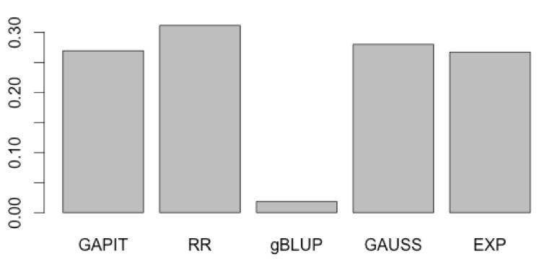
Kernels and Machine Learning
"Kernel method in machine learning: Replacing the inner product in the original (genotype) data with an inner product in a more complex features".
Jeff Endelman (The Plant Genome, 2011)
Divide population into reference and inference
Exam all Kernels
Find the one gives the maximum accuracy in inference

Slide 25
Outline
Kernel
Machine learning
Cross validation

