Slide 1


Statistical Genomics
Lecture 28: Bayesian methods
Zhiwu Zhang
Washington State University

Slide 2
Administration
Homework 5 graded
Homework 6 (last) due April 29, Friday, 3:10PM
Final exam: May 3, 120 minutes (3:10-5:10PM), 50
Evaluation due May 6 (10 out of 19 (53%) received, THANKS).

Slide 3
Outline
Concept development
Gibbs
Bayesians
BLR

Slide 4
Bayesian likelihood
P(g_{i}, σ_{gi}², σ_{e}² v, s | y) =
P(y | g_{i}, σ_{gi}², σ_{e}² v, s) P(g_{i}, σ_{gi}², σ_{e}² v, s)
Gibbs sampling

Slide 5
Gibbs sampling
Josiah Willard Gibbs
Described by Stuart and Donald Geman in 1984
Difficult
Joint distribution of x and y
Starting values of x and y
Marginal distribution of x given y
Easy
Marginal distribution of y given x

Slide 6
Example
r=75%
?
x=rnorm(10000)
y=rnorm(10000)
plot(x,y)

Slide 7
Example
gibbs=function (n=10000, r=.75, sd=1)
{
mat=matrix(ncol = 2, nrow = n)
x=-5
y=5
mat[1, ]=c(x, y)
for (i in 2:n) {
x=rnorm(n=1, mean=r*y, sd=1)
y=rnorm(n=1, mean=r*x, sd=1)
mat[i, ]=c(x, y)
}
mat
}
n= 10000
bvn<-gibbs(n,.75, sd=1)
cor(bvn)
batch=5000
ndisp=1000
xlim=c(min(bvn[,1]),max(bvn[,1]))
ylim=c(min(bvn[,2]),max(bvn[,2]))
for(i in 1:n){
if(i==1)plot(bvn[i,1],bvn[i,2],xlim=xlim,ylim=ylim,pch=20,col="red")
if(i<ndisp&i>1)points(bvn[i,1],bvn[i,2],pch=20)
if(i>ndisp)points(bvn[i,1],bvn[i,2],col=floor(i/batch)+1)
if(i<ndisp)Sys.sleep(1/i)
if(i==ndisp)Sys.sleep(2)
if(floor(i/batch)*batch==i) Sys.sleep(1)
}
x=-5
y=5
Starting values
x=rnorm(n=1, mean=.75*y, sd=1)
y=rnorm(n=1, mean=.75*x, sd=1)

Slide 8
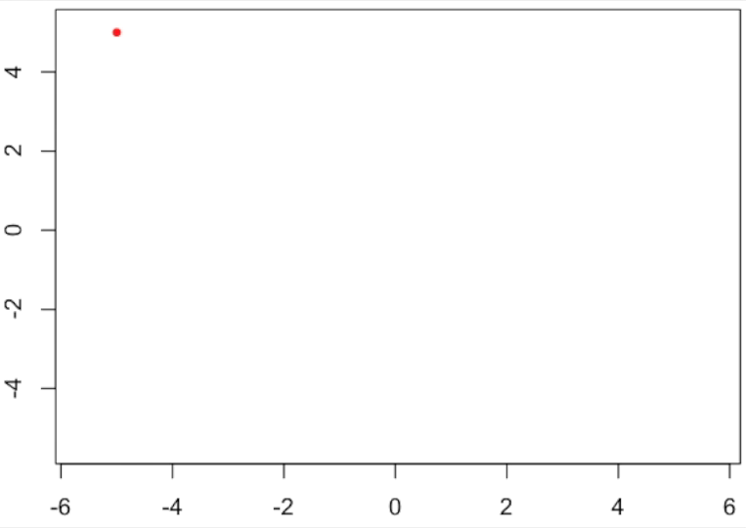
Gibbs sampling

Slide 9
Distribution of the correlations
(500 replicates)

Slide 10
Extra homework credit
Use sampling approach to generate three random variables with expected pairwise correlations of 50%. 20 points. Due on May 3:10 PM.
}
}
x=rnorm(n=1, mean=.5*z, sd=1)
50%
25%
y=rnorm(n=1, mean=.5*x, sd=1)
}
50%
z=rnorm(n=1, mean=.5*y, sd=1)

Slide 11
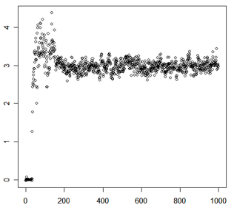
Markov chain Monte Carlo (MCMC)
Sample value
Burn in
Converge
Start
Iteration

Slide 12



Software for Bayesian methods
June 12-17, 2016
https://www.youtube.com/watch?v=RovnCsda-zQ

Slide 13
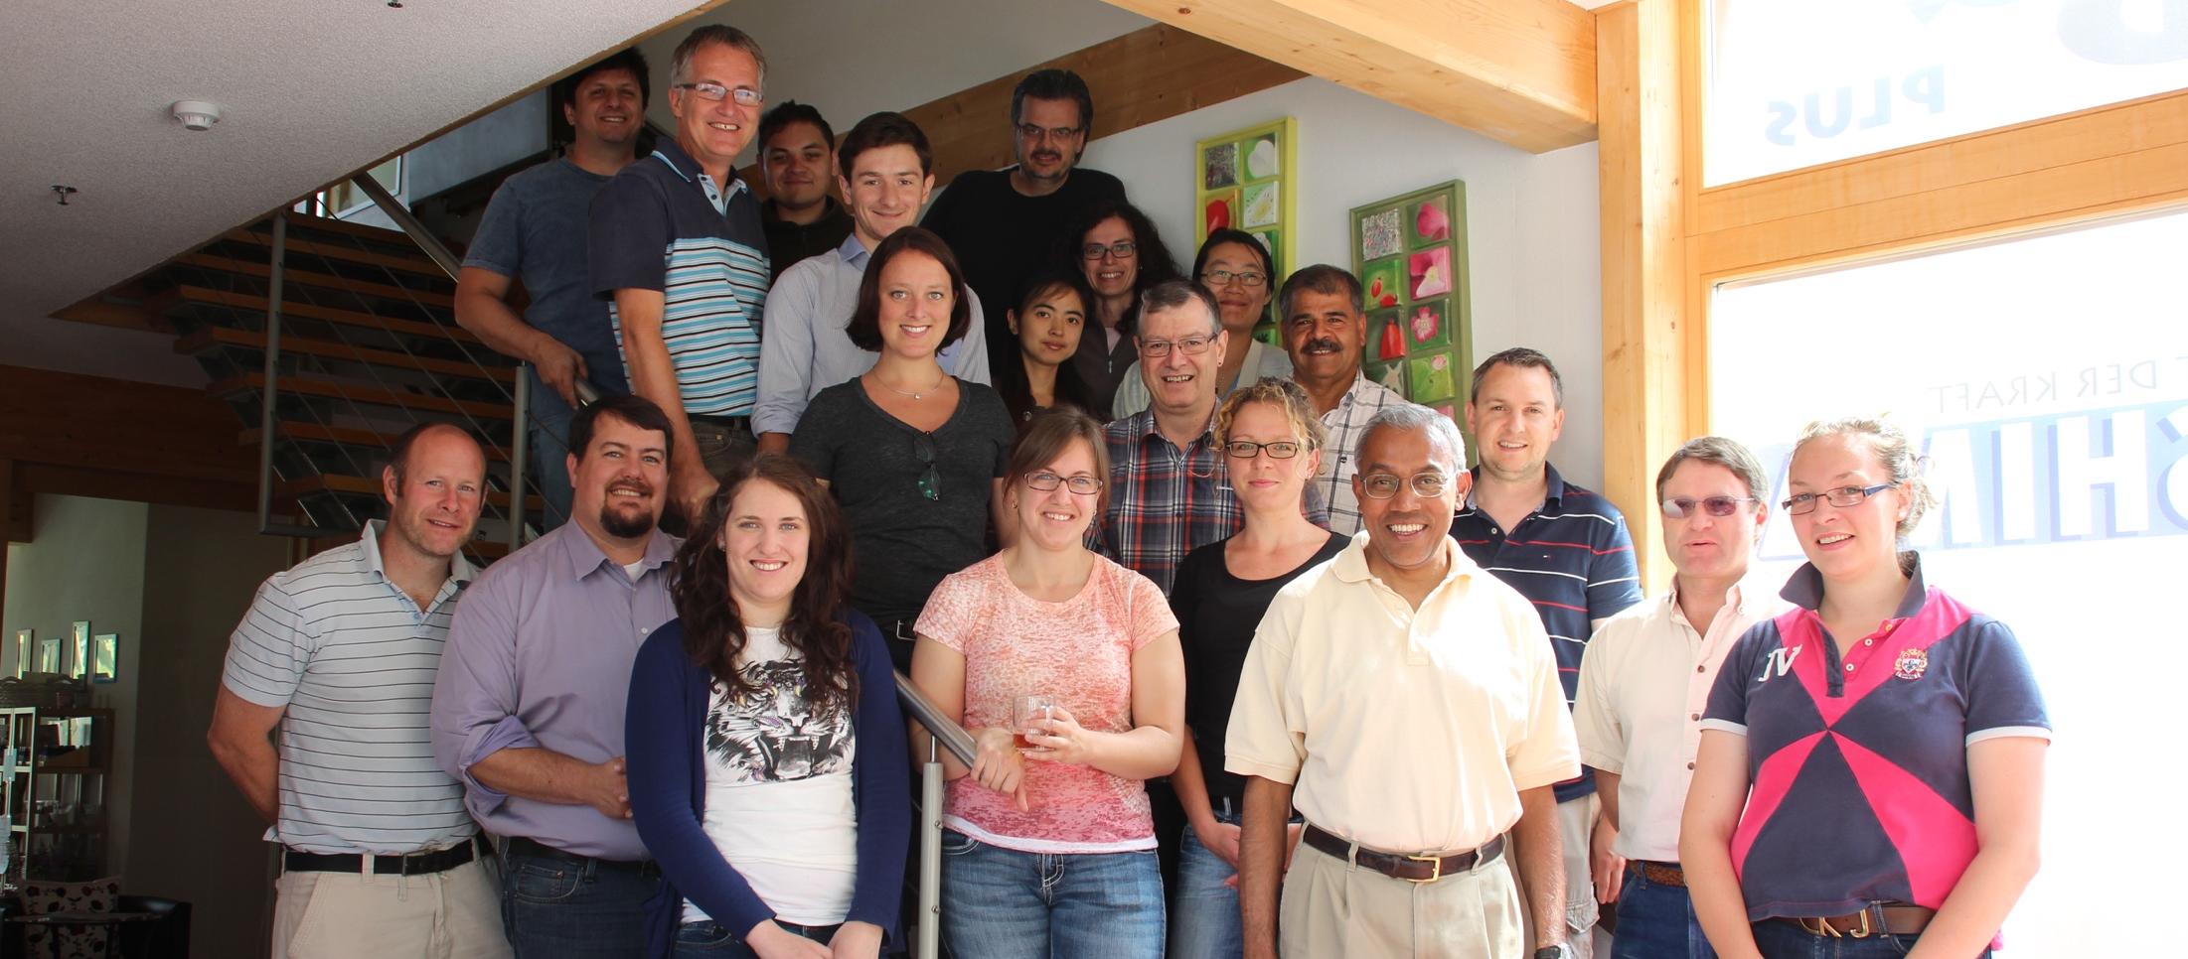
http://taurus.ansci.iastate.edu/wiki/projects
Rohan Fernando
Dorian J Garrick
Jack C M Dekkers

Slide 14
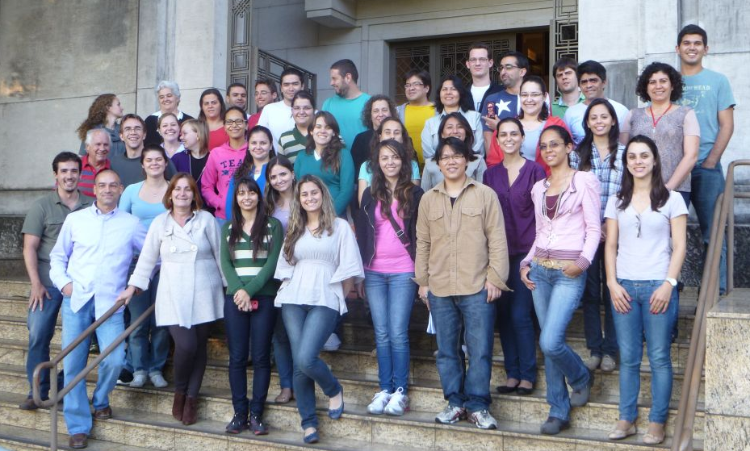
R package BLR
Daniel Gianola
Gustavo
de los Campos
Jose Crossa
Guilherme Rosa
http://www.lce.esalq.usp.br/arquivos/aulas/2013/LCE5713/

Slide 15

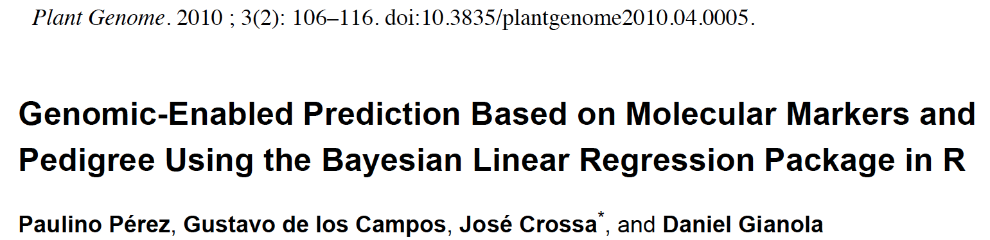
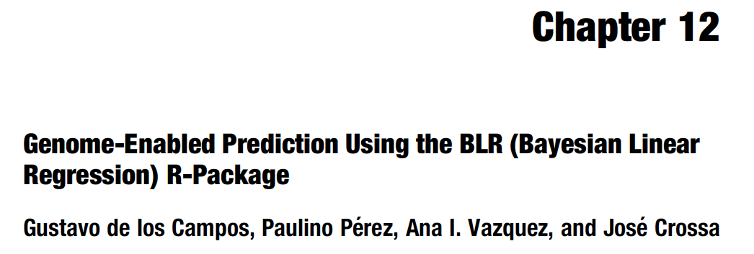
Text book

Slide 16
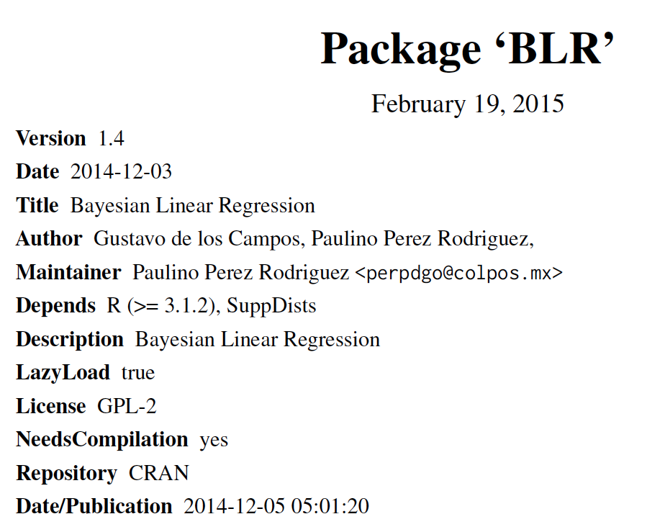
#install.packages("BLR")
library(BLR)

Slide 17
Model in BLR
Breeding values
(gBLUP)
Intercept
Fixed effects
(MAS)
Bayeian LASSO
(Bayes)
random regression
(Ridge regression)

Slide 18
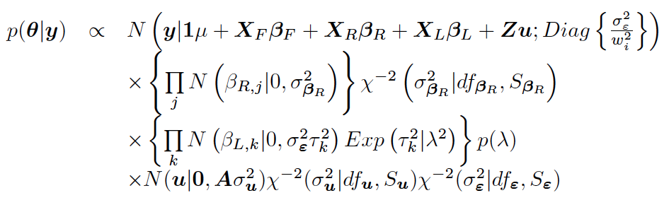
Bayesian likelihood

Slide 19
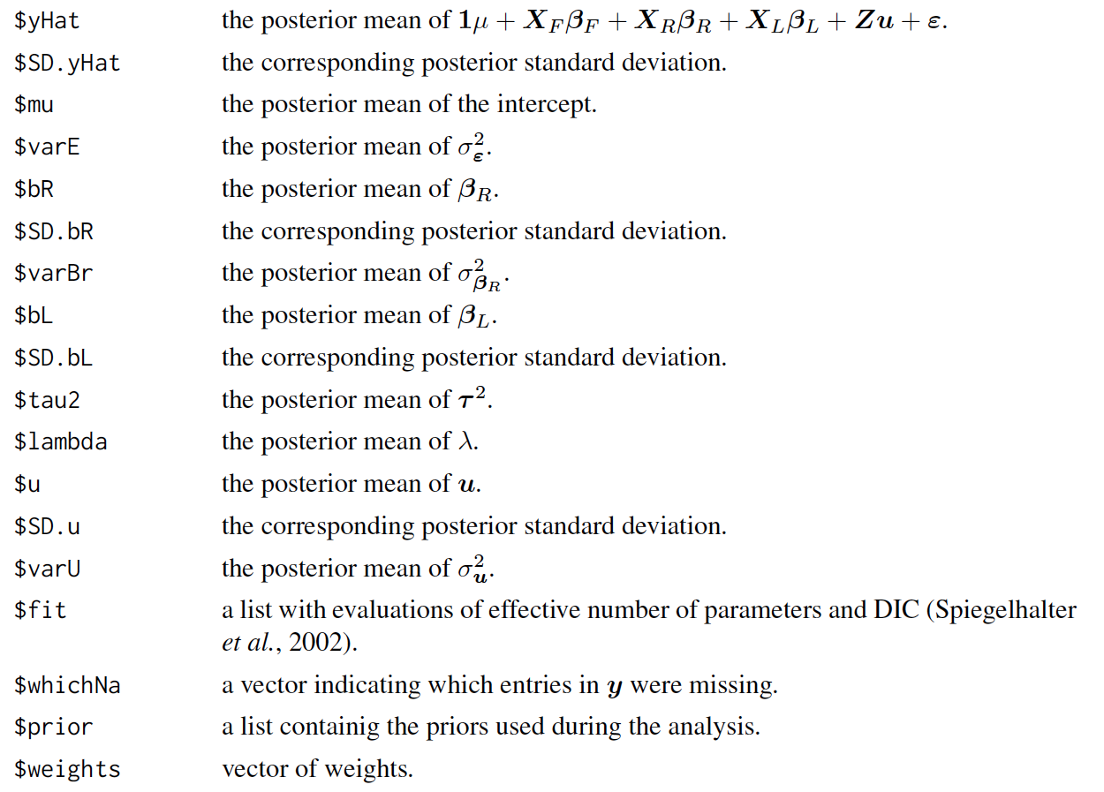
BLR output

Slide 20
Setup GAPIT and BLR
rm(list=ls())
#Import GAPIT
#source("http://www.bioconductor.org/biocLite.R")
#biocLite("multtest")
#install.packages("EMMREML")
#install.packages("gplots")
#install.packages("scatterplot3d")
library('MASS') # required for ginv
library(multtest)
library(gplots)
library(compiler) #required for cmpfun
library("scatterplot3d")
library("EMMREML")
source("http://www.zzlab.net/GAPIT/emma.txt")
source("http://www.zzlab.net/GAPIT/gapit_functions.txt")
#install.packages("BLR")
library(BLR)

Slide 21
Data and simulation
#Import demo data
myGD=read.table(file="http://zzlab.net/GAPIT/data/mdp_numeric.txt",head=T)
myGM=read.table(file="http://zzlab.net/GAPIT/data/mdp_SNP_information.txt",head=T)
myCV=read.table(file="http://zzlab.net/GAPIT/data/mdp_env.txt",head=T)
X=myGD[,-1]
taxa=myGD[,1]
index1to5=myGM[,2]<6
X1to5 = X[,index1to5]
GD.candidate=cbind(as.data.frame(taxa),X1to5)
set.seed(99164)
mySim=GAPIT.Phenotype.Simulation(GD=GD.candidate,GM=myGM[index1to5,],h2=.5,NQTN=20, effectunit =.95,QTNDist="normal",CV=myCV,cveff=c(.2,.2),a2=.5,adim=3,category=1,r=.4)
set.seed(99164)
n=nrow(mySim$Y)
pred=sample(n,round(n/5),replace=F)
train=-pred

Slide 22
Run GAPIT
myY=mySim$Y
y <- mySim$Y[,2]
myGAPIT <- GAPIT(
Y=myY[train,],
GD=myGD,
GM=myGM,
PCA.total=3,
CV=myCV,
group.from=1000,
group.to=1000,
group.by=10,
QTN.position=mySim$QTN.position,
memo="MLM")
order.raw=match(taxa,myGAPIT$Pred[,1])
pcEnv=cbind(myGAPIT$PCA[,-1],myCV[,-1])
acc.GAPIT=cor(myGAPIT$Pred[order.raw,5][pred],mySim$u[pred])
fit.GAPIT=cor(myGAPIT$Pred[order.raw,5][train],mySim$u[train])
acc.GAPIT
fit.GAPIT
0.3032198
0.7337175

Slide 23
GWAS

Slide 24
Run BLR
nIter=2000 #### number of iteration
burnIn=1500 #### burnin a part of iteration
nyBLR =BLR(y=as.matrix(myY[train,2]),
XF=pcEnv[train,],
XL=as.matrix(myGD[train,-1]),
nIter=nIter,
burnIn=burnIn)
pred.inf=as.matrix(myGD[pred,-1])%*%myBLR$bL
pred.ref=as.matrix(myGD[train,-1])%*%myBLR$bL
accuracy <- cor(myY[pred,2],pred.inf)
modelfit <- cor(myY[train,2],pred.ref)
accuracy
modelfit
0.1364273
0.7958675
0.1364273
0.7958675
0.1364273
0.7958675
0.1364273
0.7958675
…

Slide 25
GWAS
plot(fm$tau2)

Slide 26
Visualization by GAPIT
myP=1/(exp(10000*fm$tau2))
myGI.MP=cbind(myGM[,-1],myP)
GAPIT.Manhattan(GI.MP=myGI.MP,seqQTN=mySim$QTN.position)
GAPIT.QQ(myP)

Slide 27
Highlight
Concept development
Gibbs
Bayesians
BLR

