Slide 1


Statistical Genomics
Lecture 29: Bayesian implementation
Zhiwu Zhang
Washington State University

Slide 2
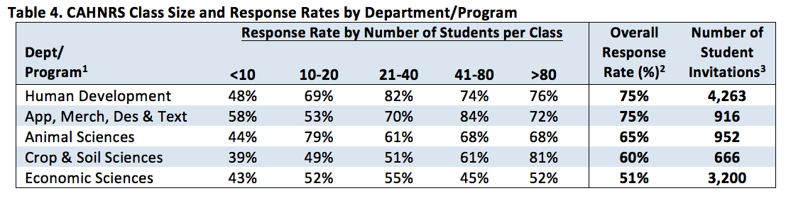
Administration
Homework 6 (last) due April 29, Friday, 3:10PM
Final exam: May 3, 120 minutes (3:10-5:10PM), 50
Evaluation due May 6 (12 out of 19 (63%) received, THANKS).
Group picture after class

Slide 3
Outline
Prediction based on individuals vs. markers
Connections between rr and Bayesian methods
Programming for Bayesian methods
BAGS
Results interpretation

Slide 4

Genome prediction
Based on markers
Based on individuals
Y1, Y2, …, Y_{thousands}
1990s
MAS
Zhang et al,
JAS, 2007
Y = Xb + Zu
Kinship
_{among individuals}
Ridge regression
Bayes (A, B…)
Ys = S1, + S2, + …, + S _{millions}
Mewwissen et al,
Genetics, 2001
S1, S2, …, S_{millions}

Slide 5
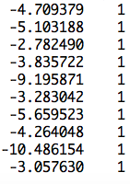
Marker assisted selection
b=(X'X)⁻¹X'y
observation
mean
SNP1 | SNP2 | … | SNP4 | SNP5
b1 | b2 | … | b4 | b5
0 | 1 | … | 2 | 0
2 | 2 | … | 0 | 2
2 | 0 | … | 2 | 2
0 | 2 | … | 0 | 0
b0
]
[
b=
y
x1
x2
x5
x6
x0
]
[
X=
y = x0b0 + x1b1 + x2 +b2 + ... + x5b5 + e

Slide 6
More markers
Small n and big p problem
observation
mean
SNP1 | SNP2 | … | SNPp-1 | SNPp
g1 | g2 | … | gp-1 | gp
0 | 1 | … | 2 | 0
2 | 2 | … | 0 | 2
2 | 0 | … | 2 | 2
0 | 2 | … | 0 | 0
μ
]
[
b=
y
x1
x2
xp-1
xp
x0
]
[
X=
y = x0μ + x1g1 + x2g2 + ... + xpgp + e

Slide 7
Treat markers as random effects with identical independent distribution (iid)
EMMA
Ridge Regression/BLUP
N(0, I σ_{g}²)
y=x₁g₁ + x₂g₂ + … + x_{p}g_{p} + e

Slide 8
Solve by Bayesian approach
σ_{g}²~X⁻²(v, S)
Gibbs
Bayes C
N(0, I σ_{g}²)
y=x₁g₁ + x₂g₂ + … + x_{p}g_{p} + e

Slide 9
Bayes A
σ_{gi}²~X⁻²(v, S)
Differnt
N(0, I σ_{g1}²)
N(0, I σ_{g2}²)
…
N(0, I σ_{gp}²)
y=x₁g₁ + x₂g₂ + … + x_{p}g_{p} + e

Slide 10
Bayes B
σ_{gi}²~X⁻²(v, S)
Zero
π
1−π
Different
N(0, I σ_{g1}²)
N(0, I σ_{g2}²)
…
N(0, I σ_{gp}²)
y=x₁g₁ + x₂g₂ + … + x_{p}g_{p} + e

Slide 11
Bayes Cpi
σ_{g}²~X⁻²(v, S)
Zero
π
1−π
Common
N(0, I σ_{g1}²)
N(0, I σ_{g2}²)
…
N(0, I σ_{gp}²)
y=x₁g₁ + x₂g₂ + … + x_{p}g_{p} + e

Slide 12
Bayesian LASSO
Double Exponential
Differnt
N(0, I σ_{g1}²)
N(0, I σ_{g2}²)
…
N(0, I σ_{gp}²)
y=x₁g₁ + x₂g₂ + … + x_{p}g_{p} + e
getAnywhere('BLR')

Slide 13
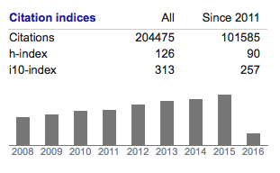
LASSO
Least Absolute Shrinkage and Selection Operator
Robert Tibshirani

Slide 14
Implementation in R
Bayesian Alphabet for Genomic Selection (BAGS)
source("http://www. zzlab.net/sandbox/BAGS.R
Based on the source code originally developed by Rohan Fernando (http://taurus.ansci.iastate.edu/wiki/projects)
Intensively revised
Methods: Bayes A, B and Cpi

Slide 15
Input
G: numeric genotype with individual as row and marker as column (n by m).
y: phenotype of single column (n by 1)
pi: 0 for Bayes A, 1 for Cpi and between 0 and 1 for Bayes B
burn.in: number iterations not used
burn.out: number iterations used
recording: T or F to return MCMC results

Slide 16
Output
$effect: The posterior means of marker effects (m elements)
$ var: The posterior means of marker variances (m elements)
$ mean: The posterior mean of overall mean
$ pi: The posterior mean of pi
$ Va: The posterior mean of genetic variance
$ Ve: The posterior mean of residual variance

Slide 17
Output of MCMC with t iterations
$mcmc.p: The posterior samples of four parameters (t by 4 elements)
  $ mean: The posterior mean of overall mean
  $ pi: The posterior mean of pi
  $ Va: The posterior mean of genetic variance
  $ Ve: The posterior mean of residual variance
$mcmc.b: The posterior samples of marker effects (t by m elements)
$mcmc.v: The posterior samples of marker variances (t by m elements)

Slide 18
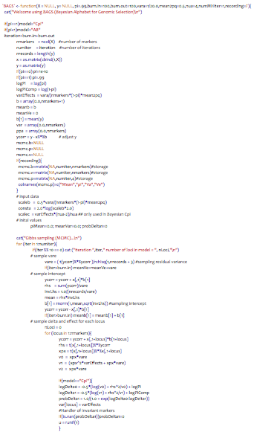
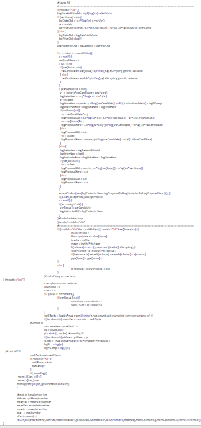
BAGS.R
varCandidate = var[locus]*2 /rchisq(1,4)
vare = ( t(ycorr)%*%ycorr )/rchisq(1,nrecords + 3)
varEffects = (scalec*nua + sum)/rchisq(1,nua+countLoci)
b[1+locus]= rnorm(1,mean,sqrt(invLhs))
b[1] = rnorm(1,mean,sqrt(invLhs))
pi = rbeta(1, aa, bb)

Slide 19
Beta distribution
total SNPs
SNPs with effects
par(mfrow=c(4,1), mar = c(3,4,1,1))
x=rbeta(n,3000,2500)
plot(density(x),xlim=c(0,1))
x=rbeta(n,3000,1000)
plot(density(x),xlim=c(0,1))
x=rbeta(n,3000,100)
plot(density(x),xlim=c(0,1))
x=rbeta(n,3000,10)
plot(density(x),xlim=c(0,1))

Slide 20
Set up GAPIT and BAGS
rm(list=ls())
#Import GAPIT
#source("http://www.bioconductor.org/biocLite.R")
#biocLite("multtest")
#install.packages("EMMREML")
#install.packages("gplots")
#install.packages("scatterplot3d")
library('MASS') # required for ginv
library(multtest)
library(gplots)
library(compiler) #required for cmpfun
library("scatterplot3d")
library("EMMREML")
source("http://www.zzlab.net/GAPIT/emma.txt")
source("http://www.zzlab.net/GAPIT/gapit_functions.txt")
#Prepare BAGS
source('http://zzlab.net/sandbox/BAGS.R')

Slide 21
Prepare data
myGD=read.table(file="http://zzlab.net/GAPIT/data/mdp_numeric.txt",head=T)
myGM=read.table(file="http://zzlab.net/GAPIT/data/mdp_SNP_information.txt",head=T)
myCV=read.table(file="http://zzlab.net/GAPIT/data/mdp_env.txt",head=T)
#Preparing data
X=myGD[,-1]
taxa=myGD[,1]
index1to5=myGM[,2]<6
X1to5 = X[,index1to5]
GD.candidate=cbind(as.data.frame(taxa),X1to5)
set.seed(99164)
mySim=GAPIT.Phenotype.Simulation(GD=GD.candidate,GM=myGM[index1to5,],h2=.5,NQTN=100, effectunit =.95,QTNDist="normal",CV=myCV,cveff=c(.0002,.0002),a2=.5,adim=3,category=1,r=.4)
n=nrow(X)
m=ncol(X)
setwd("~/Desktop/temp") #Change the directory to yours
set.seed(99164)
ref=sample(n,round(n/2),replace=F)
GR=myGD[ref,-1];YR=as.matrix(mySim$Y[ref,2])
GI=myGD[-ref,-1];YI=as.matrix(mySim$Y[-ref,2])

Slide 22
RUN BAGS with different model
#Bayes A:
myBayes=BAGS(X=GR,y=YR,pi=0,burn.in=100,burn.out=100,recording=T)
#Bayes B:
myBayes=BAGS(X=GR,y=YR,pi=.95,burn.in=100,burn.out=100,recording=T)
#Bayes Cpi:
myBayes=BAGS(X=GR,y=YR,pi=1,burn.in=100,burn.out=100,recording=T)

Slide 23
Bayes Cpi
A, B, or Cpi?
Overall mean
Pi
par(mfrow=c(2,2), mar = c(3,4,1,1))
plot(myBayes$mcmc.p[,1],type="b")
plot(myBayes$mcmc.p[,2],type="b")
plot(myBayes$mcmc.p[,3],type="b")
plot(myBayes$mcmc.p[,4],type="b")
Va
Ve

Slide 24
Bayes B
A, B, or Cpi?
Overall mean
Pi
Va
Ve

Slide 25
Bayes A
A, B, or Cpi?
Overall mean
Pi
Va
Ve

Slide 26
Visualizing MCMC
myVar=myBayes$mcmc.v
av=myVar
for (j in 1:m){
for(i in 1:niter){
av[i,j]=mean(myVar[1:i,j])
}}
ylim=c(min(av),max(av))
plot(av[,1],type="l",ylim=ylim)
for(i in 2:m){
points(av[,i],type="l",col=i)
}

Slide 27
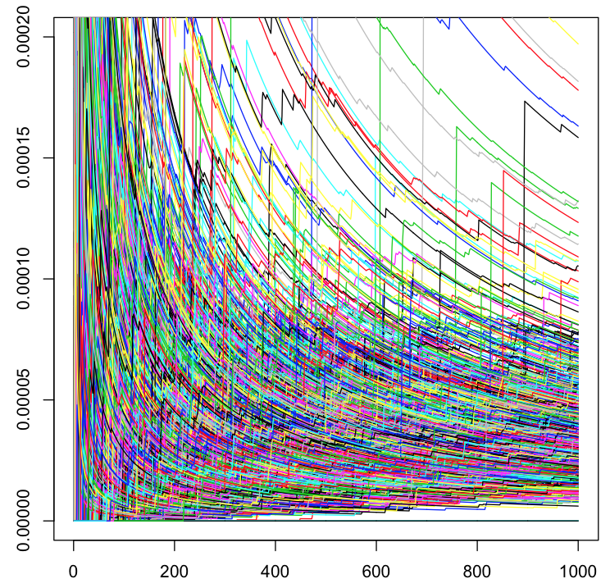
Average variances of SNPs
New stars
Variance
Iteration

Slide 28
Highlight
Prediction based on individuals vs. markers
Connections between rr and Bayesian methods
Programming for Bayesian methods
BAGS
Results interpretation

