Slide 1
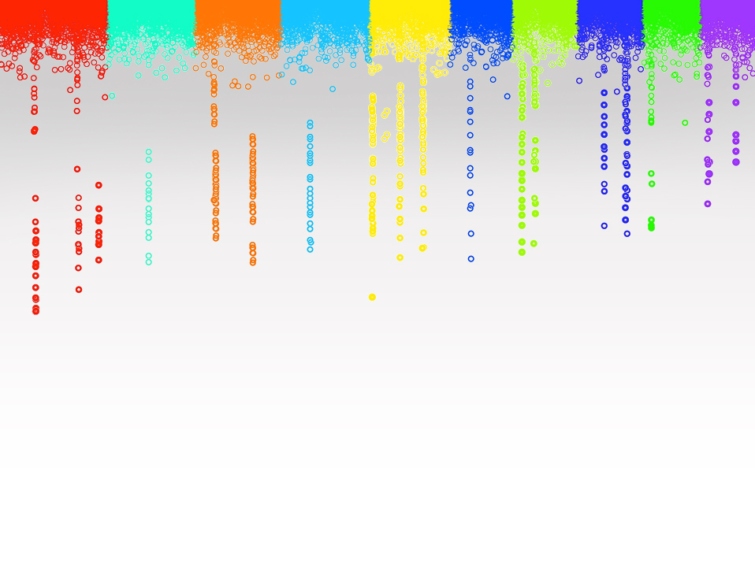
Statistical Genomics
Lecture 17: Likelihood and estimates of variances
Zhiwu Zhang
Washington State University

Slide 2
Administration
Homework 4, due March 22, Wednesday, 3:10PM
Final exam: May 5, 120 minutes (3:10-5:10PM), 50 questions, reasoning

Slide 3
Outline
Solve MLM with unknown heritability
Likelihood(Uni-variate)
Multi-variate likelihood
Full and REML
EM algorith
EMMA

Slide 4
Mixed Model Equation
y = Xb + Zu + e
$\left[\begin{matrix}X^{′}X & X^{′}Z \\ Z^{′}X & Z^{′}Z+{δA}^{−1}\end{matrix}\right]\left[\begin{matrix}b \\ u\end{matrix}\right]$=$\left[\begin{matrix}X^{′}y \\ z^{′}y\end{matrix}\right]$
$$δ=\frac{σ_{e}^{2}}{σ_{a}^{2}}$$
$$h^{2}=\frac{σ_{a}^{2}}{σ_{a}^{2}+σ_{e}^{2}}$$
$$δ=\frac{{1−h}_{}^{2}}{h_{}^{2}}$$

Slide 5
Unknown heritability
$$h^{2}=\frac{σ_{a}^{2}}{σ_{a}^{2}+σ_{e}^{2}}$$
$$δ=\frac{σ_{e}^{2}}{σ_{a}^{2}}$$
$$h^{2}=\frac{1}{1+δ}$$

Slide 6
A variable was observed as 95 from a normal distribution. The mean and SD of the distribution are most likely to be:
100 and 1
100 and 2
85 and 5
85 and 10

Slide 7
By approximation
100 and 1: 5 SD from mean, P<<1%
100 and 2: 2.5 SD from mean, 1%<P<5%
85 and 5 : 2 SD from mean, P=5%
85 and 10 : 1 SD from mean, P=32%

Slide 8
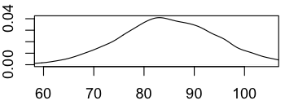
Visualization
x=rnorm(10000,100,1)
plot(density(x),xlim=c(60,105))
x=rnorm(10000,100,2)
plot(density(x),xlim=c(60,105))
x=rnorm(10000,85,5)
plot(density(x),xlim=c(60,105))
x=rnorm(10000,85,10)
plot(density(x),xlim=c(60,105))

Slide 9
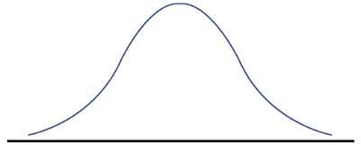
By density function
68% of data
95% of data
99.7% of data
-3
-2
-1
0
1
2
3
$f(x; μ,σ^{2})=\frac{1}{\sqrt{2π}σ}$ exp(-$\frac{1}{2σ^{2}}{(x−μ\text{) }}^{2})$
$$\frac{1}{\sqrt{2π}σ}\int_{−∞}^{∞}{exp\text{(−}\frac{1}{2σ^{2}}{(x−μ\text{) }}^{2}) }=1$$

Slide 10
Density function of uni-variate normal distribution
$f(x,μ,σ^{2})=\frac{1}{\sqrt{2π}σ}$ exp(-$\frac{1}{2σ^{2}}{(x−μ\text{) }}^{2})$
dnormal=function(x=0,mean=0,sd=1){
p=1/(sqrt(2*pi)*sd)*exp(-(x-mean)^2/(2*sd^2))
return(p)
}

Slide 11
Density function of normal distribution
x=c(95,95,95,95)
mean=c(100,100,85,85)
sd=c(1,2,5,10)
dnormal(x,mean,sd)
dnorm(x,mean,sd)

Slide 12
Two variables were observed as 95 and 97 from a normal distribution. The mean and SD of the distribution are most likely to be:
100 and 1
100 and 2
85 and 5
85 and 10
mean=c(100,100,85,85)
sd=c(1,2,5,10)
x1=rep(95,4)
x2=rep(97,4)
p1=dnormal(x1,mean,sd)
p2=dnormal(x2,mean,sd)
p1*p2
A: 6.5pe-09
B: 5.7e-04
C: 4.8e-05
D: 4.7e-04

Slide 13
Three individuals have kinship of and observations of 95, 100 and 70, respectively. The population has mean of 90. Square root of genetic and residual variances are most likely to be:
95 and 5
5 and 95
50 and 50
I do not know

Slide 14
Variance in MLM
y = Xb + Zu + e
Var(y)=V=Var(u)+Var(e)
Var(u)=G=2K$σ_{a}^{2}$=A$σ_{a}^{2}$
Var(e)=R=I$σ_{e}^{2}$

Slide 15
Density function of multi-variate normal distribution
$f(x; μ, H)=\frac{1}{({2π)}^{n/2}{\left|V\right|}^{1/2}}$ exp(- $\frac{1}{2}{(x−μ\text{) }}^{T}V^{−1}(x−μ\text{)})$
dmnormal=function(x=0,mean=0,V=NULL){
n=length(x)
p=1/(sqrt(2*pi)^n*sqrt(det(V)))*exp(-t(x-mean)%*%solve(V)%*%(x-mean)/2)
return(p)
}

Slide 16
Density function of multi-variate normal distribution
x=matrix(c(100,95,70),3,1)
mean=rep(90,3)
K=matrix(c(1,.75,.25,.75,1,.25,.25,.25,1),3,3)
va=95
ve=5
V=2*K*va+ve
dmnormal(x,mean,V)
va=5
ve=95
V=2*K*va+ve
dmnormal(x,mean,V)
va=50
ve=50
V=2*K*va+ve
dmnormal(x,mean,V)

Slide 17
Log Likelihood
$f(x; μ, H)=\frac{1}{({2π)}^{n/2}{\left|V\right|}^{1/2}}$ exp(- $\frac{1}{2}{(x−μ\text{) }}^{T}V^{−1}(x−μ\text{)})$
$$σ_{}^{2}=σ_{a}^{2}, H=σ_{}^{−1}V$$

Slide 18
Full and REsidual Maximum Likelihood
q is rank of X

Slide 19
Differences between Full ML and REML
Features | Full ML | REML
Likelihood | y | residual: y-Xb
Fixed effect | Depend on | Removed
Model comparison | Fixed effects | random effect
Bias | Negatively | Unbiased

Slide 20
Expectation and Maximization (EM)
y = Xb + Zu + e
Expectation (E) step
$$\left[\begin{matrix}\hat{b} \\ \hat{u}\end{matrix}\right]={\left[\begin{matrix}X^{′}X & X^{′}Z \\ Z^{′}X & Z^{′}Z+{\frac{σ_{e}^{2}}{σ_{a}^{2}}A}^{−1}\end{matrix}\right]}^{−1}\left[\begin{matrix}X^{′}y \\ Z^{′}y\end{matrix}\right]$$
$$\left[\begin{matrix}C^{11} & C^{12} \\ C^{21} & C^{22}\end{matrix}\right]$$

Slide 21
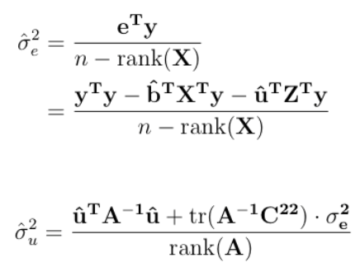
Expectation and Maximization (EM)
Maximization (M) step
tr=Trace=sum of diagonals
rank=max dimension of non singular submatrix

Slide 22
EM is time demanding
Expectation (E) step
Until converge
Maximization (M) step

Slide 23
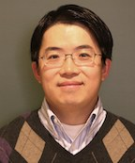
EMMA: two dimensions to one dimension optimization
Kang, H. M. et al. Efficient control of population structure in model organism association mapping. Genetics 178, 1709–1723 (2008).
Kang
$$H=σ_{}^{−1}V$$
$$=A+δI$$
$=U_{F}^{}diag({\text{ξ}}_{1}$+$δ$, …, ${\text{ξ}}_{n}$+$δ)U_{F}^{′}$
U_{F} and ξ are eigen vector and values of spectral decomposition of A matrix

Slide 24
Iterations in EMMA R package
$$δ=\frac{σ_{e}^{2}}{σ_{a}^{2}}$$
$$δ=\frac{{1−h}_{}^{2}}{h_{}^{2}}$$
$$h_{}^{2}$$
= 0.01, 0.02, …, 0.98, 0.99

Slide 25
Highlight
Solve MLM with unknown heritability
Likelihood (Uni-variate)
Multi-variate likelihood
Full and REML
EM algorithm
EMMA

