Slide 1
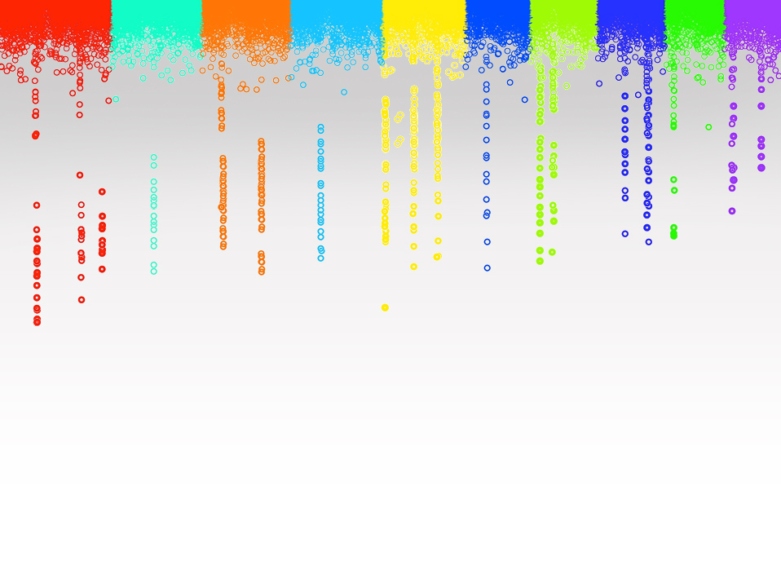
Statistical Genomics
Lecture 21: FarmCPU
Zhiwu Zhang
Washington State University

Slide 2
Administration
Homework 5, due April 12, Wednesday, 3:10PM
Final exam: May 4 (Thursday), 120 minutes (3:10-5:10PM), 50

Slide 3
Outline
History of method and software development
FarmCPU

Slide 4
Problems in GWAS
Computing difficulties: millions of markers, individuals, and traits
False positives, ex: “Amgen scientists tried to replicate 53 high-profile cancer research findings, but could only replicate 6”, Nature, 2012, 483: 531
False negatives

Slide 5
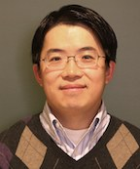
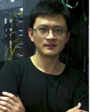
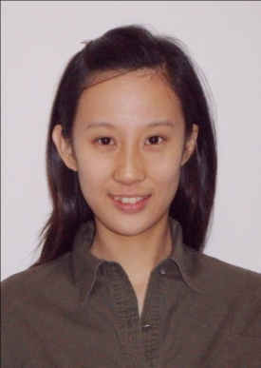
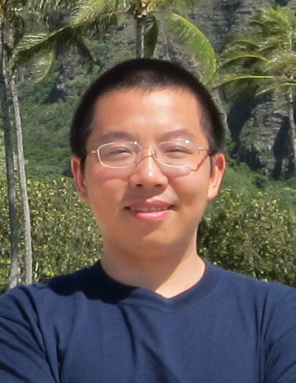
Q
EMMA
PC+K
PC
EMMAx
Q+K
GWAS Stream
MLMM
CMLM
P3D
SELECT
GCTA
ECMLM
FST-LMM
GEMMA
FarmCPU
GenAbel
BLINK

Slide 6
t test
Speed improvement
Power
improvement
GLM
GenABEL
Computing speed
FaST-LMM
CMLM
ECMLM
GEMMA
Select
P3D/EMMAX
SUPER
EMMA
MLMM
MLM
Power | type I error

Slide 7
Usage of Software Packages
Software | Leading Authors | Corresponding authors | Language | Released | Citation
PUMA | Gabriel E. Hoffman | Jason G. Mezey | C++ | 2013 | 27
TATES | Sophie van der Sluis | Sophie van der Sluis | Fortran | 2013 | 76
GAPIT | Lipka AE | Zhang Z | R | 2012 | 284
MLMM | Vincent S | Nordborg M | R/python | 2012 | 226
GEMMA | Zhou X | Stephens M | C++ | 2012 | 445
FastLMM | Christoph L, Listgarten J, Heckerman D | Christoph L, Listgarten J, Heckerman D | C++ | 2011 | 348
Qxpak | M. Pérez-Enciso | M. Pérez-Enciso | Fortran | 2004 | 141
EMMAX | Kang HM | Sabatti C & Eskin E | C++ | 2010 | 813
GCTA | Jian Y | Jian Y | C++ | 2011 | 1338
GenABEL | Aulchenko YS | Aulchenko YS | R | 2007 | 990
TASSEL | Bradbury, Zhang, and Kroon | Bradbury PJ | Java | 2006 | 1596
PLINK | Purcell S | Purcell S | C++ | 2007 | 12111
65%

Slide 8
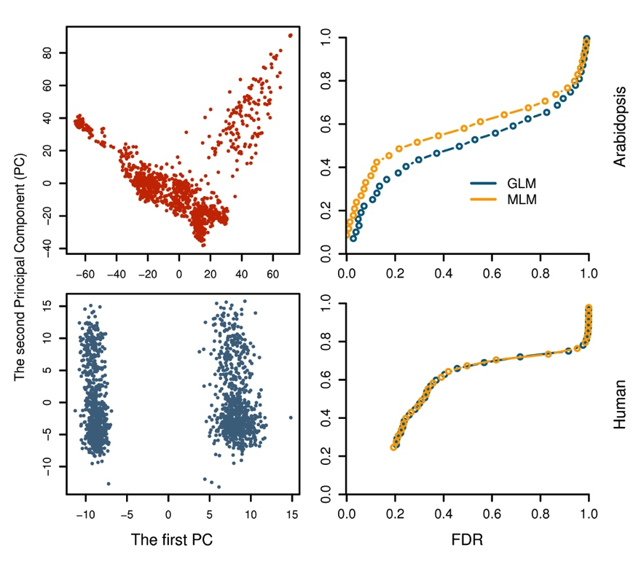
Why human geneticists not go beyond PLINK?

Slide 9
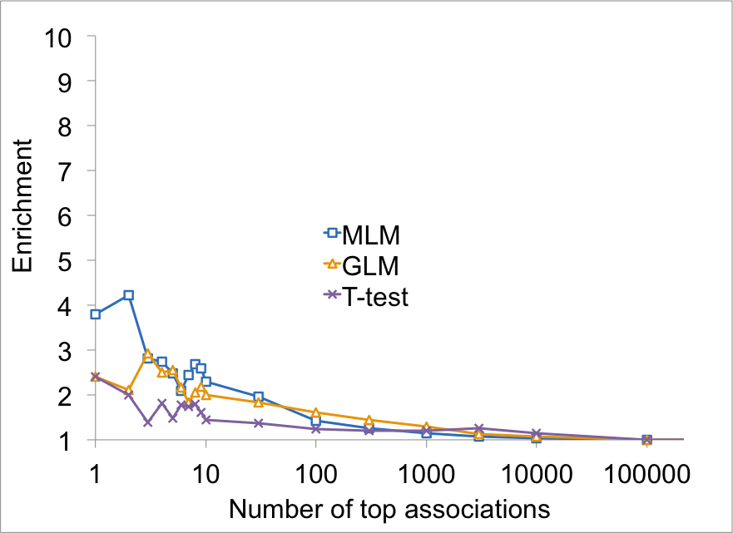
MLM was more enriched on Flowering time genes

Slide 10
Model Development
S_{i}: Testing marker
Adjustment on marker
Q: Population structure
K: Kinship
Adjustment on covariates
S: Pseudo QTNs

Slide 11
SUPER algorithm
y = PC + SNP + e
Bins
-2LL
QTNs
y = PC + Kinship + e
y = PC + Kinship + SNP + e

Slide 12
FarmCPU algorithm
y = PC + SNP + e
Bins
-2LL
QTNs
y = PC + Kinship + e
y = PC + QTNs + SNP + e

Slide 13
t test
Speed improvement
Power
improvement
GLM
GenABEL
BLINK
FarmCPU
Computing speed
FaST-LMM
CMLM
ECMLM
GEMMA
Select
P3D/EMMAX
SUPER
EMMA
MLMM
MLM
Power | type I error

Slide 14
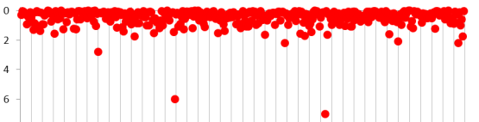
FARM-CPU (Fixed And Random Model Circuitous Probability Unification)
Fixed model
y = M₁ + … + M_{t} + m_{i} + e
SNP | p₁ | … | NA | … | NA | … | p_{l}
M_{t} | P_{t1} | … | P_{tj} | … | P_{tk} | … | P_{tl} | P_{t}
… | … | … | … | … | … | … | … | …
M₂ | P₂₁ | … | P_{2j} | … | P_{2k} | … | P_{2l} | P₂
M₁ | P₁₁ | … | P_{1j} | … | P_{1k} | … | P_{1l} | P₁
 | m₁ | … | m_{j} | … | m_{k} | … | m_{l}
Substitution
Random model
y = u + e with
Var(u)∝SVD(M)
Optimization
Notes:
FARM-CPU (Fixed And Random Model Circulative Probability Unification)
Keywords: substitution, test, screen, storage, memory, mutation, markers, formula, optimization, processer, unit, background,
The shaded area is the storage of p values for markers (dark shaded) and mutations (shadow shaded). The Manhattan plot (with red dots) area is the processer to optimize bin size and the bin selected as pseudo mutations (M) connected by the green wires. The equation is the processer to test marker (m) one at a time with mutation (M) as covariates. The p values of M are processed xx unit (non-shaded area) to get average P values which are connect by the blue wires to substitute the Nas for the corresponding markers which do not have P values in the test as they are confounded to M.

Slide 15
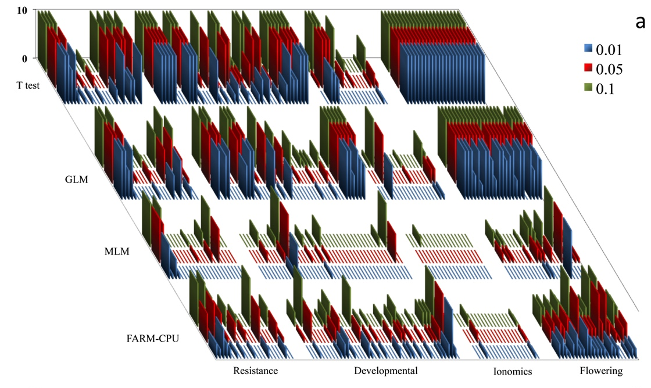
Re-analysis of Arabidopsis data
Xiaolei Liu

Slide 16
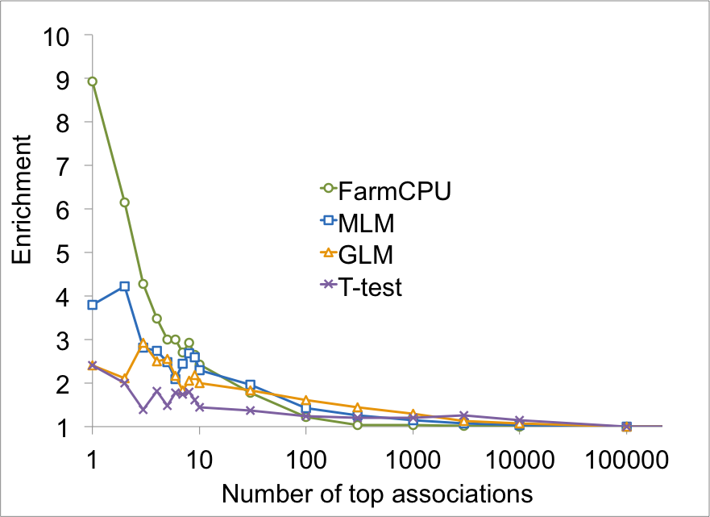
Flowering time genes enriched

Slide 17
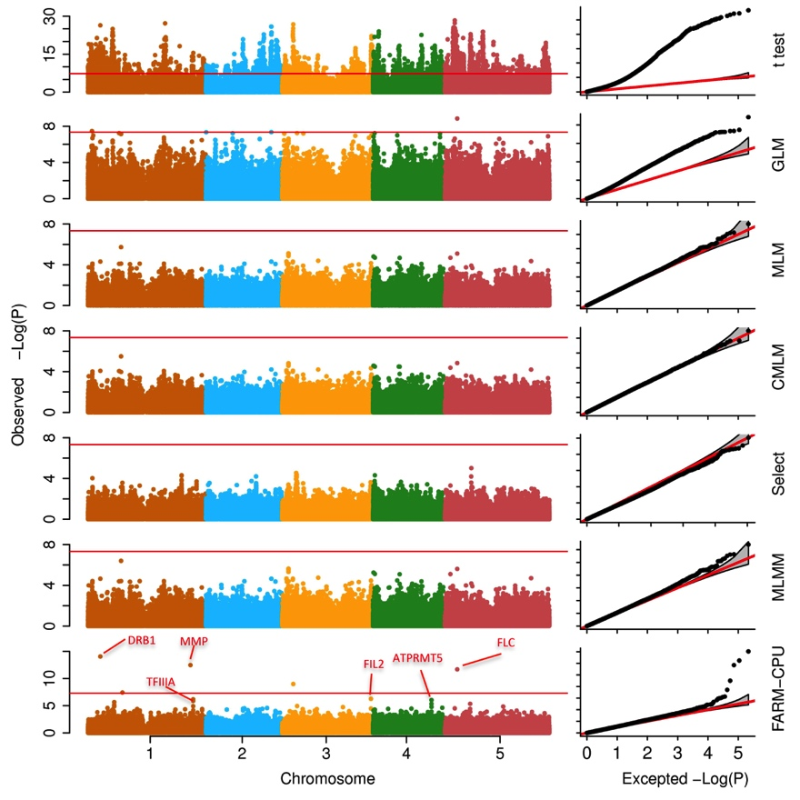
Associations on flowering time

Slide 18
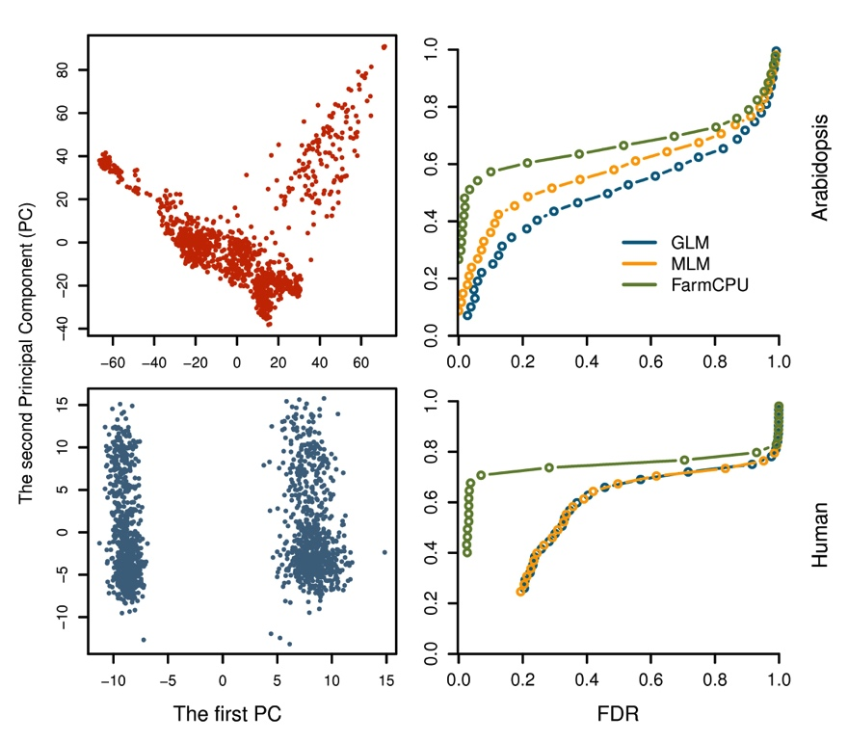
It is time for human geneticists to move forward

Slide 19
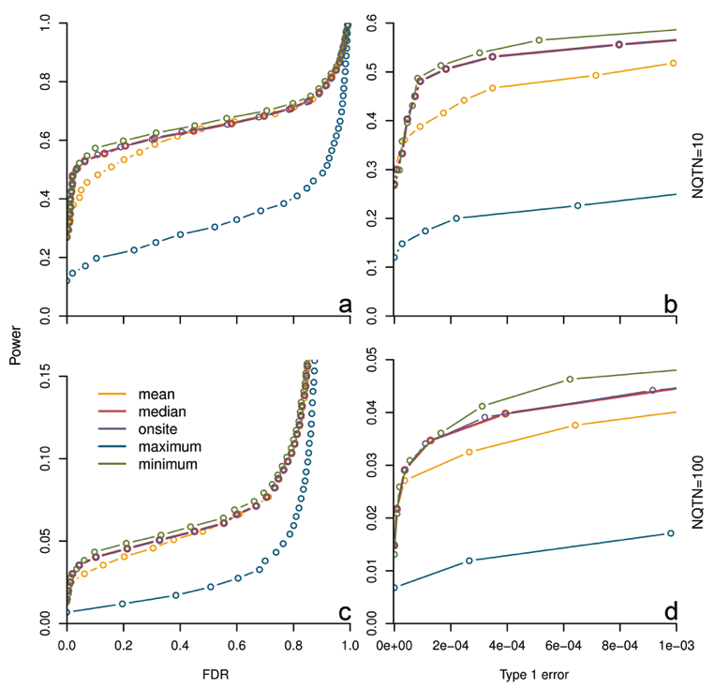
Substitution makes difference

Slide 20
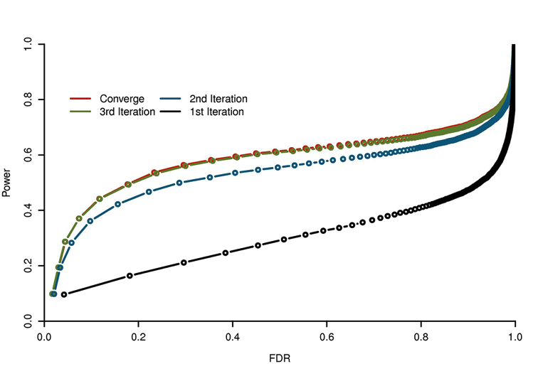
Converge fast

Slide 21
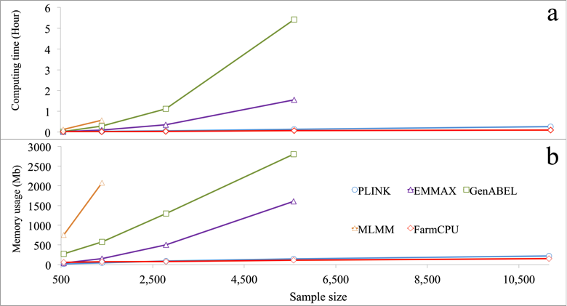
FarmCPU is computing efficient
Testing 60K SNPs

Slide 22
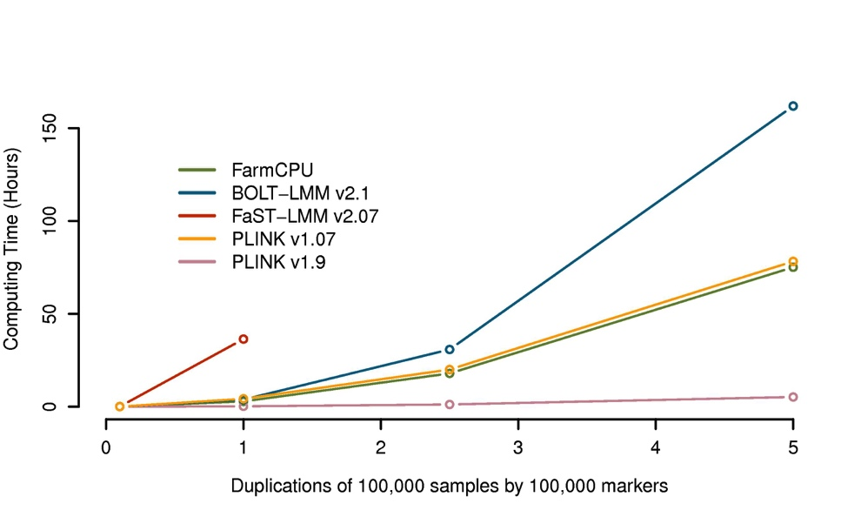
Half million individuals, half million SNPs three days
But, PINK new version is faster

Slide 24
ZZLab.Net

Slide 25
Summary
History of method and software development
FarmCPU

