Slide 1


Statistical Genomics
Lecture 24: gBLUP
Zhiwu Zhang
Washington State University

Slide 2
Administration
Homework 5, due April 12, Wednesday, 3:10PM
Final exam: May 4 (Thursday), 120 minutes (3:10-5:10PM), 50
Party: April 28, Friday, 4:30-7:30 (food at 5:00), 130 Johnson Hall

Slide 3
Outline
MAS
works for a few genes
Over-fit
CV
Inaccurate
Does not works for polygenes
Whole genome
Concept in 1990s implement in 2000s
RR and Bayes
gBLUP
=RR
Pedigree+Marker
cBLUP/sBLUP

Slide 4
MAS by GAPIT
Setup GAPIT
Import data
Simulate phenotype
Validation

Slide 5
Setup GAPIT
#source("http://www.bioconductor.org/biocLite.R")
#biocLite("multtest")
#install.packages("gplots")
#install.packages("scatterplot3d")#The downloaded link at: http://cran.r-project.org/package=scatterplot3d
library('MASS') # required for ginv
library(multtest)
library(gplots)
library(compiler) #required for cmpfun
library("scatterplot3d")
source("http://www.zzlab.net/GAPIT/emma.txt")
source("http://www.zzlab.net/GAPIT/gapit_functions.txt")

Slide 6
mdp_env.txt
Taxa | SS | NSS | Tropical | Early | Block
33-16 | 0.014 | 0.972 | 0.014 | 0 | 0
38-11 | 0.003 | 0.993 | 0.004 | 0 | 1
4226 | 0.071 | 0.917 | 0.012 | 0 | 0
4722 | 0.035 | 0.854 | 0.111 | 0 | 1
A188 | 0.013 | 0.982 | 0.005 | 0 | 1
A214N | 0.762 | 0.017 | 0.221 | 0 | 0
A239 | 0.035 | 0.963 | 0.002 | 0 | 1
A272 | 0.019 | 0.122 | 0.859 | 1 | 0
A441-5 | 0.005 | 0.531 | 0.464 | 0 | 1
A554 | 0.019 | 0.979 | 0.002 | 0 | 0
A556 | 0.004 | 0.994 | 0.002 | 0 | 1
A6 | 0.003 | 0.03 | 0.967 | 1 | 0
A619 | 0.009 | 0.99 | 0.001 | 0 | 0
A632 | 0.993 | 0.004 | 0.003 | 0 | 0

Slide 7
Import data and simulate phenotype
myGD=read.table(file="http://zzlab.net/GAPIT/data/mdp_numeric.txt",head=T)
myGM=read.table(file="http://zzlab.net/GAPIT/data/mdp_SNP_information.txt",head=T)
myCV=read.table(file="http://zzlab.net/GAPIT/data/mdp_env.txt",head=T)
#Simultate 10 QTN on the first half chromosomes
X=myGD[,-1]
index1to5=myGM[,2]<6
X1to5 = X[,index1to5]
taxa=myGD[,1]
set.seed(99164)
GD.candidate=cbind(taxa,X1to5)
mySim=GAPIT.Phenotype.Simulation(GD=GD.candidate,GM=myGM[index1to5,],h2=.5,NQTN=2, effectunit =.95,QTNDist="normal",CV=myCV,cveff=c(.01,.01))
setwd("~/Desktop/temp")

Slide 8
GWAS
myGAPIT <- GAPIT(Y=mySim$Y,GD=myGD,GM=myGM, PCA.total=3,CV=myCV,group.from=1,group.to=1,group.by=10,QTN.position=mySim$QTN.position,memo="GLM",)

Slide 9
Prediction with PC and ENV
ry2=cor(myGAPIT$Pred[,8],mySim$Y[,2])^2
ru2=cor(myGAPIT$Pred[,8],mySim$u)^2
par(mfrow=c(2,1), mar = c(3,4,1,1))
plot(myGAPIT$Pred[,8],mySim$Y[,2])
mtext(paste("R square=",ry2,sep=""), side = 3)
plot(myGAPIT$Pred[,8],mySim$u)
mtext(paste("R square=",ru2,sep=""), side = 3)

Slide 10
Top five SNPs
ntop=5
index=order(myGAPIT$P)
top=index[1:ntop]
myQTN=cbind(myGAPIT$PCA[,1:4], myCV[,2:3],myGD[,c(top+1)])
myGAPIT2 <- GAPIT(
Y=mySim$Y,
GD=myGD,
GM=myGM,
CV=myQTN,
group.from=1,
group.to=1,
group.by=10,
QTN.position=mySim$QTN.position,
SNP.test=FALSE,
memo="GLM+QTN",
)

Slide 11
Validation
#Real Cross validation
set.seed(99164)
n=nrow(mySim$Y)
testing=sample(n,round(n/5),replace=F)
training=-testing
myGAPIT3 <- GAPIT(
Y=mySim$Y[training,],
GD=myGD,
GM=myGM,
CV=myCV,
PCA.total=3,
group.from=1,
group.to=1,
group.by=10,
QTN.position=mySim$QTN.position,
#SNP.test=FALSE,
memo="GWAS",
)

Slide 12
Estimate QTN effects in training
ntop=5
index=order(myGAPIT3$P)
top=index[1:ntop]
myQTN=cbind(myGAPIT3$PCA[,1:4], myCV[,2:3],myGD[,c(top+1)])
myGAPIT4 <- GAPIT(
Y=mySim$Y[training,],
GD=myGD,
GM=myGM,
CV=myQTN,
group.from=1,
group.to=1,
group.by=1,
SNP.test=FALSE,
memo="GLM+QTN",)

Slide 13
Model fit in training
ry2=cor(myGAPIT4$Pred[training,8],mySim$Y[training,2])^2
ru2=cor(myGAPIT4$Pred[training,8],mySim$u[training])^2
par(mfrow=c(2,1), mar = c(3,4,1,1))
plot(myGAPIT4$Pred[training,8],mySim$Y[training,2])
mtext(paste("R square=",ry2,sep=""), side = 3)
plot(myGAPIT4$Pred[training,8],mySim$u[training])
mtext(paste("R square=",ru2,sep=""), side = 3)

Slide 14
Accuracy in testing
#Testing
#calculate prediction
effect=myGAPIT4$effect.cv
X=as.matrix(cbind(1, myQTN[,-1]))
Pred=X%*%effect
ry2=cor(Pred[testing],mySim$Y[testing,2])^2
ru2=cor(Pred[testing],mySim$u[testing])^2
par(mfrow=c(2,1), mar = c(3,4,1,1))
plot(Pred[testing],mySim$Y[testing,2])
mtext(paste("R square=",ry2,sep=""), side = 3)
plot(Pred[testing],mySim$u[testing])
mtext(paste("R square=",ru2,sep=""), side = 3)

Slide 15
2 QTNs
MAS works for Mendelian traits, not polygenic traits
20 QTNs

Slide 16


MAS
Prediction of maize single-cross performance using RFLPs and information related hybrids
Crop Science, 1994
Citation: 171
R. Bernardo
Prediction of total genetic value using genome wide dense marker maps
Genetics, 2001, Citation: 1711
Use of Marker Based Relationships with MTDFREML
J. Animal Sci., 2007
D. Van Vleck
T. Meuwissen
B. Hayes
M. Goddard
Efficient kinship
J. Dairy Science, 2008
Citation: 1331
P. VanRaden
gBLUP
Pedigree & Marker kinship
single step
GES, 2011
Bayes A, B, Cpi, …
I. Misztal
Genomic prediction

Slide 17
gBLUP
Prediction of maize single-cross performance using RFLPs and information related hybrids
Rex Bernardo
Crop Science, 1994
Y_{M} = C V⁻¹ Y_{p}
y_{M} = m × 1 vector of predicted yields of missing single crosses;
C = m × n matrix of genetic covariances between the missing and predictor hybrids;
V = n × n matrix of phenotypic variances and covariances among predictor hybrids;
y_{P} = nn × 1 vector of predictor hybrid yields corrected for trial effects.

Slide 18
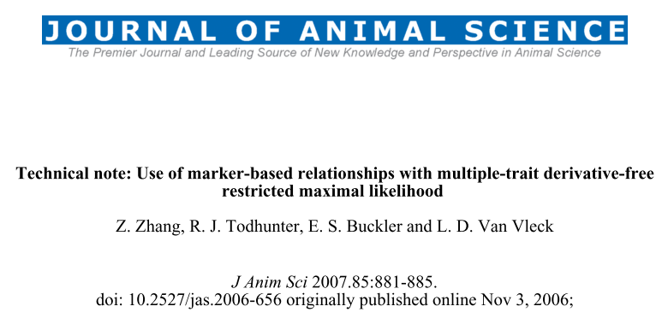
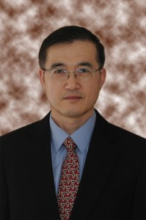
gBLUP reinvent

Slide 19
Multiple Trait Derivative Free REML (MTDFREML)
Welcome to the Multiple Trait Derivative Free REML (MTDFREML) home page. The programs were developed by Keith Boldman and Dale Van Vleck. Evolutionary development and debugging support have also been provided by by Lisa Kriese and Curt Van Tassell.
Please contact Curt Van Tassell (e-mail curtvt@aipl.arsusda.gov) or Dale Van Vleck. (e-mail lvanvleck@unlnotes.unl.edu) with any problems with the programs or discovered bugs.
Obtaining the MTDFREML programs
Get the manual
Sample analyses
Enter user information using web browser that handles forms
FTP the userinfo.txt file to enter user information (then mail completed form)
Get the Microsoft Powerstation fix for Windows 95 (compressed)
Get the Microsoft 5.1 fix for insufficient file handles (compressed)

Slide 20
Marker based kinship in MTDFREML
Pedigree
Marker
MTDF-NRM
MTDF-ARM
Arbitrary
Relationship
Matrix
kinship
MTDF-PREP
Equations
MTDF-RUN
BLUP and variance
Zhang et al., J. Anim Sci., 2007

Slide 21
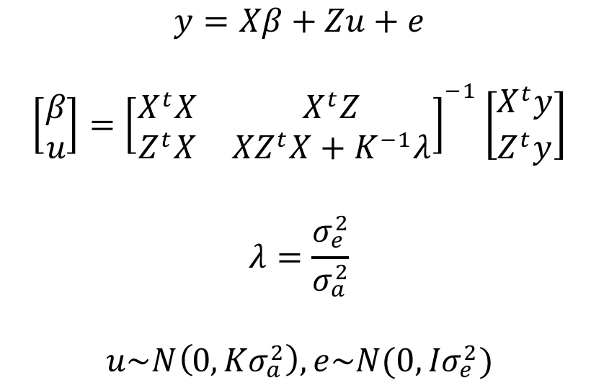
Mixed Linear Model (MLM)

Slide 22
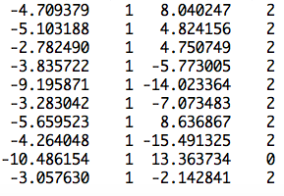
Z matrix
observation
mean
PC2
SNP
Ind1 | Ind2 | … | Ind9 | Ind10
u1 | u2 | … | u9 | u10
1 | 0 | … | 0 | 0
0 | 1 | … | 0 | 0
0 | 0 | … | 1 | 0
0 | 0 | … | 0 | 1
u=
]
[
]
[
b=
b0
b1
b2
y
1
x1
x2
=X
Z
[
]
y = Xb + Zu +e

Slide 23
Generic Z matrix
Ind1 | Ind2 | … | Ind9 | Ind10
u1 | u2 | … | u9 | u10
1 | 0 | … | 0 | 0
0 | 1 | … | 0 | 0
0 | 0 | … | 1 | 0
0 | 0 | … | 0 | 1
Ind11 | Ind12 | … | Ind19 | Ind20
u11 | u12 | … | u19 | u20
0 | 0 | … | 0 | 0
0 | 0 | … | 0 | 0
0 | 0 | … | 0 | 0
0 | 0 | … | 0 | 0
u=
]
[
]
Z_{R}
Z_{I}

Slide 24

Efficient kinship algorithm
M: n individual by m SNPs
M: -1, 0 and 1
Pi: frequency of 2nd allele for SNP i
P: Column of i is 2(pi-.5)
Z=M-P
J. Dairy Sci. 2008. 91 (11) 4414-4423. Efficient Methods to Compute Genomic Predictions P. M. VanRaden
MM^{t}, Efficient
gBLUP=Ridge Regression
Paul VanRaden: Image Number K7168-6

Slide 25
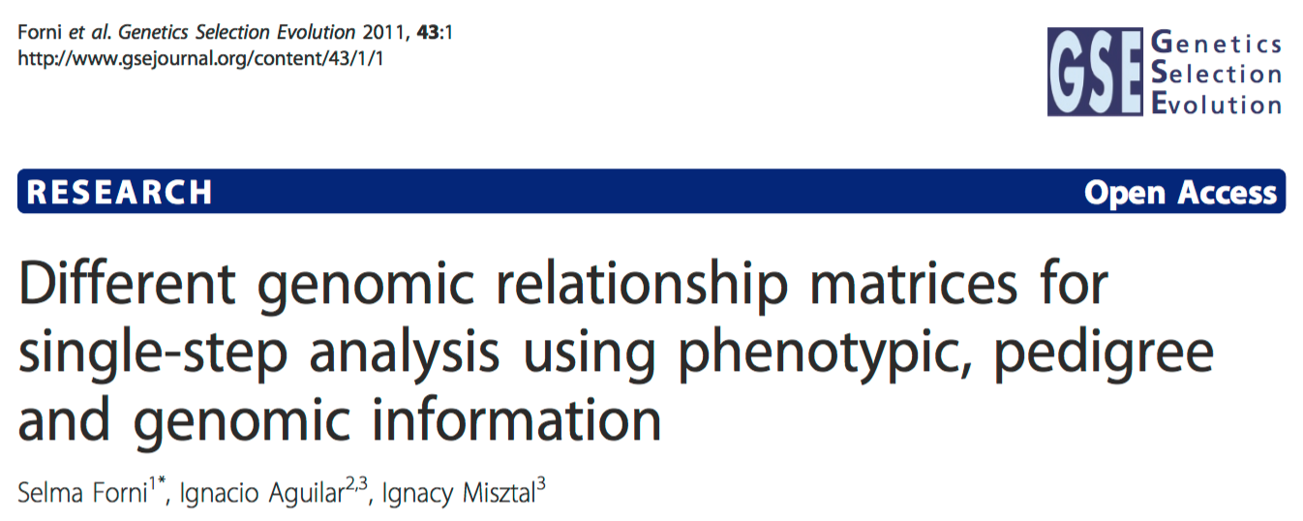
Pedigree + Marker

Slide 26
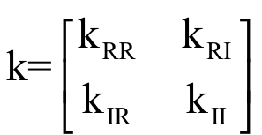
Henderson's formula

Slide 27
gBLUP by GAPIT
myGAPIT5 <- GAPIT(
Y=mySim$Y[training,],
GD=myGD,
GM=myGM,
PCA.total=3,
CV=myCV,
group.from=1000,
group.to=1000,
group.by=10,
SNP.test=FALSE,
memo="gBLUP",
)

Slide 28
Training
ry2=cor(myGAPIT5$Pred[training,8],mySim$Y[training,2])^2
ru2=cor(myGAPIT5$Pred[training,8],mySim$u[training])^2
ry2.blup=cor(myGAPIT5$Pred[training,5],mySim$Y[training,2])^2
ru2.blup=cor(myGAPIT5$Pred[training,5],mySim$u[training])^2
par(mfrow=c(2,2), mar = c(3,4,1,1))
plot(myGAPIT5$Pred[training,8],mySim$Y[training,2])
mtext(paste("R square=",ry2,sep=""), side = 3)
plot(myGAPIT5$Pred[training,8],mySim$u[training])
mtext(paste("R square=",ru2,sep=""), side = 3)
plot(myGAPIT5$Pred[training,5],mySim$Y[training,2])
mtext(paste("R square=",ry2.blup,sep=""), side = 3)
plot(myGAPIT5$Pred[training,5],mySim$u[training])
mtext(paste("R square=",ru2.blup,sep=""), side = 3)

Slide 29
phenotype
True BV
predicted
phenotype
predicted
BV

Slide 30
Testing
ry2=cor(myGAPIT5$Pred[testing,8],mySim$Y[testing,2])^2
ru2=cor(myGAPIT5$Pred[testing,8],mySim$u[testing])^2
ry2.blup=cor(myGAPIT5$Pred[testing,5],mySim$Y[testing,2])^2
ru2.blup=cor(myGAPIT5$Pred[testing,5],mySim$u[testing])^2
par(mfrow=c(2,2), mar = c(3,4,1,1))
plot(myGAPIT5$Pred[testing,8],mySim$Y[testing,2])
mtext(paste("R square=",ry2,sep=""), side = 3)
plot(myGAPIT5$Pred[testing,8],mySim$u[testing])
mtext(paste("R square=",ru2,sep=""), side = 3)
plot(myGAPIT5$Pred[testing,5],mySim$Y[testing,2])
mtext(paste("R square=",ry2.blup,sep=""), side = 3)
plot(myGAPIT5$Pred[testing,5],mySim$u[testing])
mtext(paste("R square=",ru2.blup,sep=""), side = 3)

Slide 31
phenotype
True BV
predicted
phenotype
predicted
BV

Slide 32
Highlight
The power of molecular breeding
Method development
gBLUP
Prediction of individuals without phenotypes

