Slide 1
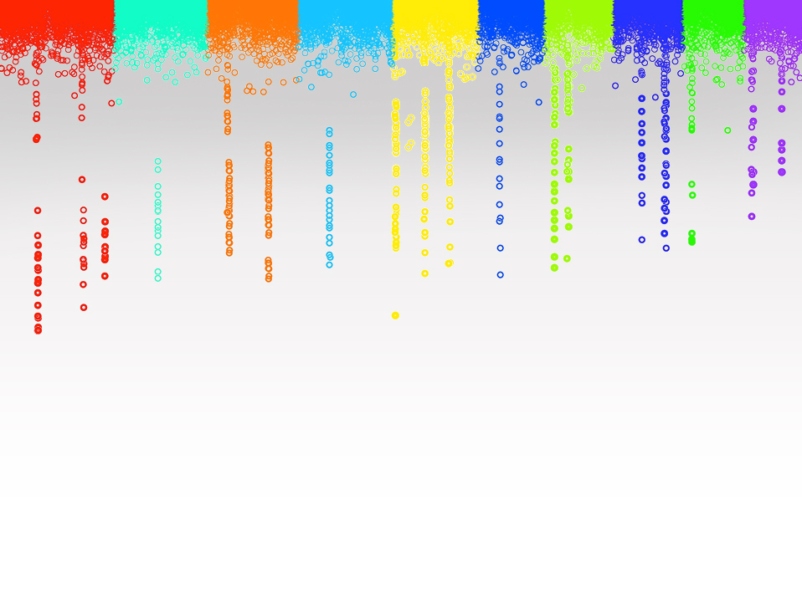
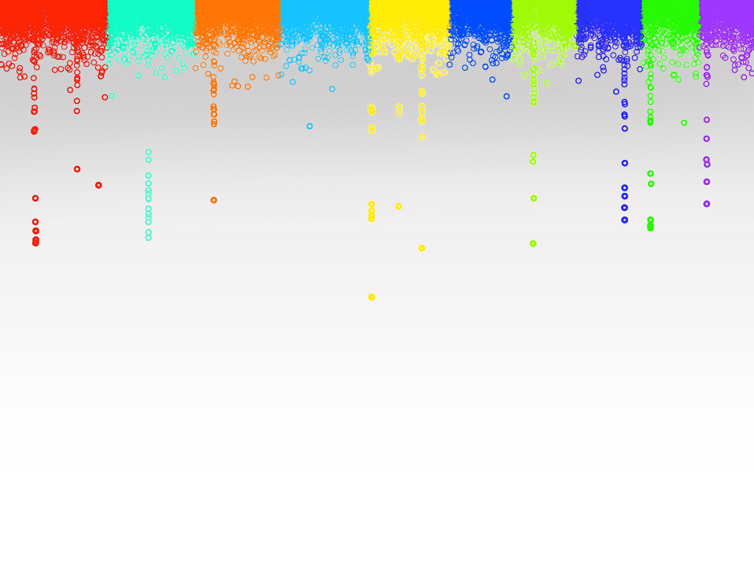
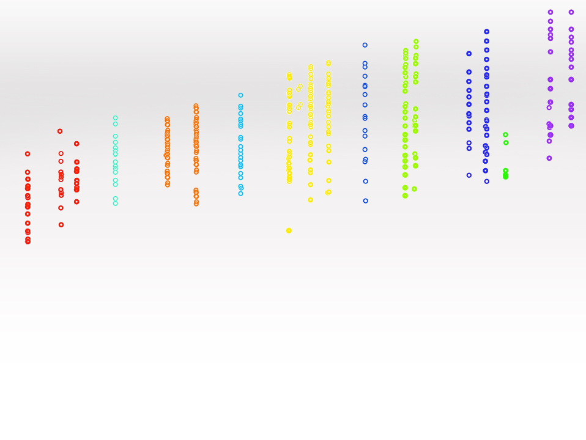
Statistical Genomics
Zhiwu Zhang
Washington State University

Slide 2
Outline
Administration
Why this course
Overview

Slide 3
Teaching assistant
Yuanhong Song
Email: yuanhong.song@wsu.edu
Office: 130 Johnson hall
Phone: 509-335-4551
Graduate student in statistics
https://www.linkedin.com/in/yuanhong-song-song-425826132/
TA: Geographic Information Systems and Remote Sensing

Slide 4
Sai Prudhvi (guest TA)
Instructor - Stat 360:Probability and Statistics (for engineering & math majors) - Spring 2017
TA - Stat 212:Introduction to Statistical Methods - Fall 2016
Instructor - Stat 212:Introduction to Statistical Methods - Summer 2016
TA - Stat 212:Introduction to Statistical Methods - Spring 2016
http://www.math.wsu.edu/students/soruganti/welcome.php

Slide 5
James Chen (Guest TA)
TA of CROPS 545 in 2017
Author of iPat

Slide 6
Mark Swanson (Guest lecture)
NATRS 519: Introduction to Statistical Programming in R
SOILS 502: Introduction to Statistics in R

Slide 7
Objectives
Useful: GWAS&GS (analyses and tools)
Be successful in research: deep understanding
Reasoning and critical thinking
Fun: motivation through re-inventing or invention

Slide 8
Grade options
Letter
S/U
No audit
Percentage | Letter
93%-100% | A
90%-93% | A-
87%-90% | B+
83%-87% | B
80%-83% | B-
77%-80% | C+
73%-77% | C
70%-73% | C-
66%-70% | D+
60%-66% | D
0%-60% | F
Satisfied
Unsatisfied

Slide 9
Grade components

Slide 10
Participation
 | Score
No question, no discussion | 0%
Question or discussion occasionally | 25%
Question actively | 50%
Discussion actively | 75%
Question AND discussion actively | 100%

Slide 11
Homework
Assignments: six in total
Due Monday 3:10PM every other week, except spring break and final
Submit by email to Song: yuanhong.song@wsu.edu
PDF Report and R source code only
PDF report is limited to five pages.
Late homework: half off per day.

Slide 12
Exams
Multiple choice: A, B, C and D (choose one only)
Question
Middle term: 25
Final: 50 (comprehensive)

Slide 13
Lectures and Labs
Spring: Jan 8- April 27
M&F (3:10-4): Lectures
W (3:10-5:40): Lab (laptops: Lectures and HW)

Slide 14
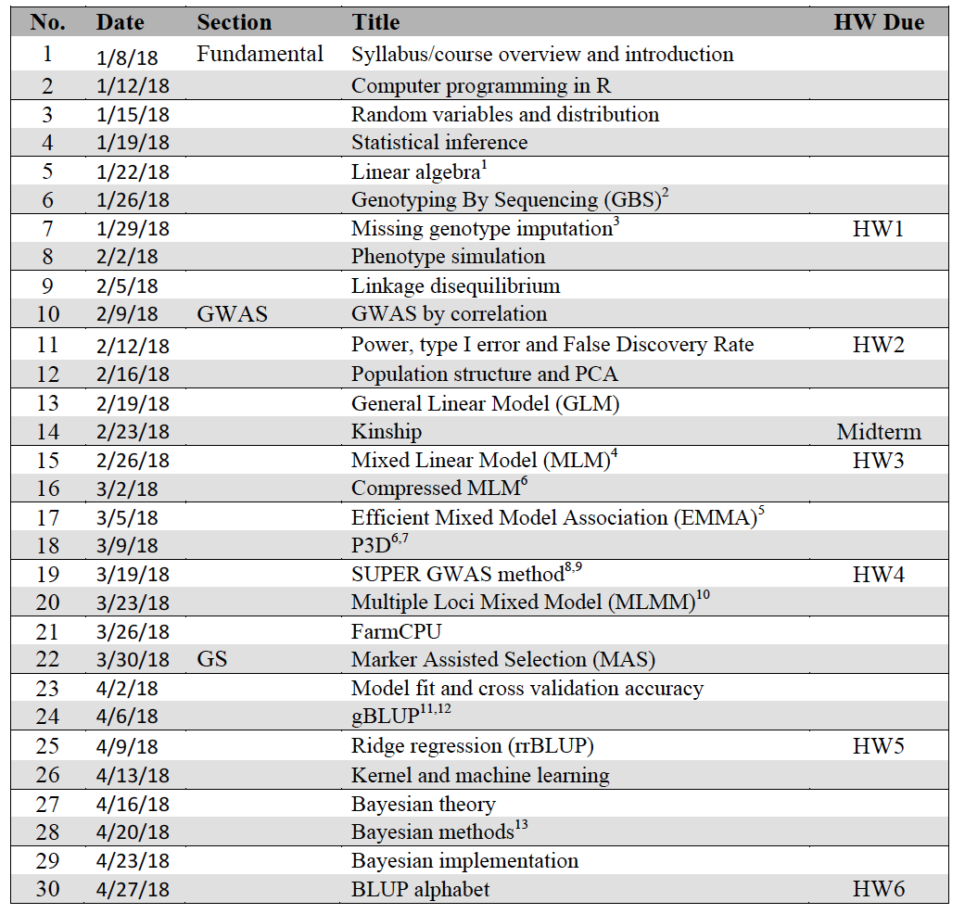

Slide 15
Reference
1. Lynch, M. & Walsh, B. Genetics and analysis of quantitative traits. Genetics and analysis of quantitative traits. (1998).
2. Elshire, R. J. et al. A robust, simple genotyping-by-sequencing (GBS) approach for high diversity species. PLoS One 6, e19379 (2011).
3. Marchini, J. & Howie, B. Genotype imputation for genome-wide association studies. Nat Rev Genet 11, 499–511 (2010).
4. VanRaden, P. M. Efficient methods to compute genomic predictions. J Dairy Sci 91, 4414–4423 (2008).
5. Yu, J. et al. A unified mixed-model method for association mapping that accounts for multiple levels of relatedness. Nat. Genet. 38, 203–208 (2006).
6. Zhang, Z. et al. Mixed linear model approach adapted for genome-wide association studies. Nat Genet 42, 355–360 (2010).
7. Kang, H. M. et al. Efficient control of population structure in model organism association mapping. Genetics 178, 1709–1723 (2008).
8. Kang, H. M. et al. Variance component model to account for sample structure in genome-wide association studies. Nat Genet 42, 348–354 (2010).
9. Wang, Q., Tian, F., Pan, Y., Buckler, E. S. & Zhang, Z. A SUPER Powerful Method for Genome Wide Association Study. PLoS One 9, e107684 (2014).
10. Lippert, C. et al. FaST linear mixed models for genome-wide association studies. Nature Methods 8, 833–835 (2011).
11. Segura, V. et al. An efficient multi-locus mixed-model approach for genome-wide association studies in structured populations. Nature Genetics 44, 825–830 (2012).
12. Liu, X., Huang, M., Fan, B., Buckler, E. S. & Zhang, Z. Iterative Usage of Fixed and Random Effect Models for Powerful and Efficient Genome-Wide Association Studies. PLoS Genet. 12, e1005767 (2016).
13. Zhou, Y., Isabel Vales, M., Wang, A. & Zhang, Z. Systematic bias of correlation coefficient may explain negative accuracy of genomic prediction. Briefings Bioinforma. (2016).
14. Zhang, Z., Todhunter, R. J., Buckler, E. S. & Van Vleck, L. D. Technical note: Use of marker-based relationships with multiple-trait derivative-free restricted maximal likelihood. J. Anim. Sci. 85, 881–885 (2007).
15. Bernardo, R. Prediction of maize single-cross performance using RFLPs and information from related hybrids. Crop Sci. 34, 20–25 (1994).
16. Endelman, J. Ridge regression and other kernels for genomic selection in the R package rrBLUP. Plant Genome 4, 250–255 (2011).
17. Meuwissen, T. H., Hayes, B. J. & Goddard, M. E. Prediction of total genetic value using genome-wide dense marker maps. Genetics 157, 1819–1829 (2001).
18. Pérez, P., de los Campos, G., Crossa, J. & Gianola, D. Genomic-Enabled Prediction Based on Molecular Markers and Pedigree Using the Bayesian Linear Regression Package in R. Plant Genome J. 3, 106 (2010).

Slide 16
Schedule for the 1st two weeks
Jan 8 (M): Lecture (Introduction)
Jan 10 (W): two lectures (distribution and inference)
Jan 12 (F): Lecture on R (no computer)
Jan 15 (M): lab on R (bring computers)
Jan 17 (W): Lab on distribution & inference (HW1)
Jan 19 (F): Lecture on algebra

Slide 17
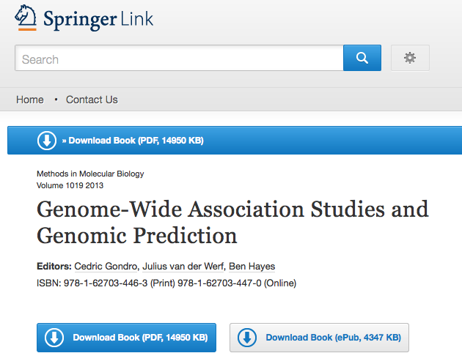
Text book
http://link.springer.com/book/10.1007%2F978-1-62703-447-0

Slide 18
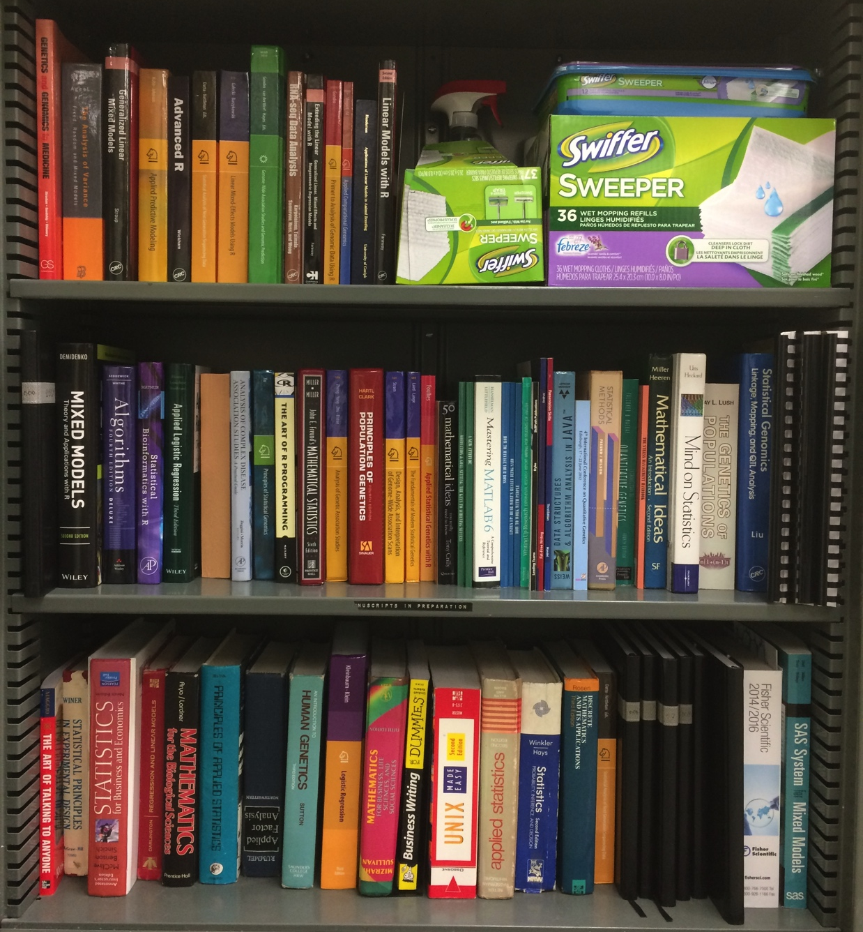
Books at ZZLab (130 Johnson Hall)

Slide 19
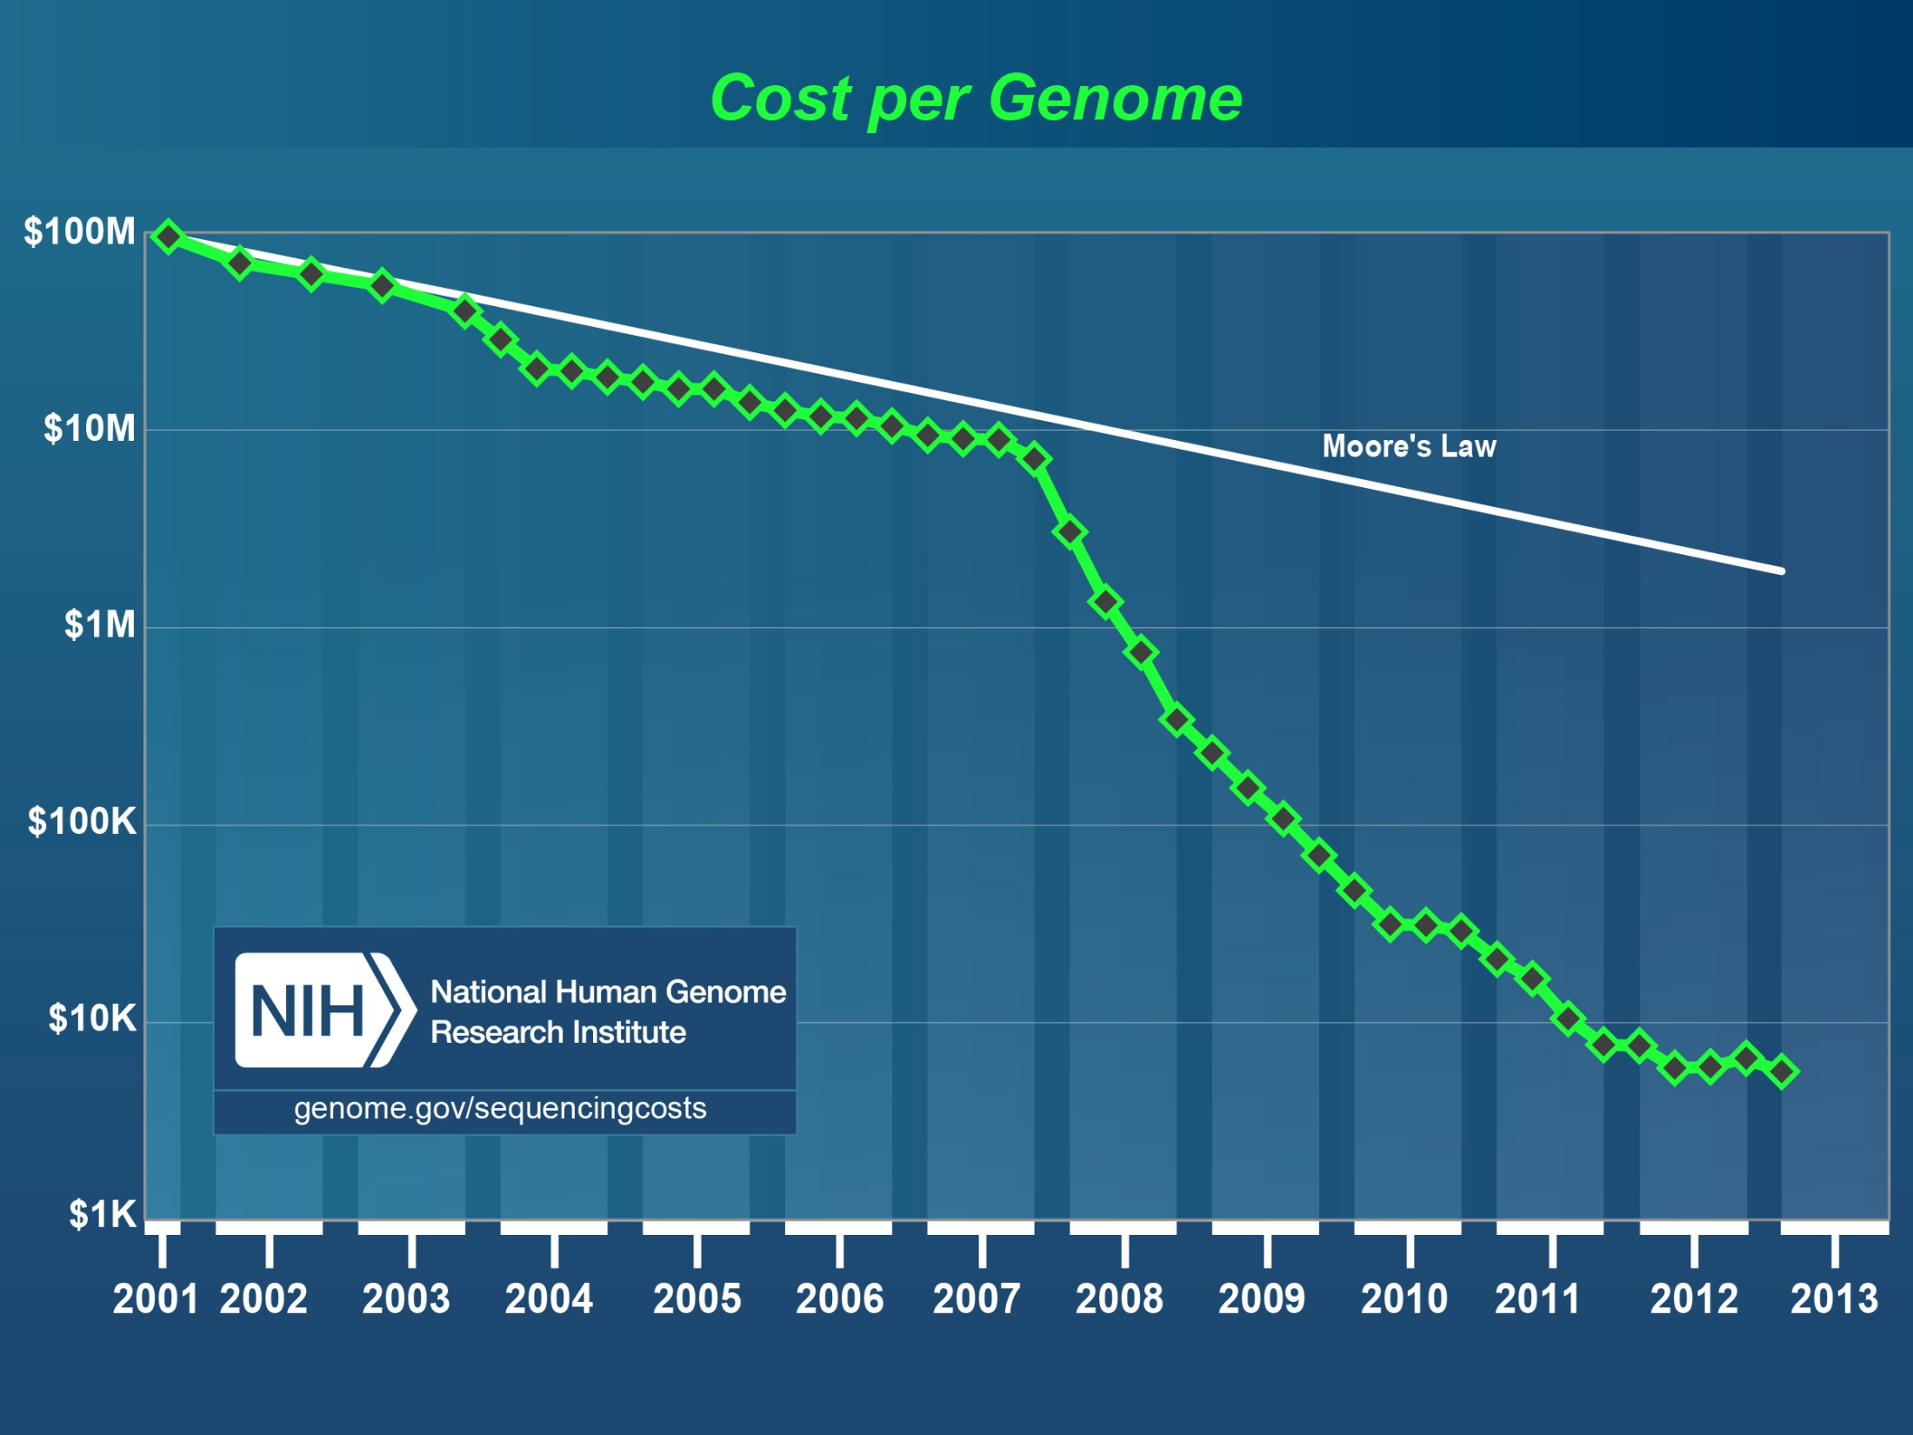
Human
genome
2nd
Generation Sequencing
http://luckyrobot.com/wp-content/uploads/2013/04/nih-cost-genome.jpg

Slide 20
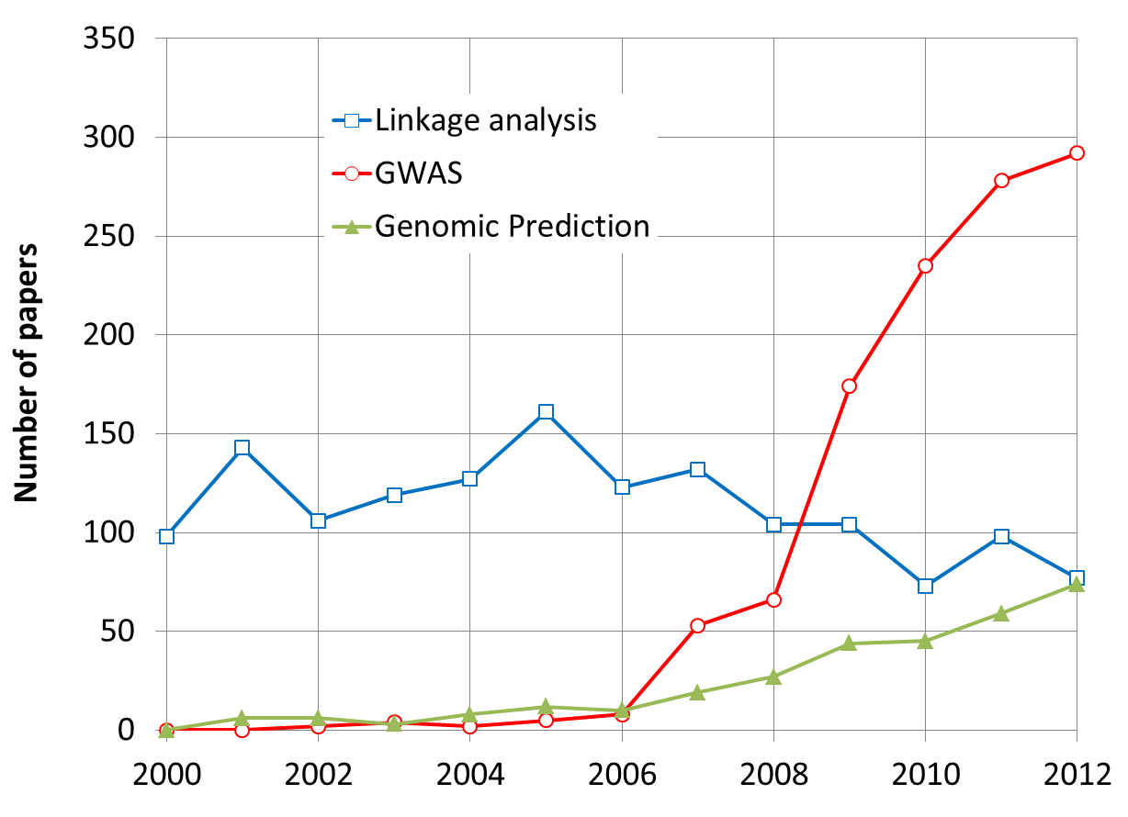
More Research on GWAS and GS
By May 31, 2013

Slide 21
Problems in GWAS
Computing difficulties: millions of markers, individuals, and traits
False positives, ex: “Amgen scientists tried to replicate 53 high-profile cancer research findings, but could only replicate 6”, Nature, 2012, 483: 531
False negatives

Slide 22
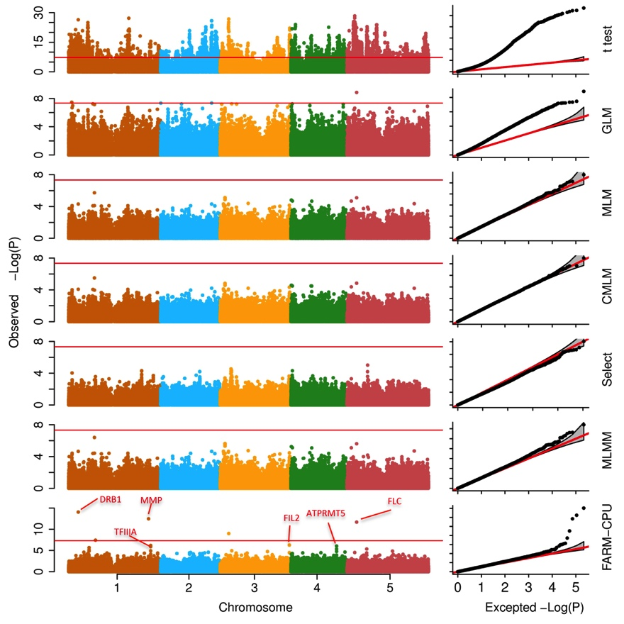
Associations on flowering time

Slide 23
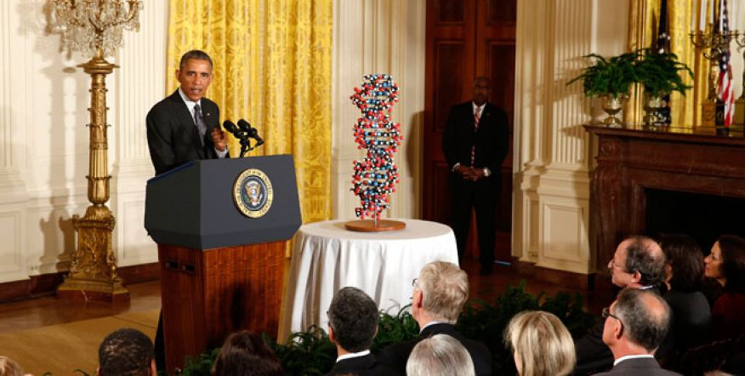
The Precision Medicine Imitative (2015)
250 Million dollars investment in 2016

Slide 24
Dosage variation among individuals

Slide 25
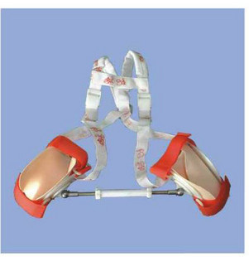
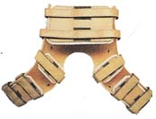
Preventive medical treatment
发育性髋关节脱位
矫形器: 用背带调节髋屈曲角度，横杆调节髋外展角度，两侧面有两个球型铰链，可在固定的情况下作髋部轻微活动。适用于1-2岁婴幼儿。
http://www.nbkangxin.com/nbkangxin/list.asp?id=126&ipage=

Slide 26
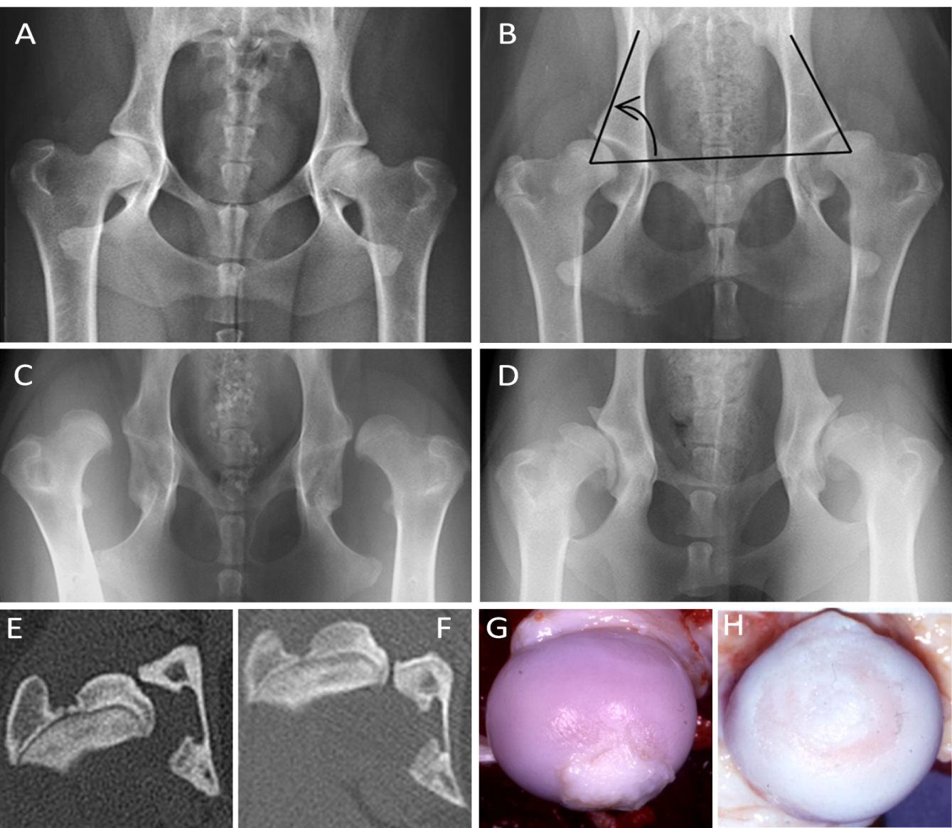
Canine Hip Dysplasia is predictive

Slide 27
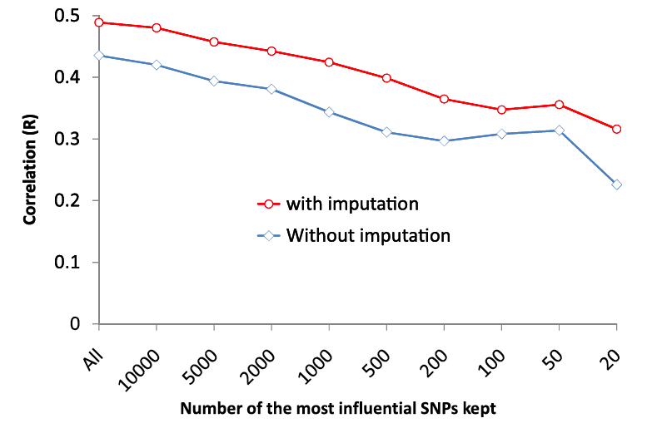
Canine hip dysplasia is predictable

Slide 28
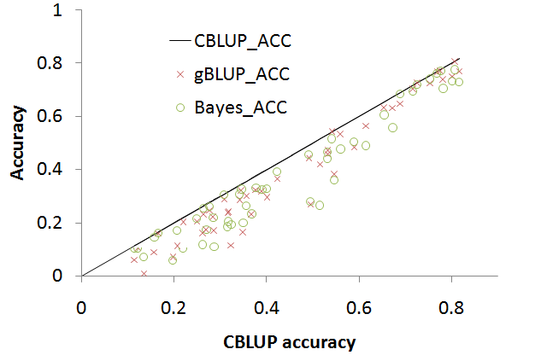
Genomic prediction

Slide 29
Highlight
Active participation + 6 HWs + Midterm/Final exam
GWAS and GS: Very active for research and applications
Rapid development

