Slide 1
Plotting in 3 dimensions
Matthew McGowan
Spring 2020

Slide 2
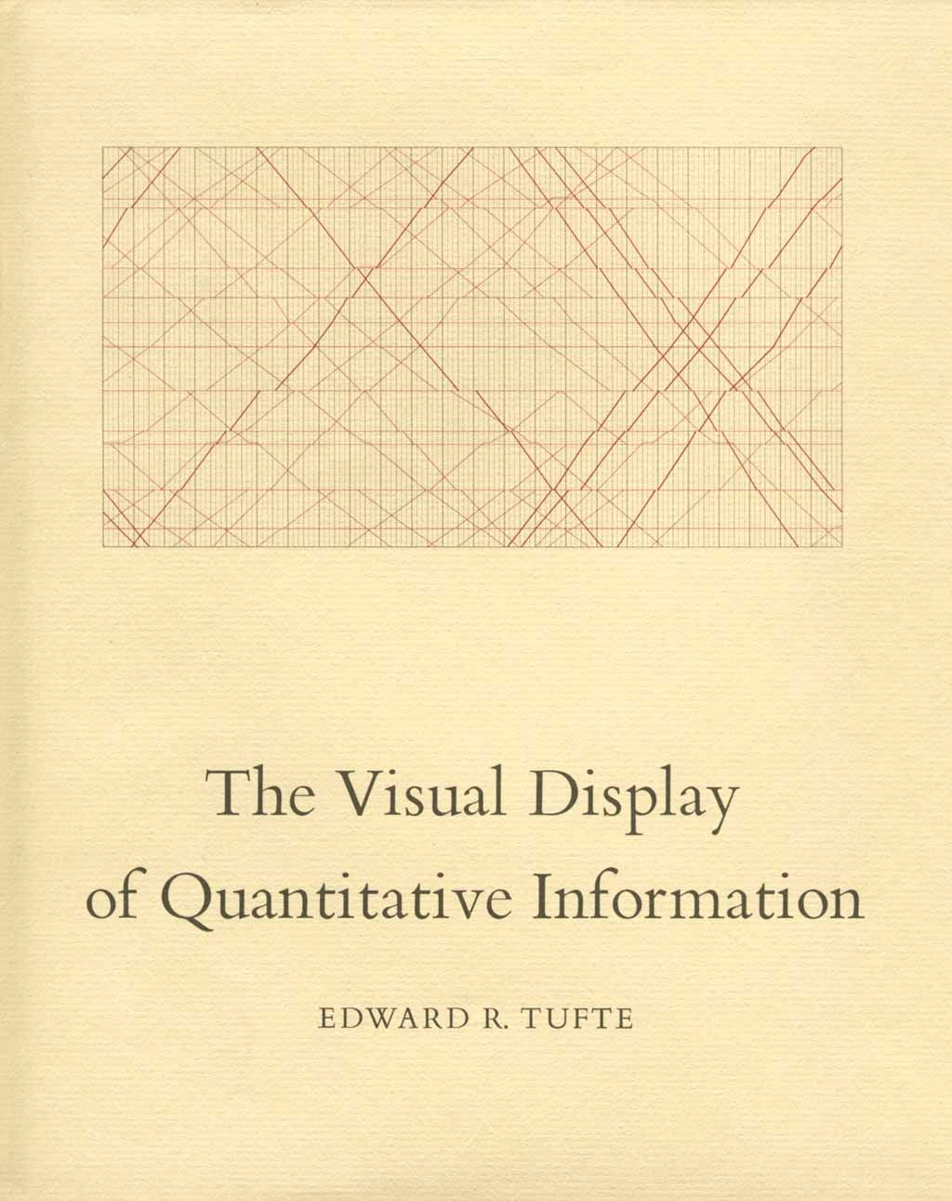
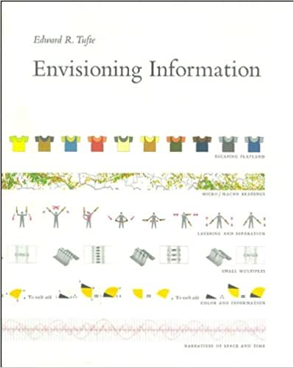
“Graphical excellence is that which gives to the viewer the greatest number of ideas in the shortest time with the least ink in the smallest space.”
― Edward R. Tufte, The Visual Display of Quantitative Information
WSU library link
WSU library link

Slide 3
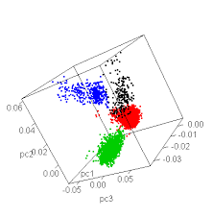
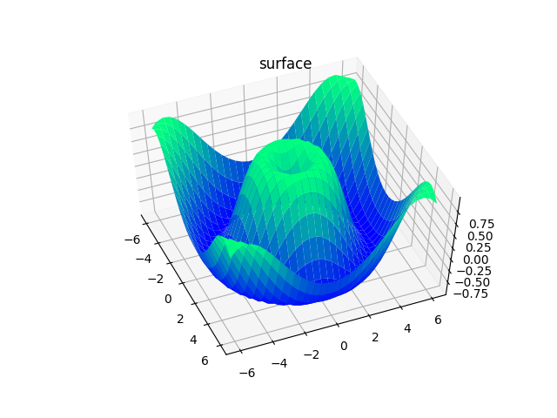
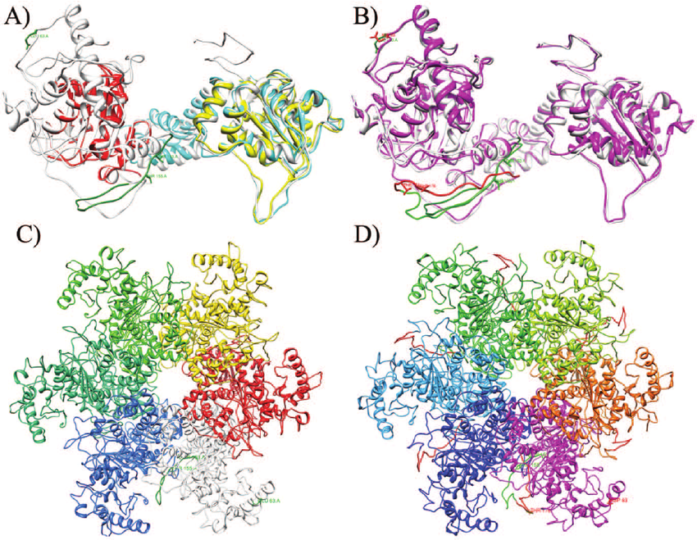
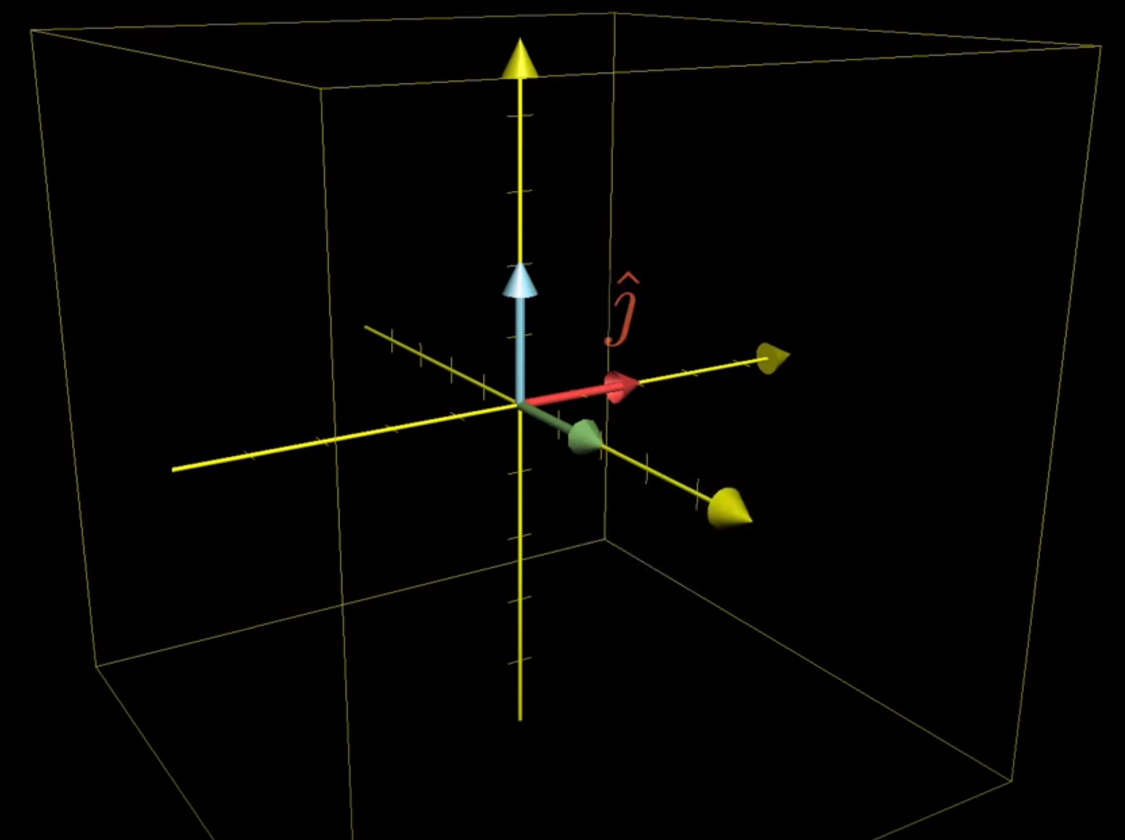
Why use a 3d plot?
matplotlib tutorial
R blog on 3d PCA
Swiss Institute of Bioinformatics on protein 3D structure
3Blue1Brown

Slide 4
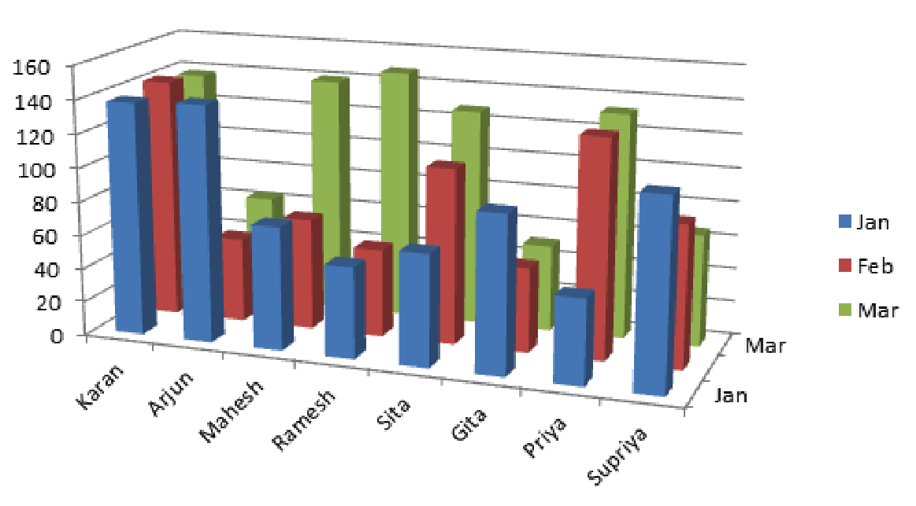
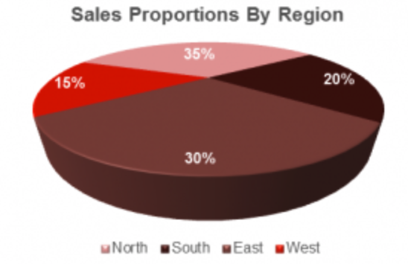
When to go 3D is a contentious topic
The issue with 3D
Is avoidance of 3d a knee-jerk reaction?
Don't go 3d!

Slide 5
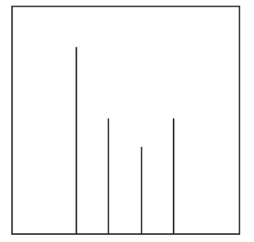
Optical illusions are more common in 3d plots

Slide 6
Why use a 3d plot?
matplotlib tutorial
R blog on 3d PCA
Swiss Institute of Bioinformatics on protein 3D structure
3Blue1Brown

Slide 7
Online 3d R Tutorials

Slide 8
Code Exercise
Work through the tutorial on interactive scatter plots
http://www.sthda.com/english/wiki/3d-graphics
Requires ‘car’ and ‘rgl’ libraries
install.packages("rgl", repos="http://R-Forge.R-project.org")
If that doesn’t work and you are on linux:
sudo apt-get install r-cran-rgl
Try making a 3d scatter plot with PCA data
GAPIT demo data
Your own data?

