Slide 1
Lab 2: Distributions and inference
Crop_Sci 545
Spring 2020

Slide 2
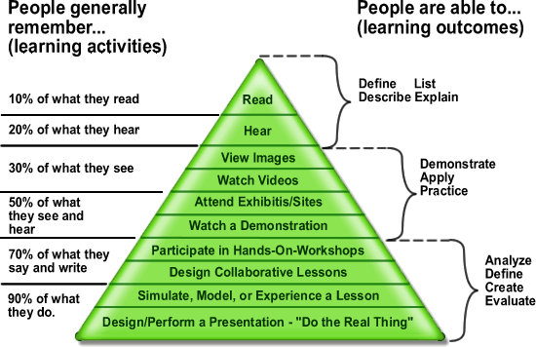

Slide 3
Demonstration: Implement the normal distribution as an R shiny app

Slide 4
Demonstration: Implement the normal distribution as an R shiny app
UI: Input Widgets
Specify the distribution
Set distribution parameters
Set visualization parameters
Server
Randomly sample from specified distribution
Calculate density function
Calculate sample statistics
UI: Output
Histogram
Density curve?
Mean line?

Slide 5
Demonstration: Build an R shiny app to explore the normal and uniform distributions
UI: Input Widgets
Specify the distribution
Set distribution parameters
Set visualization parameters
Server
Randomly sample from specified distribution
Calculate density function
Calculate sample statistics
UI: Output
Histogram
Density curve?
Mean line?

Slide 6
Hands-On: Implement other distributions with your Shiny App
Distributions to implement
Normal
Uniform
Binomial
Poisson
Chi-square
F
T
Others??

Slide 7
Test out the distribution diagram for yourself.
B(n,p)
Are there any parameter settings that make one distribution approximate another?
λ=np
t(n)
N(0,1)
P(λ)
x/X²
sum x^2
over n
F(n1,n2)
What about the central limit theory?
X²₁/n₁ /
X²₂/n₂
X²(n)
Notes:
Who are these authors?

Slide 8
Problem 1:
A poker-dealing machine is supposed to deal cards at random, as if from an infinite deck.
In a test, you counted 1600 cards, and observed the following:
Spades | 404
Hearts | 420
Diamonds | 400
Clubs | 376
Are these discrepancies too much to be random?
Notes:
Who are these authors?

Slide 9
Demonstration: Build an R shiny app to test the ‘randomness’ of a poker-dealing machine
UI: Input Widgets
Get the number of each suit
Server
Perform a chi-square test
UI: Output
Display the chi-square test results

Slide 10
Problem 2:
A poker-dealing machine is supposed to deal cards at random, as if from an infinite deck. (This time there are jokers!)
In a test, you counted 1662 cards, and observed the following:
Spades | 404
Hearts | 420
Diamonds | 400
Clubs | 356
Jokers | 82
Are these discrepancies too much to be random?
- Extend your Shiny app to include jokers
Notes:
Who are these authors?

Slide 11
Things to consider…
Today we implemented a hand-on, simple-case scenario where we only took or analyzed one sample.
How could you extend your implementation to include many different independent samples (bootstrapping)?
What would be the best approach for automating these processes?
What other kinds of outputs could be useful for analyzing these kinds of data?

