Slide 1
Lab 7 Code optimization: apply() Principal Component Analysis
Crop Sci. 545
Spring 2020

Slide 2
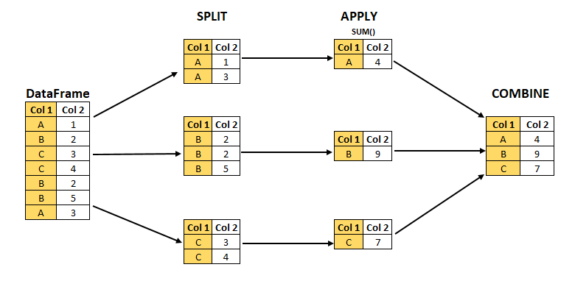
The split–apply–combine pattern
Hadley Wickham (the R guru…) coined this strategy in a paper he published in 2011
It has many advantages:
It is usually faster than using for loops
It leads to cleaner and more readable code
It is easy to parallelize (both multicore and GPU)
Anurang Pandey's blog post on split-apply-combine

Slide 3
The apply() family of functions
You may have already been using one of these functions: replicate()
However, what if you want to change variables for every ‘iteration’?
lapply() works on a list or vector, returns a list
sapply() is similar to lapply(), returns a vector or matrix
vapply() is similar to sapply(), has a prespecified type of return value
apply() works on an array, returns a list
The basic structure of an apply function:
lapply
The split objects to use
The function to use on each object
Any other parameters to use

Slide 4
Demonstration:
Timing your code with proc.time()
Using the apply() family of functions
Performing PCA analysis
Plotting PCA results

Slide 5
Activities:
Continue to work on HW4

